Slide 1
Search Algorithms
Written by J.J. Shepherd

Slide 2
Sequential Search
Examines each element one at a time until the item searched for is found or not found
Simplest search algorithm!

Slide 3
Example!

Slide 4
Binary Search
Searches a sorted data structure by recursively splitting it up
Divide and Conquer Algorithm

Slide 5
Example!

Slide 6
Asymptotic
Which is a better algorithm? How do we measure efficiency?
How theoretically fast an algorithm will perform or how much space in memory an algorithm will consume
Once you understand this you can prove someone’s code sucks using math!

Slide 7
Big O
Theoretical upper bound of an algorithm
This is the “worst case scenario”
Let f and g be functions defined on some subset of real numbers n
f(n) = O(g(n)) where n ∈ ℝ as n → ∞
Let M be a constant that’s sufficiently large then we can say
|f(n)| ≤ M|g(n)| for all x ≥ x0

Slide 8
WHAT?

Slide 9
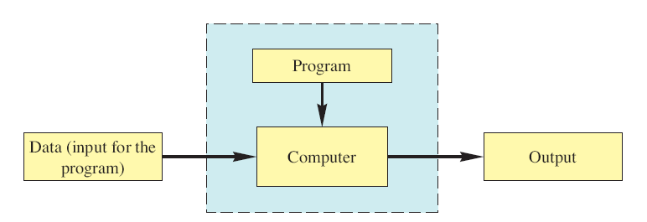
Let’s Back Up
Let’s look at the last problem we solved
The worst case scenario for a search is the item we are looking for is not there
Keep in mind when you see “n” that corresponds to the data you’re processing with the algorithm

Slide 10
Sequential Search
In sequential search we need to check every single item before we can confirm it is not in the data structure
Let’s take an instance of a sorted array and examine how this works

Slide 11
Sequential Search
We are looking for the number “8”
Index | 0 | 1 | 2 | 3 | 4 | 5 | 6
Value | 1 | 2 | 3 | 4 | 5 | 6 | 7

Slide 12
Sequential Search
We are looking for the number “8”
Index | 0 | 1 | 2 | 3 | 4 | 5 | 6
Value | 1 | 2 | 3 | 4 | 5 | 6 | 7

Slide 13
Sequential Search
We are looking for the number “8”
Index | 0 | 1 | 2 | 3 | 4 | 5 | 6
Value | 1 | 2 | 3 | 4 | 5 | 6 | 7

Slide 14
Sequential Search
We are looking for the number “8”
Index | 0 | 1 | 2 | 3 | 4 | 5 | 6
Value | 1 | 2 | 3 | 4 | 5 | 6 | 7

Slide 15
Sequential Search
We are looking for the number “8”
Index | 0 | 1 | 2 | 3 | 4 | 5 | 6
Value | 1 | 2 | 3 | 4 | 5 | 6 | 7

Slide 16
Sequential Search
We are looking for the number “8”
Index | 0 | 1 | 2 | 3 | 4 | 5 | 6
Value | 1 | 2 | 3 | 4 | 5 | 6 | 7

Slide 17
Sequential Search
We are looking for the number “8”
Now we can confirm it’s not in the array
How many steps did that take?
Index | 0 | 1 | 2 | 3 | 4 | 5 | 6
Value | 1 | 2 | 3 | 4 | 5 | 6 | 7

Slide 18
Sequential Search
Now let’s say that array had n values in sorted order
We are looking for a value that doesn’t exist in this array
How many steps will this take?
Index | 0 | 1 | 2 | 3 | 4 | … | n
Value | 1 | 2 | 3 | 4 | 5 | … | n-1

Slide 19
Sequential Search
In this case it takes n checks before we can confirm an item is not in the array
Ergo the sequential search algorithm is linear and we can say it is
f(n) = O(n)

Slide 20
Binary Search
Let’s take the same initial example and run the binary search instead
In this one we use divide and conquer to search through a sorted algorithm

Slide 21
Binary Search
We are looking for the number “8”
Index | 0 | 1 | 2 | 3 | 4 | 5 | 6
Value | 1 | 2 | 3 | 4 | 5 | 6 | 7

Slide 22
Binary Search
We are looking for the number “8”
Index | 0 | 1 | 2 | 3 | 4 | 5 | 6
Value | 1 | 2 | 3 | 4 | 5 | 6 | 7

Slide 23
Binary Search
We are looking for the number “8”
Now we can confirm it’s not in the array
How many steps did that take?
Index | 0 | 1 | 2 | 3 | 4 | 5 | 6
Value | 1 | 2 | 3 | 4 | 5 | 6 | 7

Slide 24
Binary Search
Now let’s say that array had n values in sorted order
We are looking for a value that doesn’t exist in this array
How many steps will this take?
Index | 0 | 1 | 2 | 3 | 4 | … | n
Value | 1 | 2 | 3 | 4 | 5 | … | n-1

Slide 25
Binary Search
In this case the algorithm keeps splitting the array in half, so it runs log2n = lg(n) times
Ergo the binary search algorithm is logarithmic and we can say it is
f(n) = O(lg(n))

Slide 26
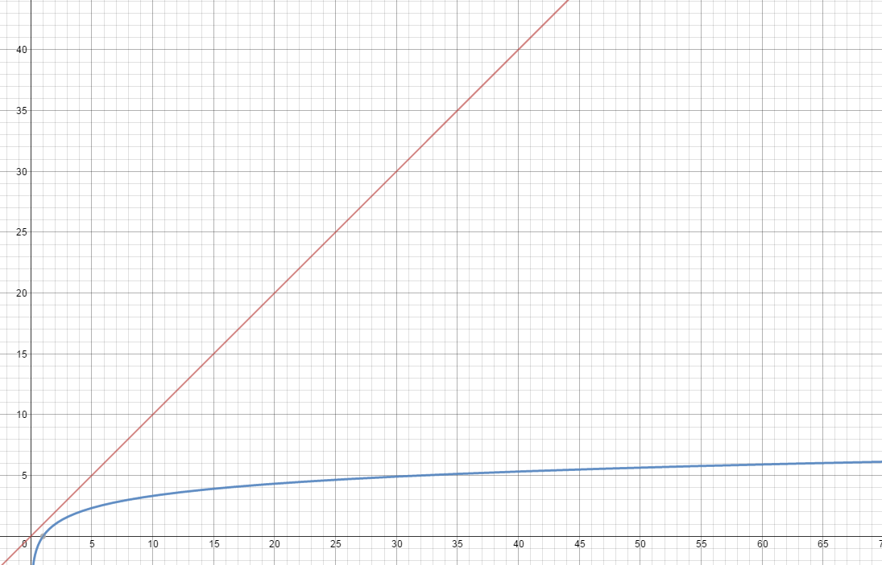
Which is better?
f(n) = n
f(n) = lg(n)

Slide 27
Common Big O Complexities
O(1) – Constant
O(log(n)) – Logarithmic
O(n) – Linear
O(nlogn) – Linearithmic
O(n²) – Quadratic
O(2^{n}) – Exponential “Bad”
O(n!) – Factorial “Really Bad”

Slide 28
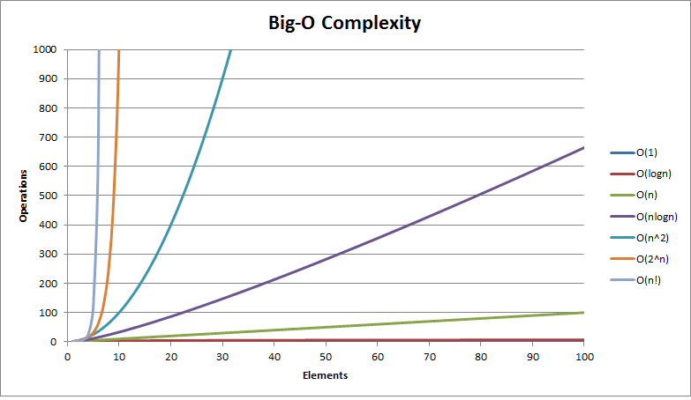
Common Big O Complexities

Slide 29
How this applies to code
Any simple statement is going to be O(1)
Loops and recursion is where complexity increases
The number of times the loop is ran or the number of times the recursive call is made
Observe how the inputted data “n” is being processed
The slowest complexity as n approaches infinity can be considered that algorithm’s Big O
Doesn’t have to be exact but close

Slide 30
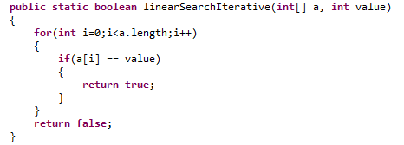
Iterative Linear Search

Slide 31
Iterative Linear Search
O(1)

Slide 32
Iterative Linear Search
O(?)

Slide 33
Iterative Linear Search
O(n)

Slide 34
Iterative Linear Search
O(n)
O(1)
=O(n) + O(1)
Since O(n) will grow way past O(1) as n approaches infinity we can ignore O(1) and just say it is
O(n)

Slide 35
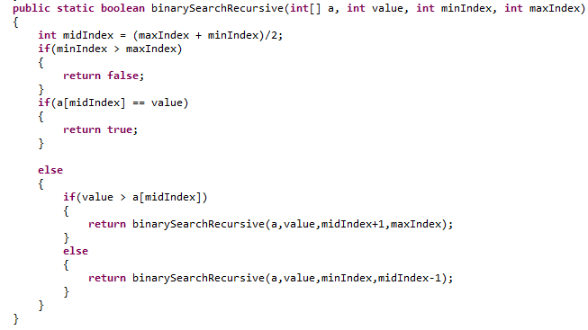
Recursive Binary Search

Slide 36
Recursive Binary Search
O(1)

Slide 37
Recursive Binary Search
O(?)

Slide 38
Recursive Binary Search
O(?)
Let’s observe how the data “n” is treated at each level.

Slide 39
Recursive Binary Search
O(?)
Either one or the other recursive call is ran at any give time.

Slide 40
Recursive Binary Search
O(?)
If we assume the array size is “n” then the first step processes observes the first n

Slide 41
Recursive Binary Search
O(?)
Then the next step halves it and processes n/2. Then n/4. Then n/8… Until there is one element left.

Slide 42
Recursive Binary Search
O(lg(n))
When the data is constantly being split like that it indicates it’s a O(lg(n))

Slide 43
Recursive Binary Search
Finally we end up with a bunch of O(1)’s + O(lg(n)) so we can assume this algorithm is
O(lg(n))

