Slide 1
Trees
By JJ Shepherd

Slide 2
Introduction
Last time we discussed searching and sorting in a more efficient way
Divide and Conquer
Binary Search
Merge Sort
Quick Sort
Let’s look at a data structure that uses a similar idea

Slide 3
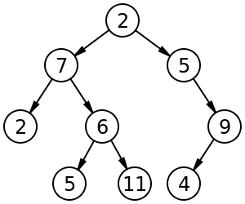
Trees
Definition: A data structure that can be defined recursively as a collection of nodes, where each node is a data structure consisting of a value, together with a list of references to nodes, with the constraints that no reference is duplicated, and none points to the root.

Slide 4
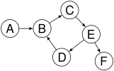




Trees
The big idea is a tree is a structure that has no self references pointers, no disjoint nodes, and no cycles
YES
NO
NO
NO
NO

Slide 5
Trees
Some definitions. Most of them work much like a family tree.
Root – The top node in a tree.
Child – A node’s reference which is at a lower level
Parent – The converse notion of child.
Siblings – Nodes with the same parent.
Leaf – a node with no children.
Degree – number of sub trees of a node.
Edge – connection between one node to another.
Path – a sequence of nodes and edges connecting a node with a descendant.
Level – The level of a node is defined by 1 + the number of connections between the node and the root.
Height of tree –The height of a tree is the number of edges on the longest downward path between the root and a leaf.
Height of node –The height of a node is the number of edges on the longest downward path between that node and a leaf.
Depth –The depth of a node is the number of edges from the node to the tree's root node.

Slide 6
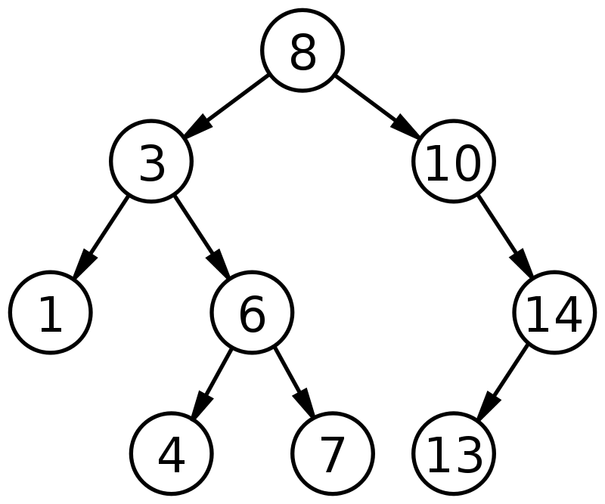
Binary Search Tree
A tree structure where each node has a comparable key
If a node’s value is larger than its parent’s it goes to the right subtree
If a node’s value is smaller or equal to its parent’s value it goes in the left subtree
Each node has at most two children

Slide 7
Example!

Slide 8
Insertion
A value is inserted into a tree based on the tree’s definition
Smaller values go to the left
Larger or equal values go to the right
A value traverses the tree following these rules until a null child value is found

Slide 9
Insertion
Inserting a 5 into this tree

Slide 10
Insertion
Inserting a 5 is less than 8 go left

Slide 11
Insertion
Inserting a 5 is greater than 3 go right

Slide 12
Insertion
Inserting a 5 is less than 6 go left

Slide 13
Insertion
Inserting a 5 is less greater than 4 go right

Slide 14
Insertion
The right child is null so insert the new node there
5

Slide 15
Example!

Slide 16
Searching
Searching works much like binary search, hence the name (Derp)
The tree is traversed until either the value is found or it hits a null reference

Slide 17
Example!

Slide 18
Traversals
How to travel and access the values in a tree
Good way to print out values of tree, so it’s great for debugging
Three types
Pre-order
In-order
Post-order

Slide 19
Traversals
Pre-order requires accessing each of the values of the node then traversing the left subtree and then the right subtree (Left side)
Pre-order would be 8 3 1 6 4 7 10 14 13

Slide 20
Traversals
In-order requires traversing each left subtree, then accessing the values, then traversing each right subtree (Underneath)
Pre-order would be 1 3 4 6 7 8 10 13 14

Slide 21
Traversals
Post-order requires traversing each left subtree, then traversing each right subtree, then accessing the values (Right Side)
Pre-order would be 1 4 7 6 3 13 14 10 8

Slide 22
Example!

Slide 23

Deletion… Ugh…

Slide 24
Deletion
Basic idea is first find if the value is in the tree
If it is then there are three cases
If it has no children, then simply remove it
If it has one child, then replace the removed node with that child
If it has two children then
Find the smallest value in the right subtree and replace the value with that
Recursively delete that value from the right subtree
This can also be alternated with the left subtree to avoid unbalanced trees

Slide 25
Deletion
Deleting 3

Slide 26
Deletion
3 is found!

Slide 27
Deletion
Find the smallest value in the right subtree
It will be the left most value of that tree

Slide 28
Deletion
It’s a 4 whoa!

Slide 29
Deletion
Replace 3 with 4
4

Slide 30
Deletion
Delete 4 but… The process has to be repeated
4

Slide 31
Deletion
Luckily 4 has no children and can be wiped off the face of the earth
4

Slide 32
Example!

Slide 33
Summary
Trees are amazing
Just the best
Wow
BS Trees are neat but they do have some issues
They can become unbalanced and thus ineffceint
Self balancing trees fix this

