Slide 1
Trees Part 2!!!
By JJ Shepherd

Slide 2
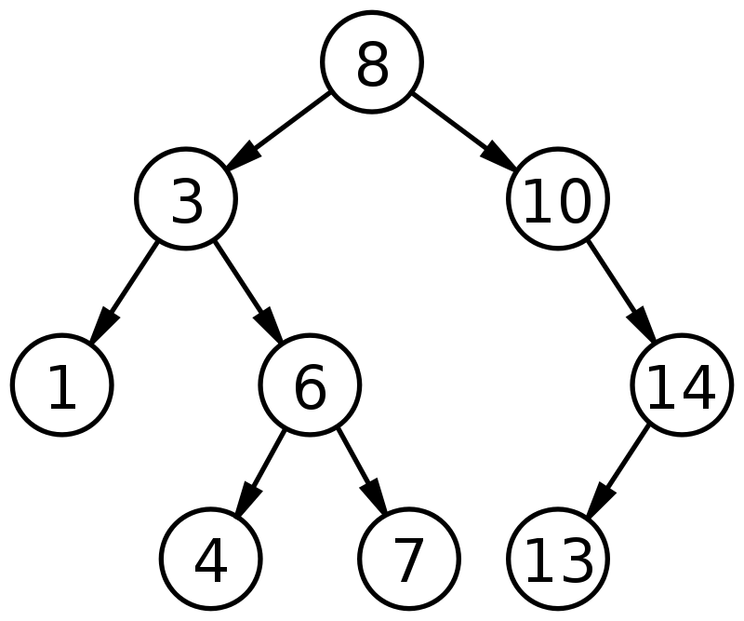
Binary Search Tree
A tree structure where each node has a comparable key
If a node’s value is larger than its parent’s it goes to the right subtree
If a node’s value is smaller or equal to its parent’s value it goes in the left subtree
Each node has at most two children

Slide 3
Binary Search Tree
Can be represented also by an array

Slide 4
Binary Search Tree
Each node is an index in the array
[0]
[1]
[2]
[3]
[4]
[5]
[6]
[7]
[8]
[9]
[10]
[13]
[14]
index
0 | 1 | 2 | 3 | 4 | 5 | 6 | 7 | 8 | 9 | 10 | 11 | 12 | 13 | 14
8 | 3 | 10 | 1 | 6 | - | 14 | - | - | 4 | 7 | - | - | 13 | -
value

Slide 5
Binary Search Tree
To go to left child the formula is
leftChildIndex = index*2+1
To go to the right child the formula is
rightChildIndex = index*2+2
Each level has 2^{depth} amount of nodes

Slide 6
Binary Search Tree
BUT WHERE IS 11 AND 12? They are children of node at spot 5 that is null, so they are null too. No need to waste space.
[0]
[1]
[2]
[3]
[4]
[5]
[6]
[7]
[8]
[9]
[10]
[13]
[14]
index
0 | 1 | 2 | 3 | 4 | 5 | 6 | 7 | 8 | 9 | 10 | 11 | 12 | 13 | 14
8 | 3 | 10 | 1 | 6 | - | 14 | - | - | 4 | 7 | - | - | 13 | -
value

Slide 7
Example!

Slide 8
Insertion
A value is inserted into a tree based on the tree’s definition
Smaller values go to the left
Larger or equal values go to the right
A value traverses the tree following these rules until a null child value is found

Slide 9
Insertion
Inserting a 5 into this tree
[0]
[1]
[2]
[3]
[4]
[5]
[6]
[7]
[8]
[9]
[10]
[13]
[14]
index
0 | 1 | 2 | 3 | 4 | 5 | 6 | 7 | 8 | 9 | 10 | 11 | 12 | 13 | 14
8 | 3 | 10 | 1 | 6 | - | 14 | - | - | 4 | 7 | - | - | 13 | -
value

Slide 10
Insertion
Inserting a 5 is less than 8 go left
[0]
[1]
[2]
[3]
[4]
[5]
[6]
[7]
[8]
[9]
[10]
[13]
[14]
index
0 | 1 | 2 | 3 | 4 | 5 | 6 | 7 | 8 | 9 | 10 | 11 | 12 | 13 | 14
8 | 3 | 10 | 1 | 6 | - | 14 | - | - | 4 | 7 | - | - | 13 | -
value

Slide 11
Insertion
Inserting a 5 is greater than 3 go right
[0]
[1]
[2]
[3]
[4]
[5]
[6]
[7]
[8]
[9]
[10]
[13]
[14]
index
0 | 1 | 2 | 3 | 4 | 5 | 6 | 7 | 8 | 9 | 10 | 11 | 12 | 13 | 14
8 | 3 | 10 | 1 | 6 | - | 14 | - | - | 4 | 7 | - | - | 13 | -
value

Slide 12
Insertion
Inserting a 5 is less than 6 go left
[0]
[1]
[2]
[3]
[4]
[5]
[6]
[7]
[8]
[9]
[10]
[13]
[14]
index
0 | 1 | 2 | 3 | 4 | 5 | 6 | 7 | 8 | 9 | 10 | 11 | 12 | 13 | 14
8 | 3 | 10 | 1 | 6 | - | 14 | - | - | 4 | 7 | - | - | 13 | -
value

Slide 13
Insertion
Inserting a 5 is less greater than 4 go right
[0]
[1]
[2]
[3]
[4]
[5]
[6]
[7]
[8]
[9]
[10]
[13]
[14]
index
0 | 1 | 2 | 3 | 4 | 5 | 6 | 7 | 8 | 9 | 10 | 11 | 12 | 13 | 14
8 | 3 | 10 | 1 | 6 | - | 14 | - | - | 4 | 7 | - | - | 13 | -
value

Slide 14
Insertion
The right child is null so insert the new node there
[0]
[1]
[2]
[3]
[4]
[5]
[6]
[7]
[8]
[9]
[10]
[13]
[14]
[20]
5
index
0 | 1 | 2 | 3 | 4 | 5 | 6 | 7 | 8 | 9 | 10 | 11 | 12 | … | 20
8 | 3 | 10 | 1 | 6 | - | 14 | - | - | 4 | 7 | 13 | - | … | 5
value

Slide 15
Example!

Slide 16
Searching
Searching works much like binary search, hence the name (Derp)
The tree is traversed until either the value is found or it hits a null reference

Slide 17
Example!

Slide 18
Traversals
How to travel and access the values in a tree
Good way to print out values of tree, so it’s great for debugging
Three types
Pre-order
In-order
Post-order

Slide 19
Traversals
Pre-order requires accessing each of the values of the node then traversing the left subtree and then the right subtree (Left side)
Pre-order would be 8 3 1 6 4 7 10 14 13

Slide 20
Traversals
In-order requires traversing each left subtree, then accessing the values, then traversing each right subtree (Underneath)
Pre-order would be 1 3 4 6 7 8 10 13 14

Slide 21
Traversals
Post-order requires traversing each left subtree, then traversing each right subtree, then accessing the values (Right Side)
Pre-order would be 1 4 7 6 3 13 14 10 8

Slide 22
Traversals
Breadth First visits ever node on the same levels before going lower
For Arrays just print it out in index order

Slide 23
Example!

Slide 24

Deletion… AGAIN!!!

Slide 25
Deletion
Basic idea is first find if the value is in the tree
If it is then there are three cases
If it has no children, then simply remove it
If it has one child, then replace the removed node with that child
If it has two children then
Find the smallest value in the right subtree and replace the value with that
Recursively delete that value from the right subtree
This can also be alternated with the left subtree to avoid unbalanced trees

Slide 26
Deletion
Deleting 3
[0]
[1]
[2]
[3]
[4]
[5]
[6]
[7]
[8]
[9]
[10]
[13]
[14]
index
0 | 1 | 2 | 3 | 4 | 5 | 6 | 7 | 8 | 9 | 10 | 11 | 12 | 13 | 14
8 | 3 | 10 | 1 | 6 | - | 14 | - | - | 4 | 7 | - | - | 13 | -
value

Slide 27
Deletion
3 is found!
[0]
[1]
[2]
[3]
[4]
[5]
[6]
[7]
[8]
[9]
[10]
[11]
[12]
index
0 | 1 | 2 | 3 | 4 | 5 | 6 | 7 | 8 | 9 | 10 | 11 | 12 | 13 | 14
8 | 3 | 10 | 1 | 6 | - | 14 | - | - | 4 | 7 | - | - | 13 | -
value

Slide 28
Deletion
Find the smallest value in the right subtree
It will be the left most value of that tree
[0]
[1]
[2]
[3]
[4]
[5]
[6]
[7]
[8]
[9]
[10]
[13]
[14]
index
0 | 1 | 2 | 3 | 4 | 5 | 6 | 7 | 8 | 9 | 10 | 11 | 12 | 13 | 14
8 | 3 | 10 | 1 | 6 | - | 14 | - | - | 4 | 7 | - | - | 13 | -
value

Slide 29
Deletion
It’s a 4 whoa!
[0]
[1]
[2]
[3]
[4]
[5]
[6]
[7]
[8]
[9]
[10]
[13]
[14]
index
0 | 1 | 2 | 3 | 4 | 5 | 6 | 7 | 8 | 9 | 10 | 11 | 12 | 13 | 14
8 | 3 | 10 | 1 | 6 | - | 14 | - | - | 4 | 7 | - | - | 13 | -
value

Slide 30
Deletion
Replace 3 with 4
[0]
[1]
4
[2]
[3]
[4]
[5]
[6]
[7]
[8]
[9]
[10]
[13]
[14]
index
0 | 1 | 2 | 3 | 4 | 5 | 6 | 7 | 8 | 9 | 10 | 11 | 12 | 13 | 14
8 | 4 | 10 | 1 | 6 | - | 14 | - | - | 4 | 7 | - | - | 13 | -
value

Slide 31
Deletion
Delete 4 but… The process has to be repeated
[0]
[1]
4
[2]
[3]
[4]
[5]
[6]
[7]
[8]
[9]
[10]
[13]
[14]
index
0 | 1 | 2 | 3 | 4 | 5 | 6 | 7 | 8 | 9 | 10 | 11 | 12 | 13 | 14
8 | 4 | 10 | 1 | 6 | - | 14 | - | - | 4 | 7 | - | - | 13 | -
value

Slide 32
Deletion
Luckily 4 has no children and can be wiped off the face of the earth
[0]
[1]
4
[2]
[3]
[4]
[5]
[6]
[7]
[8]
[9]
[10]
[13]
[14]
index
0 | 1 | 2 | 3 | 4 | 5 | 6 | 7 | 8 | 9 | 10 | 11 | 12 | 13 | 14
8 | 4 | 10 | 1 | 6 | - | 14 | - | - | - | 7 | - | - | 13 | -
value

Slide 33
Deletion
If that node had more children to the right they need to be shifted
[0]
[1]
4
[2]
[3]
[4]
[5]
[6]
[7]
[8]
[9]
[10]
[13]
[14]
index
0 | 1 | 2 | 3 | 4 | 5 | 6 | 7 | 8 | 9 | 10 | 11 | 12 | 13 | 14
8 | 4 | 10 | 1 | 6 | - | 14 | - | - | - | 7 | - | - | 13 | -
value

Slide 34
Example!

Slide 35
Summary
BS Trees are neat but they do have some issues
They can become unbalanced and thus inefficient
Self balancing trees fix this
BS Trees can also be represented by arrays
Can take up a lot of memory

