Slide 1
Heaps
By JJ Shepherd

Slide 2
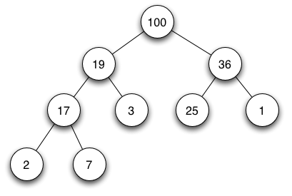
Introduction
Heaps are another type of binary tree
Each node has to have some comparable value
Think of each of these values as a priority

Slide 3
Introduction
Is always balanced as each node is put in via breadth order
Each node is comparable to its parent
Either greater than or less than depending on the type of heap

Slide 4
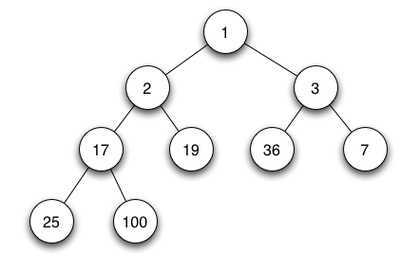
Introduction
2 common versions versions
Min Heap
Max Heap

Slide 5
Insertion
Add the new node to the first available child in breath order
Next “bubble up” that node so it’s in the correct position
If the node above it is less than the node’s value then swap those values
Continue to do this until that’s not true or the root is reached

Slide 6
Insertion
Insert 7 to the max heap
20
16
6
8
11
4
5
1
2
3
10
-
-
-
-

Slide 7
Insertion
Check breath order to find the first empty (-) value
20
16
6
8
11
4
5
1
2
3
10
-
-
-
-

Slide 8
Insertion
Add the new value 7
20
16
6
8
11
4
5
1
2
3
10
7
-
-
-

Slide 9
Insertion
“Bubble up” that value until the parent is greater than that value
20
16
6
8
11
4
5
1
2
3
10
7
-
-
-

Slide 10
Insertion
7 > 4 SWAP
20
16
6
8
11
7
5
1
2
3
10
4
-
-
-

Slide 11
Insertion
7 > 6 SWAP
20
16
7
8
11
6
5
1
2
3
10
4
-
-
-

Slide 12
Insertion
7 < 20 DONE!
20
16
7
8
11
6
5
1
2
3
10
4
-
-
-

Slide 13
Deletion
You always remove the node at the root
Get the last node via breadth order and place that node at the root
Finally take that node and “bubble down”
First see which of the two children are larger
If the larger child is larger then SWAP
Otherwise it is sorted

Slide 14
Deletion
Remove and return the node at the root
20
16
7
8
11
6
5
1
2
3
10
4
-
-
-

Slide 15
Deletion
Take the last node in breadth order and place it at the root
-
16
7
8
11
6
5
1
2
3
10
4
-
-
-

Slide 16
Deletion
Bubble that value down. Pick the larger of the two children. If it is larger then swap
4
16
7
8
11
6
5
1
2
3
10
-
-
-
-

Slide 17
Deletion
16 > 4 SWAP
16
4
7
8
11
6
5
1
2
3
10
-
-
-
-

Slide 18
Deletion
11 > 4 SWAP
16
11
7
8
4
6
5
1
2
3
10
-
-
-
-

Slide 19
Deletion
10 > 4 SWAP
16
11
7
8
10
6
5
1
2
3
4
-
-
-
-

Slide 20
Deletion
There are no more children. DONE!
16
11
7
8
10
6
5
1
2
3
4
-
-
-
-

Slide 21
Heap Sort
If a heap is constructed if every element is removed it is returned in that order
Max Heap returns everything largest to smallest
Min Heap return everything smallest to largest
This is due to the value of the root is either the largest or smallest value always

Slide 22
Heap Sort
20
20
16
7
8
11
6
5
1
2
3
10
4
-
-
-

Slide 23
Heap Sort
20 16
16
11
7
8
10
6
5
1
2
3
4
-
-
-
-

Slide 24
Heap Sort
20 16 11
11
10
7
8
4
6
5
1
2
3
-
-
-
-
-

Slide 25
Heap Sort
20 16 11 10
10
8
7
3
4
6
5
1
2
-
-
-
-
-
-

Slide 26
Heap Sort
20 16 11 10 8
8
4
7
3
2
6
5
1
-
-
-
-
-
-
-

Slide 27
Heap Sort
20 16 11 10 8 7
7
4
6
3
2
1
5
-
-
-
-
-
-
-
-

Slide 28
Heap Sort
20 16 11 10 8 7 6
6
4
5
3
2
1
-
-
-
-
-
-
-
-
-

Slide 29
Heap Sort
20 16 11 10 8 7 6 5
5
4
1
3
2
-
-
-
-
-
-
-
-
-
-

Slide 30
Heap Sort
20 16 11 10 8 7 6 5 4
4
3
1
2
-
-
-
-
-
-
-
-
-
-
-

Slide 31
Heap Sort
20 16 11 10 8 7 6 5 4 3
3
2
1
-
-
-
-
-
-
-
-
-
-
-
-

Slide 32
Heap Sort
20 16 11 10 8 7 6 5 4 3 2
2
1
-
-
-
-
-
-
-
-
-
-
-
-
-

Slide 33
Heap Sort
20 16 11 10 8 7 6 5 4 3 2 1
1
-
-
-
-
-
-
-
-
-
-
-
-
-
-

Slide 34
Heap Sort
20 16 11 10 8 7 6 5 4 3 2 1
DONE!
-
-
-
-
-
-
-
-
-
-
-
-
-
-
-

