Slide 1
Git
The stupid content tracker

Slide 2
0. Prerequisites
Basics
Uses
Tips and Tricks
Plumbing and Pedantry
Table of Contents

Slide 3
Scavenger hunt! https://tinyurl.com/acm-git-talk
This presentation: https://github.com/jyn514/git-ctf/blob/master/talk.pptx
Note – although the link above is the same repo as in the zip file, it doesn’t have all the info you need to solve the scavenger hunt.
Before we begin
Notes:
Time permitting, we’ll cover why this is in part 4 (as well as why I didn’t use `git bundle`).

Slide 4
Part 0 - Prerequisites

Slide 5
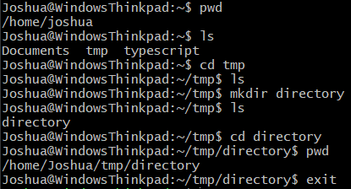
pwd: show the current directory
Usage: `pwd`
ls: shows all files in a directory
Usage: `ls [<directory>]`
cd: change the current working directory
Usage: `cd [<directory>]’
mkdir: create a new directory
Usage: `mkdir <directory>`
Prerequisites - Commands

Slide 6
Part 1 - basics

Slide 7
Version control
No more ‘essay_final (1) (3) (2).docx’
Allows multiple people to work offline
See how document changes over time
Basics – concepts

Slide 8
Repository (repo) – one logical group of code, according to git
Tracked in <base directory>/.git
By default, all files in <base directory> (recursively) are part of the repo
Commit – one logical change to the files in a repository, according to git. Must have:
Author
Commit date
Commit message
Parent commit
Hash (sha1sum)
For the pedantic: you don’t have to change any files in a commit (although it’s silly not to)
Basics – concepts

Slide 9
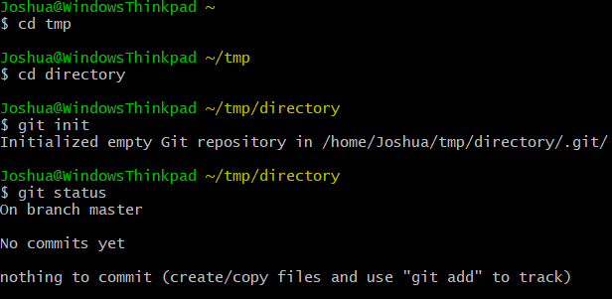
Init
Usage: `mkdir myrepo; cd myrepo; git init`
For starting a new git repository
Basics – commands

Slide 10
Status: show the current state of the repo
Usage: `git status [--short] [--branch]`
Basics – Commands

Slide 11
Clone
Usage: `git clone <url>`
Creates a new directory with the same name as the end of the url
Example: `git clone https://github.com/torvalds/linux` creates the directory ‘linux’
By default, runs `git checkout master`. You can change this by
Adding `-b <branch>` on the client side
Adding `--bare` on the client side
Running `git checkout <branch>` (or more likely, `git symbolic-ref HEAD refs/heads/<branch>`) on the server
For the pedantic: <url> can be many protocols (git://, http://, ssh://)
Basics – commands

Slide 12
Working Tree – the files on the disk
Index – the files that are ‘staged’, but have not been committed
Remote – another repo, possibly across a network connection
Basics – concepts

Slide 13
Add
Usage: `git add <file> [<file> […]]`
Take a file in your working directory and put it in the index
Can be run with --interactive (like many others)
Can be run with --patch (like many others)
For the pedantic: git tracks whether a file is
Executable or not (by default)
A regular file, a symbolic link, or a directory (always). I have not experimented with block or character devices.
Basics – commands

Slide 14
Commit
Usage: `git commit`
Take the things in your index, create a commit object with the current HEAD as a parent, and move HEAD to that new commit.
When used with a file (`git commit <file> [<file> […]]`), ignore the index and commit changes to the file instead
For the pedantic: `git commit <file>` will fail if <file> is not tracked by git.
Basics – commands

Slide 15
Push/pull
Usage: `git push` or `git pull`
Updates the remote repo or the local repo, respectively.
For the pedantic: if both repos have made commits, push and pull will automatically run `git merge`. To disable this behavior, use `git fetch`. To use rebase instead, use `git pull --rebase` (client-side only).
Basics – commands

Slide 16
git help [(-a|-g)]
Online help: reference and book
Github tutorials
More
Interlude – Tutorials

Slide 17
Part 2 – uses

Slide 18
Branches: Allow multiple people to work on different things
Scenario: Everyone works on `master` and pushes as soon as they commit
Commits come in constantly, so you’re never up to date (this happened to Windows)
Commits aren’t logically connected, they’re ordered by date
Scenario: Everyone works on `master` and pushes when their feature is complete
No code review until merge time (can’t catch things early)
Nobody wants to read all that code
Typical workflow: People work on branches and push as they commit
Few people work on a branch, so it’s easy to stay up to date
Commits are automatically related by branch
When a feature is complete, the owner/team lead merges the branch into master
Uses - concepts

Slide 19
Merge: combine two branches with different history
If only other branch has changed (and is a child of the current), apply all of its commits in order (--ff-only)
If only current branch has changed, do nothing
If both have changed, show the differences and let the user figure it out; once this is done, create a new commit on the current branch.
For the pedantic: https://git-scm.com/docs/git-merge#_true_merge shows the algorithm used
Advantage: work is never lost unless explicitly discarded by the user. Disadvantage: leads to lots of extraneous commits (‘merge master into upstream’)
Uses – CONCEPTS

Slide 20
Branch: create a new branch or show existing branches
Usage: `git branch <branch name>` to create a branch
Usage: `git branch` to show existing branches
USES – COMMANDS

Slide 21
Checkout: switch to a different branch or checkout specific files from a branch
Usage: `git checkout <branch>` to switch branches
Usage: `git checkout [<branch>] [--] <file> [<file> […]]` to checkout a specific file
Shortcut: `git checkout –b <branch>` is the same as `git branch <branch>; git checkout <branch>`
`git checkout -- <file>` discards all work you’ve done and replaces the file with the version in HEAD
Supports –patch
USES – COMMANDS

Slide 22
Merge
Usage: `git merge <branch>`
For the pedantic: when <branch> is not specified, origin/<current branch> is assumed
USES – Commands

Slide 23
Tag: identifies a commit after more commits are added
Example: v1.1, working-commit
Can be ‘annotated’ (have a message in addition to a title)
USES – Concepts

Slide 24
Tag: tag a commit with a title
Usage: `git tag <title> [<commit>]`
USES – COMMANDS
Notes:
24

Slide 25
History
ALL files are stored in every commit, not diffs
For the pedantic: `git gc` will try to delta-compress (different from diff, binary not text) when you push to a remote. However, the default is to store the whole file.
Because of this, you can see any file at any point in history, including files that have since been deleted
USES – CONCEPTS
Notes:
25

Slide 26
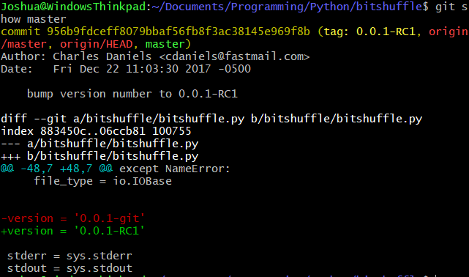
Show: show what changed in a commit
Usage: `git show [<commit>]
Can be used for individual files: `git show [<commit>]:<file>`, in which case it shows the whole file as stored in the commit
Uses – Commands

Slide 27
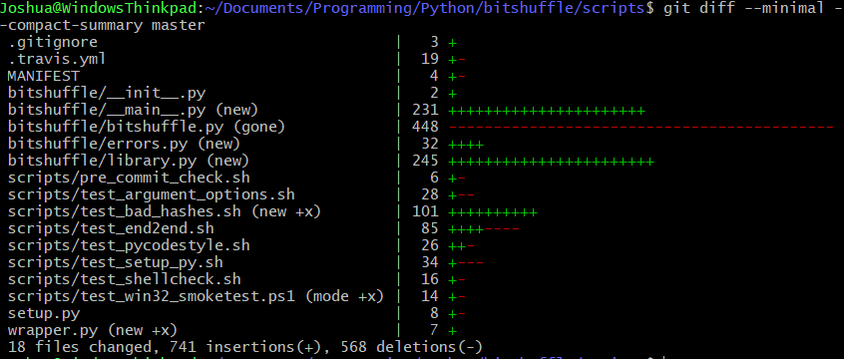
Diff: Show the difference between two commits
Usage: `git diff <commit> <commit>` or `git diff [--cached] [<commit>]`
With no arguments, show what’s changed since the last commit
For sequential commits, you probably want `git show` instead
USES – Commands

Slide 28
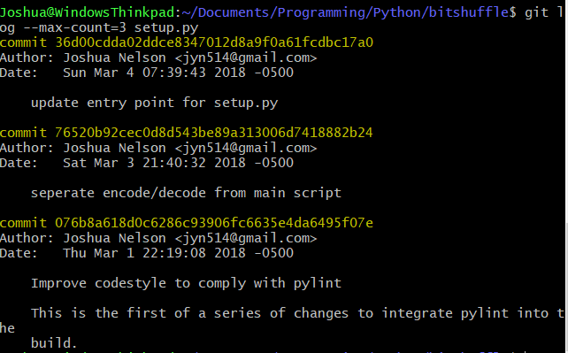
Log: show the history of a repo
Usage: `git log [-p] [<file> […]]
Extremely powerful
Try using -p to show source or -S<string> to find specific changes
USES – Commands

Slide 29
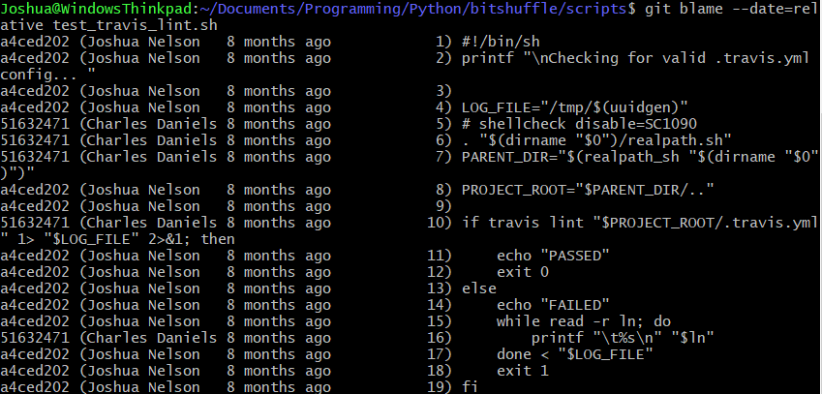
Blame: show the person that wrote a line of code
Usage: `git blame <file>`
Note: this is really ugly and there’s no way to customize it. Additionally, it only catches the last person who modified a line, which is usually a refactor (i.e. uninteresting). I usually use `git log –p` instead.
USES – Commands
Notes:
This is not useful enough to share in the hour we have. Show this slide if anyone asks why `blame` isn’t included.
29

Slide 30
GUIs
gitk/git-gui (the original): very good for patching
GitHub Desktop, GitKraken, Git-Tower, etc: have not used
Add-ons
Hub (github integration) – replaces git with a superset. I find it inelegant and not particularly useful.
LFS (large file storage) – adds new command `git lfs`. Useful, but no good adopters on the server (GitHub requires money)
Write your own – git looks on PATH for git-* commands
Integration with most major IDES (on the IDE side)
Hosting (because servers are hard)
GitHub
Bitbucket
Gitlab
Interlude – External Tools

Slide 31
PART 3 – Tips and tricks

Slide 32
Tips and Tricks - Revisiting commands
git add –patch
git merge –abort
git log <commit range>
Commit range :: (<commit>..[<commit>]|[<commit>]..<commit>)
git diff –cached

Slide 33
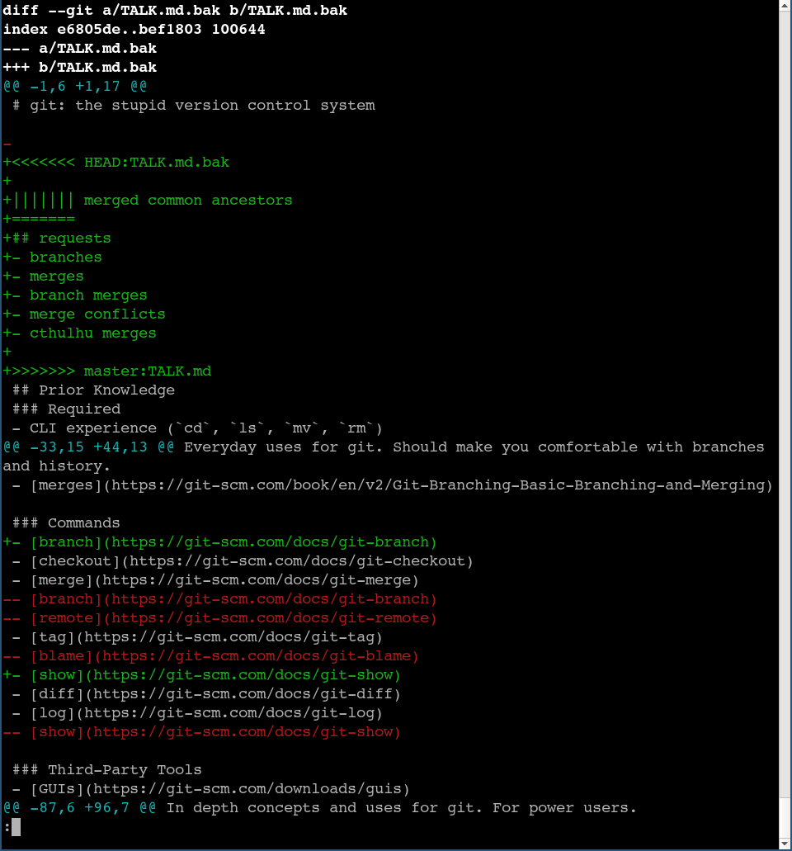
Merge Conflict: Two branches have different changes
Hint: git config merge.conflictstyle diff3
Use mergetool (I like meld but YMMV)
Once you finish, run `git add <file>` and commit
Tips and Tricks - Concepts
Notes:
http://weblog.masukomi.org/2008/07/12/handling-and-avoiding-conflicts-in-git/
https://help.github.com/articles/resolving-a-merge-conflict-using-the-command-line/
https://stackoverflow.com/questions/161813/how-to-resolve-merge-conflicts-in-git
33

Slide 34
Don’t change published history.
Deletes existing work
Breaks links (commit doesn’t exist anymore, think github)
Breaks versioning (if two commits have same tag, which one does client have?)
Breaks bug reporting (the client has a build you don’t have sources for)
Tips and Tricks – concepts

Slide 35
You can change local history
Delete empty and duplicate commits
Avoid endlessly re-merging old code by rebasing (e.g. move to new directory)
How does it work?
Reset history to start of branch
For each commit between beginning and tip of branch, rerun that commit
This is less editing and more brute force, but it works
If you don’t get it that’s OK, I don’t either ¯\_(ツ)_/¯
Tips and tricks – concepts

Slide 36
Rebase: change arbitrary history
Usage: 1) `git rebase –i` to edit history since branch started
2) `git rebase <branch> [<current>]` to rebase current branch since branch started onto <branch>
Note: these are *different* things, they just happen to use the same command
Tips and Tricks – Commands

Slide 37
Tips and Tricks – concepts
Referring to commits: 3 main ways
Hash (SHA1, created automatically)
For the pedantic: might switch to SHA256 eventually; compatibility issues
Symbolic ref (branch name, tags, etc.)
Derived (<commit>@3, <branch>@{time}, etc.)
Will not cover, reference here if you want it

Slide 38
Tips and Tricks – Commands
Reset: undo commits
Usage: `git reset [--soft | --hard | --mixed] [<commit>]
Commits still exist, just not on branch
Good for discarding commit but keeping changes on disk
This is how rebase works
Can also be used to unstage changes from index (when no commit given)
Different from revert: commits are deleted from history

