Slide 1
Recursion
Chapter 11
Modified by JJ

Slide 2
Objectives
Describe the concept of recursion
Use recursion as a programming tool
Describe and use recursive form of binary search algorithm
Describe and use merge sort algorithm

Slide 3
Basics of Recursion: Outline
Basics of Recursion
Case Study: Digits to Words
How Recursion Works
Infinite Recursion
Recursive versus Iterative Methods
Recursive Methods that Return a Value

Slide 4
Basics of Recursion
A recursive algorithm will have one subtask that is a small version of the entire algorithm's task
A recursive algorithm contains an invocation of itself
Must be defined correctly else algorithm could call itself forever or not at all

Slide 5
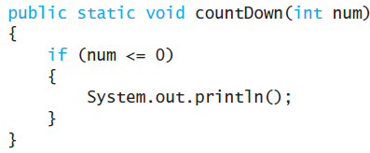
Simple Example - Countdown
Given an integer value num output all the numbers from num down to 1
Can do this easier and faster with a loop; the recursive version is an example only
First handle the simplest case; the base case or stopping condition

Slide 6
Recursive Countdown
Next handle larger cases; phrase solution in terms of a smaller version of the same problem
countDown(3) is to output 3 then output the result of countDown(2)
View demonstration, listing 11.1
class RecursionCountdown

Slide 7
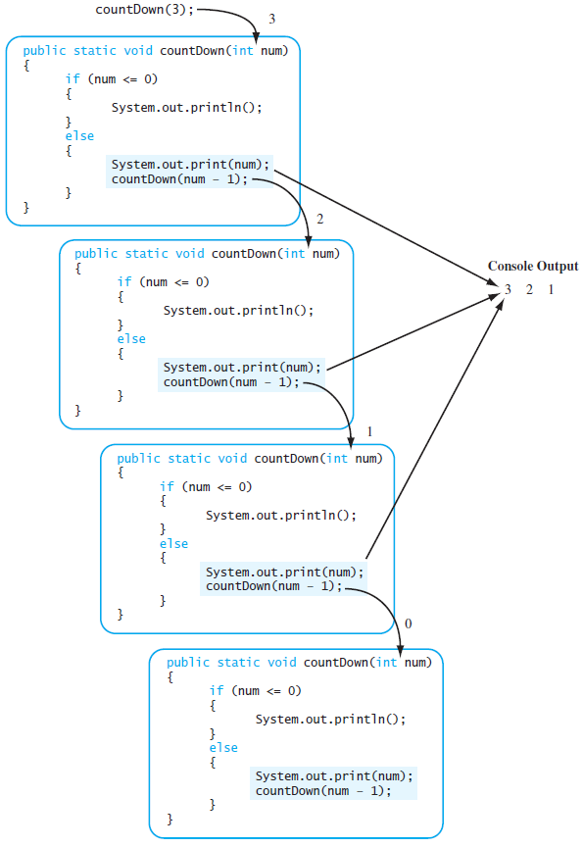
Sequence of Calls
countDown(3)

Slide 8
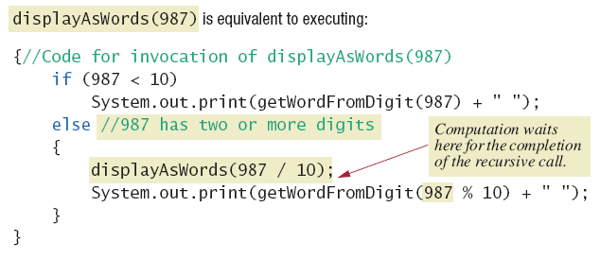
How Recursion Works
Figure 11.2a Executing recursive call

Slide 9
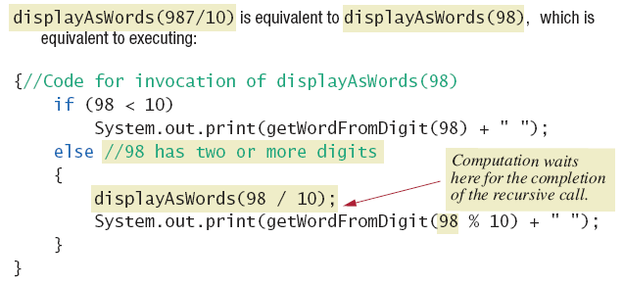
How Recursion Works
Figure 11.2b Executing recursive call

Slide 10
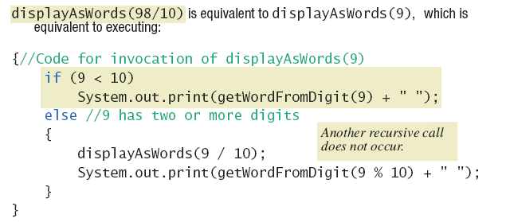
How Recursion Works
Figure 11.2c Executing recursive call

Slide 11
Keys to Successful Recursion
Must have a branching statement that leads to different cases
One or more of the branches should have a recursive call of the method
  Recursive call must us "smaller" version of the original argument
One or more branches must include no recursive call
  This is the base or stopping case

Slide 12
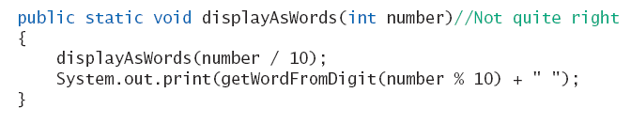
Infinite Recursion
Suppose we leave out the stopping case
Nothing stops the method from repeatedly invoking itself
  Program will eventually crash when computer exhausts its resources (stack overflow)

Slide 13
Recursive Versus Iterative
Any method including a recursive call can be rewritten
  To do the same task
  Done without recursion
Non recursive algorithm uses iteration
  Method which implements is iterative method

Slide 14
Recursive Versus Iterative
Recursive method
  Uses more storage space than iterative version
  Due to overhead during runtime
  Also runs slower
However in some programming tasks, recursion is a better choice, a more elegant solution

Slide 15
Recursive Methods that Return a Value
Follow same design guidelines as stated previously
Second guideline also states
  One or more branches includes recursive invocation that leads to the returned value
View program with recursive value returning method, listing 11.4
class RecursionDemo2

Slide 16

Recursive Methods that Return a Value
Sample
screen output
Note recursive method NumberOfZeros
  Has two recursive calls
  Each returns value assigned to result
  Variable result is what is returned

Slide 17

Factorial
Mathematical function denoted by “!”
Returns the value of the product of every value before it
Represented by this equation

Slide 18
Greatest Common Divisor (GCD)
Given two numbers what is the largest number that divides into them evenly?
THAT’S WHAT THE GCD DO!

Slide 19
Fibonacci Number / Sequence
A series of numbers whose value is the sum of the two values that preceded it
Occurs a lot in nature

Slide 20
Summary
Method with self invocation
  Invocation considered a recursive call
Recursive calls
  Legal in Java
  Can make some method definitions clearer
Algorithm with one subtask that is smaller version of entire task
  Algorithm is a recursive method

Slide 21
Summary
To avoid infinite recursion recursive method should contain two kinds of cases
  A recursive call
  A base (stopping) case with no recursive call
Good examples of recursive algorithms
  Binary search algorithm
  Merge sort algorithm

