Slide 1

Project Title: PixelAura+
Name: Ajay Naranbhai Kathi
Enrolment No : 240220320014
Branch : MCA(Sem-4)
Subject : : Industrial Internship
Guide Name : Prof. Sunny Goswami
University Name : Dr. Shubhash Technical Campus
Academic Year: 2025–2026
Submission Date : Feb 28 2026

Slide 2

Project Introduction
About Project
Pixel Aura+ is a web-based image sharing platform that allows users to create accounts, upload images, like posts, comment on posts, and follow other users. The system simulates the core functionality of modern social media platforms like Instagram.
Why The Project develop?
To understand how social media platforms work internally
To implement real-world web development concepts
To practice frontend and backend integration
To gain hands-on experience during internship training

Slide 3

Project Introduction
What Problem It Solves?
Existing social media systems are complex and difficult for beginners to understand
Students need a simplified system to learn database relationships and user interaction
Provides a structured learning platform for authentication, posting, and user engagement features

Slide 4
Problem Statement
What Problem Exists?
Modern social media platforms are highly complex systems.
They involve advanced algorithms, security layers, and large-scale database management.
Beginners find it difficult to understand how such systems work internally.
Why Current Systems Are Complex?
Platforms like Instagram and Facebook operate on large distributed architectures.
They use advanced technologies such as AI-based recommendations, cloud infrastructure, and real-time processing.
Their source code and system design are not accessible for educational learning.

Slide 5
Problem Statement
Why Students Need a Simplified Learning System?
Students need a structured and simplified platform to understand:
User authentication
Database relationships
CRUD operations
Like, comment, and follow systems
A simplified model helps bridge the gap between theoretical knowledge and practical implementation.

Slide 6
Objectives of the Project
To build an image sharing platform
To implement user authentication
To implement likes, comments, follow system
To understand database relationships
To practice full-stack development

Slide 7
Scope of the Project
Who Can Use It?
Students learning web development
Beginner developers practicing full-stack development
Educational institutions for demonstration purposes
Anyone who wants to understand how social media systems function
Where Can It Be Used?
Academic project demonstrations
Internship training programs
Web development learning workshops
As a prototype model of platforms like Instagram

Slide 8
Existing System
Modern social media platforms such as Instagram and Facebook provide advanced digital communication and content-sharing services to millions of users worldwide.
User registration and authentication
Image and video sharing
Likes, comments, and reactions
Follow / Friend system
Real-time notifications
AI-based content recommendation
Cloud storage and scalability

Slide 9
Existing System
Complexity of Existing Systems
Built on large-scale distributed architectures
Use advanced algorithms and AI models
Implement high-level security mechanisms
Operate with massive real-time databases
Use cloud infrastructure for global access
Why Pixel Aura+ is Simplified
Focuses only on core social media features
Designed for learning full-stack development
Uses simplified database relationships
Easy to understand structure for students
Developed as an educational prototype

Slide 10
Proposed System
Main modules:
User Registration/Login
Upload Image
Like & Comment
Follow System
Dark/Light Mode
Set Profile
Chat

Slide 11
System Architecture
Architecture Diagram
User
↓
Frontend ( HTML / CSS / JS)
↓
Backend (Python With Django )
↓
MySQL WorkBench

Slide 12
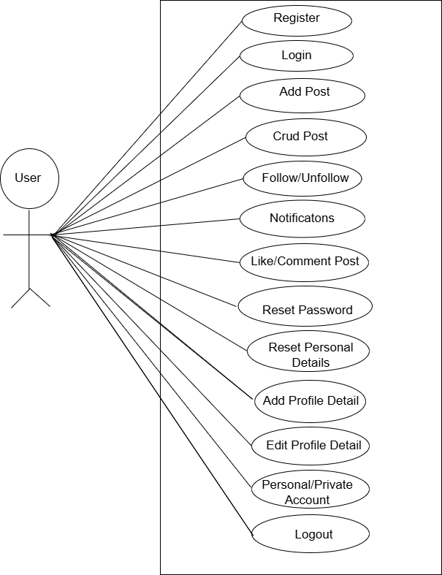
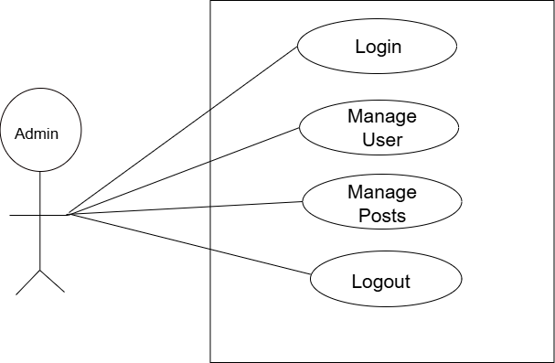
Database Design
Use Case
Admin User

Slide 13
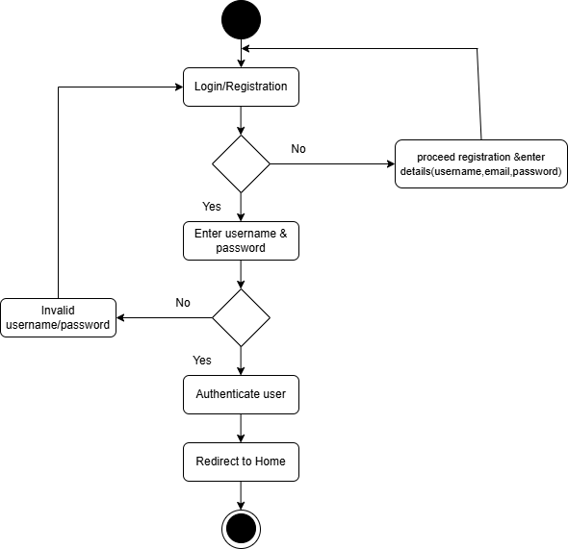
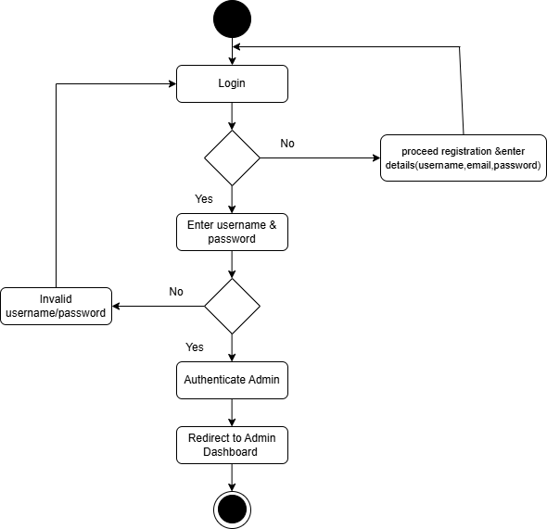
Database Design
Activity Diagram
User Admin

Slide 14
Technology Stack
📌 Frontend Technologies
HTML5 – Structure of the web pages
CSS3 – Styling and layout design
BOOTSTRAP ICON – Modern utility-based styling
📌 Backend Technologies
Python (Django Framework) – Server-side logic and request handling
📌 Database
MySQL – Data storage and relationship management
📌 Version Control
Git – Source code management
📌 Development Tools
VS Code – Code editor

Slide 15
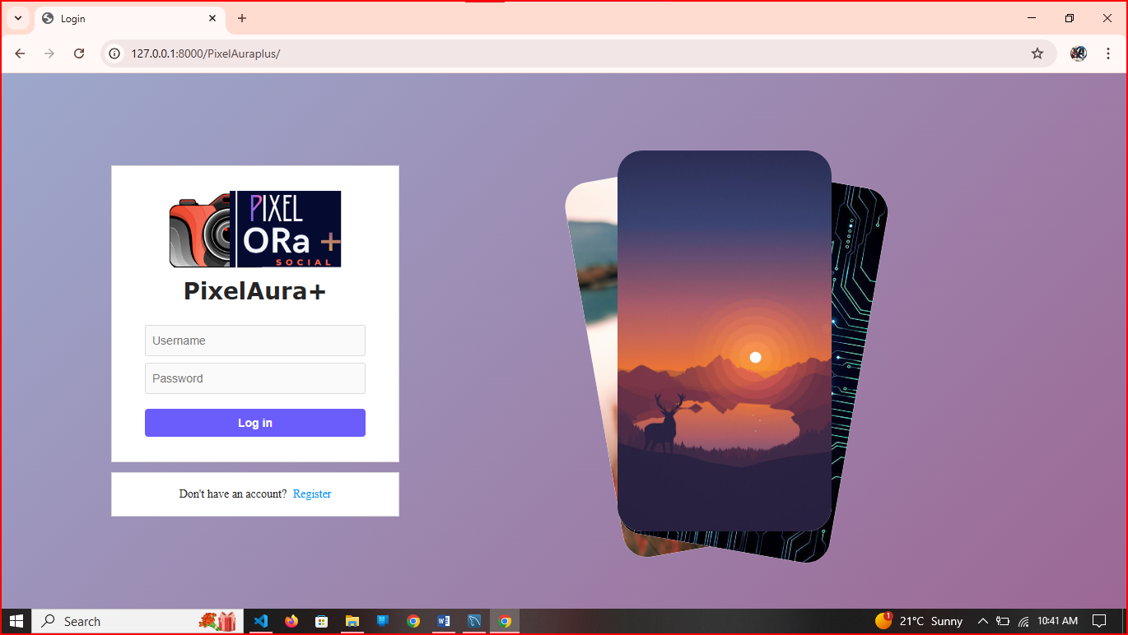
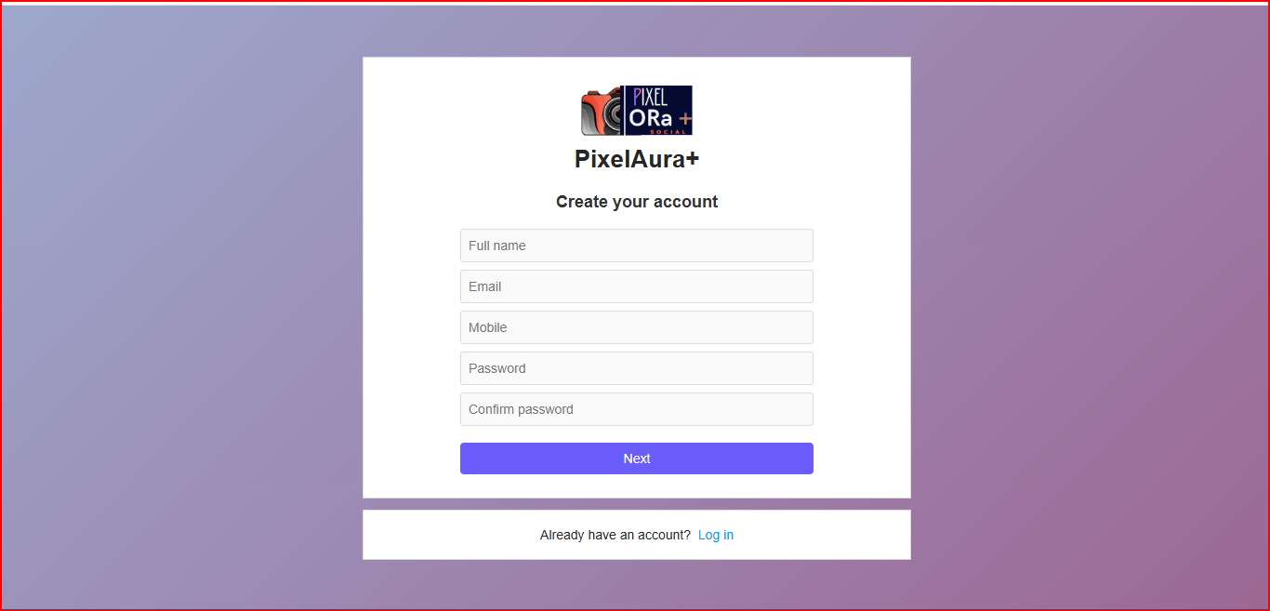
11. Implementation Screenshots

Slide 16
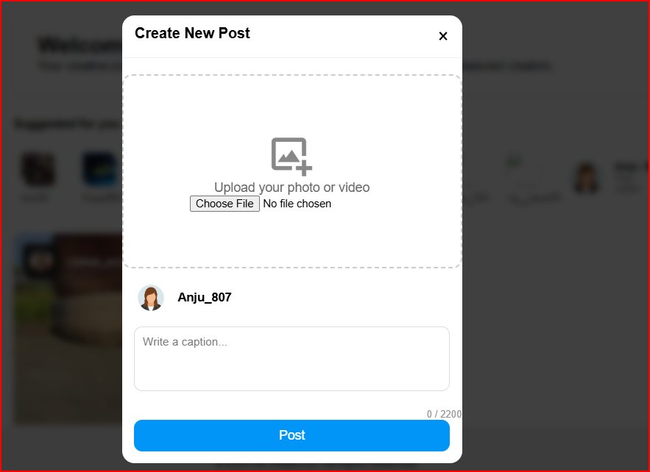
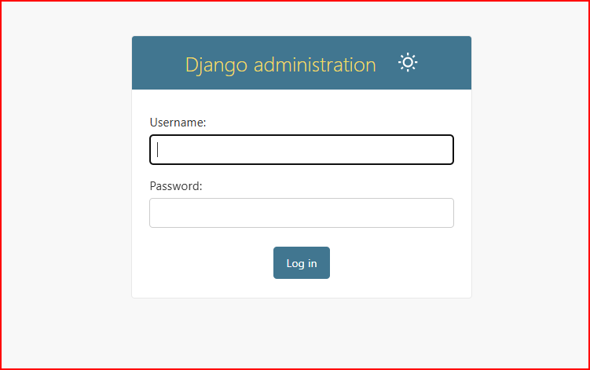
Implementation Screenshots

Slide 17
Future Enhancements
Mobile app
AI-based image filter
Deployment on cloud
Security
Saved
Story

Slide 18

Conclusion
What I Learned ?
Understood how a real-world social media application works
Learned the importance of proper database design and relationships
Improved problem-solving and debugging skills
Gained experience in structuring a full-stack project
Technical Knowledge Gained
Frontend development using React / HTML / CSS / Tailwind
Backend development and API handling
Database management (tables, relationships, queries)
Authentication system (login, registration, session handling)
Version control using Git and GitHub

Slide 19
16Conclusion
Practical Experience
Faced and resolved technical errors independently
Implemented features like image upload, likes, comments, and follow system
Understood how platforms like Instagram manage user interaction systems

Slide 20
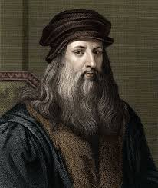
Thank You
“Learning never exhausts the mind.”
— Leonardo da Vinci

