Slide 1

Real-Time Property Rental, Maintenance & Amenity Management Platform
Name : Ajay Kathi N
Internship Role : Full Stack Web Developer Intern
Company Name : Unified Mentor
Duration : January 2026 – April 2026

Slide 2

Unified Mentor
Unified Mentor Provide Courses Like Web Development , Data Science , Data Analyst , Digital Marketing , Machine learning , UI/UX Designer , Graphic Design. Also Offers Fellowship Like Full Stack Development , Frontend Development , Backend development , Machine learning , UI/UX Designer , Data Science , Digital Marketing , Data Analyst , Business Analyst , Financial Analyst.
At Unified Mentor, we focus on delivering career-focused courses that help you gain practical skills and land real jobs quickly. Learn the skills employers are looking for and accelerate your career growth today.
I have Join this online Internship program as full Stack Developer.

Slide 3

My Role & Responsibilities
As A Full Stack Developer Intern I Have to Create a website that is assigned By Unifiedmentor.
I Have To Create Or design :
Developed frontend using React.js
Built REST APIs using Node.js & Express
Designed MongoDB schemas
Implemented role-based authentication

Slide 4
Problem Statement
Lack of real-time maintenance tracking
Poor visibility of request status
Miscommunication between tenants and owners
Amenity booking conflicts due to untracked schedules
These challenges result in delays, confusion, and inefficient property management.

Slide 5

Objective / Goal
Primary Objectives
Centralize rental, maintenance, and amenity-related information
Enable real-time tracking of maintenance requests
Improve transparency between tenants and property owners
Prevent double booking and conflicts for shared amenities
2. Secondary Objectives
Deliver a simple, responsive, and intuitive user interface
Provide learners with hands-on experience in building a real-time property management system
Lay the foundation for scalable property management solutions

Slide 6
System Users
Admin
Manage all properties
Approve or reject property listings
Manage users (Owner, Tenant, Staff)
Assign staff for maintenance tasks
Monitor complaints and system activity
2. Owner
Add and manage properties
Update property details (price, amenities, images)
View bookings and tenant details
3. Tenant
Browse and book properties

Slide 7
System Users
Book amenities (gym, hall, etc.)
Raise complaints or maintenance requests
Track complaint status
4. Staff
View assigned maintenance tasks
Update task status (Pending → In Progress → Completed)
Resolve tenant complaints
Report work updates to Admin

Slide 8

Features Overview
Property Listing
Booking System
Rent Management
Complaint System
Staff Assignment
Amenities Management (gym, Wi-Fi, etc.)

Slide 9

Technology Stack
Frontend: React.js
Backend: Node.js + Express.js
Database: MongoDB

Slide 10
Database Design
Users
Properties
Amenity
Bookings
Amenity Booking
Maintenance
Notification
Support Request

Slide 11
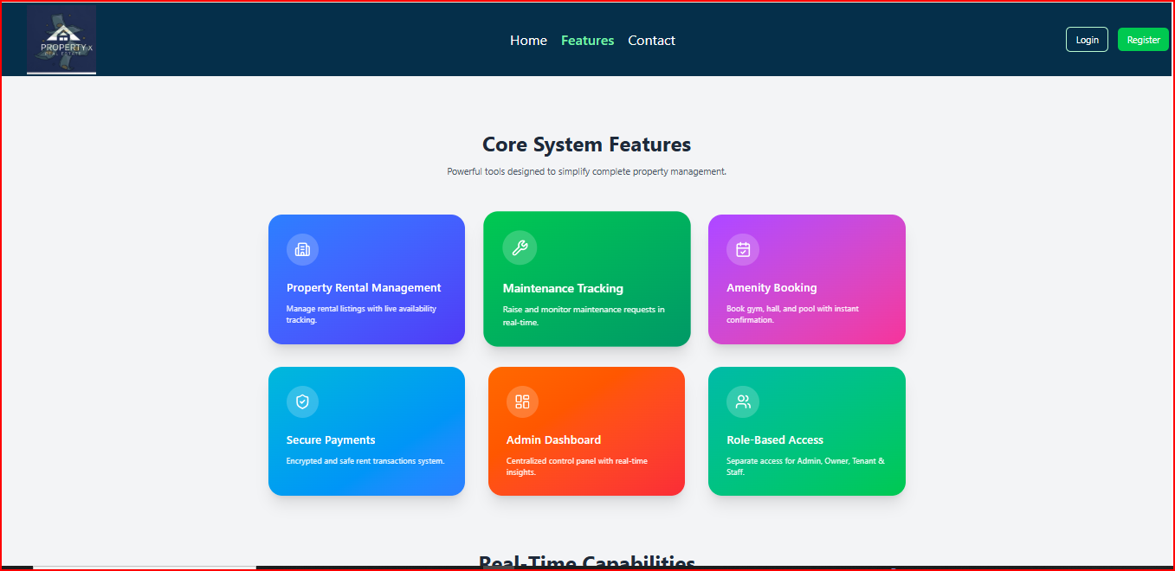
UI Screens
Features

Slide 12
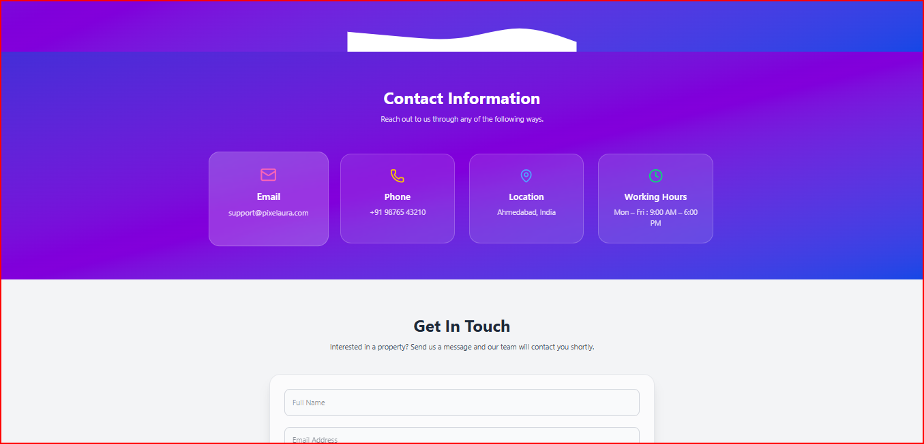
UI Screens
Contact Us

Slide 13
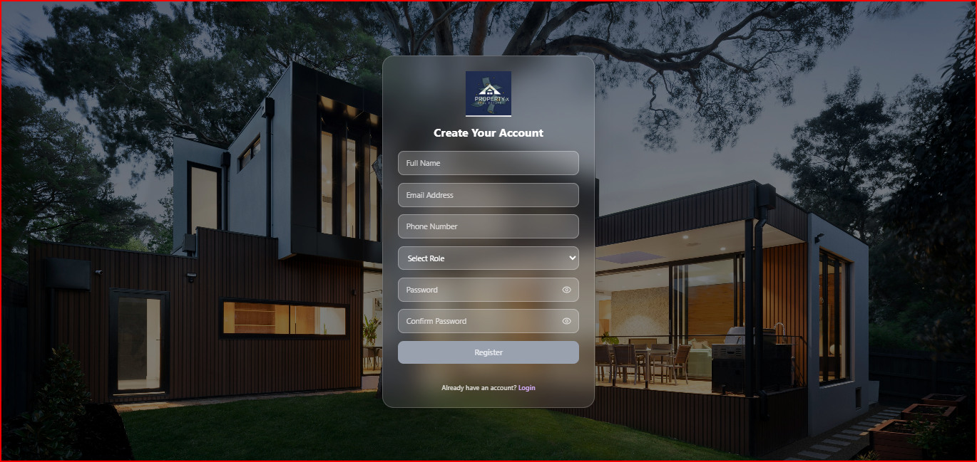
UI Screens
Register

Slide 14
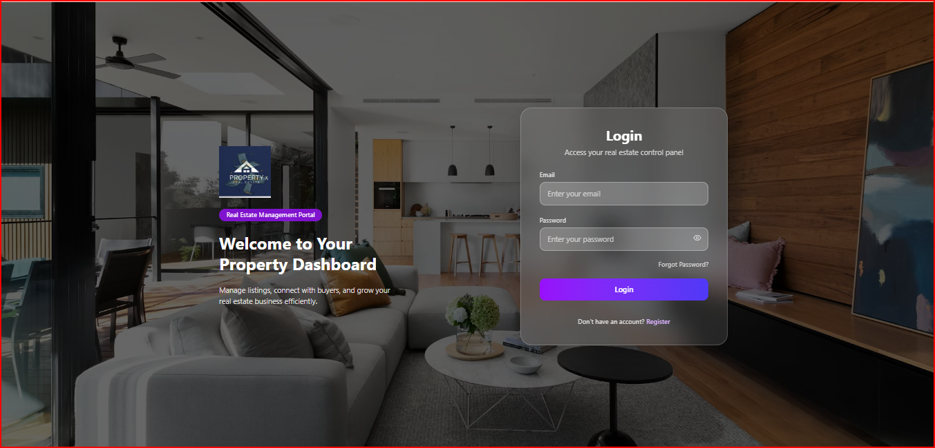
UI Screens
Login

Slide 15
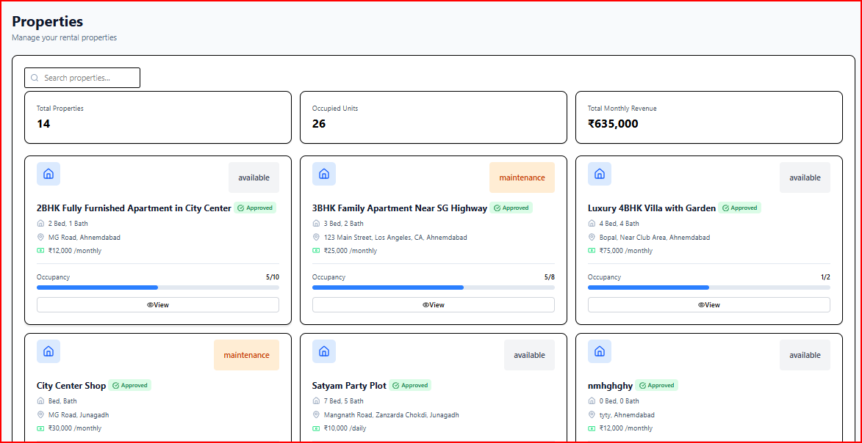
UI Screens
Admin Property

Slide 16
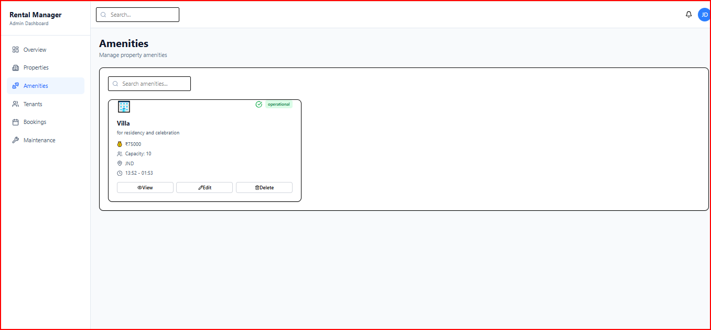
UI Screens
Admin Amenity

Slide 17
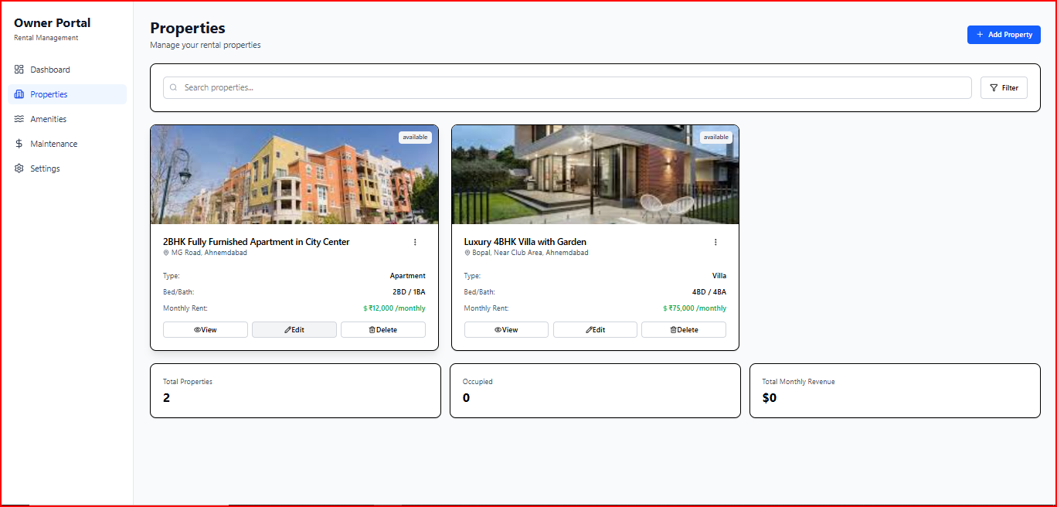
UI Screens
Owner Property(only show owner Specific Property)

Slide 18
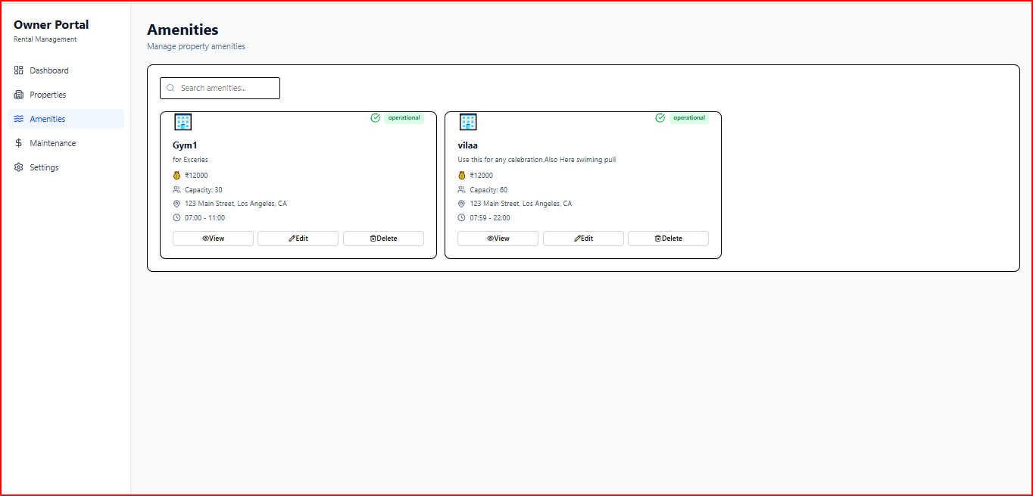
UI Screens
Owner Amenity(only show owner Specific Amenity)

Slide 19
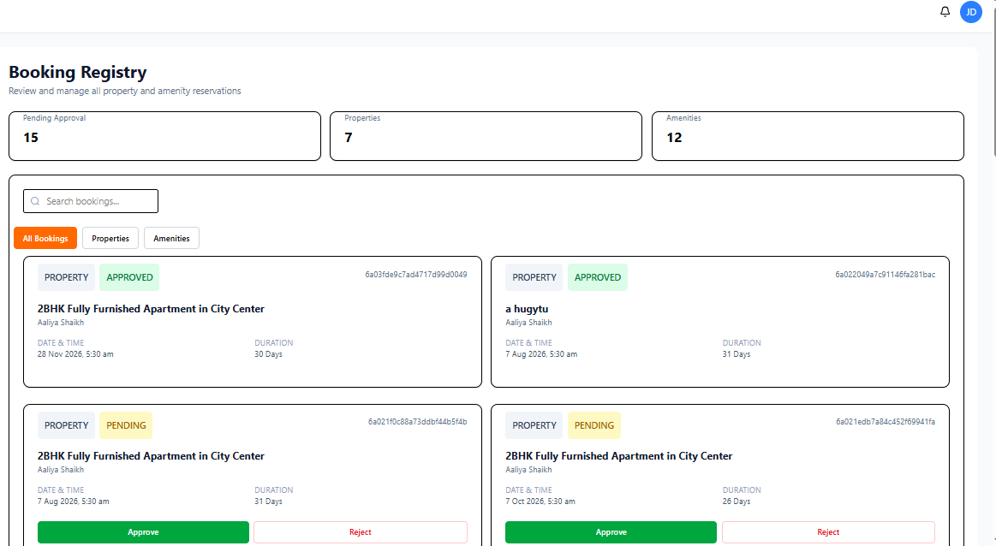
UI Screens
Owner Booking

Slide 20
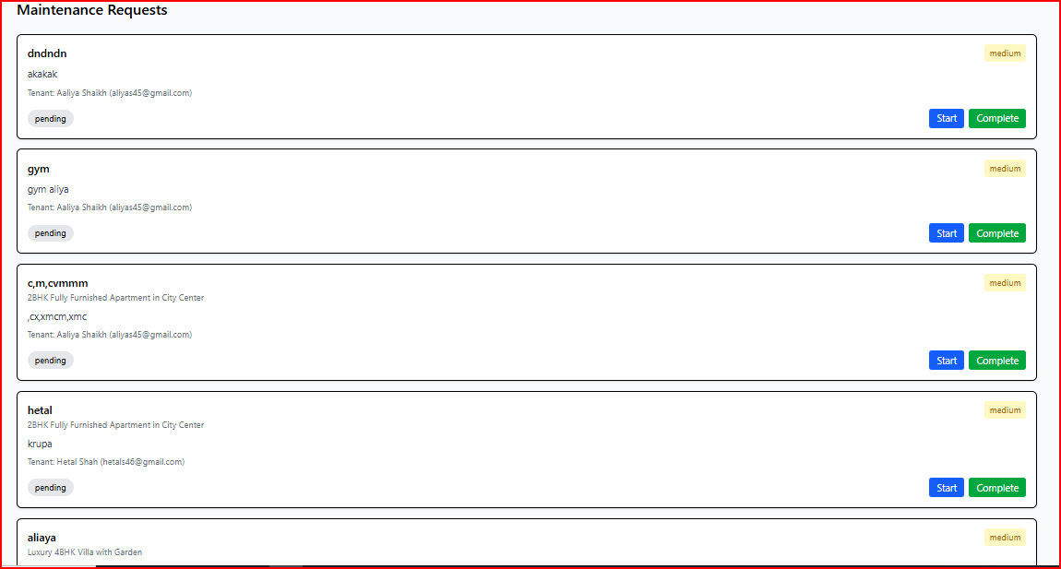
UI Screens
Owner Maintenance Request

Slide 21
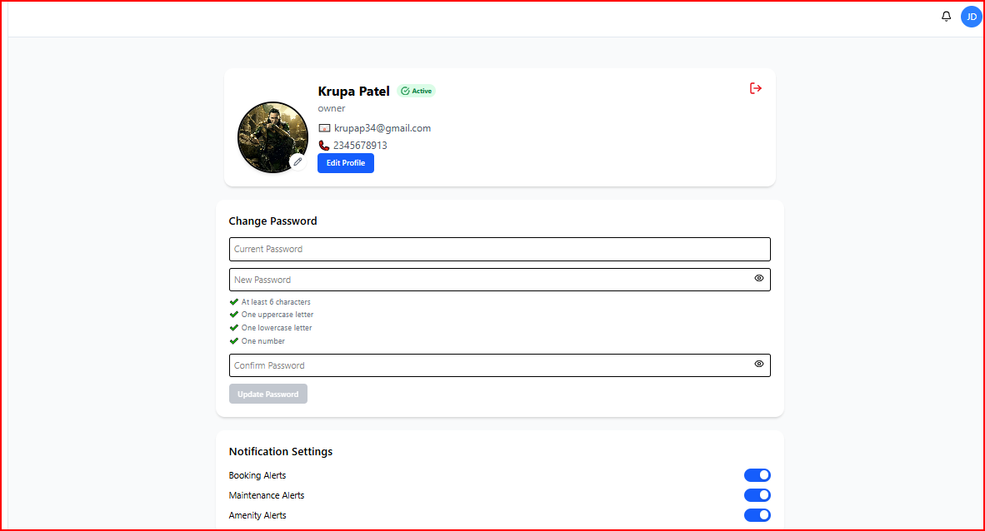
UI Screens
Owner Settings

Slide 22
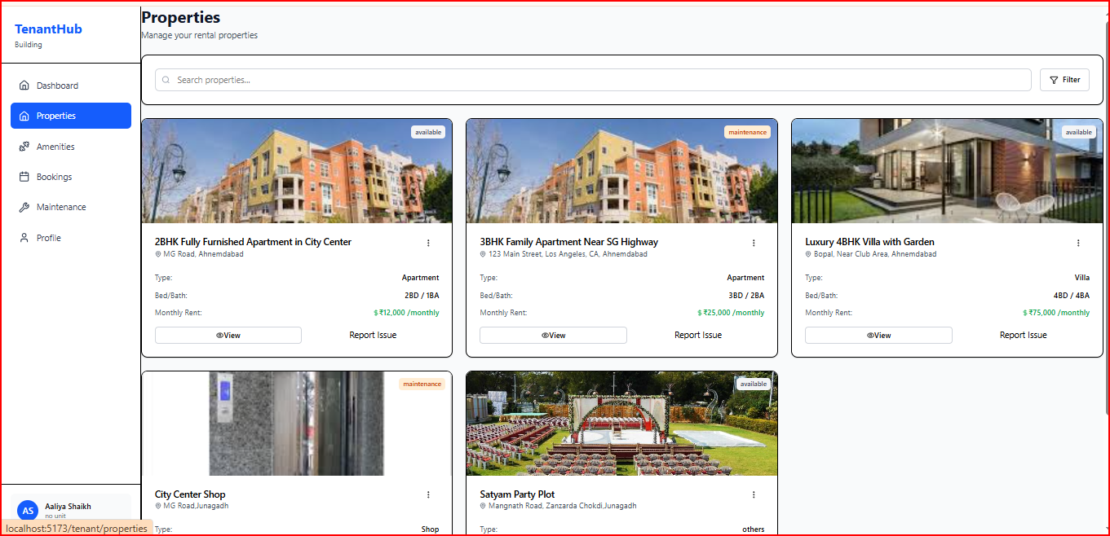
UI Screens
Tenant Property

Slide 23
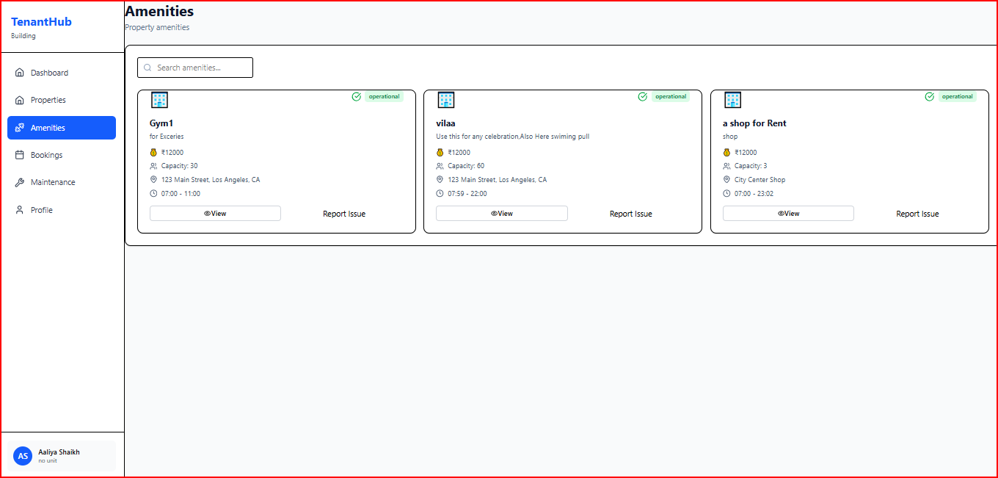
UI Screens
Tenant Amenity

Slide 24
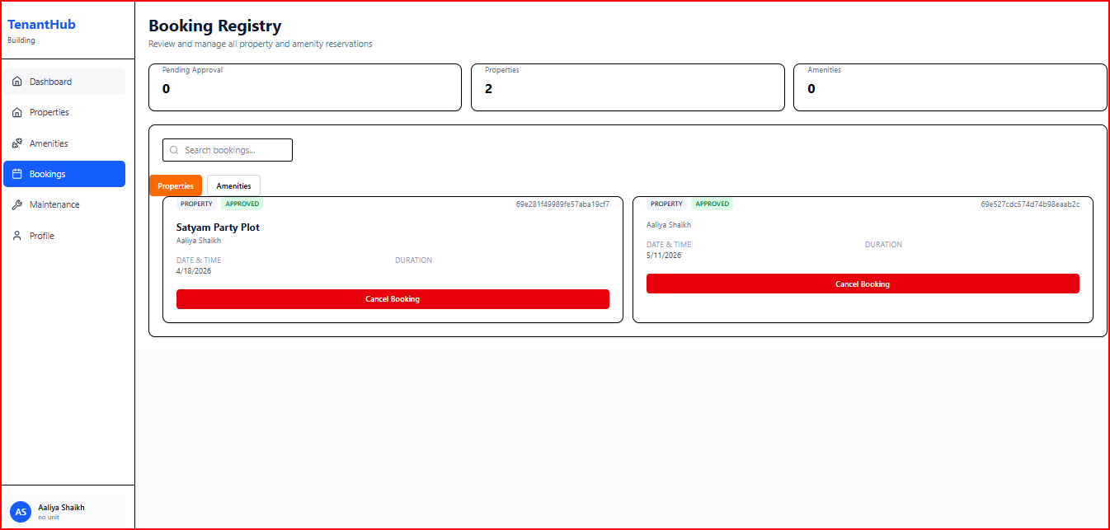
UI Screens
Tenant Booking

Slide 25
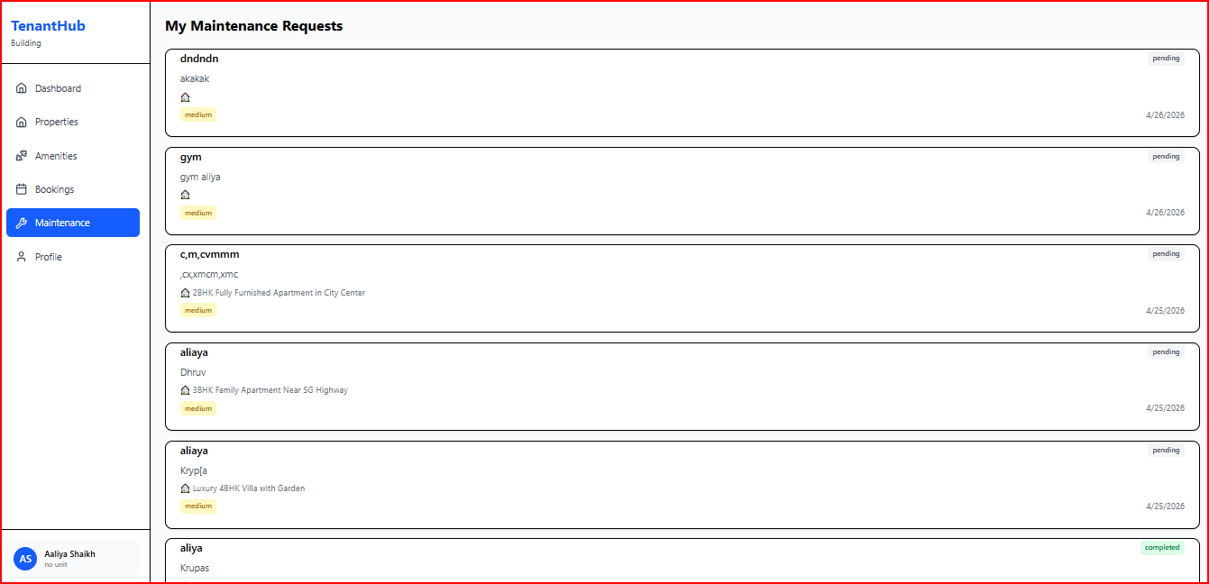
UI Screens
Tenant Maintenance

Slide 26
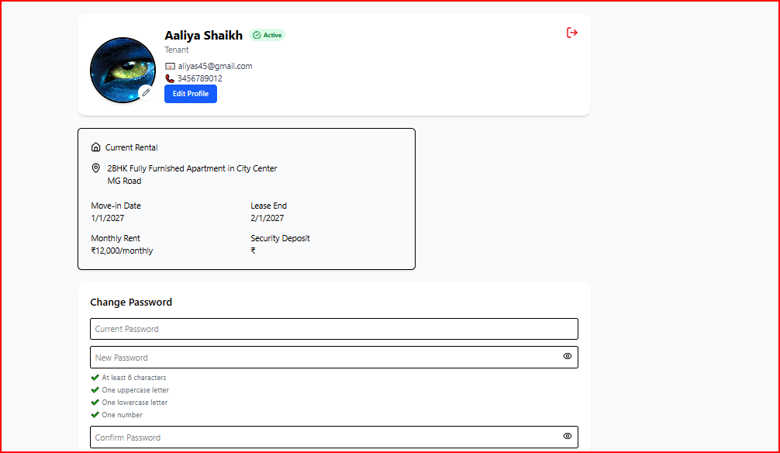
UI Screens
Tenant Profile

Slide 27
Workflow
Owner adds property
Admin reviews and approves property
Tenant books property
Tenant raises complaint
Staff resolves it
Get Notification to all User as per their Action

Slide 28
Real-Time Features
Instant updates
Complaint tracking
Status change (pending → resolved)

Slide 29
Challenges Faced
API errors (500 error )
MongoDB schema design
Role-based authentication
State management in React
Id fetch error

Slide 30
Future Scope
Mobile App 📱
Online Payment Integration 💳
AI-based recommendations 🤖
Notification system 🔔
Mobile App
Online Payment Integration
AI-based recommendations

Slide 31
Conclusion
The Real-Time Property Rental, Maintenance & Amenity Management Platform successfully provides a centralized solution for managing rental properties, tenant activities, maintenance requests, and amenities in real time.
The system simplifies communication between Admin, Owners, Tenants, and Staff through features such as property requests, booking management, notifications, user profiles, complaint handling, and messaging functionality.
By using React.js, Node.js, Express.js, and MongoDB, the platform delivers

Slide 32
Thank You

