Slide 1
MST BLOCKCHAIN × NEWRRO BUILDATHON · OPEN INNOVATION · ROBOTICS × BLOCKCHAIN
Ghostless: Nothing Gets Paid That Didn't Happen
A proof-of-service network for cities. Machines prove the work, the ledger makes skipping or faking it provable and punishable, and payment settles on MST Blockchain. First deployment: smart waste collection in Bengaluru.
SENSE
VERIFY
GATE
SETTLE
Two ultrasonic sensors, IR, lid, RFID on an ESP32
Sensor-fusion AI signs a verdict with its evidence
No receipt, no effect: the lid won't open without one
Escrow on MST; slashed if anything is omitted
Team Ghostless · Hirthik Balaji · Anandhappriya · Jyothi · Lakshaya Sasikumar
GHOSTLESS · MST BLOCKCHAIN
01
Notes:
Open with the tagline. Ghostless = two proofs combined: proof that work happened (sensors) and proof that nothing was quietly left out (reserved, bonded ledger slots). Waste collection is where we start.

Slide 2
01 · THE PROBLEM
Cities pay for work nobody can see, and the worst fraud leaves no record at all.
Ghost pickups
WHAT A NORMAL AUDIT LOG SEES
A hauler bills for a collection that never happened. The only proof is a paper slip or a WhatsApp photo, easy to fake and impossible to audit.
#101
BIN-004 collected
✓
#102
BIN-011 collected
✓
Ghost omissions
A full bin is quietly never logged. A complaint is dropped before it reaches the record. Nothing was edited, so every audit log looks clean.
#103
BIN-019 full: never written
✓ ?
#104
BIN-022 collected, paid
✓ ?
Blockchains don't fix this yet
#105
BIN-007 collected
✓
A ledger proves that what was written wasn't changed. It cannot prove that nothing was left out.
Both frauds pass the audit. The log is "tamper-proof" and still wrong.
GHOSTLESS · MST BLOCKCHAIN
02
Notes:
Two failure modes. Integrity (nobody edited history) is solved by blockchains. Completeness (nothing was left out) and truth (the work happened) are not.

Slide 3
02 · THE INSIGHT
Two proofs, not one.
PROOF OF SERVICE
PROOF OF NON-OMISSION
Did the work happen?
Was anything left out?
The bin measures itself. Both ultrasonic sensors see the level fall 95% → 10% while the lid is open, the assigned worker's RFID card is on the record, and the device signs the evidence. Nobody types "done".
Ledger slots are reserved on MST before decisions exist. Every action carries a signed receipt. If the operator hides a receipted decision, anyone can challenge it, and an unanswered challenge slashes the operator's bond.
Together: you can't be paid for work that didn't happen, and you can't bury work that should have.
GHOSTLESS · MST BLOCKCHAIN
03

Slide 4
03 · HOW IT WORKS
From a full bin to a paid worker, with no step that runs on trust.
1
2
3
4
5
6
Bin detects
AI verifies
Slot on MST
City approves
Gate opens
Proof & pay
Ultrasonic × 2, IR, lid sensor stream to the gateway (HMAC-signed)
Sensor fusion rejects blocked or noisy sensors; signs its verdict
Request recorded in a pre-reserved ledger slot; can't be dropped silently
Nearest worker assigned; payment escrowed in the contract
Lid unlocks only for the assigned worker's card: no receipt, no effect
Level drop re-verified; approval releases MSTC to the worker's wallet
What's on-chain: request, approval, assignment + escrow, RFID proof, completion evidence, approval, payment. Each carries EIP-712 signatures from the bin device and the AI verifier, which the contract checks. What's not: raw sensor readings. Only their hashes go on-chain.
GHOSTLESS · MST BLOCKCHAIN
04

Slide 5
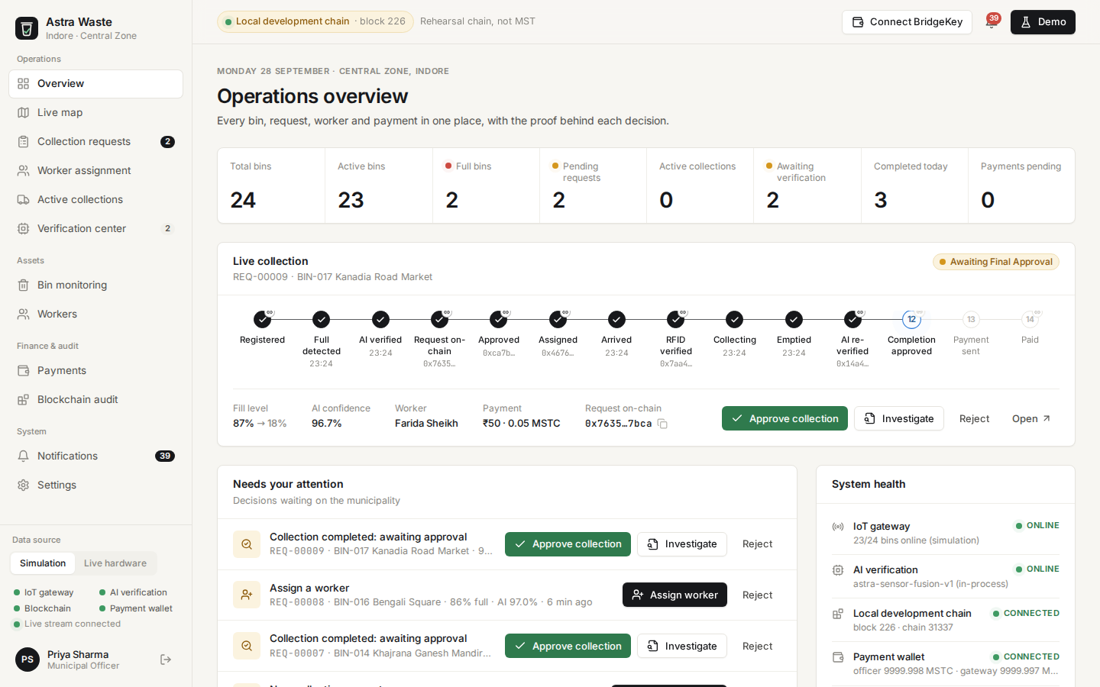
04 · THE PRODUCT
A live operations room for the city, with the proof behind every decision.
Everything live
Bins, requests, workers and payments stream in real time. The 14-step lifecycle marks which stages are on-chain.
Decide in one click
Approve, assign, investigate or release payment. Each click is a signed MST transaction, from the municipal wallet or your own BridgeKey.
MUNICIPAL DASHBOARD · OPERATIONS OVERVIEW
Built: contract · Node server · React dashboard · worker app · simulation + live-hardware modes
GHOSTLESS · MST BLOCKCHAIN
05

Slide 6
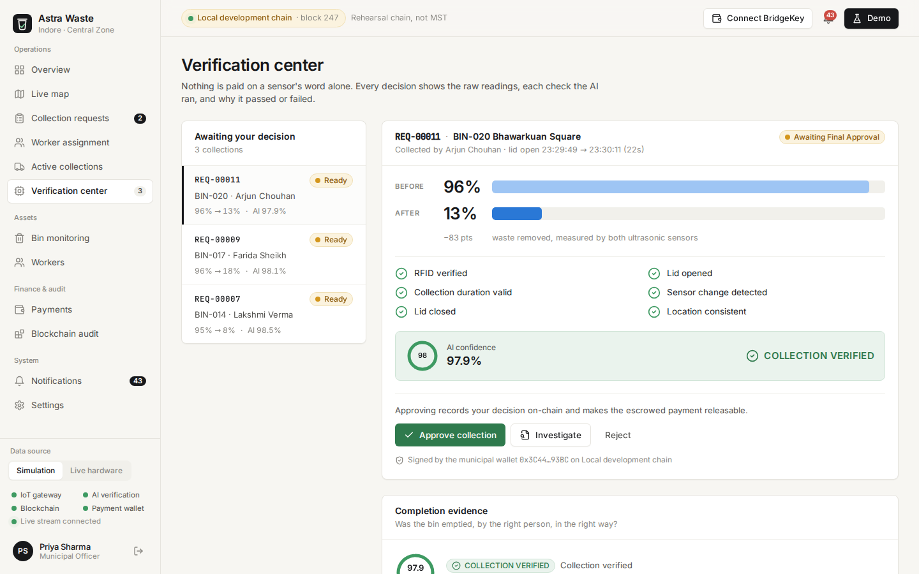
05 · VERIFICATION
The bin proves it was emptied. Nobody types "done".
95% → 10%
Both ultrasonic sensors, lid-open window only
98.0%
AI confidence, with every check shown and explained
6 / 6
RFID, lid open, duration, level drop, lid closed, location
The contract re-checks the numbers: approval is refused if less than 50 points were removed, even by an officer.
VERIFICATION CENTER · BEFORE / AFTER, SIX CHECKS, AI CONFIDENCE
GHOSTLESS · MST BLOCKCHAIN
06

Slide 7
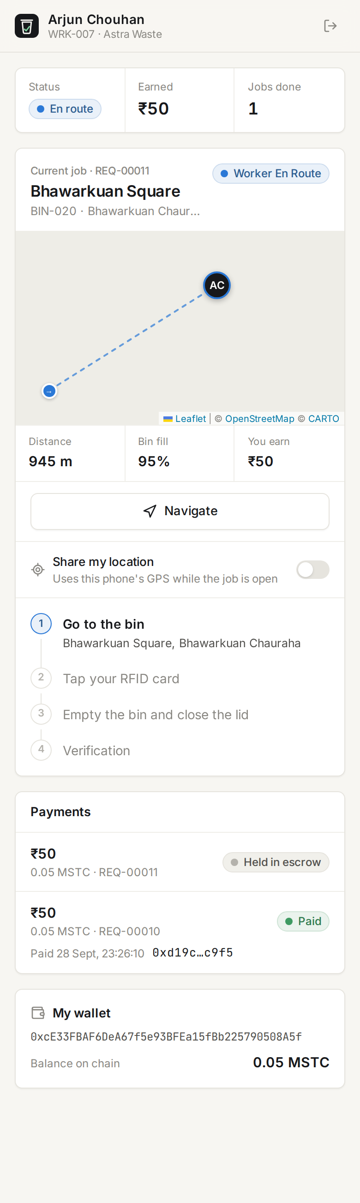
06 · NO RECEIPT, NO EFFECT
The lid is a gate. It opens only for a signed receipt.
Right worker, right bin
Card → worker → wallet → assignment → bin → location → time all match. Servo unlocks, RFID proof recorded on MST.
Wrong card
Refused at the bin. An RFID mismatch is recorded on-chain, the lid stays locked, and the officer is alerted.
No receipt at all
Ghostless's actuator gate returns 403. A "ghost" action can't touch the physical world.
Honest boundary: an action that never asks for a receipt (cash under the table) can't be seen by any ledger. Ghostless shrinks that gap by putting the gate on the machine.
WORKER APP · CURRENT JOB
GHOSTLESS · MST BLOCKCHAIN
07

Slide 8
07 · WE BROUGHT THE ATTACKER
Every fraud we could think of, run against the live system.
Attack | Plain log | Batch anchor | Ghostless
Fake "bin full" (blocked sensor) | Paid | Paid | Rejected by AI, incident on-chain
Wrong worker at the bin | Unseen | Unseen | Lid locked, mismatch on-chain
Partial collection | Paid | Paid | Investigation; ledger refuses payment
Edit a decision after the fact | Detected | Detected | Detected & slashed
Omit a receipted decision | Not detected | Not detected | Detected & slashed
Two conflicting records for one slot | Not detected | Not detected | Slashed in 1 tx
Never publish a window | n/a | Not detected | Slashed (unsealed)
Falsify policy fields | Not detected | Not detected | Slashed by fraud proof
Top 3: our waste flow, tested end to end in the UI on a local chain. Bottom 5: Ghostless red-team harness, run live on MST Testnet. Slash tx e.g. 0x0278691f…0e2 on MSTScan.
GHOSTLESS · MST BLOCKCHAIN
08

Slide 9
08 · MEASURED ON MST TESTNET
Completeness costs less than logging one decision at a time.
99.6×
cheaper per decision than anchoring each one
683
gas per decision, window of 256
3.0 s
average MST block time, measured
GHOSTLESS · MST BLOCKCHAIN
09

Slide 10
09 · WHY A BLOCKCHAIN
Because the parties don't trust each other, and nobody should own the record.
Buyer ↔ vendor
The device owns the proof
A tech park escrows funds; the hauler is paid automatically when proof verifies. Neither side can rewrite history or hold payment hostage.
Readings are signed by the bin's own key. Even we can't forge a pickup.
Auditors need no login
Cheating costs money
A pollution board or ESG auditor verifies from MSTScan alone, without trusting us.
Operators post a bond. Omission or equivocation is slashed on-chain and pays the reporter.
A database can't do these four things between companies that don't trust each other. That's the line we hold.
GHOSTLESS · MST BLOCKCHAIN
10

Slide 11
10 · WHERE IT GOES
The bin hires and pays its own truck.
Give every bin an MST wallet and a monthly budget. When it's full, it posts the job, accepts the nearest truck, opens only for that truck, measures the pickup, and pays it directly. Humans handle exceptions, not every approval.
Bin wallet
Truck device
Gate + sensors
MST
posts job
accepts
prove it
pays truck
Machine-to-machine settlement between devices owned by different companies is exactly where a shared ledger beats a database.
GHOSTLESS · MST BLOCKCHAIN
11
Notes:
Next build: M2M mode. Contract already has escrow, device signatures and release; we add bin-owned wallets, an open job board and truck devices as payees.

Slide 12
11 · ONE ENGINE, MANY SERVICES
Anywhere work changes something a sensor can measure.
Service | Who pays | Who is paid | Evidence | Status
Commercial waste | Tech parks, malls, hospitals | Haulers | Fill level, worker card | Built
Water tanker delivery | Apartments, sites | Tanker suppliers | Receiving-tank level rise | Config profile
Septic desilting | Societies, hotels | Septic operators | Tank level before/after | Config profile
Used cooking oil | Restaurants, canteens | Collectors | Container weight | Needs load cell
AI decision audit | Banks, insurers | n/a | Reserved slots, receipts | Ghostless core
Three tests for every new vertical: a sensor measures the outcome · one company pays another and can't verify the work · the job repeats.
GHOSTLESS · MST BLOCKCHAIN
12

Slide 13
12 · SCALING IN BENGALURU
Don't put a computer in every bin. Put the proof where the money is.
Start with bulk generators
Sensor on the truck
Sell through others
Tech parks, campuses, hospitals and apartments: few bins, large bills, and a legal duty to use authorised handlers.
One load cell on a truck's lift plus a tag per bin covers hundreds of bins. Retrofit clip-on pods only where fill level matters.
Bin makers pre-fit the pod; haulers adopt it to get paid faster; municipalities write it into tenders.
BUSINESS MODEL
Per device
Per settlement
Per auditor
Per gate
Hardware pod + monthly monitoring
Small fee on each verified payout
Watcher nodes for regulators and ESG auditors
Actuator Gate SDK licences for other machines
GHOSTLESS · MST BLOCKCHAIN
13

Slide 14
13 · WHERE WE ARE
Working today. Here's what the grant buys.
BUILT
NEXT 90 DAYS
Ledger contracts with device + AI signatures, escrow, pay-once release (20 tests)
Ghostless ledger: reserved windows, bonded challenges, slashing; live on MST Testnet
Sensor-fusion AI with explainable checks
Dashboard, worker app, live map (Bengaluru)
Red-team harness: 10 attack scenarios
Signing key on the ESP32 itself
Machine-to-machine mode: bin pays truck
Truck load cell for per-kg billing
Water-tanker profile on the same engine
50-bin pilot on one Bengaluru campus, 3 months
Success metric for the pilot: share of billed pickups that could not be verified, before vs after.
GHOSTLESS · MST BLOCKCHAIN
14

Slide 15
GHOSTLESS
Wherever work changes something a machine can measure, payment should follow proof, and nothing should be able to disappear.
We start with waste in Bengaluru.
github.com/jyo-coded/MST · github.com/HirthikBalaji/ghostless · MST Testnet, chain 91562037
Live demo: fill a bin → watch it get verified, collected and paid on MSTScan.
GHOSTLESS · MST BLOCKCHAIN
15

