Slide 1
INDUSTRY:AEROSPACE
DEPARTMENT: CRUCIAL
PAIN POINT OF ORGANIZATION
PROBLEM CHOOSEN: SUPPLY CHAIN MANAGEMENT
PROBLEM STATEMENT : INEFFECTIVE RELATIONSHIP MANGEMENT WITH SUPPLIERS.
BATCH NO:40
K.JYOTHI CHANDRIKA
I.ANUSHA
M.RAAGA CHANDRIKA
K.NAGA HANUMANTHA RAO

Slide 2
FEATURE CREATION
FEATURE SELECTION
TRANSACTIONAL MINDSET
RESPECTING DEADLINES
CUSTOMER RELATIONSHIPS
QUALITY
ACCESSIBLITY
LEADING TIME
PRICING
RISK MANAGEMENT
COMMUNICATION
BACKWORD INTEGRATION
EXPECTATIONS
ACCOUNTING TOOLS
DELIVERY TIMINGS
QUALITY
ACCESSIBILTY
MEETING EXPECTATIONS
COMMUNICATION
RESPECTING DEADLINES
PRICING
https://www.grosvenor.com.au/10-tips-to-improve-supplier-procurement-relationships

Slide 3
FEATURE EXTRACTION
FEATURE TRANSFORMATION
COMMUNICATION: Customer Relationships, Logistics
QUALITY: Performance Management
PRICING
RESPECTING DEADLINES: Delivery Timings
ACCESSIBILITY
MEETING EXPECTATIONS
COMMUNICATION:
1-4(1-Ineffective, 4-Very Effective).
QUALITY: 1-10(Rating).
PRICING:
1-4(1-Not Affordable,4-Cheaper).
RESPECTING DEADLINESS:
1-7(1-On Date, 7-Not Delivered).
ACCESSIBILITY:
1-5(1- Reachable,5-Not Reachable).
MEETING EXPECTATIONS:
1-4(1-Appretiative,4-Unacceptable).

Slide 4
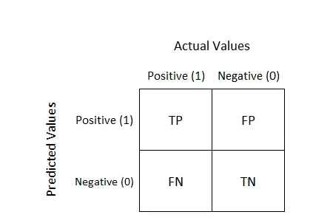
DATA SET CREATION
BY CONFUSION MATRIX:
TP- predicting positive and actuality is true.
FP- predicting positive and actuality is false.
FN- predicting negative and actuality is false.
TN- predicting negative and actuality is true.
Example : TP-Considering maximum value 4 of communication and predicting efficiency as high(1)
FP-Considering maximum value 4 of communication and predicting efficiency as low(0)
TN- Considering minimum value 1 of communication and predicting efficiency as low(0)
FN-Considering minimum value 1 of communication and predicting efficiency as high(1)
https://www.analyticssteps.com/blogs/what-confusion-matrix

Slide 5
MODEL CREATION
WE CHOSE RANDOM FOREST MODEL AMONG OTHER MODELS.
Reasons for selecting random forest as a data model:
Works well with non-linear data.
Lower risk of over fitting.
Runs efficiently on a large dataset.
Better accuracy than other classification algorithms.
Less Data Preparation.
Less complexity.
Versatility (adaptability).
Simple to understand for coders.
Can fit more features.

Slide 6
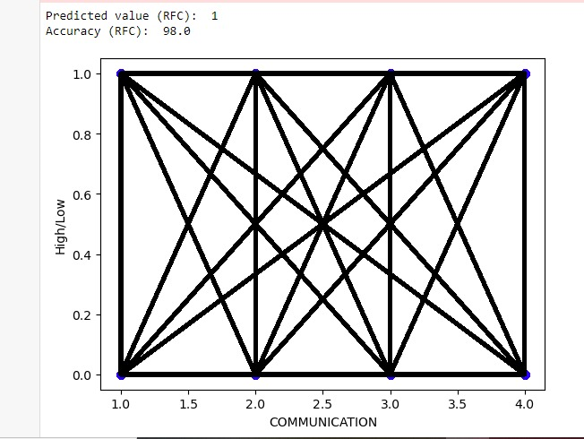

Slide 7
WRAPPING UP…
So we finally worked out and brought the outcome that is to improve supplier relationships and optimize the supply chain, our organization will implement clear communication protocols, foster collaboration, implement performance metrics, develop long-term relationships.
THANK YOU …….

