Slide 1

Basic Details of the Team and Problem Statement
Ministry/Organization Name/Student Innovation:
Ministry of Power
PS Code: SIH1301 Problem Statement Title: Language translator tool to convert English to Hindi (official Language) which can be used by all the government organizations websites officially.
Team Name: Six Indian Hackers (SIH)
Team Leader Name: K. N. Hanumantha Rao
Institute Code (AISHE): C-24163
Institute Name: SRKR Engineering College
Theme Name: Smart Automation

Slide 2
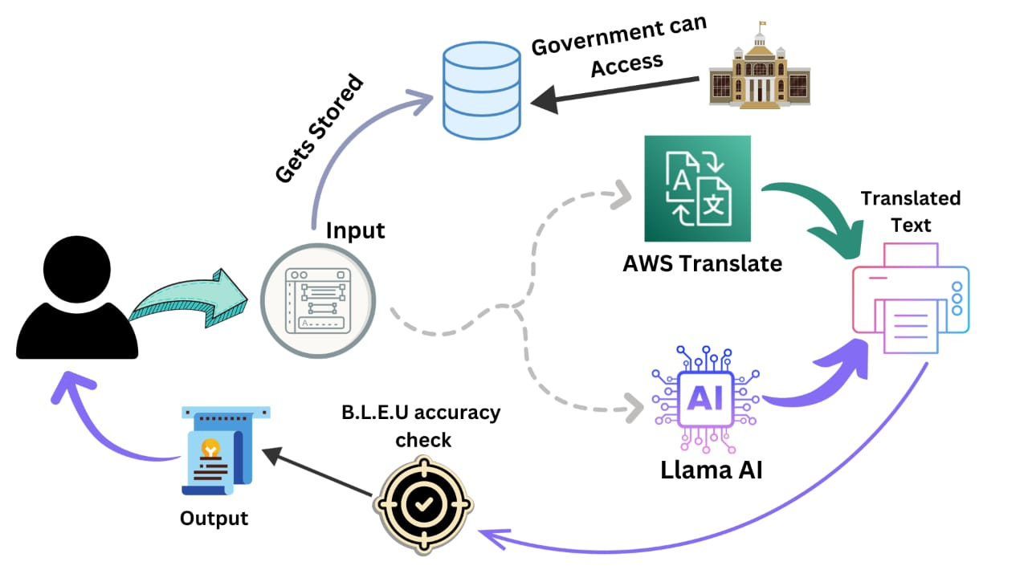
Idea/Approach Details
Describe your idea/Solution/Prototype here:
We develop a state-of-the-art NLP model as the foundation of the translator, leveraging techniques like Neural Machine Translation (NMT) to ensure efficient and accurate translation.
We are using the BLEU (Bilingual Evaluation Understudy) metric to the accuracy of translations, ensuring alignment with government standards and linguistic accuracy.
Incorporated Machine Learning and user feedback loops to continuously refine and enhance the performance of translator and it evolves and adapts to user needs.
Our translator is a user-friendly interface for both administrators and citizens, simplifying access to government information in Hindi.
Describe your Technology stack here:
Programming Languages: Python for BLEU, OS Commands, HTML, JavaScript and CSS.
Frameworks: HTML for User-Interface.
Database: DynamoDB/MY SQL for storing user preferences and most frequently translated texts.

Slide 3
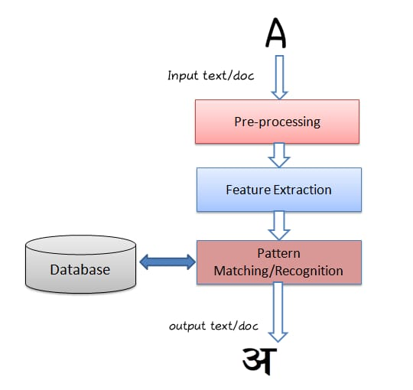
Idea/Approach Details
Describe your Dependencies / Show stopper here
Smart Device.
Internet.
Key features we are developing:
Multi-Language Support.
Customisable models.
Secure data handling.
Scalability and reliability.
Intuitive user interface.
Cost – effective deployment using Llama.
AI for precision.
Feedback loop for continuous improvement.
Text-voice translation.
Real-time translation
Most frequent translations.
Describe your Use Cases here
Official Document Translation : Translating government documents, policies, or forms from English to Hindi.
Administrative Services: Providing translation services for government websites and portals which is accessible to Hindi speaking individuals.
Legal and Legislative: Translating legislative documents, laws, and regulations into Hindi to ensure legal compliance and accessibility.
Accuracy Metrics:
Human evaluation.
Subjective assessment.
Domain- specific Evaluation.
Iterative testing

Slide 4
Team Member Details
Team Leader Name: : Kattamuri Naga Hanumantha Rao
Branch (Btech/Mtech/PhD etc): BTech Stream (ECE, CSE etc): CSBS Year (I,II,III,IV): III
Team Member 1 Name: Kari Jyothi Chandrika
Branch (Btech/Mtech/PhD etc): Btech Stream (ECE, CSE etc): CSBS Year (I,II,III,IV): III
Team Member 2 Name: Gubbala Praveen Lakshmi Narasimha
Branch (Btech/Mtech/PhD etc): BTech Stream (ECE, CSE etc): CSBS Year (I,II,III,IV): III
Team Member 3 Name: Juttiga Rohita
Branch (Btech/Mtech/PhD etc): Btech Stream (ECE, CSE etc): CSBS Year (I,II,III,IV): III
Team Member 4 Name: Manam Raaga Chandrika
Branch (Btech/Mtech/PhD etc): BTech Stream (ECE, CSE etc): CSBS Year (I,II,III,IV): III
Team Member 5 Name: Ibrapatnam Anusha
Branch (Btech/Mtech/PhD etc): Btech Stream (ECE, CSE etc): CSBS Year (I,II,III,IV): III
Team Mentor 1 Name: Type Your Name Here
Category (Academic/Industry): Expertise (AI/ML/Blockchain etc): Domain Experience (in years):

