Slide 1
Project Architecture
Team Whatever: Kristie Gong, Jane Yoo, Manting Yu, Victoria Kang

Slide 2
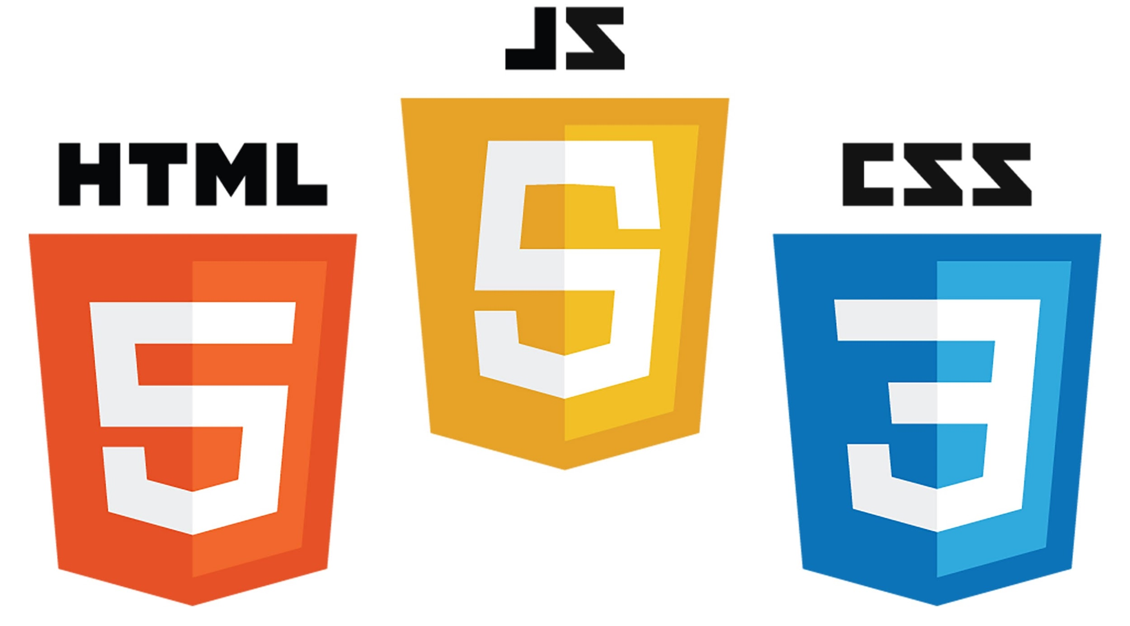
Intro
The typing game(Run George Run) was made by using the following
HTML: Designs/outlines elements that are going to be on the website
CSS: Styles/determines how the elements mentioned in the HTML will look like
Javascript: Has complex functions and feature that helps the users interact with the website

Slide 3
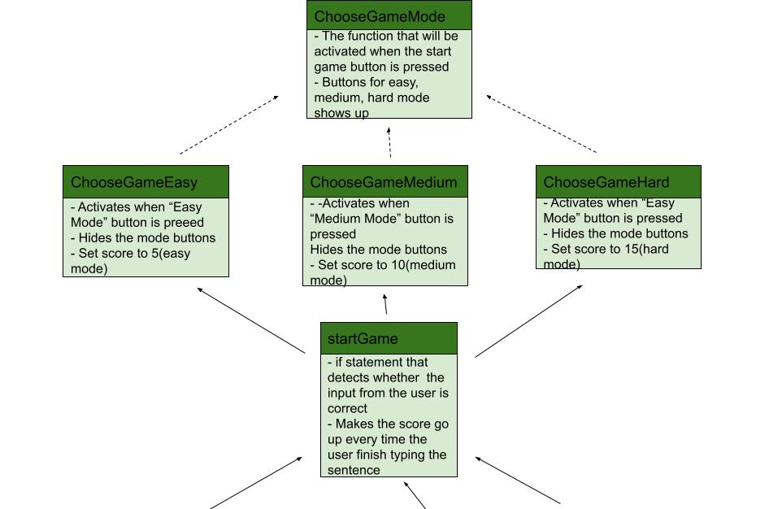
base.js Functions Relationship Diagram(1)

Slide 4
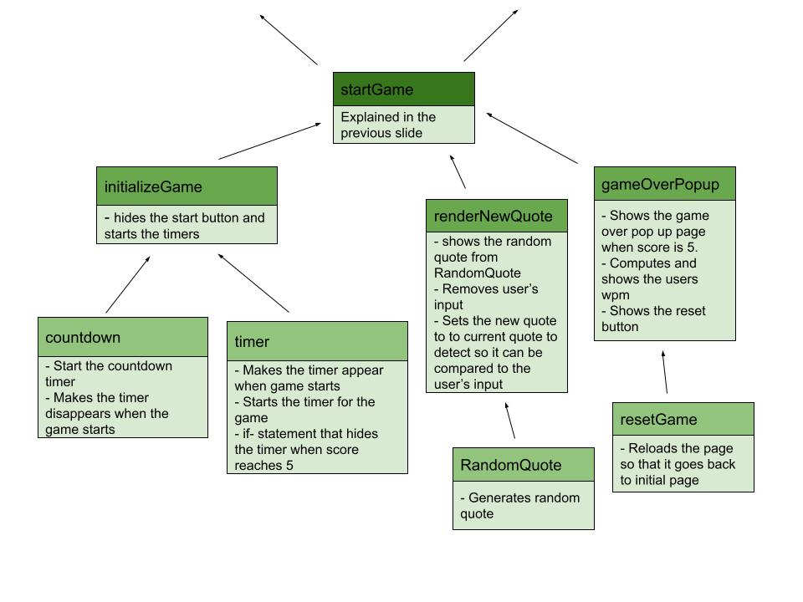
base.js Functions Relationship Diagram(2)

Slide 5
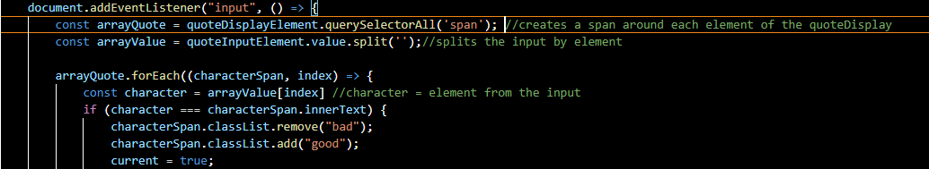
Important Functions
Color Correction Function:
- creates a span around each element of the sentence generated
- splits each input by the element and saves it as an array
- iterates through each span which corresponds to an index number and compares to the index it correlates to in arrayValue

Slide 6
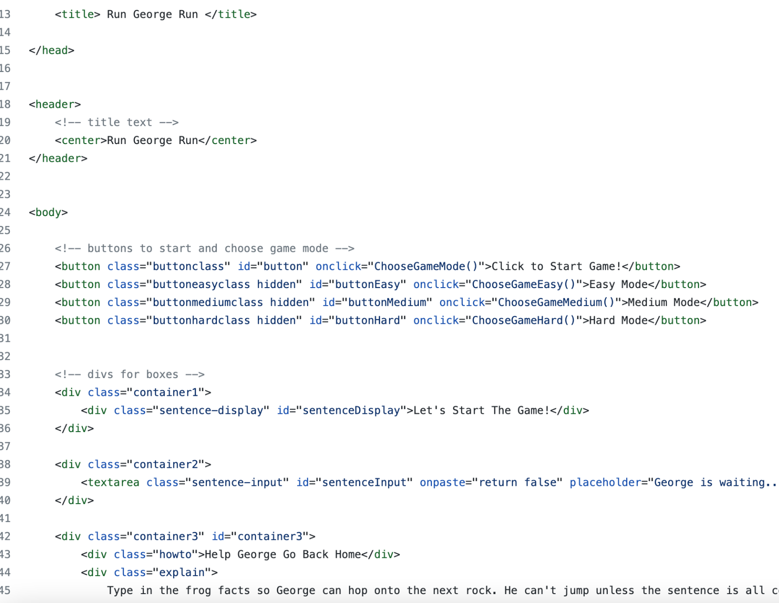
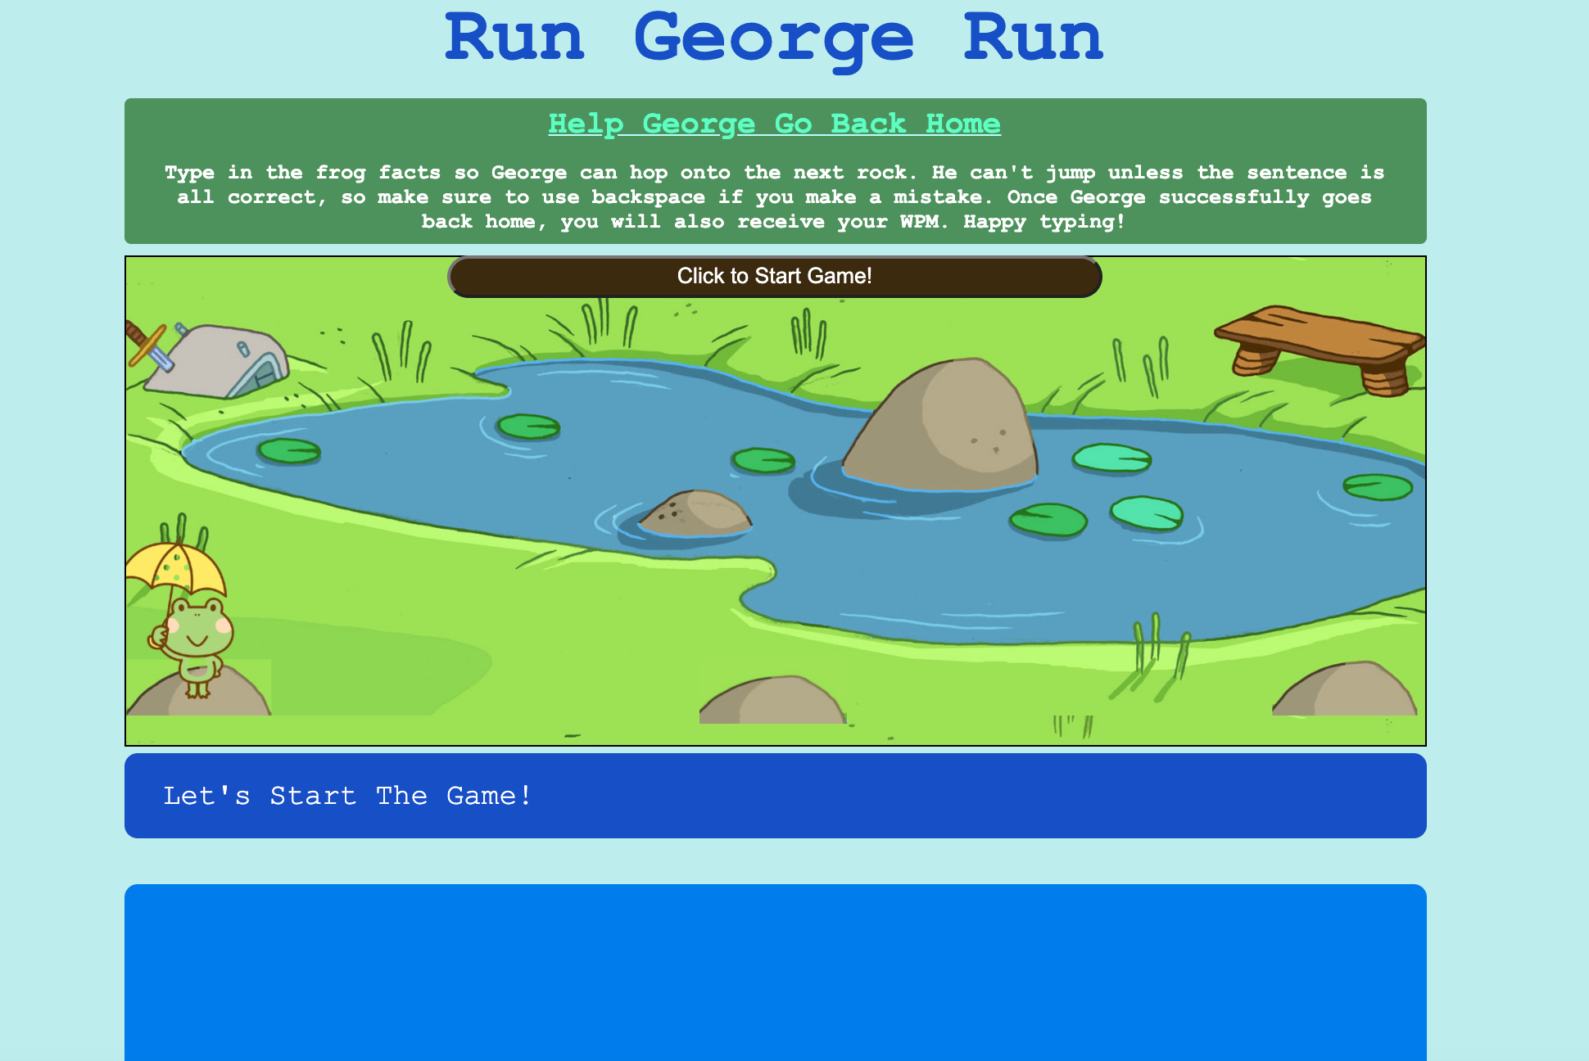
runGeorgeRun.html Explanation (1)
Creates basic layout of game
Makes divs so we can call them in a style sheet
Links to javascript functions

Slide 7
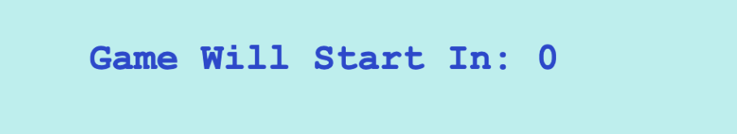
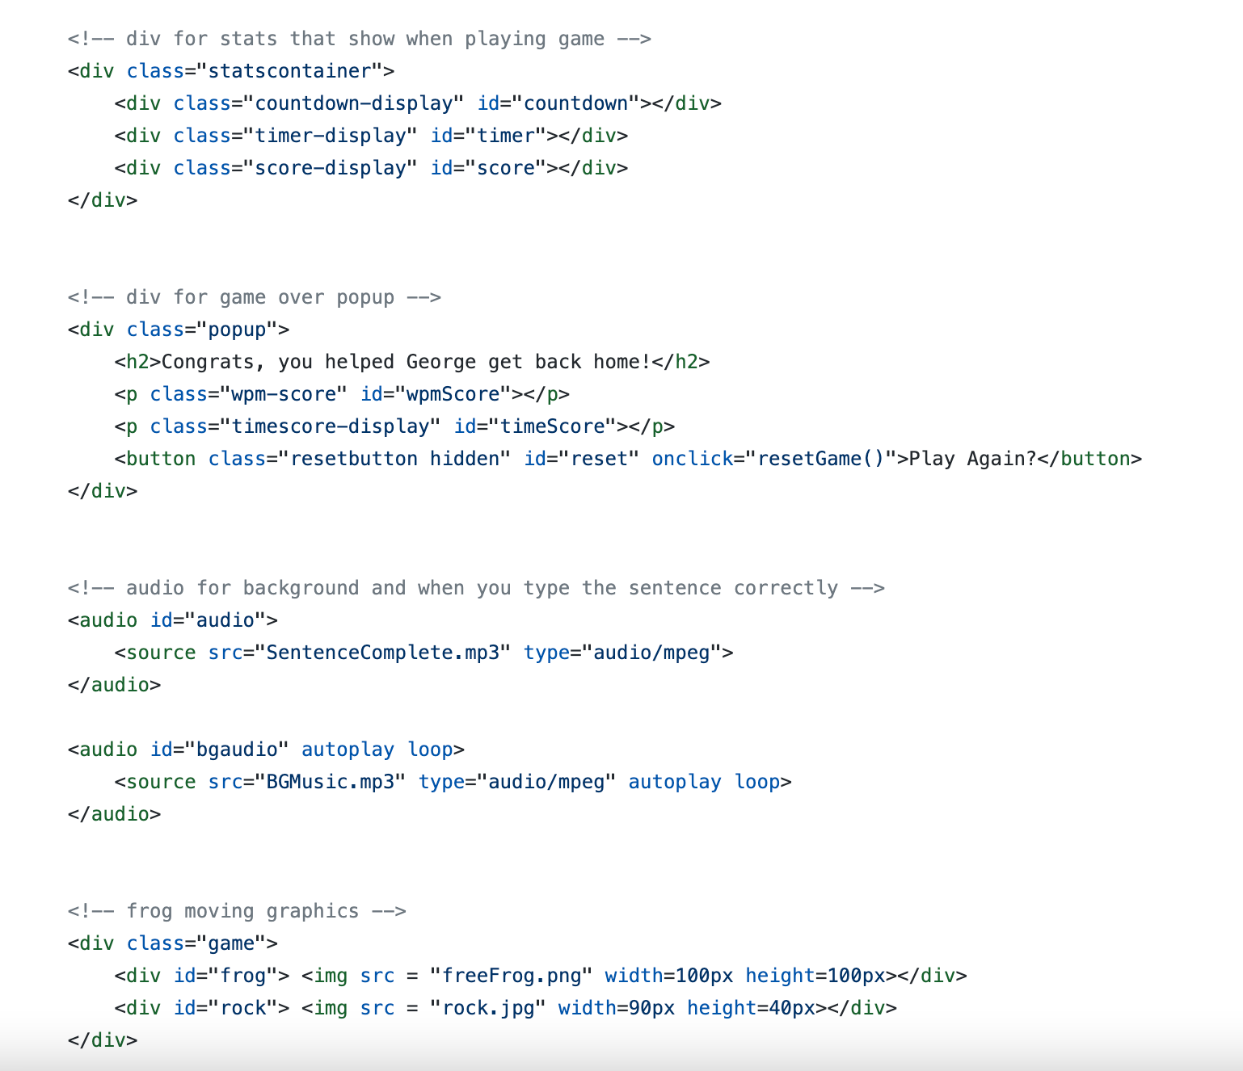
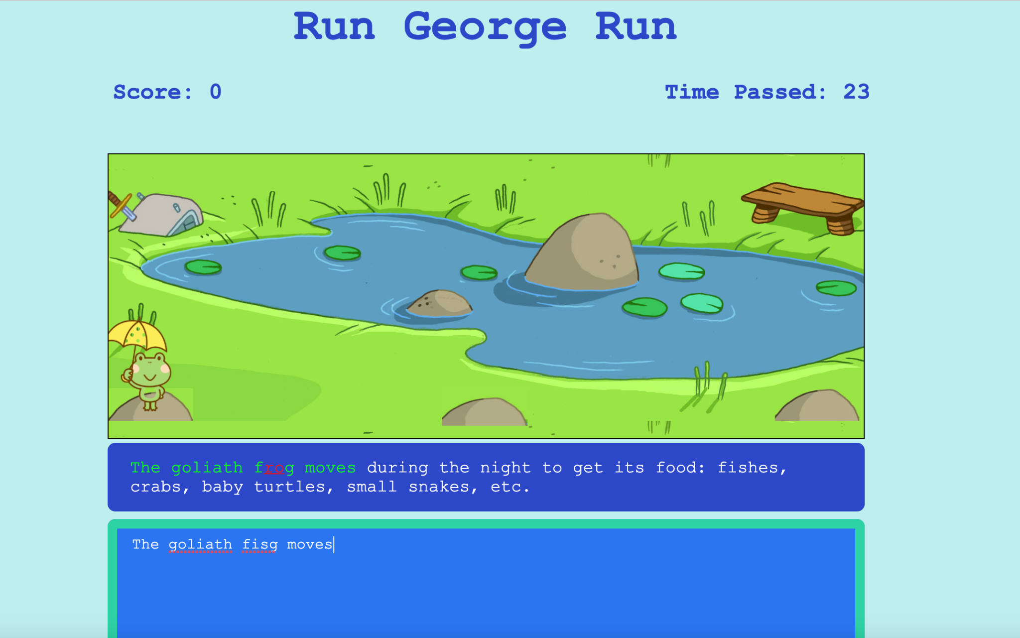
runGeorgeRun.html Explanation (2)

Slide 8
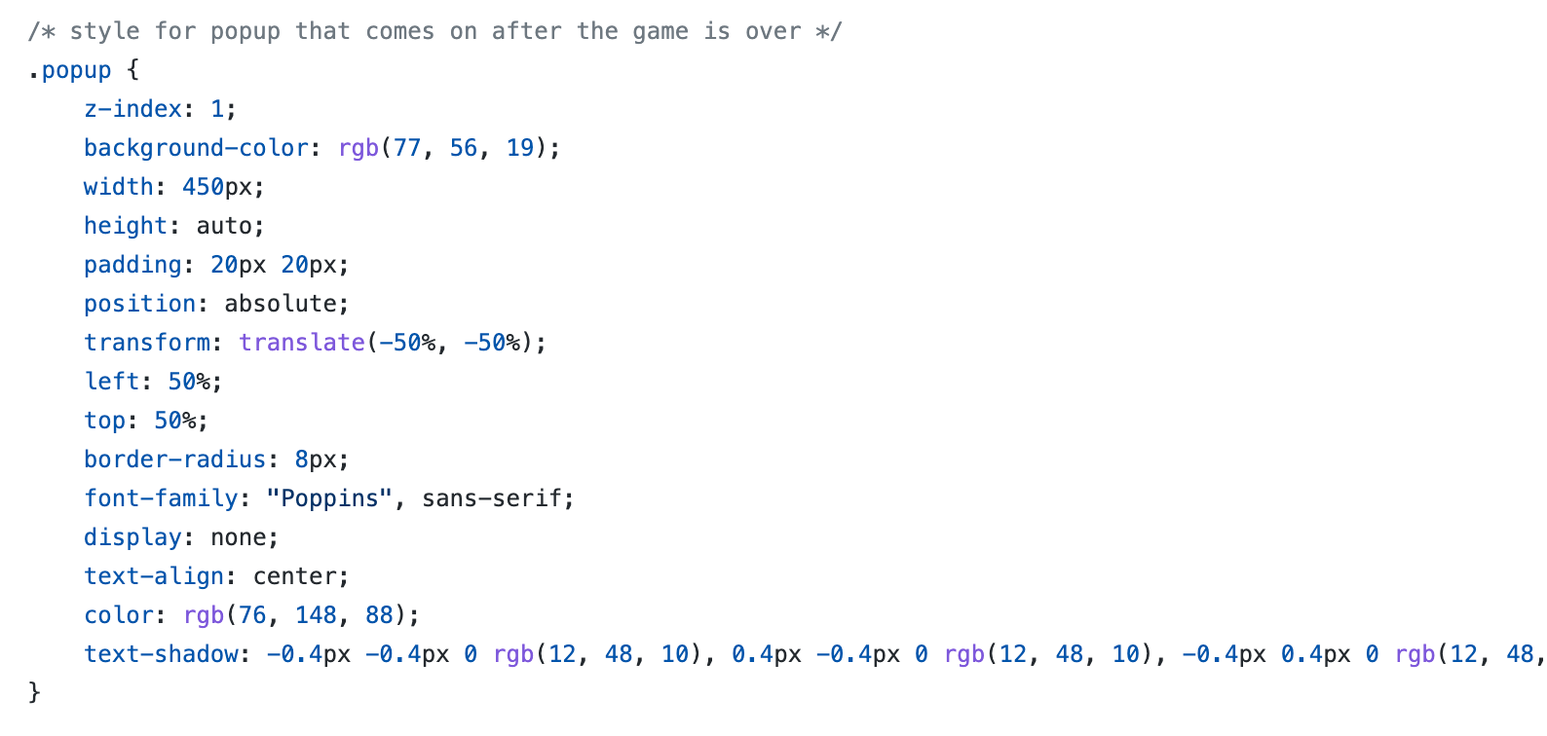
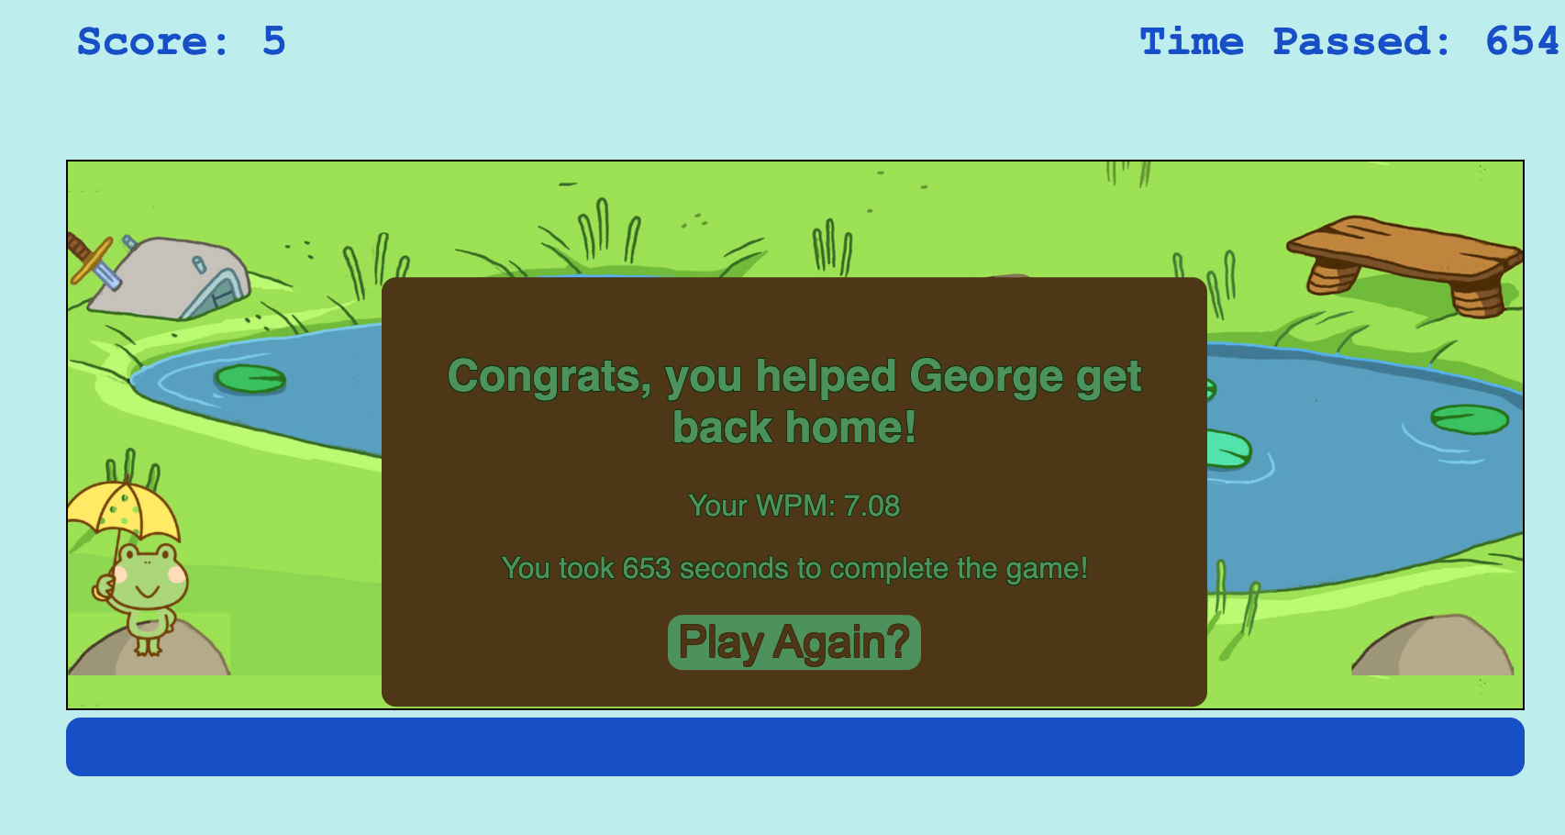
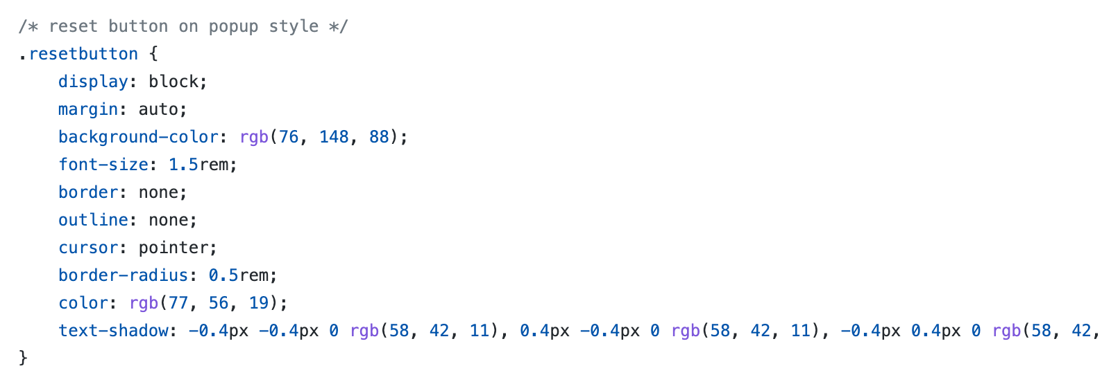
style.css explanation (3)
creates a color scheme to reflect ponds and frogs
positions containers and other game elements for better viewing

Slide 9

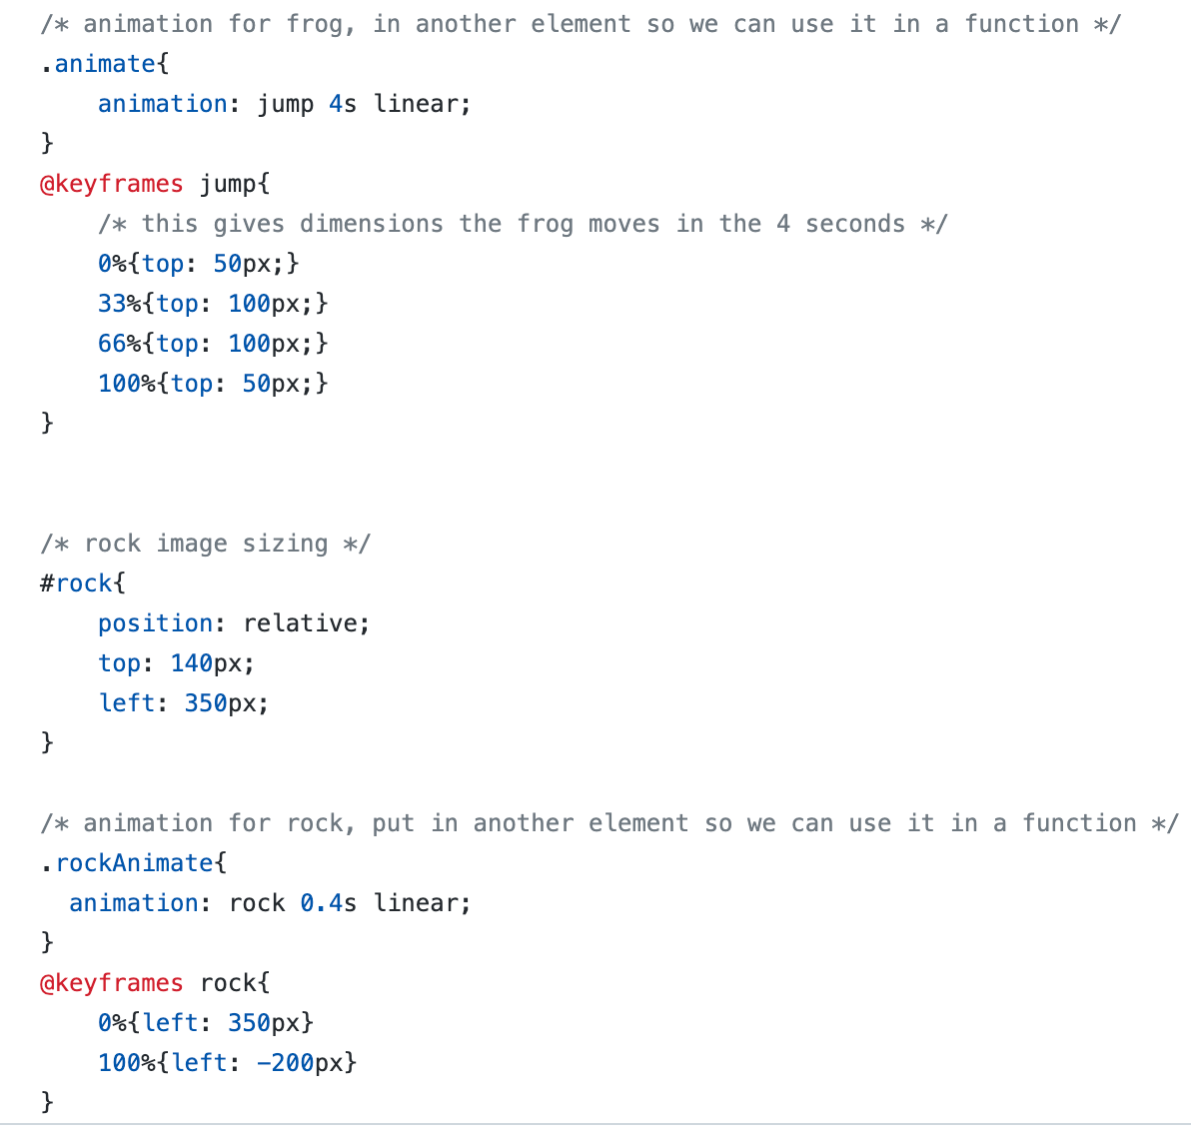
style.css explanation (3)
Animates the frog to jump
Animates the rock to move left

Slide 10
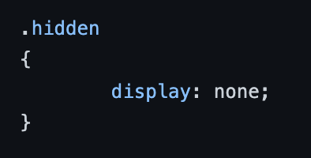
.hidden(css)
This can be used in functions written in Javascript to hide different elements in the website
e.g. timerDisplay.classList.add(.hidden)
Notes:
WHAT ANIMATION CODE

