Slide 1
Project Architecture
Team Whatever: Kristie Gong, Jane Yoo, Manting Yu, Victoria Kang

Slide 2
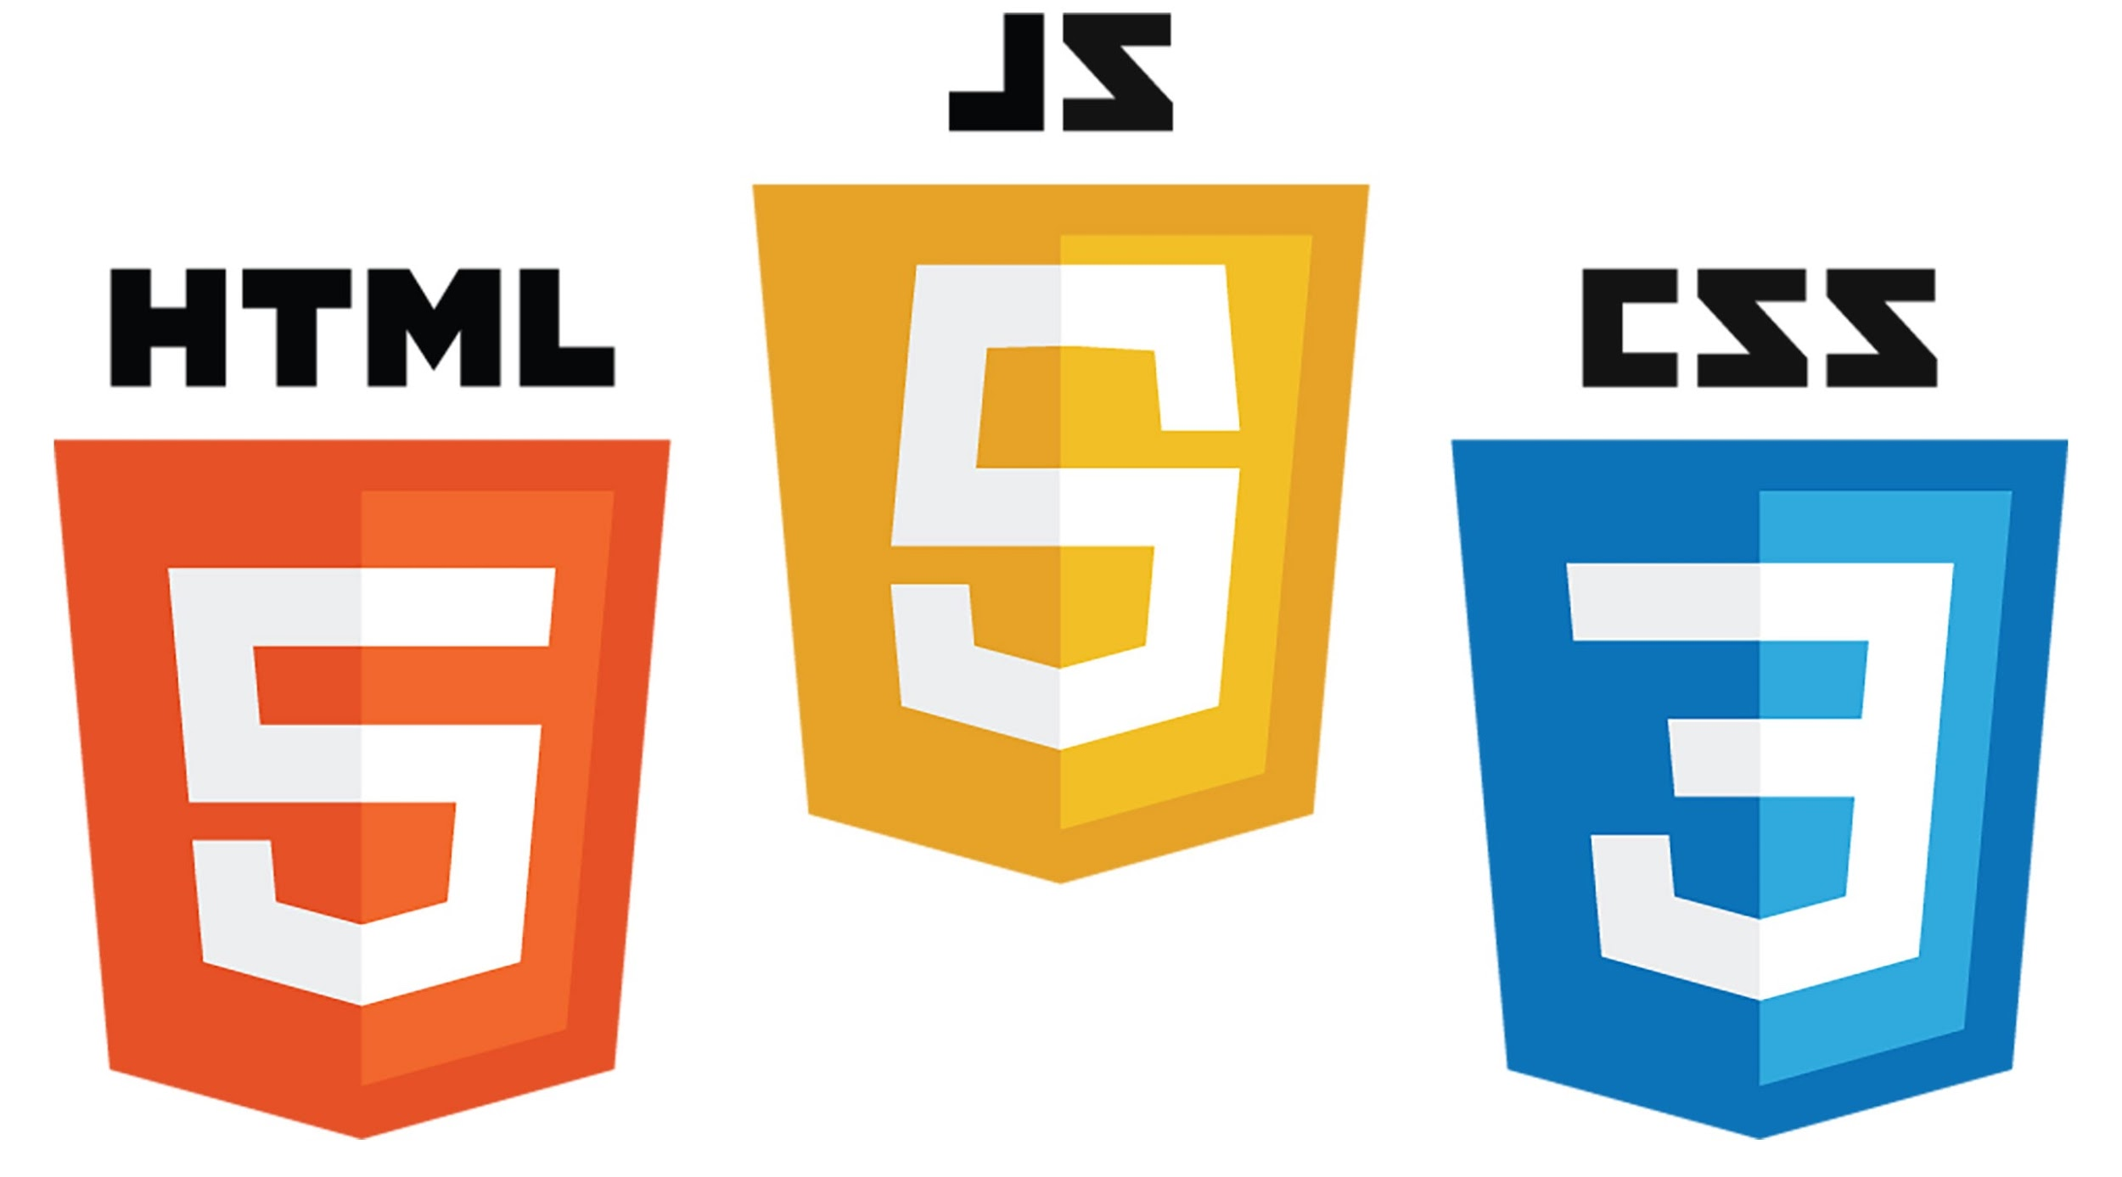
Intro
The typing game(Run George Run) was made by using the following
HTML: Designs/outlines elements that are going to be on the website
CSS: Styles/determines how the elements mentioned in the HTML will look like
Javascript: Has complex functions and feature that helps the users interact with the website

Slide 3
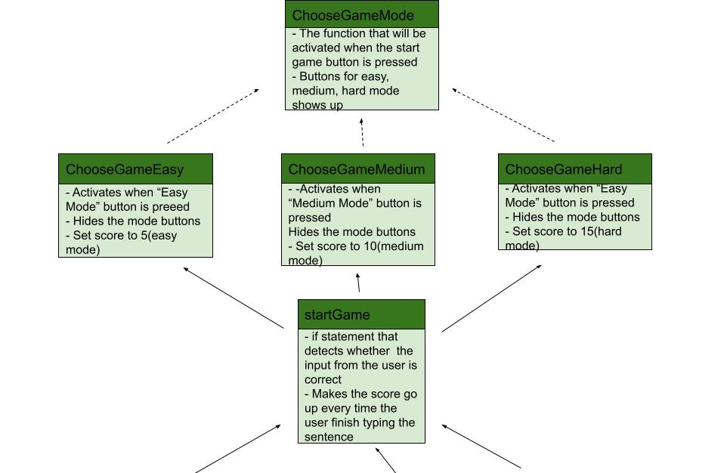
base.js Functions Relationship Diagram(1)

Slide 4
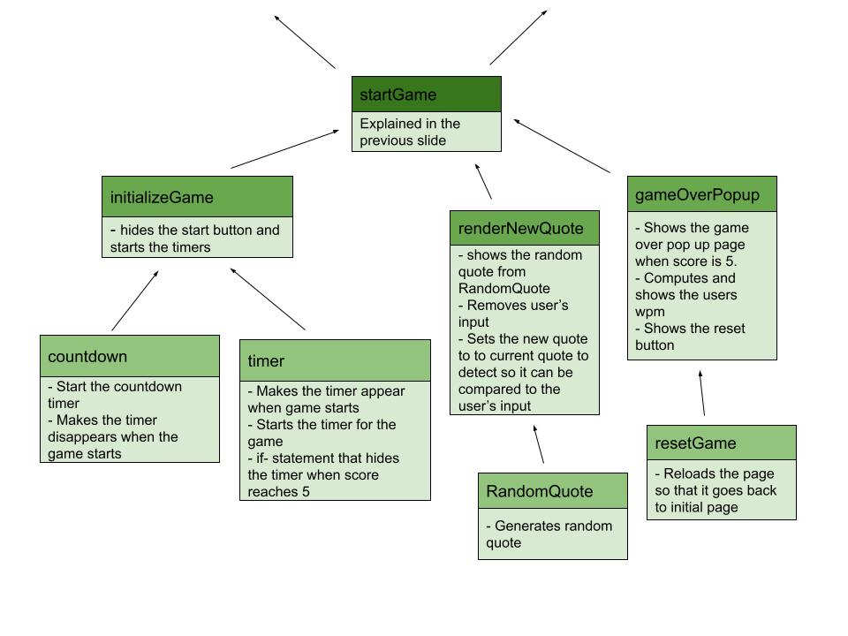
base.js Functions Relationship Diagram(2)

Slide 5
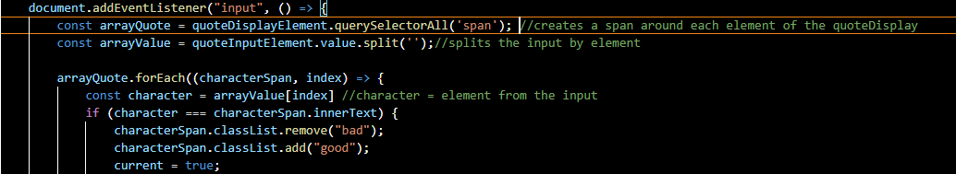
Important Functions
Color Correction Function:
- creates a span around each element of the sentence generated
- splits each input by the element and saves it as an array
- iterates through each span which corresponds to an index number and compares to the index it correlates to in arrayValue

Slide 6
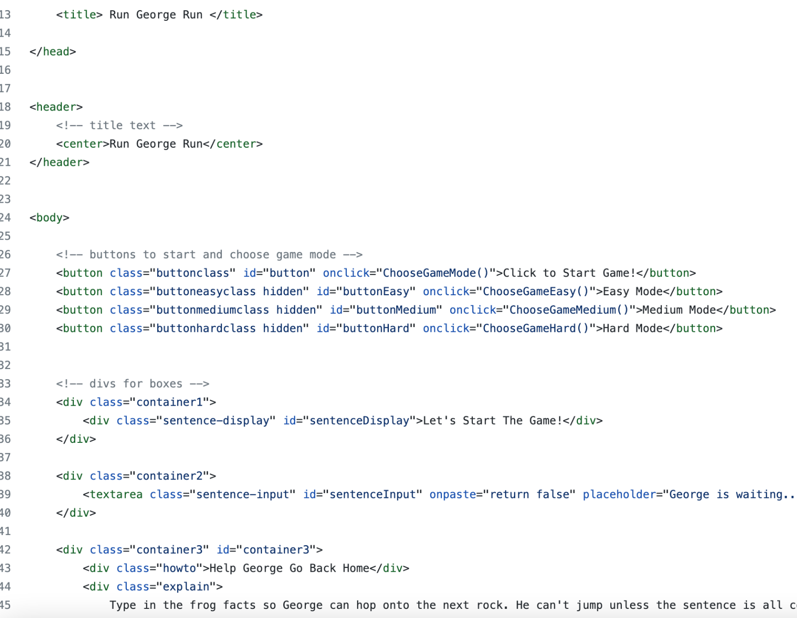
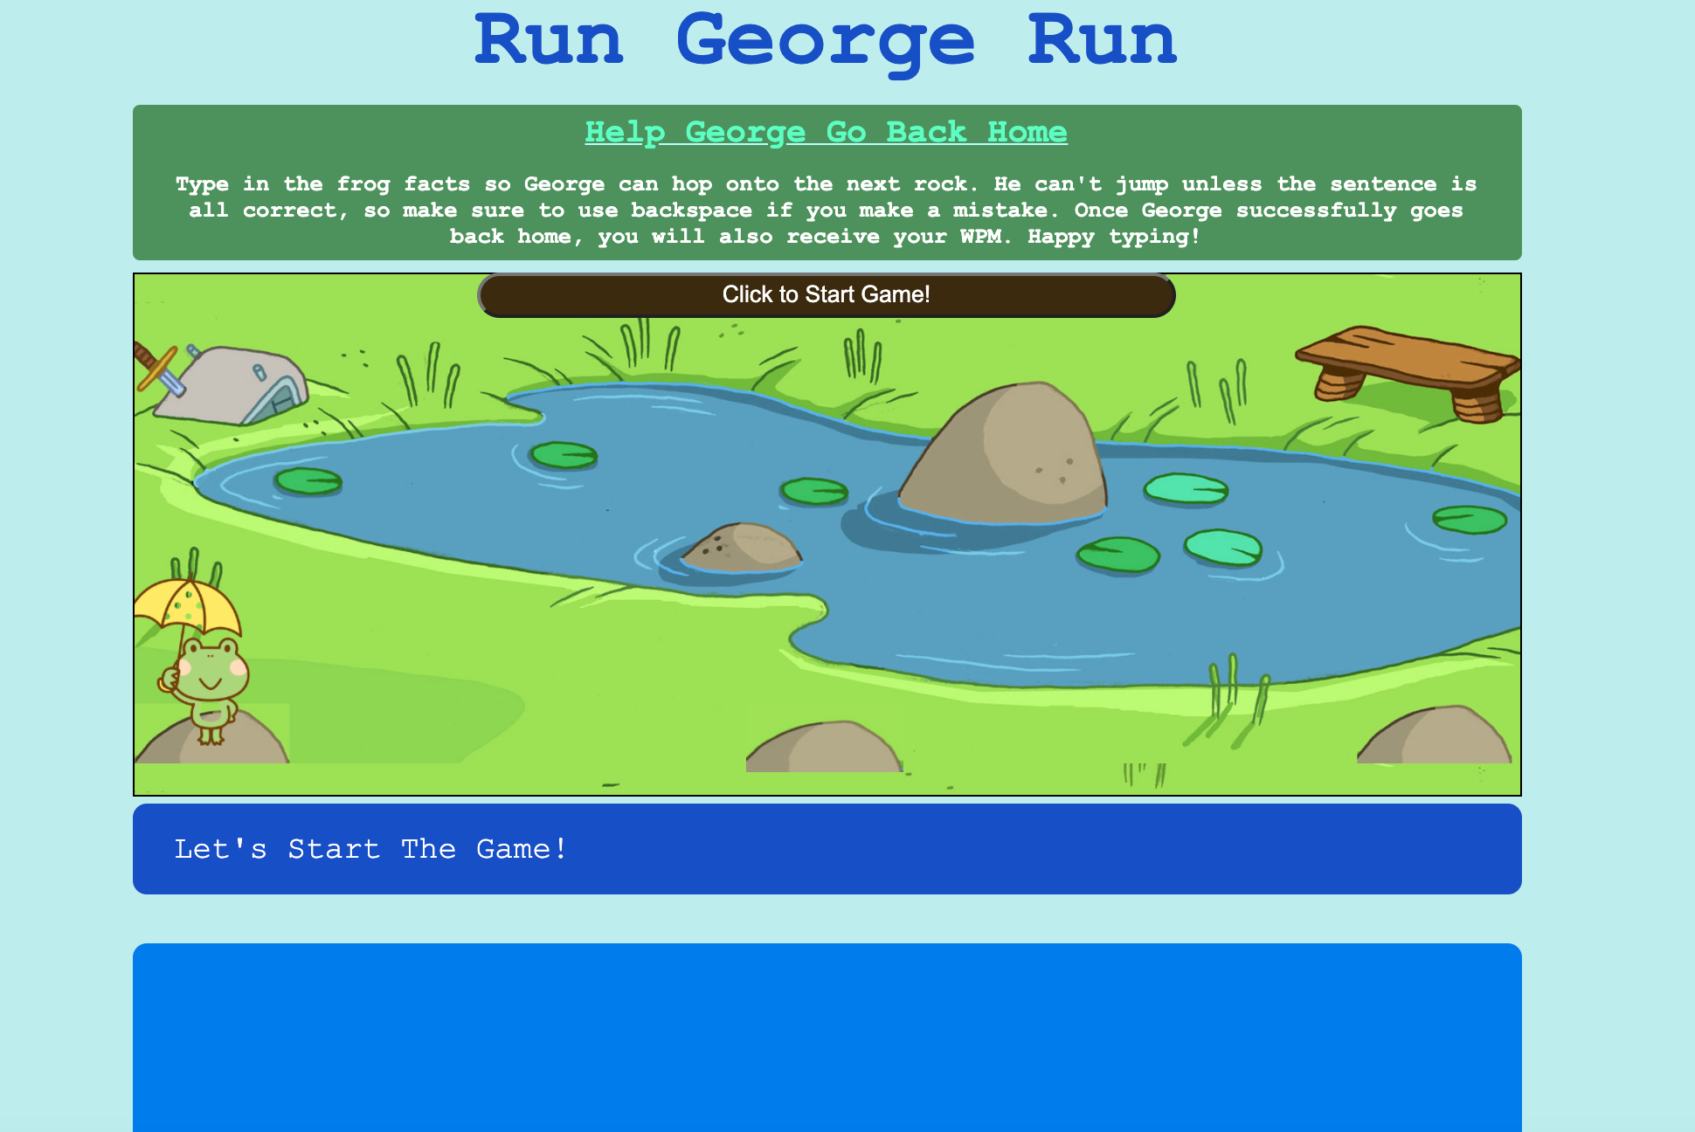
runGeorgeRun.html Explanation
Creates basic layout of game
Makes divs so we can call them in a style sheet
Links to javascript functions

Slide 7
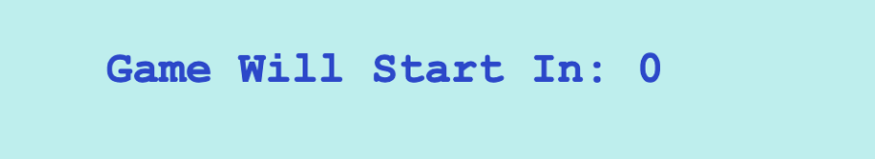
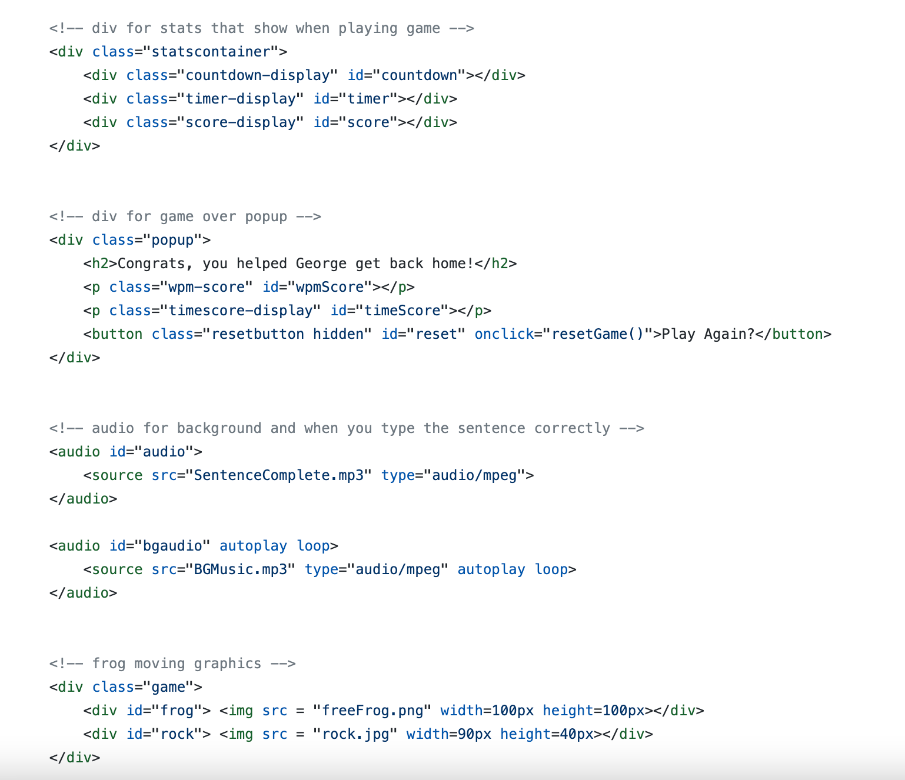
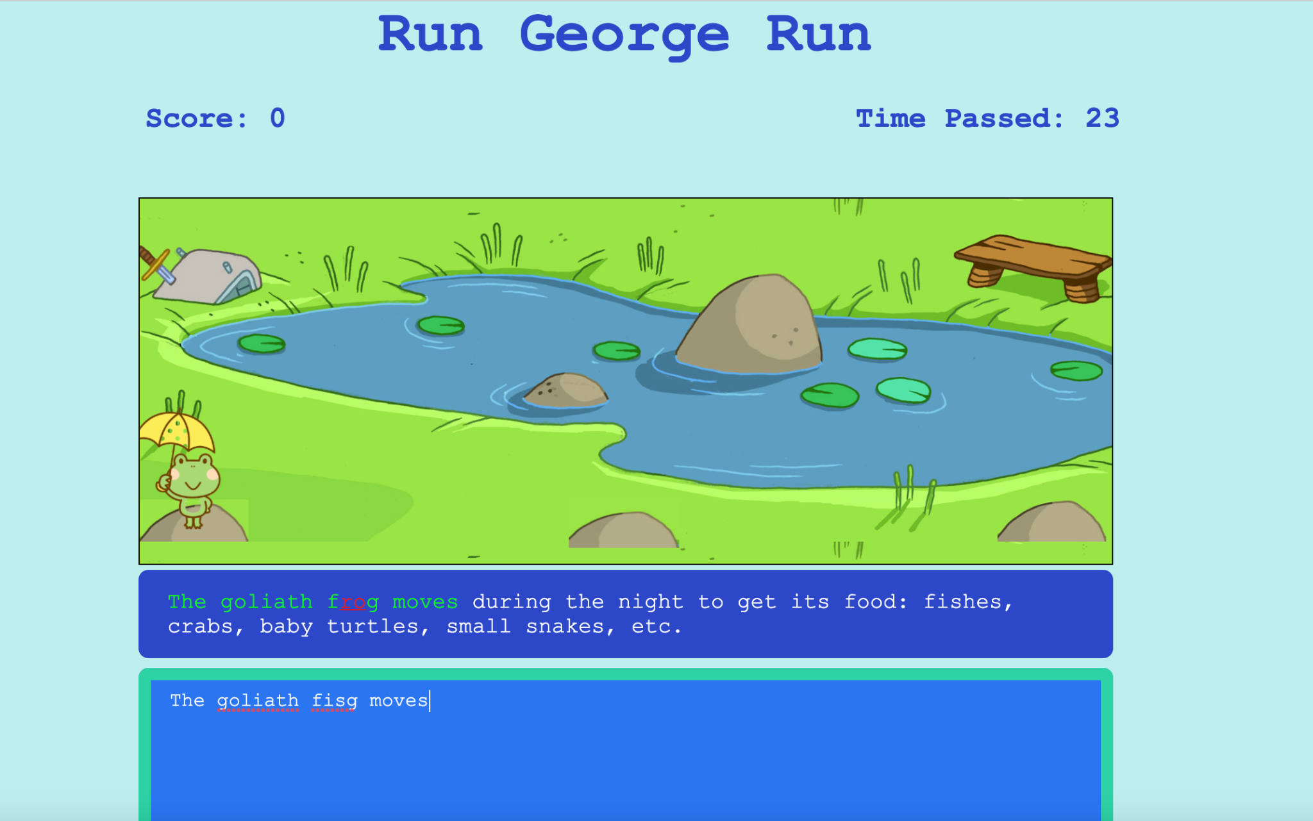
runGeorgeRun.html Explanation

Slide 8
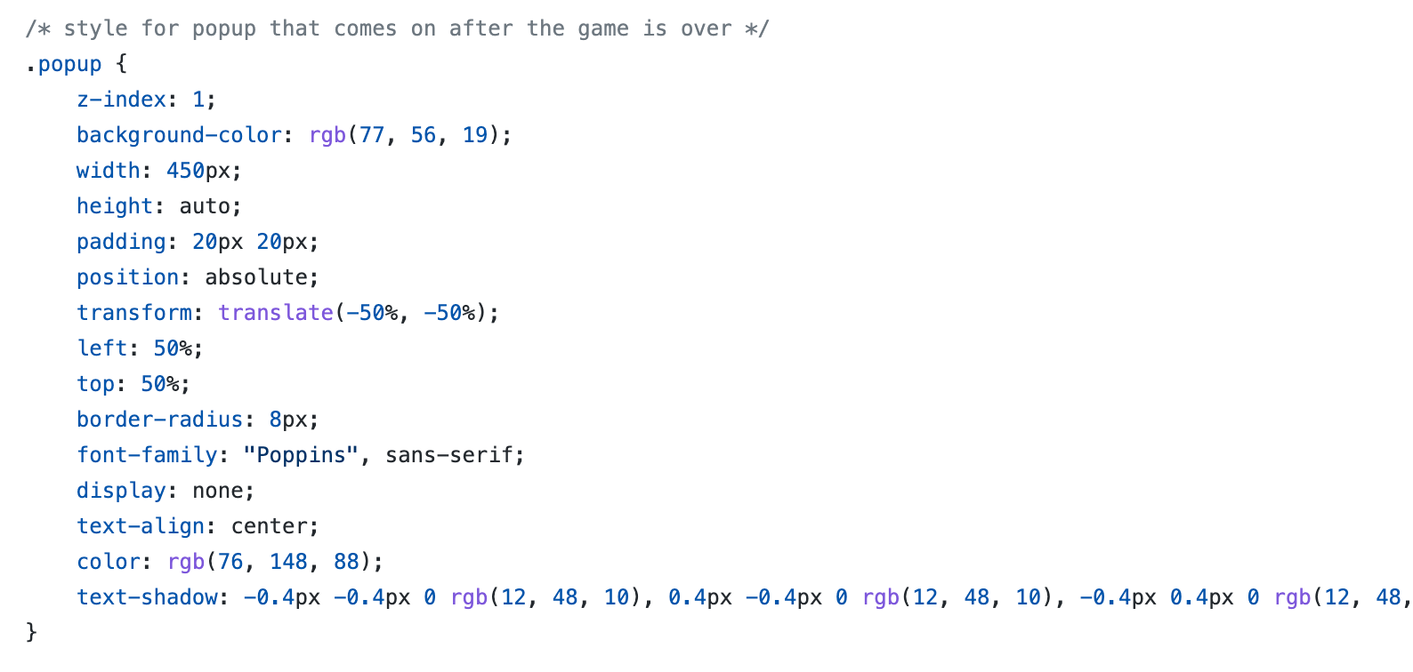
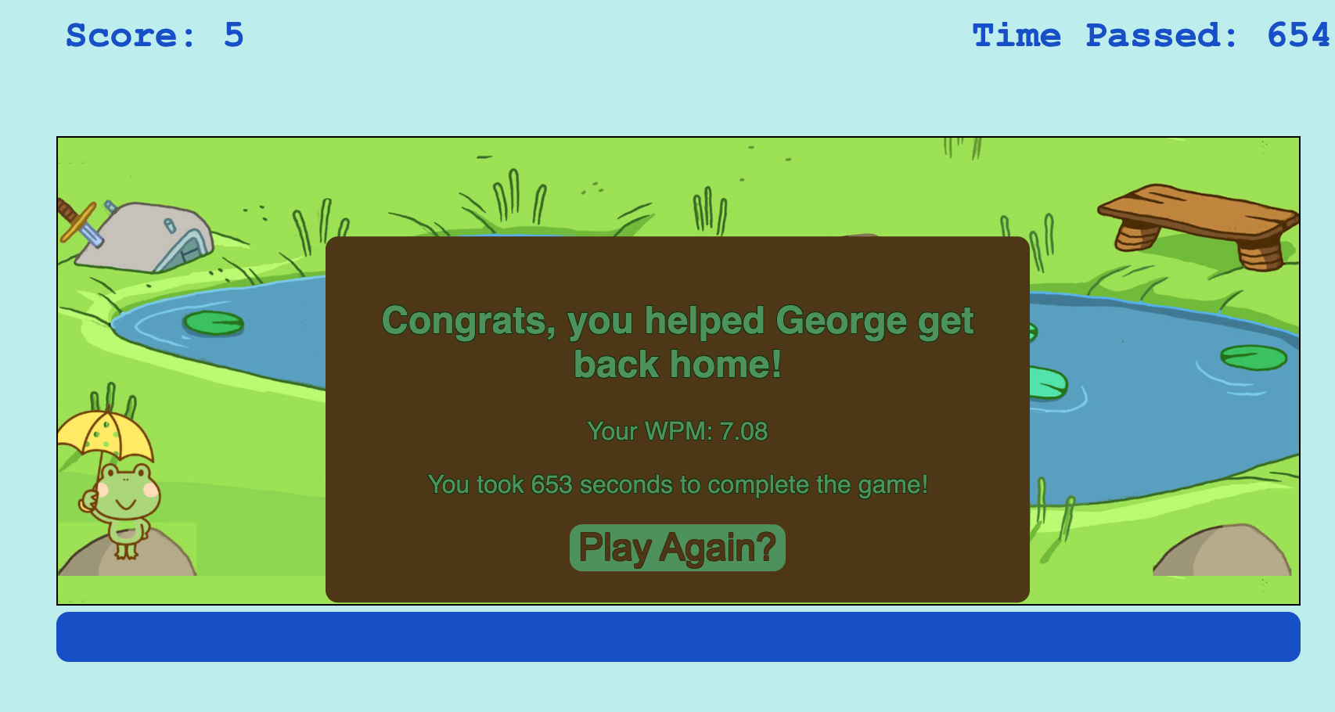
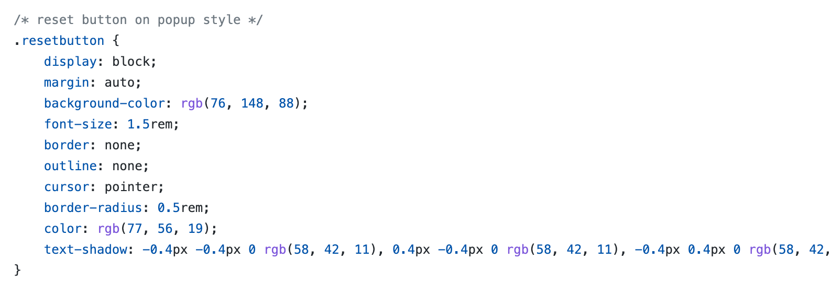
style.css explanation
creates a color scheme to reflect ponds and frogs
positions containers and other game elements for better viewing

Slide 9
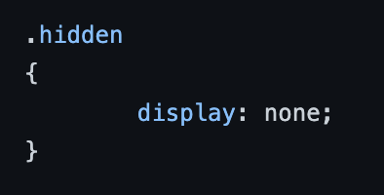
.hidden(css)
This can be used in functions written in Javascript to hide different elements in the website
e.g. timerDisplay.classList.add(.hidden)

