Slide 1
Classical Music Player
Jee Whan Yoon

Slide 2
What is your project?
A simple music player written in Python
Provides basic playback functionalities
Displays tag information relevant specifically to classical music (composer, conductor, performer, opus number, etc.)
If available, provides access to album booklet and scores

Slide 3
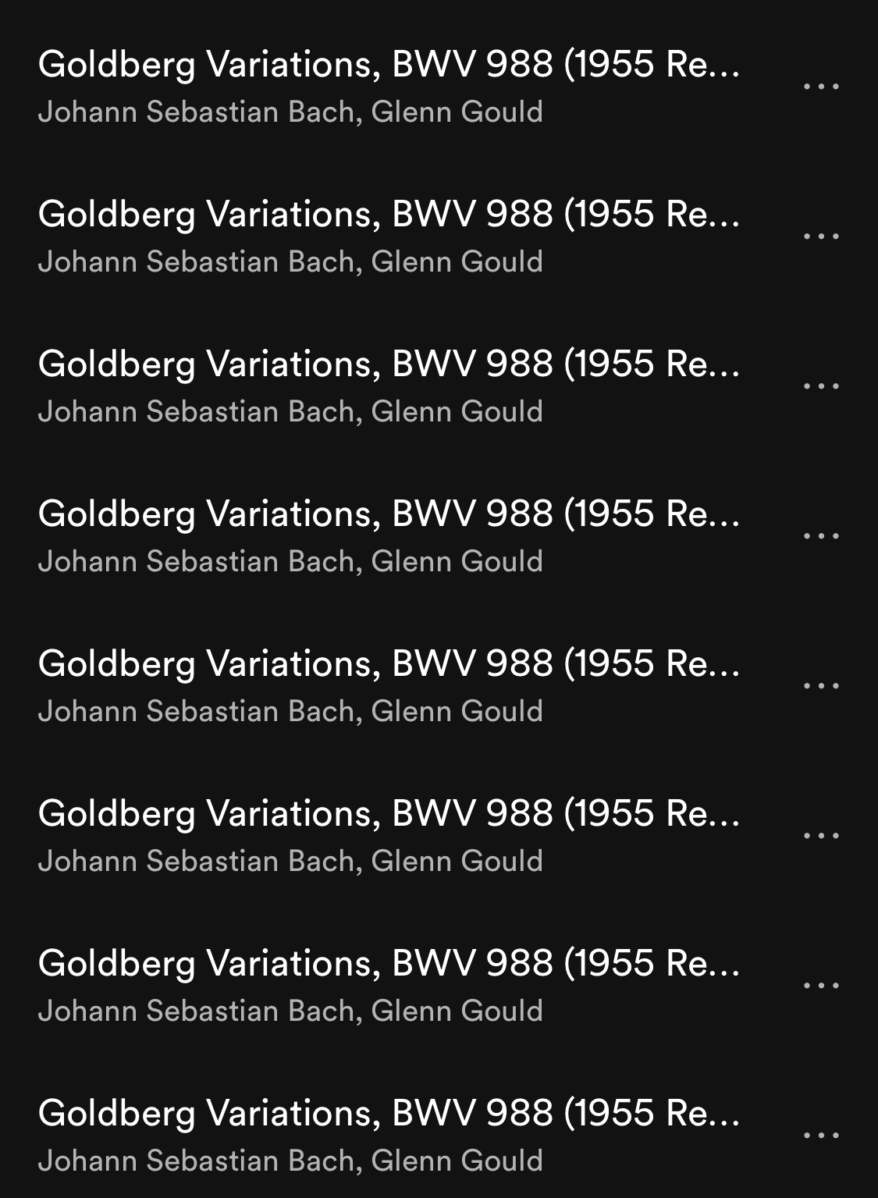
Why this project?
Motivation:
Music streaming apps generally have very bad interfaces when it comes to displaying information about classical music
Created a desktop application to be able to learn more about using Python
Philosophy:
To provide a clean and intuitive interface that displays necessary tag information
Inspirations: foobar (desktop), cesium (iOS)

Slide 4
How does it work?
Operating System: Windows 10
Libraries used:
Tkinter: allows for creation of simple GUI interface
Pygame: modules used for writing video games (pygame.mixer for audio)
Mutagen: used to access ID3 tag information from audio files
Os: allows for navigating through system directories

Slide 5
What does not work yet?
Opendir() uses os.listdir() which does NOT open directories recursively (cannot import an entire library of songs)
Tried to use os.walk(), PERMISSION DENIED!?!?!

Slide 6
Future implementation
Ability to import entire libraries
Custom tagging / automated tagging
Support for other file types (.flac, .alac)

