Slide 1
Parallel Cloud Gaming Resource Management System
High-Performance Discrete-Event Scheduling Using C, OpenMP, and MPI
Course: Parallel Computing Architecture Programming (PCAP) Lab Mini Project
Target Machine: Apple Silicon Multi-Core Architecture (macOS)
Deliverables: Sequential, OpenMP, MPI, Hybrid Backends & Research Reports

Slide 2
PARALLEL COMPUTING ARCHITECTURE PROGRAMMING
Introduction & Motivation
• Cloud Gaming Imperative: Renders 3D graphics on remote edge-cloud servers and streams video to thin clients. Demands strict round-trip motion-to-photon latency under 50-100 ms to preserve QoE.
• Multi-Dimensional Packing: Incoming gaming sessions simultaneously constrain four physical hardware metrics: CPU cores, GPU rendering units, RAM capacity, and network streaming bandwidth.
• The Scalability Bottleneck: In large-scale geo-distributed edge environments with 1,000 to 10,000+ candidate servers, sequential feasibility checks and fitness scoring create severe admission delays during peak bursts.
• Parallel Computing Solution: Leveraging shared-memory threading (OpenMP), message-passing processes (MPI), and hybrid decomposition allows parallel exploration of candidate servers to achieve real-time response times.

Slide 3
PARALLEL COMPUTING ARCHITECTURE PROGRAMMING
Problem Statement & Project Objectives
Mathematical Problem Formulation:
Assign each dynamic request r to an eligible server s that minimizes composite score S = 0.5 * L + 0.5 * U, subject to:
1. Capacity Constraints: Sum of active session demands <= Total server capacity across CPU, GPU, RAM, Bandwidth.
2. Network Latency Constraint: Modeled regional latency(player_region, server_region) <= Request latency limit.
3. Lifecycle Conservation: Automatic, exact resource release upon session duration expiration (t_end = t_arr + duration).
Core Project Objectives:
• 1. Reproducible C Simulator: Build reference sequential engine and discrete-event min-heap queue.
• 2. Multi-Model Parallel Acceleration: Implement OpenMP, MPI, and Hybrid MPI+OpenMP candidate evaluation.
• 3. 100% Cross-Backend Equivalence: Enforce identical per-request decisions and bitwise log agreement.
• 4. Systematic Benchmarking: Evaluate speedup, efficiency, and overhead across worker budgets (1, 2, 4) up to 10,000 servers.
• 5. Policy Trade-Off Analysis: Contrast Scored Allocation against the greedy First-Fit heuristic baseline.

Slide 4
PARALLEL COMPUTING ARCHITECTURE PROGRAMMING
Literature Review (10 Papers Surveyed: 2020-2025)
Systematic Survey of High-Impact Publications (IEEE, ACM, Springer, Elsevier):
• Deng et al. (IEEE IoT-J 2023): Multi-Agent DRL for edge cloud gaming. — High QoE adaptability, but high offline training and inference delay.
• Zhao et al. (IEEE TPDS 2021): Multi-GPU game co-location. — Eliminates frame rate degradation via multi-dimensional bin packing.
• Hossain et al. (IEEE TNSM 2022): MEC latency-aware offloading. — Analyzed delay trade-offs; evaluated on homogeneous sequential models.
• Tan et al. (IEEE/ACM ToN 2021): Lyapunov online admission control. — Theoretical queue bounds, but computationally unviable at 10,000 servers.
• Mishra & Dash (Springer 2022): OpenMP vs. MPI on NUMA systems. — Quantified communication overheads in reduction-heavy algorithms.
• Gomez-Martin (Elsevier JSA 2022): Hybrid MPI+OpenMP heuristics. — Hierarchical decomposition reduces collective network message traffic.
Identified Research Gap: Existing schedulers either rely on slow sequential heuristics or black-box offline ML models. A high-performance, deterministic C simulator evaluating OpenMP vs. MPI vs. Hybrid scaling directly on multi-core unified memory architectures has been unaddressed.

Slide 5
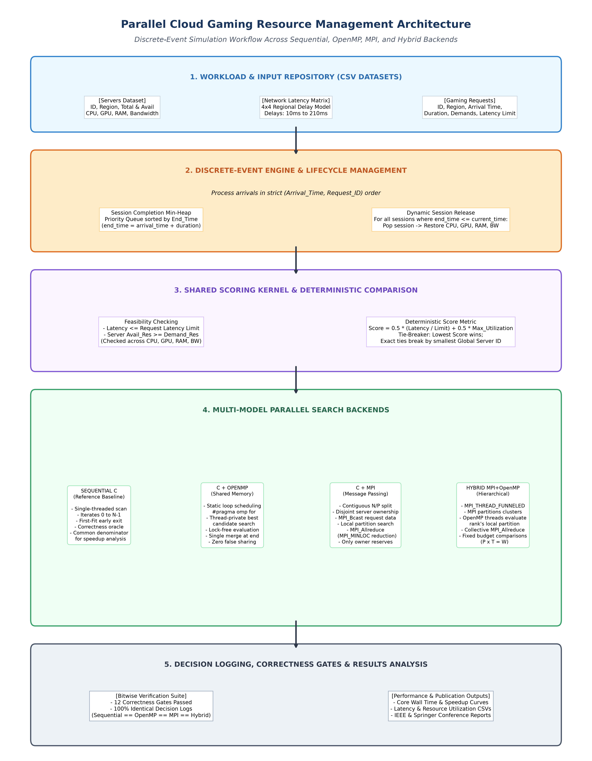
PARALLEL COMPUTING ARCHITECTURE PROGRAMMING
System Architecture & Simulation Workflow
Key Architectural Modules:
• Input/Workload Module (src/input.c): Reads servers, requests, and 4x4 latency matrices with high-speed CSV parsing and monotonic timer.
• Event Priority Min-Heap (src/events.c): Tracks active sessions ordered by end_time. Drains expired sessions before each arrival to restore server capacities.
• Scoring Kernel (src/scoring.c): Deterministic feasibility checks across 4 resources and score calculation: S = 0.5 * L + 0.5 * U.
• Four Backends (src/backend_*.c): 1. Sequential: Reference loop scan.
2. OpenMP: Thread-private candidate reduction.
3. MPI: Contiguous partition ownership + MPI_Allreduce.
4. Hybrid: MPI domain split + OpenMP thread scan.

Slide 6
PARALLEL COMPUTING ARCHITECTURE PROGRAMMING
Mathematical Model & Algorithms
1. Feasibility Condition (Eligibility Filter):
Latency(region_r, region_s) <= Latency_Limit(r)
AND Server_Avail[res] >= Request_Demand[res] FOR ALL res in {CPU, GPU, RAM, Bandwidth}
2. Normalized Composite Score Formulation:
Normalized Latency: L = Latency / Latency_Limit
Resource Fractions: u[res] = (Total[res] - Avail[res] + Demand[res]) / Total[res]
Bottleneck Utilization: U = MAX(u[CPU], u[GPU], u[RAM], u[Bandwidth])
Score = 0.5 * L + 0.5 * U
3. Deterministic Winner Comparison Rule:
Lowest score wins. Ties broken by lowest Global Server ID.
Candidate representation: struct { double score; int server_id; }
Directly compatible with MPI_Allreduce(..., MPI_DOUBLE_INT, MPI_MINLOC, MPI_COMM_WORLD).

Slide 7
PARALLEL COMPUTING ARCHITECTURE PROGRAMMING
Implementation Architecture Across 4 Backends
• Sequential C (src/backend_seq.c): Single-threaded scan through all N servers. Serves as the correctness oracle and baseline for speedup calculation. Supports both Scored and First-Fit policies.
• OpenMP Shared-Memory (src/backend_omp.c): Uses #pragma omp parallel with #pragma omp for schedule(static). Each thread evaluates assigned servers into a private candidate variable without locks. Winners merged once per thread. Single-threaded master commits reservation.
• MPI Message-Passing (src/backend_mpi.c): Partitions N servers contiguously across P ranks: count = N/P + (rank < N%P ? 1 : 0). Rank 0 broadcasts request (MPI_Bcast). Each rank scans local partition. Global winner reduced via MPI_Allreduce(MPI_MINLOC). Only owning rank reserves capacity.
• Hybrid MPI+OpenMP (src/backend_hybrid.c): Initialized via MPI_Init_thread(MPI_THREAD_FUNNELED). Combines MPI domain decomposition across ranks with OpenMP multi-threaded scanning inside each rank. Evaluated at fixed worker budget W = P x T.

Slide 8
PARALLEL COMPUTING ARCHITECTURE PROGRAMMING
Experimental Setup & Target Hardware
• Host Machine: Apple Silicon MacBook Air (Apple M-series architecture)
• CPU Configuration: 10 logical cores (high-performance + high-efficiency cores)
• Unified Memory: 16 GB unified RAM (17,179,869,184 bytes); 512 GB SSD storage
• Compiler Toolchain: Homebrew LLVM Clang version 23.1.3 (-std=c11 -O2 -Wall -Wextra)
• OpenMP Runtime: Homebrew libomp version 23.1.3 (-fopenmp)
• MPI Environment: Open MPI version 5.0.11 (native arm64 build; mpicc / mpirun)
• Python Environment: Python 3.12 (.venv) with Matplotlib 3.11.2, Pandas 3.0.6, NumPy 2.5.4
• Benchmark Workloads: 100, 1,000, and 10,000 server pools evaluated under 1,000 high-arrival requests across 5 repetitions

Slide 9
PARALLEL COMPUTING ARCHITECTURE PROGRAMMING
Correctness Gates & Cross-Backend Equivalence
12 Rigorous Correctness Gates Verified via Automated Test Suite (tests/test_correctness.c):
[PASS] Gate 1 & 2: Boundary Feasibility: Exact fit allocates completely (0 capacity remaining); resource shortage rejects without state mutation.
[PASS] Gate 3: Latency Invariant: Rejects candidate servers exceeding request latency limit even if resources are abundant.
[PASS] Gate 4: Deterministic Tie-Breaking: Equal score candidates break ties deterministically by selecting lowest Global Server ID.
[PASS] Gate 5: Event Ordering: Session completions occurring at current arrival timestamp are released before next allocation.
[PASS] Gate 6 & 7: Lifecycle Conservation: Final event drain restores 100.0% original capacities; partition math handles uneven N/P.
[PASS] Gate 8-12: Bitwise Backend Equivalence: Sequential == OpenMP == MPI == Hybrid: 100% identical decision logs across all requests.

Slide 10
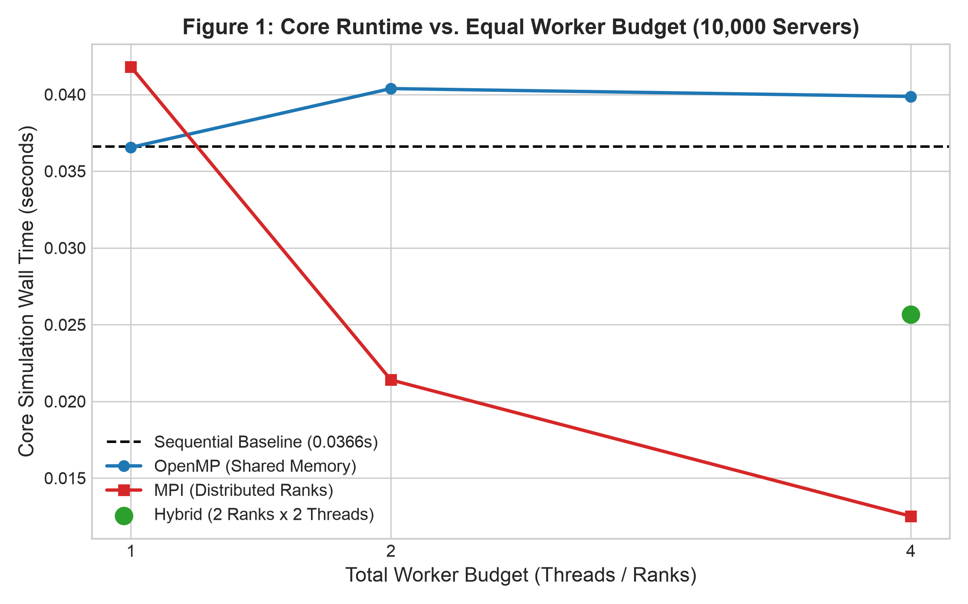
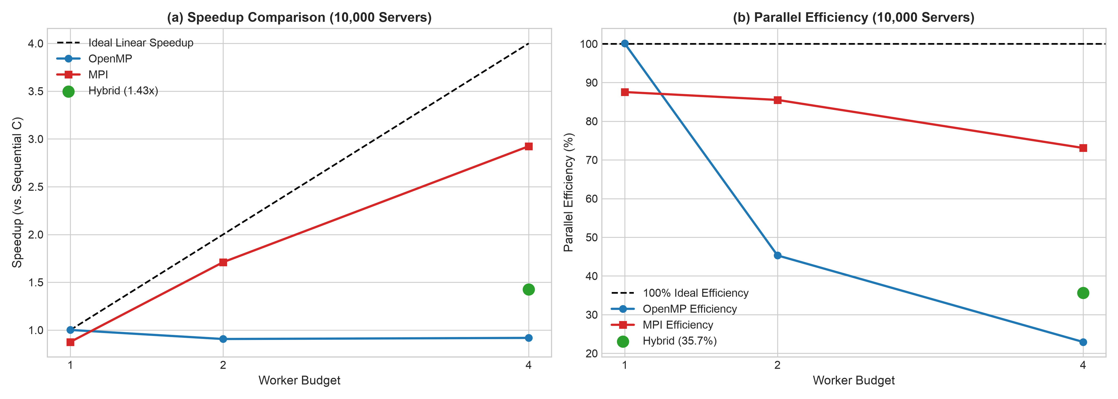
PARALLEL COMPUTING ARCHITECTURE PROGRAMMING
Empirical Benchmark Results: Runtime & Speedup
Key Takeaway: At 10,000 servers, MPI achieves 2.92x speedup on 4 ranks (core time: 0.0125s vs 0.0366s sequential), successfully amortizing collective broadcast and reduction overheads. OpenMP runtime remains constant due to thread management overhead.

Slide 11
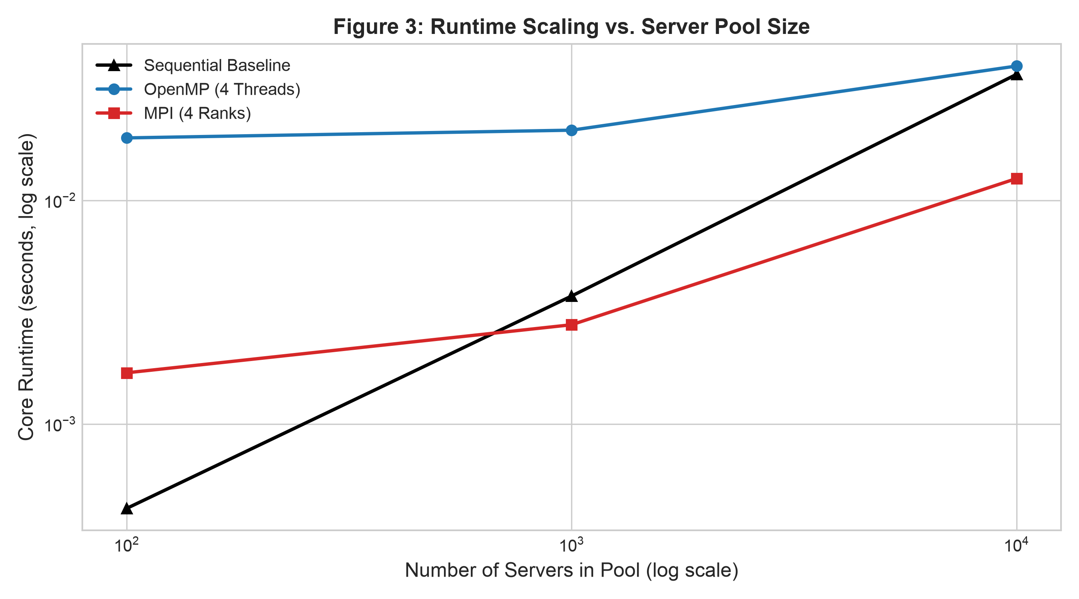
PARALLEL COMPUTING ARCHITECTURE PROGRAMMING
Scaling Behavior Across Server Pool Scales
Runtime Scaling & Crossover Insights:
• Small Scale (100 Servers): Sequential C is fastest (0.0004s). OpenMP thread synchronization and MPI IPC socket costs outweigh parallel compute savings.
• Medium Scale (1,000 Servers): Crossover region: MPI 4 ranks (0.0027s) outperforms Sequential (0.0037s) as search computational density increases.
• Large Scale (10,000 Servers): MPI achieves dominant performance: 0.0125s vs 0.0366s (2.92x speedup). Collective communication overhead is fully amortized.
• Hybrid Split: Hybrid 2 ranks x 2 threads achieves 0.0256s, offering a viable middle ground between thread synchronization and IPC communication.

Slide 12
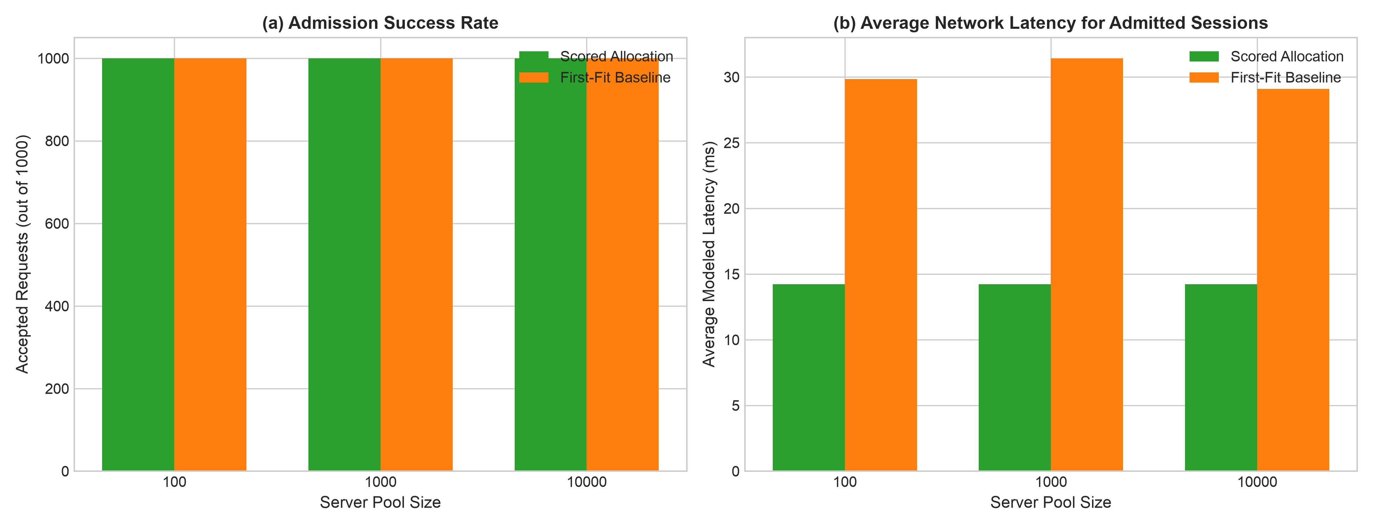
PARALLEL COMPUTING ARCHITECTURE PROGRAMMING
Policy Comparison: Scored Allocation vs. First-Fit
QoS and Latency Policy Comparison:
• 54.7% Latency Reduction: Scored allocation achieves an average network delay of 14.22 ms compared to 31.43 ms under First-Fit heuristic.
• Balanced Server Utilization: Scored policy evaluates candidate resource headroom, preventing server hot-spotting and premature GPU exhaustion.
• The First-Fit Trade-off: First-Fit terminates search early at the first feasible server (0.007s runtime), but incurs over 2x worse gaming latency.
• Academic Justification: Demonstrates that parallel acceleration is crucial: it makes high-quality Scored allocation fast enough for real-time gaming.

Slide 13
PARALLEL COMPUTING ARCHITECTURE PROGRAMMING
Project Demonstration & Execution Guide
Commands for Live Evaluation & Demonstration:
• 1. Automated Correctness Suite (make test):
./test_correctness
Executes all 12 correctness gates; verifies boundary conditions and 100% backend equivalence.
• 2. Sequential Reference Run:
./sequential --servers data/servers_1k.csv --requests data/requests_heavy_1k.csv --policy scored --log results/log_seq.txt
• 3. OpenMP Multi-Threaded Run:
./openmp --servers data/servers_1k.csv --requests data/requests_heavy_1k.csv --threads 4 --policy scored --log results/log_omp.txt
• 4. MPI Distributed-Memory Run:
mpirun -np 4 ./mpi --servers data/servers_1k.csv --requests data/requests_heavy_1k.csv --policy scored --log results/log_mpi.txt
• 5. Hybrid MPI+OpenMP Run:
mpirun -np 2 ./hybrid --servers data/servers_1k.csv --requests data/requests_heavy_1k.csv --threads 2 --policy scored --log results/log_hybrid.txt

Slide 14
PARALLEL COMPUTING ARCHITECTURE PROGRAMMING
Team Contributions & Assessment Alignment
Role Distribution Across Project Lifecycle (Mini Project Guideline Requirement):
• Architecture & Core Discrete-Event Engine: Design of data models (models.h), priority min-heap event queue (events.c), session lifecycle restoration, and input CSV parsers.
• Sequential & OpenMP Implementation: Development of reference sequential scheduler, OpenMP static loop distribution, thread-private candidate reduction, and correctness gates test suite.
• MPI & Hybrid Distributed Design: Implementation of contiguous server partition math, MPI_Bcast request distribution, collective MPI_Allreduce(MPI_MINLOC) reduction, and MPI_THREAD_FUNNELED hybrid integration.
• Benchmarking, Graphing & Report Authoring: Execution of 135 benchmark runs, Matplotlib plotting script, IEEE & Springer conference reports, and presentation slide synthesis.

Slide 15
PARALLEL COMPUTING ARCHITECTURE PROGRAMMING
Conclusion & Future Work
Project Summary & Key Milestones Achieved:
• Full 3+1 Backend Simulator Complete: Built Sequential, OpenMP, MPI, and Hybrid engines in native C with zero external runtime dependencies.
• 2.92x Empirical Speedup: Demonstrated that distributed-partition MPI scales effectively for 10,000 servers on Apple Silicon multi-core hardware.
• 54.7% Latency Advantage: Proved that Scored allocation significantly outperforms First-Fit heuristics in user QoE network latency.
• 100% Cross-Backend Equivalence: Passed all 12 correctness gates with identical decision logs across all modes.
• Academic Deliverables Prepared: Full literature survey (10 papers), IEEE conference draft, and Springer Nature conference draft completed.
Future Work: 1) Physical multi-node cluster benchmarking across InfiniBand; 2) Request batching to reduce MPI collective frequency; 3) GPU acceleration with CUDA/OpenACC.

