Slide 1
SPORTS PORTAL
BY
M.SAI RISHIK (1602-21-737-302)
JYOSHNA REDDY(1602-21-737-023)
KIRAN KUMAR (1602-21-737-025)
THEME: WEB DEVELOPMENT

Slide 2
MOTIVATION
Recognized Gap: Identified a lack of comprehensive sports information access.
Personal Experience: Faced frustrations with fragmented sources like WhatsApp and newspapers in college.
Missed Opportunities: Noted outdated communication led to missed chances for sports enthusiasts.
Inequality in Access: Aimed to address unequal access to vital sports information.
Goal: Create a centralized sports portal app to democratize information, ensure equal participation opportunities, and foster inclusivity in the sporting community.

Slide 3
PROBLEM STATEMENT
In a world inundated with sports enthusiasts seeking information on various sporting activities, coaching centers, selection processes, and notable personalities, there exists a significant gap in centralized access to such comprehensive data.
Traditional methods of disseminating information, such as word of mouth or newspaper announcements, often prove inefficient and lack accessibility.

Slide 4
ABSTRACT
Our centralized sports portal addresses the challenges faced by enthusiasts in accessing comprehensive and up-to-date information. Fragmented sources like WhatsApp groups and newspaper announcements have proven insufficient, leading to missed opportunities and inequalities in information access.
Our project aims to fill this gap by providing a user-friendly online platform, offering coaching center details, selection process guidelines, athlete profiles, and timely event notifications.
By consolidating this information, we promote inclusivity and equal opportunities for participation within the sporting community

Slide 5
Existing Sports Portal:
News: Latest updates and articles.
Live Scores: Real-time match scores.
Player Stats: Detailed statistics of players.
Team Info: Details about various teams.
Proposed Solution:
Event Calendar: View upcoming sports events.
Event Integration: Adding new events.
Event Registration: Sign up for events.
Recovery Time Prediction: Estimate recovery durations.
Match Schedules: Upcoming match information.

Slide 6
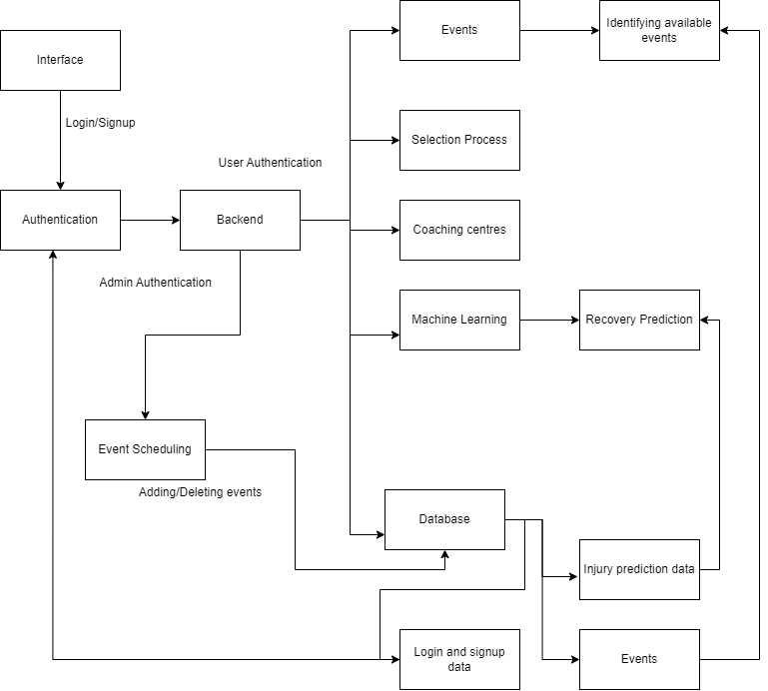
Architecture

Slide 7
Technology Stack
Web Development:
Flask: A lightweight web framework for Python used for building web applications.
HTML/CSS: Standard markup and styling languages for creating web pages.
JavaScript: Adding interactivity and dynamic behavior to web pages.
Data Analysis and Visualization Libraries:
Pandas : A powerful library for data manipulation and analysis in Python.
NumPy : A fundamental package for scientific computing with Python.
Machine Learning:
Linear regression

Slide 8
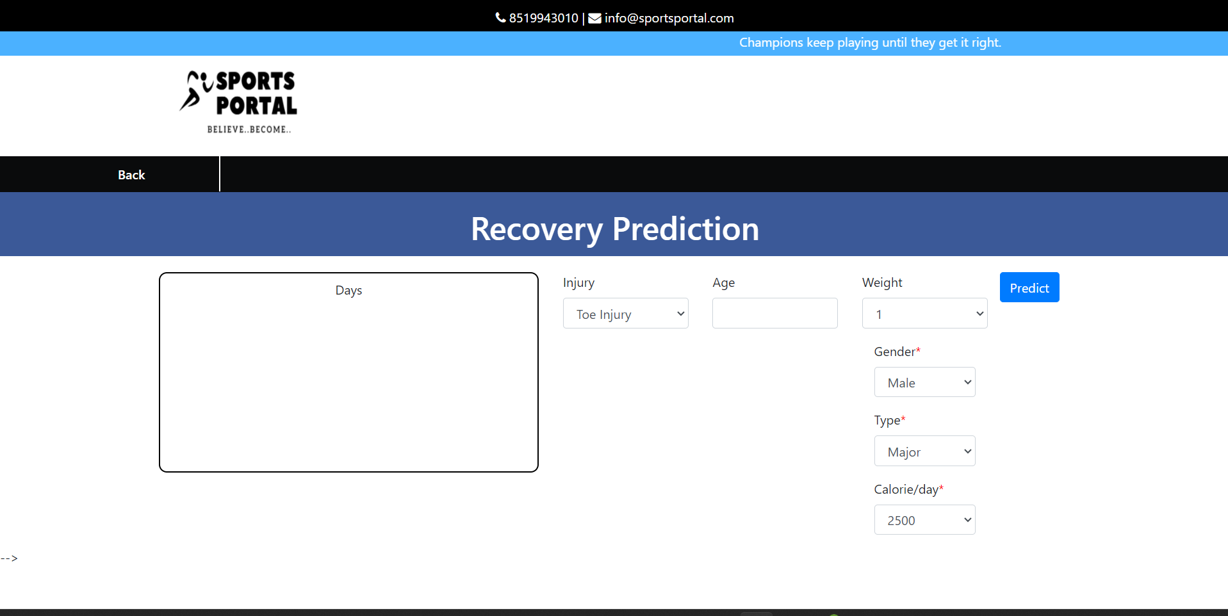
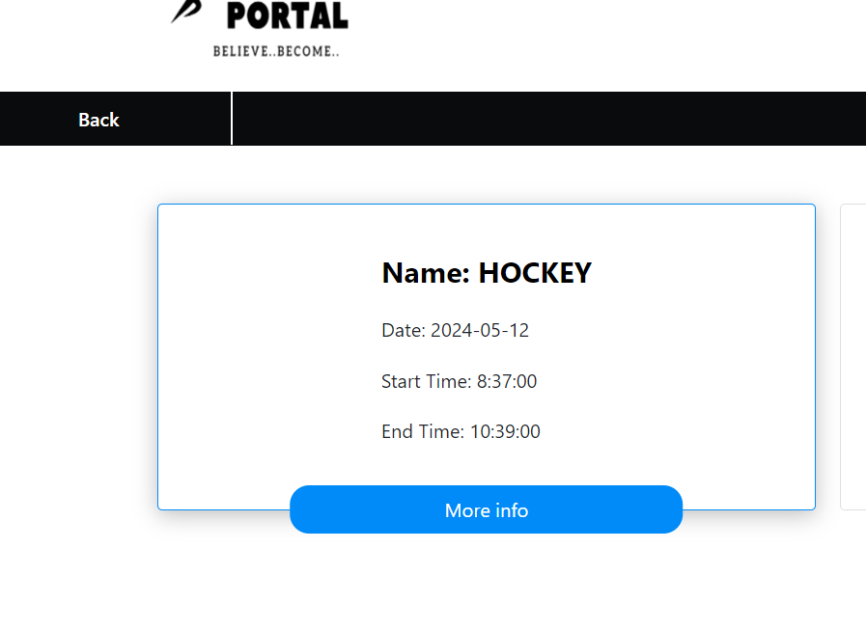
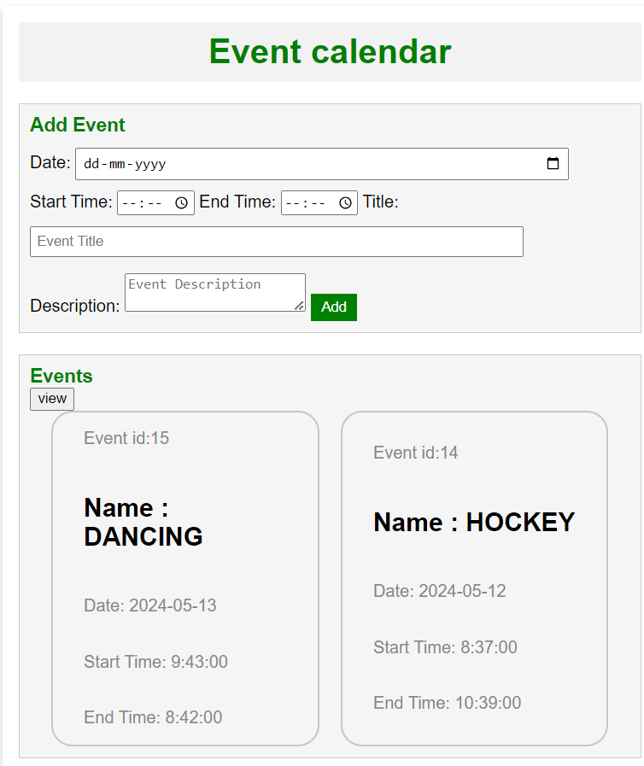
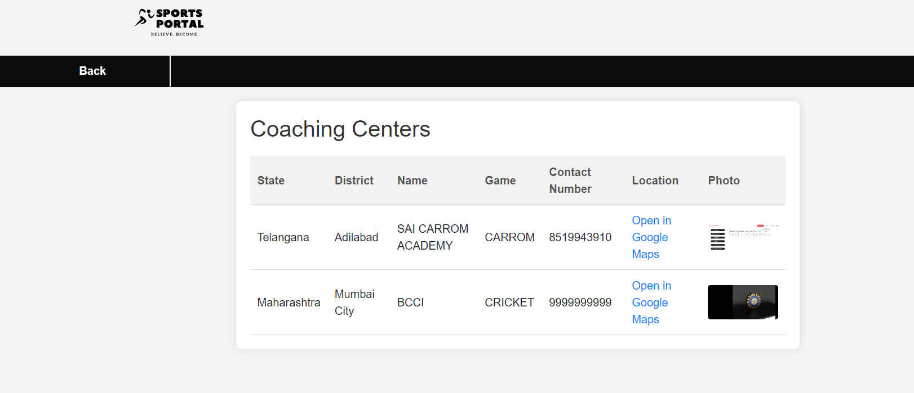
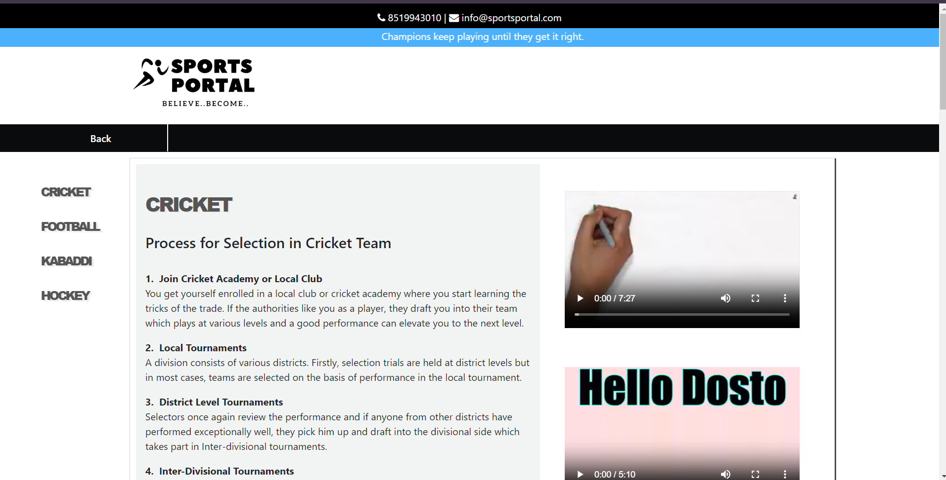
Execution Screenshots

Slide 9
Conclusion
The platform offers comprehensive support for athletes and sports enthusiasts through clear guidelines for selection processes, predictive recovery insights, easy access to coaching centers, and a convenient event calendar.
These features collectively empower athletes to navigate selection processes, manage injuries effectively, locate training facilities, and stay updated on upcoming events, optimizing their performance and participation in the sports community.

Slide 10
Future Scope
Advanced analytics for personalized insights.
Virtual coaching for remote skill development.
Community engagement for peer support.
Global expansion with localization efforts.
Partnerships for integrated services.
User experience optimization for seamless interaction.

Slide 11
References
W3Schools HTML, CSS, and JavaScript Tutorials.
Lab Experiments in Artificial Intelligence and Machine Learning (5th semester)

Slide 12
Thank you

