Slide 1
SKILLORA
A Smart Skill Progress Portfolio Platform
Verified Milestone Tracking, Authentic Consistency Engine & Dynamic Full-Stack Showcase
TECHNOLOGY STACK
Full-Stack MERN Architecture
• React.js 18 & Vite Bundler
• Node.js & Express REST API
• MongoDB & Mongoose ODM
• JWT & Bcrypt Authentication
CORE FORMULA & VALUE
Task-Based Calculation
Progress = (Completed / Total) × 100
• 0% Vanity Sliders
• 100% Proven Deliverables
• Real-Time Recalculation
ACADEMIC SCOPE
B.Tech Mini Project Defense
• Clean Component-Driven Design
• 1-Click Demo Workspace
• Shareable Public Portfolio
• PDF & CSV Client-Side Export

Slide 2
SKILLORA • PROJECT PRESENTATION
Problem Statement: Why Skillora Was Created
1. Vanity & Unverified Ratings
• Traditional portfolios rely on decorative sliders (e.g., 'React - 90%', 'Python - 85%').
• These ratings have ZERO proof or measurable deliverables behind them.
• Recruiters, mentors, and viva examiners cannot verify whether the candidate actually mastered core concepts.
• Students lack a standard benchmark to self-assess genuine technical competency.
2. Fragmented Learning Management
• Tasks, milestones, and deadlines are scattered across notes, spreadsheets, and bookmark folders.
• No integrated system correlates individual learning steps with overarching skill progression.
• Lack of streak tracking leads to inconsistency and study procrastination.
• Deadlines easily slip past without proactive in-app reminder thresholds.
3. The Showcase & Export Barrier
• Bridging private daily study notes into a professional public portfolio requires manual formatting.
• Generating formatted PDF resumes with real percentage charts typically requires paid third-party tools.
• Need for a unified platform providing both a private developer workspace and a verified public showcase link.

Slide 3
SKILLORA • PROJECT PRESENTATION
Technology Stack: What We Used Till Now
FRONTEND ARCHITECTURE (Client)
• React.js 18.3: Component-driven user interface with hooks (useState, useEffect, useMemo, useCallback).
• Vite 6.4: Next-gen lightning bundler with Hot Module Replacement & production chunk splitting.
• Pure CSS3 Tokens: Handcrafted lavender-and-cream editorial design system without heavy framework bloat.
• Recharts: Interactive SVG Bar Charts, Donut Charts, and 7-day consistency activity trends.
• jsPDF & html2canvas: Client-side verified multi-page PDF generation with progress bar rendering.
• Axios HTTP Client: Modular REST API client with automatic JWT Bearer token request interceptors.
BACKEND & PERSISTENCE (Server)
• Node.js Runtime: Scalable, non-blocking asynchronous event loop with modern ESM module syntax.
• Express.js 4.21: Lightweight REST API framework organizing modular controllers, routes, and middleware.
• MongoDB Database: High-performance NoSQL document store with persistent local storage engine.
• Mongoose 8.9 ODM: Strict schemas, validation, and pre-save lifecycle calculation hooks.
• JWT Authentication: Stateless JSON Web Tokens with 30-day expiry and protected route guards.
• Bcryptjs Encryption: One-way cryptographic password hashing using 10 salt rounds (zero plain-text).

Slide 4
SKILLORA • PROJECT PRESENTATION
Technology Justification: Why Only We Use That?
React.js + Vite (vs. Angular / Vue / Plain JS)
✓ Component-Driven UI: Isolated, reusable components (SkillCard, GoalCard, StatCard).
✓ Vite HMR: Instant build updates (<100ms) compared to slow legacy Webpack builds.
✓ Unidirectional Data Flow: Predictable state changes via useState and custom handlers.
Node.js + Express (vs. Django / Spring Boot)
✓ Unified Language: JavaScript across both client and server eliminates context switching.
✓ Non-Blocking I/O: High concurrency for handling simultaneous REST requests effortlessly.
✓ Lightweight: No monolithic overhead; minimal boilerplate for academic viva demonstration.
MongoDB + Mongoose (vs. Relational SQL)
✓ Nested Task Hierarchies: Skills natively embed sub-tasks as JSON-like documents.
✓ Pre-Save Hooks: Backend automatically recalculates progress % before saving to disk.
✓ Schema Flexibility: Seamlessly allows custom categories, tags, and dynamic goal structures.
JWT + Bcrypt (vs. State-heavy Session Cookies)
✓ Stateless Auth: Server does not store active sessions in memory, maximizing scalability.
✓ One-Way Bcrypt Hashing: Passwords never stored in plain-text; select:false protects queries.
✓ Client Interceptor: Token automatically passed in Authorization: Bearer headers.

Slide 5
SKILLORA • PROJECT PRESENTATION
What We Have Done Till Now: Core Implemented Modules
1. Auth & Demo System
• Dual Registration & Login with bcrypt hashing.
• 1-Click Demo Workspace (Ananya Sharma).
• JWT protected routes & automatic session rehydration.
2. Task-Based Skill Engine
• Granular task checklists per skill.
• Backend Mongoose pre-save progress formula.
• Status transitions: Not Started → In Progress → Completed.
3. Strategic Learning Goals
• Target deadlines with Priority tags (High/Med/Low).
• Links goals to specific skills or independent targets.
• Real-time countdown and overdue milestone tracking.
4. Streaks & Notifications
• Activity logger captures task completion timestamps.
• Calculates current & peak consecutive study streaks.
• In-app deadline alert banners with configurable days.
5. Public Shareable Portfolio
• Dedicated public endpoint (/api/portfolio/public/:id).
• Sanitizes output (excludes emails, hashes & internal IDs).
• Customizable visibility flags (Bio, Streaks, Skills).
6. Cloud Sync & Export Hub
• 1-Click LocalStorage to MongoDB cloud migration.
• Client-side styled PDF generation via jsPDF.
• RFC 4180-compliant CSV spreadsheet exports.

Slide 6
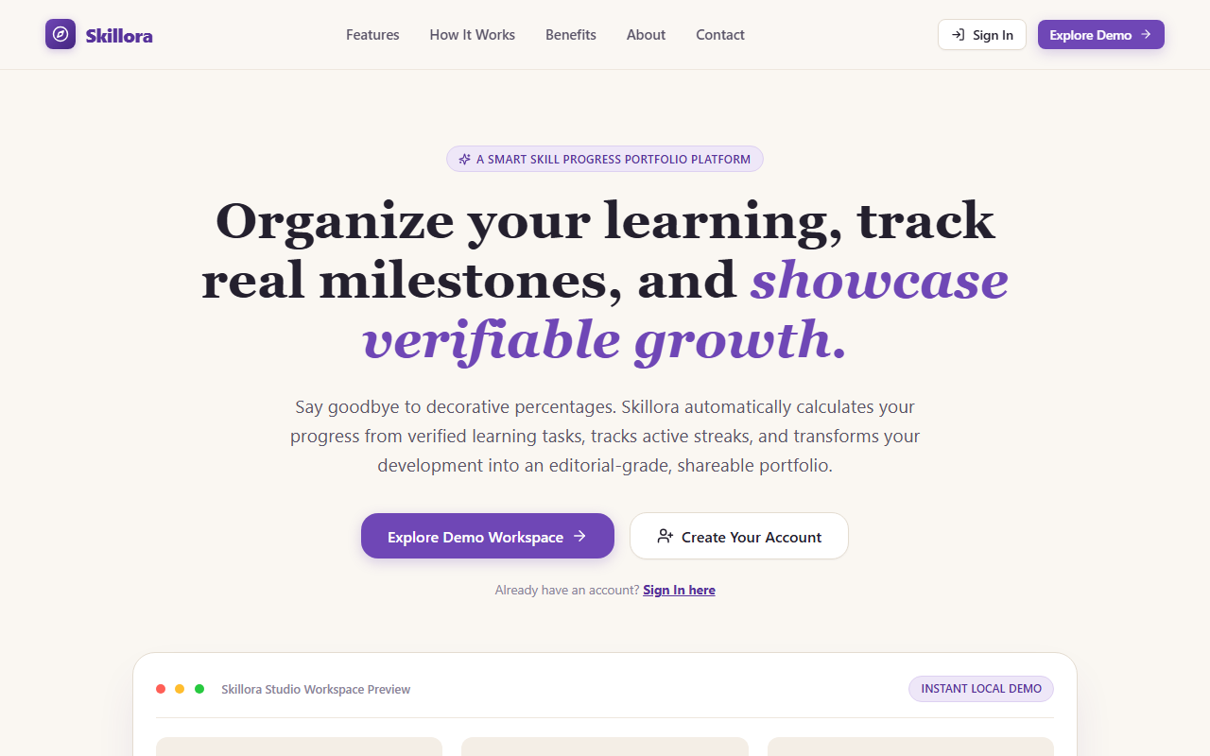
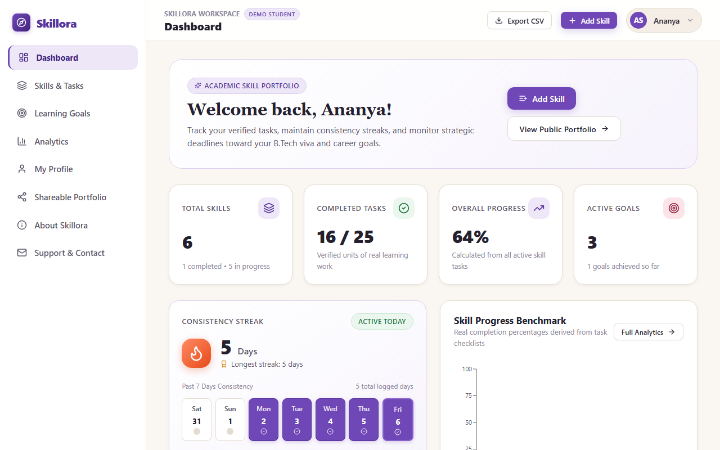
SKILLORA • PROJECT PRESENTATION
UI Showcase: Landing Page & Central Dashboard
Landing Page & Brand Aesthetic
• Editorial lavender-and-cream visual identity with hero typography.
• 1-Click 'Explore Demo' and 'Create Account' conversion points.
• How It Works, Features breakdown, and responsive navigation.
Workspace Dashboard
• Top Stat Cards: Total Skills, Completed Tasks, and Overall Progress %.
• Interactive Recharts Bar Chart benchmarks skill progress.
• In-app reminder strips for upcoming deadlines and overdue milestones.

Slide 7
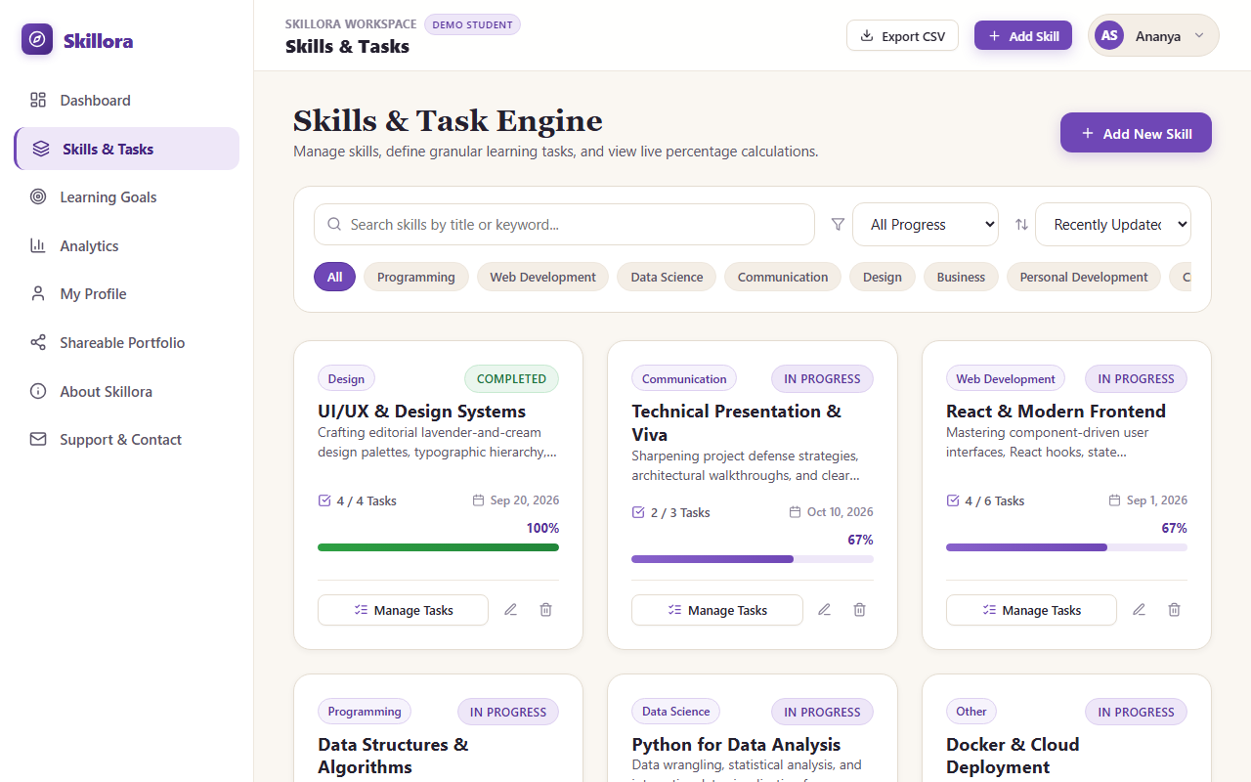
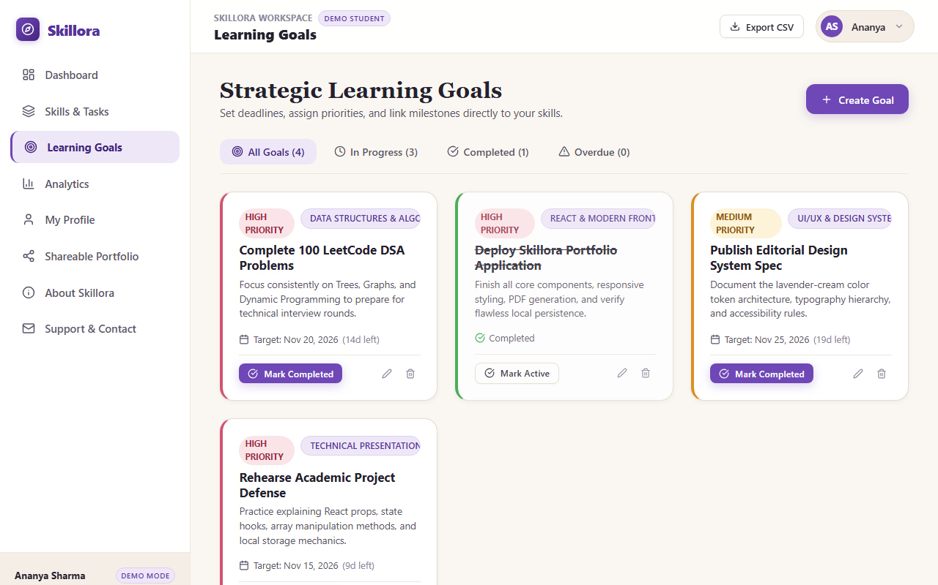
SKILLORA • PROJECT PRESENTATION
UI Showcase: Skill Engine & Learning Goals Planner
Skills & Task Management Engine
• Real-time search query and dynamic category filter chips.
• Sort by name, progress, or recently updated.
• Task Checklist Drawer with inline add, toggle, edit, and deletion.
Strategic Learning Goals
• Tab filtering: All, In Progress, Completed, and Overdue.
• Priority indicators: High, Medium, and Low with target countdowns.
• One-click milestone completion toggle with activity logging.

Slide 8
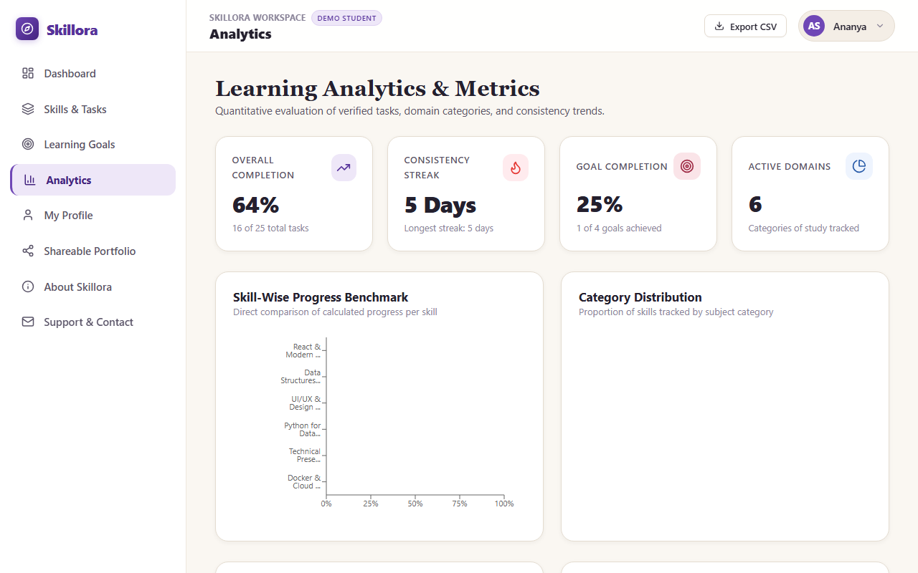
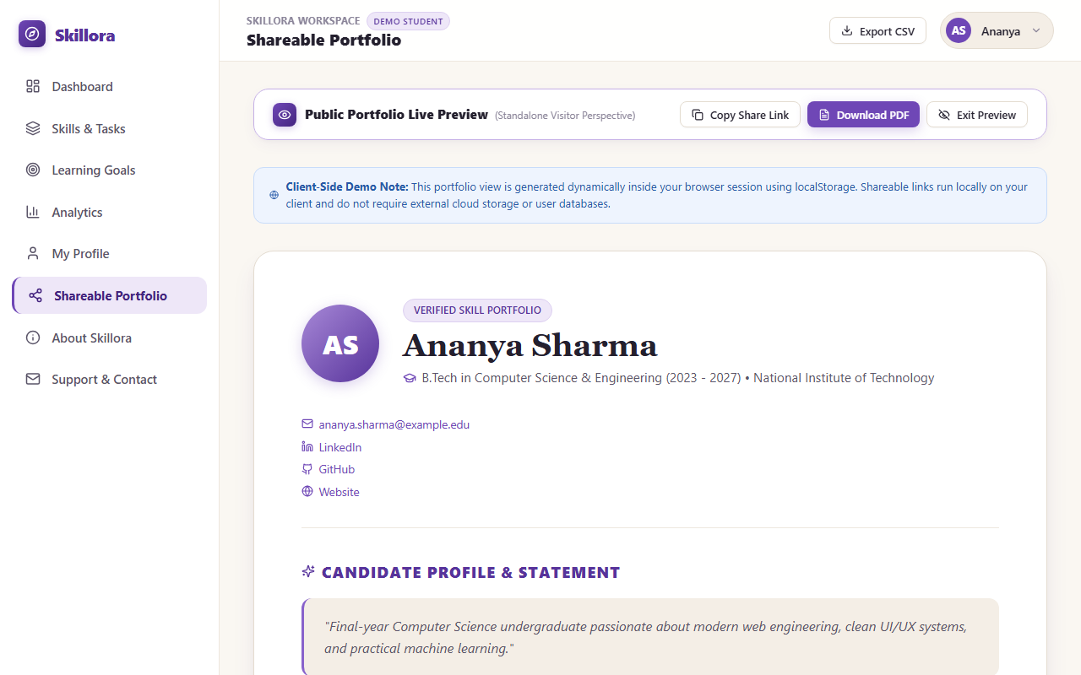
SKILLORA • PROJECT PRESENTATION
UI Showcase: Quantitative Analytics & Public Portfolio
Quantitative Analytics & Charts
• Category breakdown pie charts & task completion ratios.
• 7-day activity consistency matrix tracking actual study sessions.
• Comprehensive metrics summary for academic review.
Public Shareable Portfolio & Export
• Standalone public URL (?portfolio=ananya-sharma) with privacy controls.
• Verified PDF resume download with styled headers & progress bars.
• RFC 4180 CSV spreadsheet export for offline analysis.

Slide 9
SKILLORA • PROJECT PRESENTATION
Key Advantages & Academic Value
Authentic & Verifiable Progress
✓ Replaces fake sliders with mathematical calculation based on proven tasks.
✓ Eliminates division-by-zero or NaN edge cases with defensive logic.
✓ Recruiters can inspect exact deliverables behind any claimed competency.
Zero-Barrier Onboarding
✓ 1-Click Demo Workspace allows examiners/users to test instantly.
✓ No mandatory registration or email validation required to explore.
✓ Realistic preloaded academic dataset (B.Tech student Ananya Sharma).
Dual Storage & Cloud Sync
✓ Browser LocalStorage cache allows offline responsiveness.
✓ MongoDB persistence saves records across devices and user accounts.
✓ 1-Click Cloud Migration imports offline progress into database seamlessly.
Production-Grade Security & Standards
✓ Bcrypt password hashing with salt rounds (passwords never stored plain).
✓ Stateless JWT Bearer tokens with client Axios auto-interceptors.
✓ Public portfolio API sanitizes payloads, completely excluding private data.

Slide 10
SKILLORA • PROJECT PRESENTATION
Future Scope: If There Are Another Things To Do
1. AI Learning Roadmaps
• Gemini API Integration: Auto-generate step-by-step learning task checklists for any user-entered skill.
• Adaptive Milestones: Recommend next practice tasks when progress plateaus.
• Smart Skill Gap Analysis: Compare student portfolio against live job postings to highlight missing competencies.
2. Automated Live Sync
• GitHub Webhook Integration: Automatically mark coding tasks completed upon commits to designated repositories.
• LeetCode / Codeforces API Sync: Auto-update problem-solving goal targets as online judge scores increase.
• Continuous Proof: Direct links from completed tasks to specific git commit SHAs.
3. Peer & Mentor Endorsements
• Faculty / Mentor Sign-Off: Allow university professors to sign cryptographic verification hashes on milestones.
• Custom Domain Hosting: Allow students to bind their portfolio to custom domains (e.g., student.dev).
• Interactive Viva Defense Mode: Preset presentation view tailored for practical exam evaluators.

Slide 11
SKILLORA • PROJECT SUMMARY & DEFENSE
A Complete, Verified Full-Stack MERN Portfolio
Skillora successfully replaces deceptive portfolio percentages with rigorous, task-verified learning progress. Combining an editorial frontend with an Express/MongoDB REST backend, it provides an authentic, high-impact demonstration of full-stack engineering principles.
Key Achievements:
✓ 100% Full-Stack MERN Architecture: Connected React + Node + Express + MongoDB REST API.
✓ Zero Mock Calculations: All percentages derived strictly from verified completed tasks.
✓ Clean Academic Viva Defense: Ready with VIVA_QUESTIONS.md covering Props, Hooks, Mongoose & JWT.
✓ Live GitHub Repository: https://github.com/jyoshnapramodat-crypto/Skillora.git

