Slide 1


Electviz: Election Data Visualization for Media
Power BI Based Election Analytics Platform
Github:https://github.com/Payal1726/Infosys_ElectViz-Election-Data-Visualization-for-Media-Team-A-
PRESENTED BY TEAM A
Payal Shinde Mohammad Saad
Jyothi Reddy
Gowtham Mani
Kumari Divya Sree

Slide 2
Problem Statement
During elections, media organizations operate in a fast-paced and high-pressure environment where timely and accurate information is critical. Election data is vast, complex, and collected from multiple sources, making it challenging to organize, analyze, and present in a meaningful way. Without a structured and interactive system, understanding trends such as vote share, turnout patterns, party performance, and constituency-level results becomes difficult. Therefore, there is a need for a centralized and dynamic dashboard solution that transforms raw election data into clear, insightful visual reports, enabling journalists and editorial teams to deliver precise, data-driven coverage to the public.

Slide 3
Project Objectives
• Integrate public election datasets​
• Enable real-time result tracking​
• Provide vote share and turnout analysis​
• Support party and candidate performance
evaluation​
• Deliver broadcast-ready visual dashboards​

Slide 4
Key Outcomes
Unified election data (state & national levels)​
• Real-time election result tracking​
• Party-wise & candidate-wise dashboards​
• Geographic mapping of results​
• AI-driven keyword clustering​
• Scalable model for future election

Slide 5
Module 1 – Data Integration & Modeling
• Imported data from CSV, Excel, APIs​
• Cleaned & normalized constituency and candidate data​
• Created Star Schema model​
• Fact_ElectionResults & Dimension Tables​
• Established relationships for accurate reporting​

Slide 6
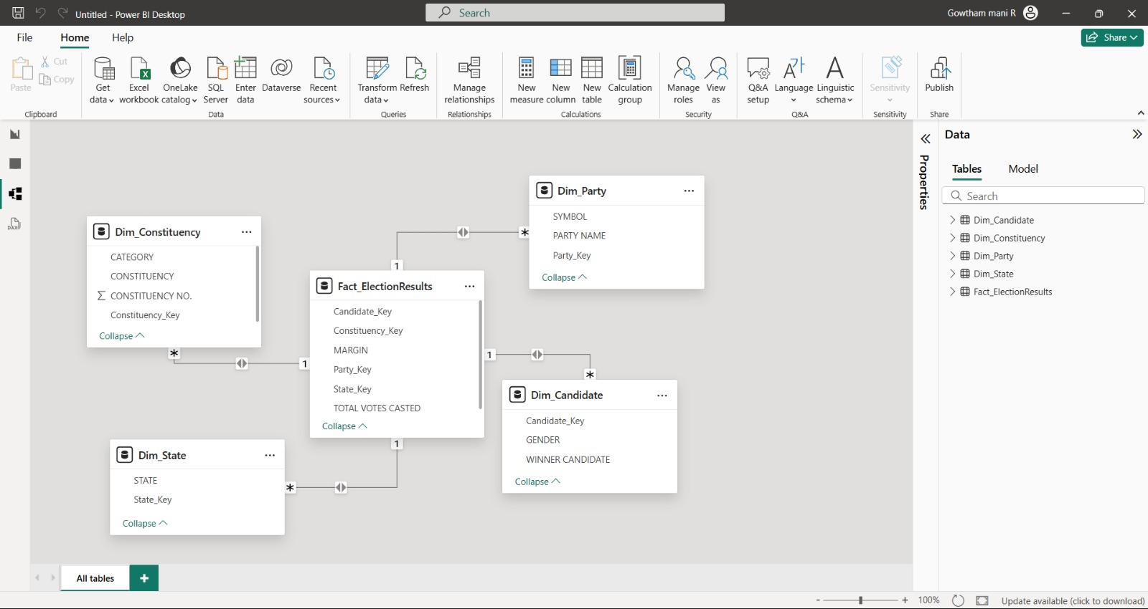
Data Integration &Modeling

Slide 7
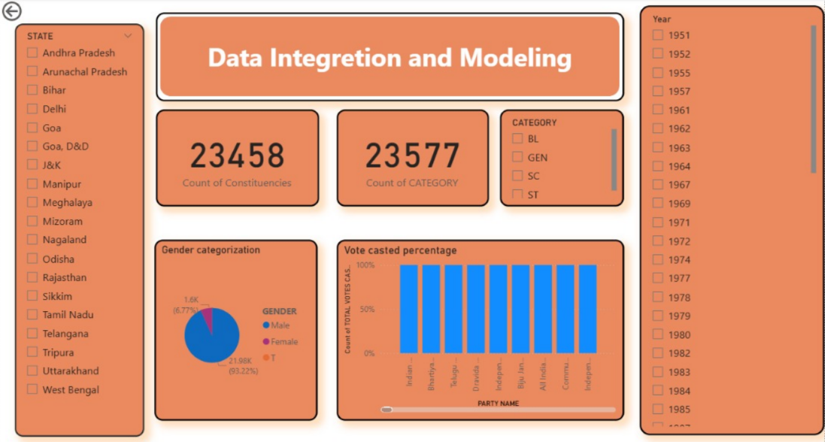
Data Integration &Modeling

Slide 8
Module 2 – Historical Trends Dashboard
Visualized vote share & turnout across years
Line charts & area charts for party trend analysis
Identified swing constituencies
Enabled filters (year, region, party)

Slide 9
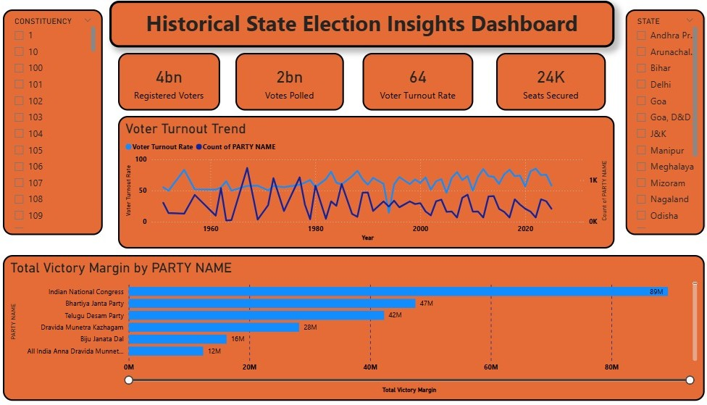
Historical Trends Dashboard

Slide 10
Module 3 – Real-Time Results Dashboard
• Simulated live result integration (API/mock)​
• Vote % bar graphs & seat indicators​
• Interactive filters (region, party, candidate ,year)​
• Constituency-level drill-down​

Slide 11
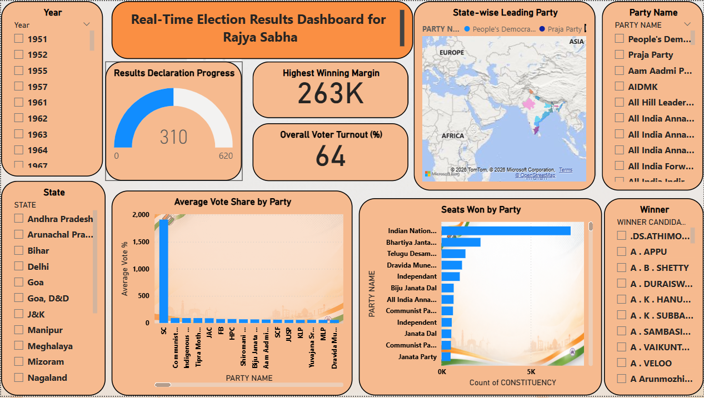
Real-Time Results Dashboard

Slide 12
Module 4 – Turnout & Demographics
Gender-based turnout trends​
• Age-group participation insights​
• Heatmaps & pie charts for demographic analysis​

Slide 13
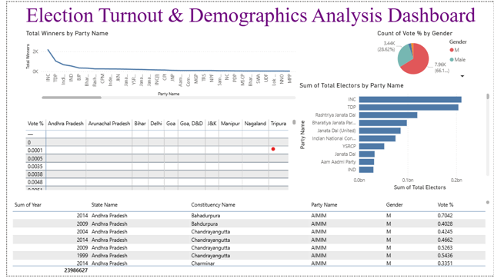
Turnout & Demographics

Slide 14
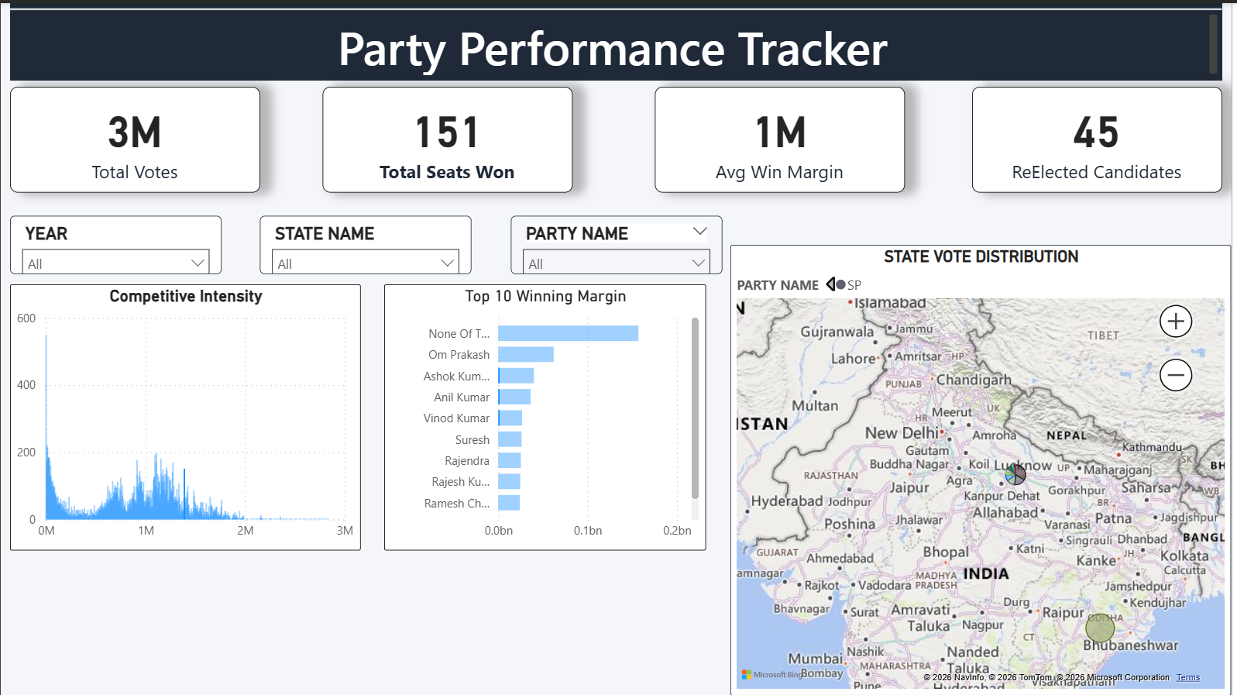
Module 5 – Party & Candidate Performance

Slide 15
Architecture Overview
• Data Ingestion Layer – CSVs & JSON APIs​
• Transformation Layer – Power Query​
• Semantic Model – Star Schema​
• Visualization Layer – Power BI Dashboards​
• Publishing via Power BI Service​

Slide 16
Impact & Applications
• Supports journalism & political reporting​
• Enables fast decision-making during elections​
• Identifies long-term political trends​
• Compares vote-to-seat conversion efficiency​
• Adaptable for future elections​

Slide 17
Contribution of Team

