Slide 1
PROJECT NO:-1
AIM:-To design a system which will take input from the user and display it and check the password.if password is correct output will be observed .otherwise the buzzer will ON and LED will glow.

Slide 2
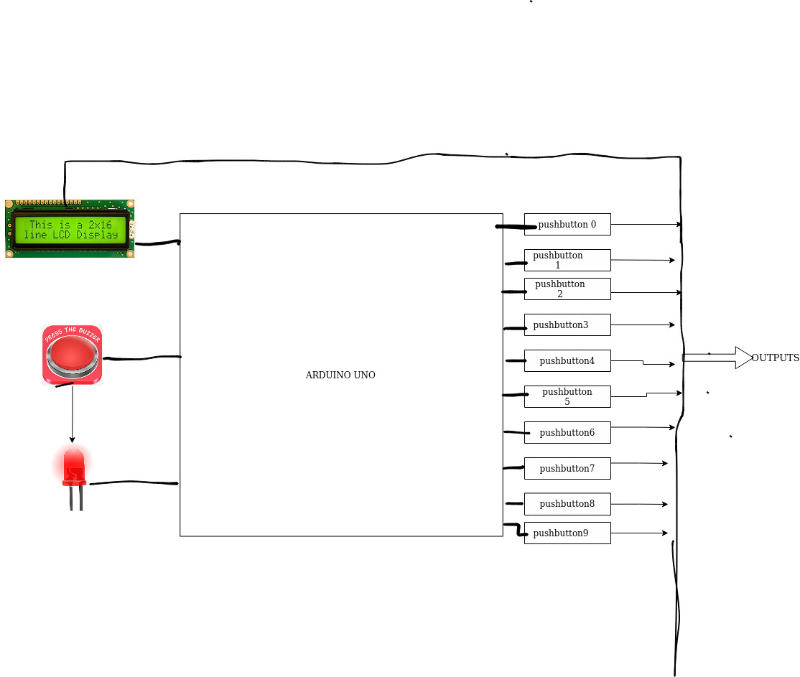
BLOCK DIAGRAM

Slide 3
I/O TABLE
INPUTS:-
1.PUSHBUTTONS
OUTPUTS:-
1.LCD Display
2.Buzzer
3.LED

