Slide 1
Profit Analysis

Slide 2
Problem Statement
Analyze the impact of R&D, Administration, and Marketing Spend on Profit.
Build a regression model.
Predict profits for given inputs.
Create visualizations and derive insights.

Slide 3
Dataset Overview
50 Startups dataset
States: New York, California, Florida
Features: R&D Spend, Administration, Marketing Spend, State, Profit
Source of dataset : data base

Slide 4
Methodology
Data Collection
Data Cleaning
Exploratory Data Analysis
Regression Analysis
Profit Prediction

Slide 5
Linear regression
Definition : Linear Regression is a statistical method used to model the relationship between a dependent variable (target) and one or more independent variables (predictors) by fitting a linear equation to the observed data.
How It Works
Identify Variables: Choose dependent and independent variables.
Fit the Line: Find the best-fitting line (or hyperplane for multiple variables) that minimizes the difference between actual and predicted values.
Predict Outcomes: Use the line equation to predict values for new inputs.
Interpret Coefficients: Understand how each independent variable impacts the target variable.

Slide 6
Predicting profit using RD_spend, Administration and Marketing_spend
RD_Spend | Administration | Marketing_spend | profit
21892.82 | 81910.77 | 164270 | 71236.89
23940.93 | 96489.63 | 137001.1 | 71040.76

Slide 7
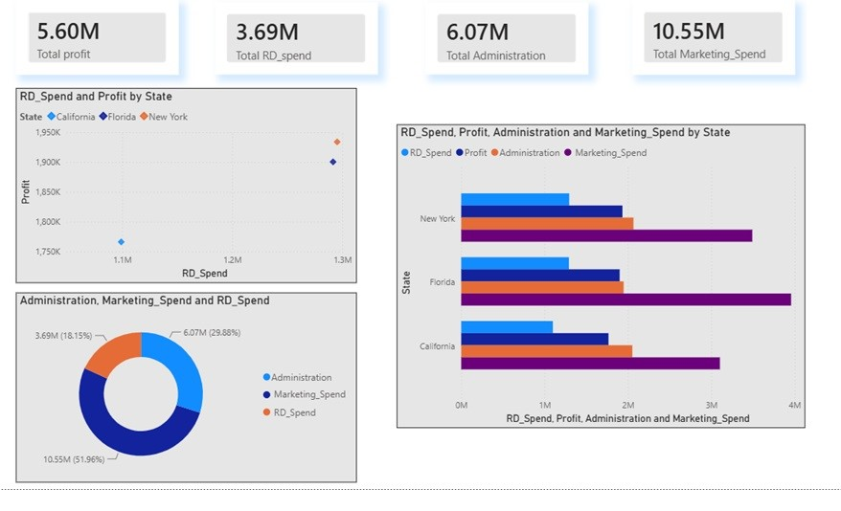
Visualizations

Slide 8
Insights & Recommendations
R&D spending generally has a strong influence on profit.
Optimize marketing investments.
Monitor administrative expenses.
Use predictive analytics for planning.

Slide 9
Thank you

