Slide 1

Shiksha
Volunteer Dashboard for Educational Non- Profit Organization
Team: NittalaDJallaJ
Devi Phani Sravanthi Nittala
Jyothika Jalla

Slide 2
Introduction
Our application is a web-based dashboard for volunteers at a non-profit organization that aims to provide educational support to children in shelter homes.
This system is to streamline the process of scheduling classes and providing a platform to bring forth any issues that any child may be facing in a transparent manner.
The volunteers can easily access class schedules, update their profiles, and report issues, if any.
The admin users can add/remove volunteers, schedule classes, resolve any reported issues assigned to them, and update profiles of volunteers.
Notes:
Shiksha stands for education in Sanskrit which we felt would apt for our application which aims to serve as a dashboard for volunteers associated with a non-profit organization that aims to provide educational support to children in need. This dashboard exists to allow volunteers and employees to keep track of classes, and issues, if any that might arise.
As we will highlight in the future slides, we have two types of users: volunteers and admin users. The former can access class schedule, report issues and view/add donations.
Admins can carry out the same functionalities as volunteers along with the additional responsibilities of creating/removing user profiles, adding/updating classes, and resolving open issues.

Slide 3
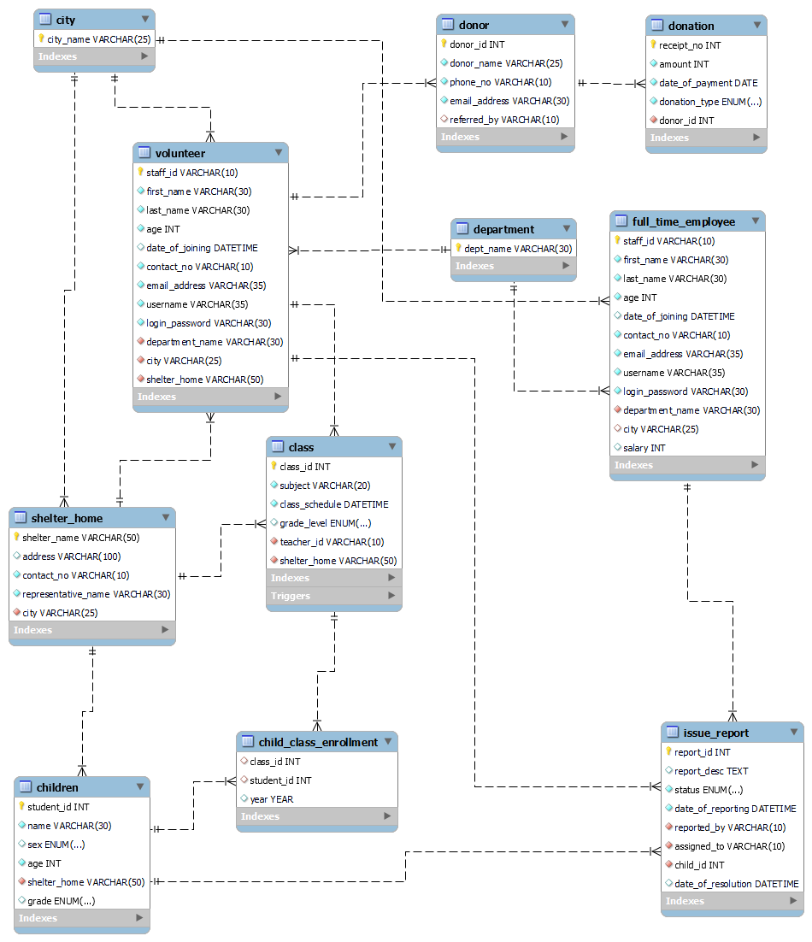
Logical Design
Notes:
This is our logical design, as shown we have chosen to have volunteer and full-time employees who represent the admin users as two separate entities as they have different relationships with different entities. We have an entity to represent the shelter homes in each city which is also another entity. Class and reports detailing issues form two other entities. This logical design is in line with our conceptual design with an additional entity the child_class_enrollement entity that represents the classes each child has enrolled in for a particular year.

Slide 4
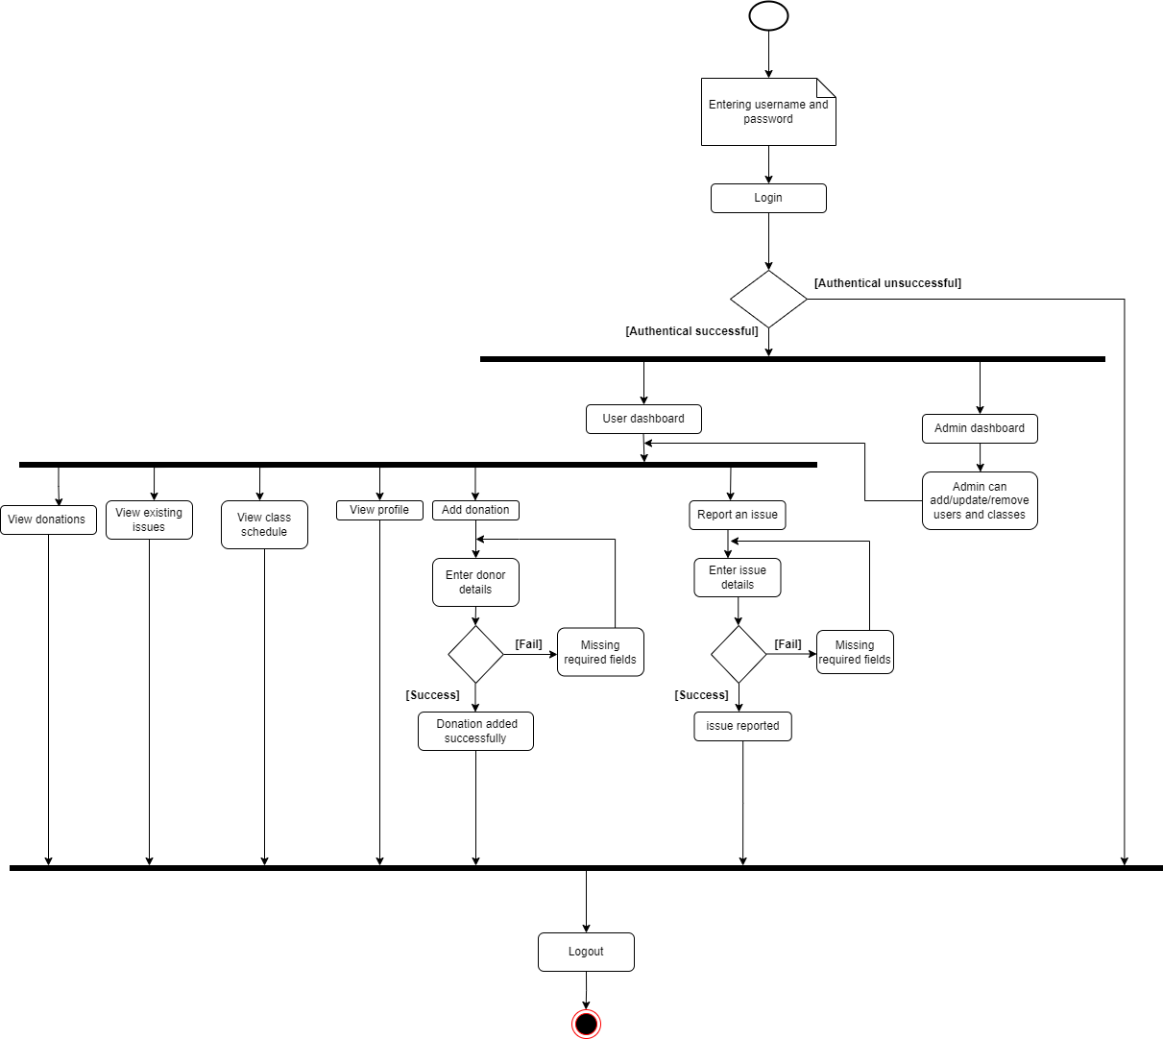
Activity diagram
Notes:
As mentioned earlier we have two users admin and volunteers, this activity diagram shows the flow of the application for the two users. As you can see the admin has the same functionality as the user with a few added functionalities.

Slide 5
Technical Description
Database – MySQL
Database Application – MySQL Workbench
Server – Flask
Host Language – Python
User Interface – web application in HTML, CSS and JS

Slide 6
A Closer Look AT THE APPLICATION

Slide 7
future scope
Support for multiple organizations: Let the database serve different organizations with similar structures and objectives.
Additional functionalities:
Raise/Accept substitution requests.
Allow volunteers to track progress reports of children.
Support for weekly lesson plans and class notes.

Slide 8
Thank you!

