Slide 1

BID MAGNET
TECH VENTURE BOOTCAMP OCT 2026
Win contracts. Put money in your pocket.
TEAM 28
Notes:
Open with the one-liner: Bid Magnet helps Spanish IT companies with no bid team decide which public tenders to chase and get a compliant, competitive bid out the door in time. Introduce the team, then go straight to the problem.

Slide 2
01 — PAIN POINT
45%
of central-government contracts got one valid bid or less
H1 2026
Sources: DoubleTrade; PLACSP & SEOPAN; OIReScon; Economía 3 via RSM (May–Aug 2026)
All figures cover Spanish public contracts only.
BID MAGNET · 02
Notes:
When a government body needs something, like new software, it can't just pick a supplier. It publishes a tender: an open competition where companies submit bids, and the best one wins.
Last year Spain published more than 170,000 of them, scattered across different platforms, with the rules buried in long documents.
So companies give up. This year, 45% of central-government contracts got one valid bid or none.
In 2025, €4 billion went unawarded. That's money that never reached the qualified companies who could have done the work.
We're here to change that.

Slide 3
01 — PAIN POINT
HARD TO FIND
HARD TO BID
01
Scattered tenders
02
Complex specs
03
Strict formats
04
Short deadlines
Sources: DoubleTrade; PLACSP & SEOPAN; OIReScon; Economía 3 via RSM (May–Aug 2026)
All figures cover Spanish public contracts only.
BID MAGNET · 03
Notes:
Why do so few firms bid? Three things push them out: complex specs, strict formats, and short deadlines. Each one is a reason a qualified company walks away from a contract it could win.

Slide 4
02 — GO-TO-MARKET · WIN SPANISH IT SMES FIRST, THEN SCALE
PHASE 3 · SCALE
EU & Beyond
PHASE 2 · EXPAND
Spain: All Verticals
€2.6T
PHASE 1 · LAUNCH
Spain: IT SMEs
Market
€180B
Market
€4.4B
Market
Same data in Phases 1 and 2
Same tech throughout → simplifies scaling
Sources: TendersTool via Computing (Feb 2026); PLACSP & SEOPAN (2026); European Commission
BID MAGNET · 04
Notes:
Click through from the inside out. Phase 1, launch: SMEs in Spanish public IT, a market of about 4.4 billion euros awarded in 2025 across roughly 12,800 contracts (TendersTool via Computing, Feb 2026). Why IT first: contracts are won on quality, not just price, so a better bid really moves the outcome; they carry heavy certification and compliance requirements, exactly where a copilot saves time; and IT buyers are the most open to trying an AI tool. Phase 2, expand: the same product and the same Spanish data sources cover SMEs in every sector, 180.6 billion euros of public contracts put out to tender in 2025 (PLACSP and SEOPAN). Phase 3, scale: EU public authorities spend around 2.6 trillion euros a year, about 15% of EU GDP (European Commission estimate); new countries need new data sources, but the technology is the same. Start with Spanish and English. If asked: IT spend fell from 5.9 billion in 2024; we prioritise recurring services contracts. The three figures measure slightly different things (awarded, tendered, total spend).

Slide 5
Why Now?
03 — Value Proposition
On average Spanish SMEs lose 35 hours and over a €1,000 per bid
DISCOVER
QUALIFY
DECIDE
PREPARE
QUALIFY
We take you from tender found to bid submitted.

Slide 6
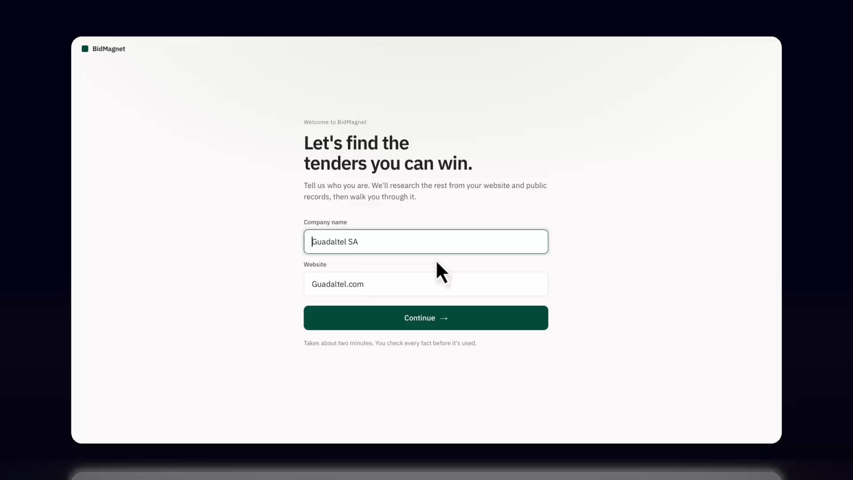

[Product screenshot or hero visual]
BID MAGNET · 04
Notes:
Placeholder. Suggested content: find relevant IT tenders early (including renewals), score each one bid/no-bid, then turn the tender documents into a cited checklist, admin pack, price simulation and first-draft technical proposal.

Slide 7
04 — HOW IT WORKS · A BID DECISION OUT, EVERY MORNING
1
2
3
4
COLLECT
CLEAN
STORE & SCORE
USE
Public tenders
Daily pipeline
Database
Web app
End User
AI assistant
Summaries · chat · drafts
BUILT IN
EU hosting
Each company sees only its own data
AI answers cite the source page
Data: PLACSP and regional platforms, official open data, refreshed daily at 07:30.
All figures cover Spanish public contracts only.
BID MAGNET · 06

Slide 8
05 — PRICING MODEL
BID PRO
€299/month
One free month trial: full product, no monthly charge.
+ 1% commission on won contracts
~ €8,388K
~ €4.6M
yearly revenue per customer for an average yearly contract size of €480K per firm
yearly revenue by year 5 from Spanish IT SMEs alone at an adoption rate of ~23% of target firm
BID MAGNET · 07
Notes:
Placeholder. Options to consider: a monthly subscription per company (tiered by number of bids or users), a per-bid fee for occasional bidders, or a success fee on contracts won. Tie the price to value: one extra contract won should pay for a year of Bid Magnet.

Slide 9
Win contracts.
Put money in your pocket.
BID MAGNET · TEAM 28
Notes:
Close on the tagline, the same line that opened the deck: win the contracts, put revenue in your pocket. [Add your ask here: what you want from the judges or the room.] Then thank them and open for questions.

Slide 10
06 — FEATURES
01
02
03
04
Discover
Qualify
Decide
Prepare
Daily import of every Spanish IT contract
Custom fit score for each tender
Swipe triage; interested, not for us
Filters: fit, deadline, budget, region, etc.
Upcoming renewals and early notices
Requirements pulled from tender documents
Checked against your profile
Source page linked for every requirement
Missing documents and certificates flagged
Who this buyer typically picks, and at what discount
Typical number of bidders
Similar contracts and who won them
Scout: AI answers on the tender documents
See which tenders are run 'a dedo'
Day by day plan to the deadline
Assign tasks, view to-do list
Price simulator with abnormally low check
Proposal outline and AI first draft
Final review checklist for every envelope
BID MAGNET · 09
Notes:
Placeholder. Stage labels follow the product overview: Discovery (unified feed, renewal radar), Qualification (eligibility, buyer and competition profile, fit score), Decision (go/no-go pipeline, partner finder), Bid preparation (cited checklist, admin pack, price simulator, proposal draft), Outcome (award tracking, win/loss).

Slide 11
07 — WHY BID MAGNET?
Bid Magnet
In-house teams
01
Bid only where you can win.
KNOWS YOUR COMPANY*
Company data used to fuel discovery
Gobierto
02
Builds a bid that won’t get thrown out
Automated compliance checks and first draft proposals
Tendios
Price simulator
03
See the average winning discount on similar contracts
Generic LLMs
04
Gets smarter with every bid
DoubleTrade
Your win/loss data sharpens future bids
KNOWS YOUR MARKET*
*Market: tenders, buyers, competitors, contracts expiring soon.
*Company: your team, experience gaps, past go/no-go decisions and results.
BID MAGNET · 10
Notes:
One line to land: everyone else knows the market or knows you, never both. Alert tools like DoubleTrade and generic LLMs know neither well. Gobierto and Tendios know the market but not your company. In-house teams know the company but lack market data. Bid Magnet sits alone top-right because every bid feeds its win/loss dataset. Then hit the four benefits: smarter with every bid, bid only where you can win, never lose on a technicality, see renewals months ahead. Our mission in one line: turning public tenders into revenue.

Slide 12
APPENDIX — REVENUE MODEL · €4.6M BY YEAR 5 THROUGH IT SMES
 | Year 1 | Year 2 | Year 3 | Year 4 | Year 5
Customers at year end | 58 | 150 | 278 | 446 | 657
Average paying customers in year | 29 | 104 | 214 | 362 | 552
Subscription revenue | €0.10M | €0.37M | €0.77M | €1.30M | €1.98M
Success-fee revenue | €0.14M | €0.50M | €1.03M | €1.74M | €2.65M
Total revenue | €0.24M | €0.87M | €1.80M | €3.04M | €4.63M
MARKET
PRICE PER CUSTOMER
METHOD & SCENARIOS
€4B IT contracts/yr; €1.4B won by SMEs
~2,900 target firms
TAM €40M · SAM €24.5M · SOM €4.6M
Subscription €3,588/yr (€299/month)
Success fees ~€4,800/yr
Total ~€8,388/yr per customer
Revenue = avg. customers × €8,388
Year 5 reaches ~23% of target firms
Assumes IT vertical only, expansion into other verticals or regions would see subsequent growth
Source: BidMagnet base-case model. Market: ~€4B Spanish public IT contracts a year.
All figures cover Spanish public contracts only.
BID MAGNET · 11

Slide 13
VALUE PROPOSITION · FROM TENDER FOUND TO BID SUBMITTED
€4B in public contracts went unawarded in 2025. Each lost bid burns ~35 hours.
SOLVES HARD TO FIND
SOLVES HARD TO BID
01 · DISCOVER
02 · QUALIFY
03 · DECIDE
04 · PREPARE
Never miss a relevant tender
Know upfront if you qualify
Bid only where you can win
Submit on time with less effort
Every Spanish IT tender, imported daily and scored for fit
Requirements checked against your profile, gaps flagged
Who this buyer picks, how many bid, and who won before
Day-by-day plan, price simulator and AI first draft
WHY US All four steps in one tool. Pay 1% only when you win.
BID MAGNET · 05
Notes:
Bid Magnet covers the whole journey in four steps. Discover fixes 'hard to find': every Spanish IT tender, imported daily and scored for fit. Qualify, Decide and Prepare fix 'hard to bid': we check the requirements against your profile, show who this buyer picks and who won before, then give you a day-by-day plan, a price simulator and an AI first draft. Full feature list in the appendix.

Slide 14
04 — HOW IT WORKS · A BID DECISION OUT, EVERY MORNING
1 · COLLECT
2 · CLEAN
3 · STORE & SCORE
4 · USE
Public tenders
PLACSP + regional platforms, official open data
Daily pipeline
Python · GitHub Actions. IT tenders only, daily at 07:30
Database
Supabase, EU (Ireland). 23,000+ IT tenders, fit score, likely winner
Web app
Next.js. Discover → Decide → Prepare the bid
SME
bid team
BUILT IN
AI assistant
Summaries · chat · drafts
EU hosting
Each company sees only its own data
AI answers cite the source page
Data: PLACSP and regional platforms, official open data, refreshed daily at 07:30.
All figures cover Spanish public contracts only.
BID MAGNET · 05

Slide 15

01 — PAIN POINT · HARD TO FIND, HARDER TO WIN
HARD TO FIND
HARD TO BID
REVENUE LEFT BEHIND
170K+
45%
€4.0B
public contracts tendered in 2025, scattered across national and regional platforms, with vague titles and eligibility rules buried in long documents
of central-government contracts got one valid bid or less (H1 2026). Complex specs, strict formats, and short deadlines push firms out
in public contracts went unawarded in 2025, with ~10K contracts getting no valid bid.
Sources: DoubleTrade; PLACSP & SEOPAN; OIReScon; Economía 3 via RSM (May–Aug 2026)
All figures cover Spanish public contracts only.
BID MAGNET · 02
Notes:
When a government body needs something, like new software, it can't just pick a supplier. It publishes a tender: an open competition where companies submit bids, and the best one wins.
Last year Spain published more than 170,000 of them, scattered across different platforms, with the rules buried in long documents.
So companies give up. This year, 45% of central-government contracts got one valid bid or none.
In 2025, €4 billion went unawarded. That's money that never reached the qualified companies who could have done the work.
We're here to change that.

Slide 16

Win Spanish IT SMEs first, then scale.
02 — CUSTOMER & GO-TO-MARKET
PHASE 1 · LAUNCH
€4.4B
Spanish IT SMEs
Spain IT
Technical proposals matter, buyers open to AI
2025
PHASE 2 · EXPAND
SMEs in every Spanish sector
€180B
Same product, new industry verticals.
All Spain · 2025
PHASE 3 · SCALE
SMEs across Europe
New countries and EU-level contracts. Spanish and English first.
€2.6T
EU, per year
Same tech throughout and same data in Phases 1 and 2 simplifies scaling
EC estimate
Sources: TendersTool via Computing (Feb 2026); PLACSP & SEOPAN (2026); European Commission
BID MAGNET · 11
Notes:
Click through from the inside out. Phase 1, launch: SMEs in Spanish public IT, a market of about 4.4 billion euros awarded in 2025 across roughly 12,800 contracts (TendersTool via Computing, Feb 2026). Why IT first: contracts are won on quality, not just price, so a better bid really moves the outcome; they carry heavy certification and compliance requirements, exactly where a copilot saves time; and IT buyers are the most open to trying an AI tool. Phase 2, expand: the same product and the same Spanish data sources cover SMEs in every sector, 180.6 billion euros of public contracts put out to tender in 2025 (PLACSP and SEOPAN). Phase 3, scale: EU public authorities spend around 2.6 trillion euros a year, about 15% of EU GDP (European Commission estimate); new countries need new data sources, but the technology is the same. Start with Spanish and English. If asked: IT spend fell from 5.9 billion in 2024; we prioritise recurring services contracts. The three figures measure slightly different things (awarded, tendered, total spend).

Slide 17
05 — PRICING MODEL
BID PRO
€299/month
One free month trial: full product, no monthly charge.
After that: €299/month for unlimited bidding and all features, plus 1% of any contract they win.
+ 1% success fee on every contract won
BID MAGNET · 06
Notes:
Placeholder. Options to consider: a monthly subscription per company (tiered by number of bids or users), a per-bid fee for occasional bidders, or a success fee on contracts won. Tie the price to value: one extra contract won should pay for a year of Bid Magnet.

