Slide 1
Data Warehousing

Slide 2
Data Warehouse
data warehouse is the foremost repository for the data available for developing business intelligence architectures and decision support systems.
Data Warehousing indicates the whole set of interrelated activities involved in designing, implementing and using a data warehouse.

Slide 3
Data Sources of Data Warehouse
Internal Data
External Data
Personal Data

Slide 4
Internal Data
Transactional or Operational Systems capturing day to day business processes
  back-ofﬁce systems, that collect basic transactional records such as orders, invoices, inventories, production and logistics data;
  front-ofﬁce systems, that contain data originating from call-center activities, customer assistance, execution of marketing campaigns;
  web-based systems, that gather sales transactions on e-commerce web sites, visits to websites, data available on forms ﬁlled out by existing and prospective customers.

Slide 5
External Data
Data present externally to an organization
  For example:
    Some agencies gather and make available data relative to sales, market share and future trend predictions for speciﬁc business industries, as well as economic and ﬁnancial indicators.
    Other agencies provide data market surveys and consumer opinions collected through questionnaires.
    Geographic Information Systems (GIS), which represent a set of applications for acquiring, organizing, storing and presenting territorial data.

Slide 6
Personal Data
Information and Personal Assessments stored inside worksheets or local databases located in their computers.

Slide 7
OLTP versus OLAP
Software applications that are at the heart of operational systems are referred to as on-line transaction processing (OLTP).
The whole set of tools aimed at performing business intelligence analyses and supporting decision-making processes go by the name of on-line analytical processing (OLAP).
The function of a data warehouse is to provide input data to OLAP applications.

Slide 8
OLTP versus OLAP
Several reasons for implementing a data warehouse separately from the databases supporting OLTP applications in an enterprise
  Integration
    Data originating from several data sources.
    Data Integration
  Quality
    Examined and corrected inorder to obtain reliable and error-free information → increase the practical values of BI

Slide 9
OLTP versus OLAP
  Efficiency
    Quries extracting info from BI may turn out to be burdensome inform of computing resources and processing time
  Extendibility
    Data stored in transactional systems has limited time span
      Limitation of memory
    BI needs to access all available past data and tries to predict pattern.

Slide 10
OLTP versus OLAP
Data warehouse characteristics w.r.t decision-making processes and BI
  Entity-oriented
    Data in this is mainly concerned with the main entities of interest for analysis
    Examples: products, customers, etc
  Integrated
    Integrated and homogenized
    Example: measurement units and encodings are harmonized and made consistent

Slide 11
OLTP versus OLAP
Data warehouse characteristics w.r.t decision-making processes and BI
  Time-variant
    All data entered in a data warehouse are labeled with the time period to which they refer.
    Data stored in DW to a sequence of nonvolatile snapshot pictures.
    Helps in developing historical trend analysis.
  Persistent
    Once data stored in DW, data are usually not modified and held permanently.
    Read only access to user → avoid concurrency

Slide 12
OLTP versus OLAP
Data warehouse characteristics w.r.t decision-making processes and BI
  Consolidated
    Some data stored in a data warehouse are obtained as partial summaries of primary data belonging to the operational systems from which they originate.
    Uses: Reduction in Space and Consolidated data may meets the needs of BI
  Denormalized
    Have provision of redundancies.

Slide 13
OLTP versus OLAP
Granularity represents the highest level of detail expressed by the primary data contained in a data warehouse, also referred to as atomic data.
In general, it is strictly lower due to consolidation aimed at reducing storage occupancy

Slide 14
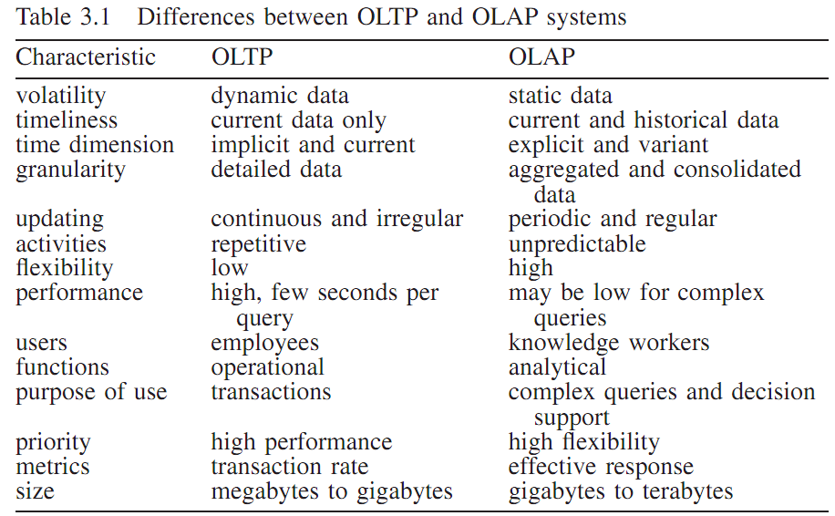

Slide 15
Data Marts
Functional or departmental data warehouse of a smaller size and a more speciﬁc type than the overall company data warehouse.
Managed by company departments.
Data warehouses and data marts thus share the same technological framework.
Incremental design of integrated data marts

Slide 16
Data marts
Data Quality
  need to verify, preserve and improve the quality of data is a constant concern of those responsible for the design and updating of a data warehouse.
  The main problems that might compromise the validity and integrity of the data.

Slide 17
Data marts
Data Quality : factors effects
  Accuracy →
  Completeness → less # of missing values
  Consistency → form and content of the data must be consistent after integration w.r.t concurrency, etc
  Timeliness → frequent updating based on objective of analysis.
  Non-redundancy → waste of memory
  Relevance → relevant to needs of BI
  Interpretability → well understood
  Accessibility → easily accessible

Slide 18
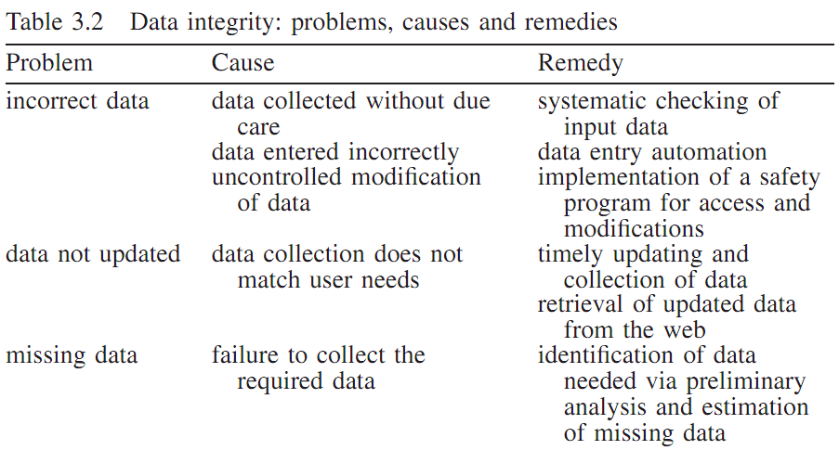

Slide 19
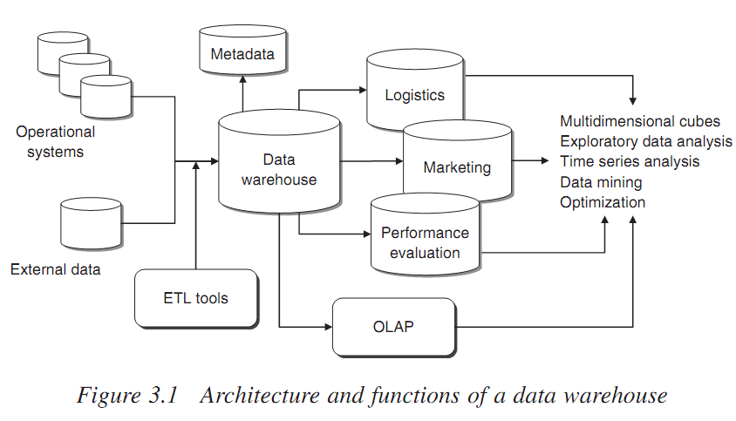
Architecture & Functions of a DW

Slide 20
Data Warehouse: Implementation Approach
Top-down. The top-down methodology is based on the overall design of the data warehouse, and is therefore more systematic. However, it implies longer development times and higher risks of not being completed within schedule since the whole data warehouse is actually being developed.
Bottom-up. The bottom-up method is based on the use of prototypes and therefore system extensions are made according to a step-by-step scheme. This approach is usually quicker, provides more tangible results but lacks an overall vision of the entire system to be developed.
Mixed. The mixed methodology is based on the overall design of the data warehouse, but then proceeds with a prototyping approach, by sequentially implementing different parts of the entire system. This approach is highly practical and usually preferable, since it allows small and controlled steps to be taken while bearing in mind the whole picture.

Slide 21
Data Warehouse: Implementation Approach
The steps in the development of a data warehouse or a data mart can be summarized as follows
  One or more processes within the organization to be represented in the data warehouse are identified, such as sales, logistics or accounting
  The appropriate granularity to represent the selected processes is identified and the atomic level of the data is defined.
  The relevant measures to be expressed in the fact tables for multidimensional analysis
  Finally, the dimensions of the fact tables are determined.

Slide 22
ETL Tools
Extraction. During the ﬁrst phase, data are extracted from the available internal and external sources.
Transformation. The goal of the cleaning and transformation phase is to improve the quality of the data extracted from the different sources, through the correction of inconsistencies, inaccuracies and missing values. Some of the
Loading. Finally, after being extracted and transformed, data are loaded into the tables of the data warehouse to make them available to analysts and decision support applications.

Slide 23
Cubes and multidimensional analysis
Design of DW and DM are based on a multidimensional paradigm for data representation.
This approaches provides two major advantages:
  Functional Side: it can guarantee fast response times even to complex queries
  Logical Side: the dimensions are helpful in analysis
multidimensional representation is based on a star schema which contains two types of data tables
  Dimension tables
  Fact tables

Slide 24
Cubes and multidimensional analysis
Dimension tables:
  Dimensions are associated with the primary entities in DW.
  Derived from master table stored in OLTP. Ex: customer, etc.
  Each dimension table is often internally structured according to hierarchical relationships
  Example: {street, zip code, city, province, region, country, area} of location table
Flat tables:
  Fact tables usually refer to transactions.
  It contains two types of data
    links to dimension tables,
    numerical values of the attributes
  Example: sales transactions and make reference to several dimension tables, customers, points of sale, products, suppliers, time

Slide 25
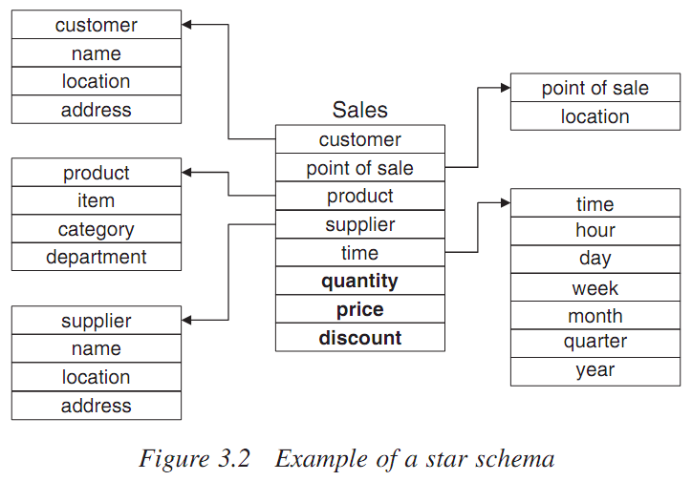
Dimensional Model: Star Schema

Slide 26
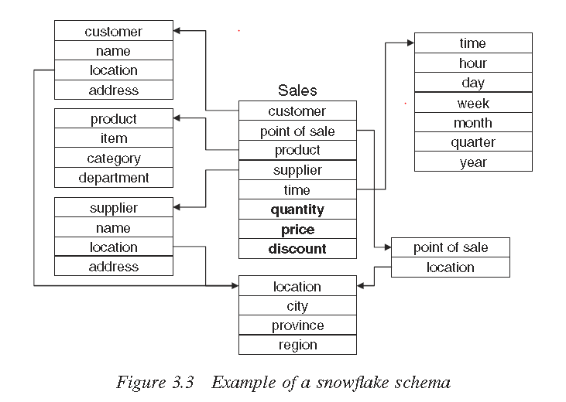
Dimensional Model: Snowflake Schema

Slide 27
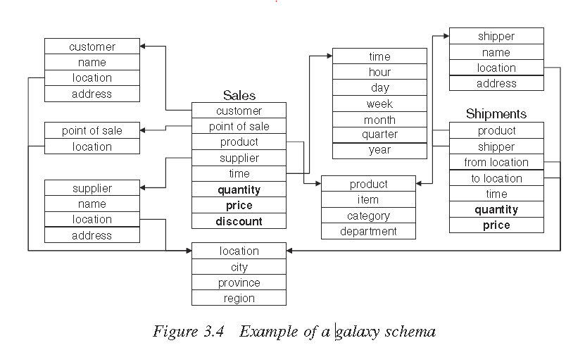
Dimensional Model: Galaxy Schema

Slide 28
Cubes and multidimensional analysis
A fact table connected with n dimension tables may be represented by an n-dimensional data cube.
Multidimensional cubes are a natural extension of the two-dimensional
Example: a sales fact table developed along the three dimensions of {time, product, region}
  select only two dimensions for the analysis, such as {time, product} having present the region attribute along the three values {USA,Asia, Europa}.
  In this way we obtain the three two-dimensional tables in which the rows correspond to quarters of a year and the columns to products

Slide 29
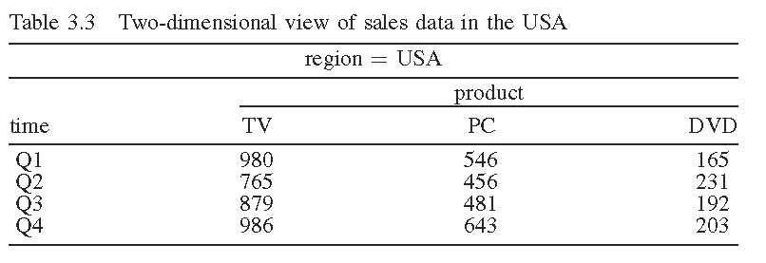
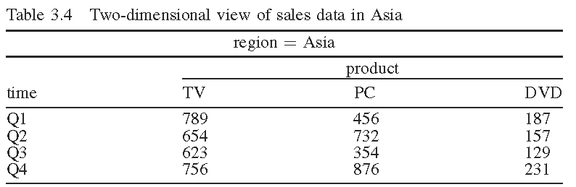
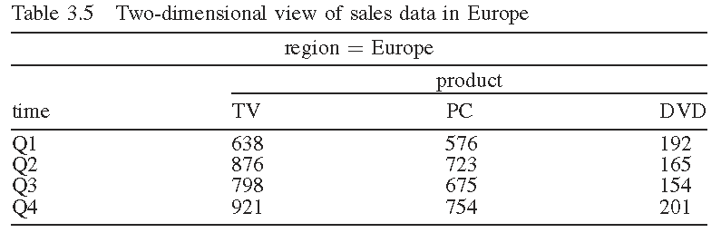
Three-Dimensional Cube

Slide 30
Three-Dimensional Cube
Atomic data are represented by 36 cells that can be obtained by crossing all possible values along the three dimensions:
  Time {Q1, Q2, Q3, Q4}
  region {USA, Asia, Europa}
  product {TV, PC, DVD}
These atomic cells can be supplemented by 44 cells corresponding to the summary values
If the sales fact table contains suppliers → four dimensional space → graphically difficult → four logical views composed of three-dimensional cubes → cuboids → inside the four-dimensional cube, by fixing the values of one dimension.

Slide 31
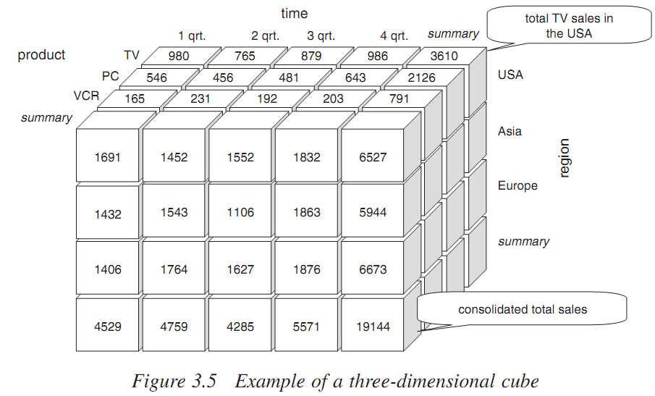
Three-Dimensional Cube

Slide 32
Three-Dimensional Cube
If a fact table linked to n dimension tables, then it is possible to obtain a lattice of cuboids, each of them corresponding to a different level of consolidation along one or more dimensions.
This type aggregation is equivalent in SQL to a query SUM derived from a group-by condition.
In the following figure, the lattice composed by the cuboids obtained from the data cube defined along the four dimensions {time, product, region, supplier}
The cuboid associated with the atomic data, which therefore does not imply any type of consolidation, is called a base cuboid.
The apex cuboid is defined as the cuboid corresponding to the consolidation along all dimensions → grand total

Slide 33
Hierarchies of concepts and OLAP operations
OLAP analyses are based on hierarchies of concepts to consolidate the data and to create logical views along the dimensions of a data warehouse.
A concept hierarchy defines a set of maps from a lower level of concepts to a higher level.
Example: {Location} dimension may originated a totally ordered hierarchy.
Specific hierarchy types may be predefined in the software platform used for the creation and management of a data warehouse.
Hierarchies of concepts are also used to perform several visualization operations dealing with data cubes in a data warehouse.
Roll-up, Roll-down and Slice and Dice

Slide 34
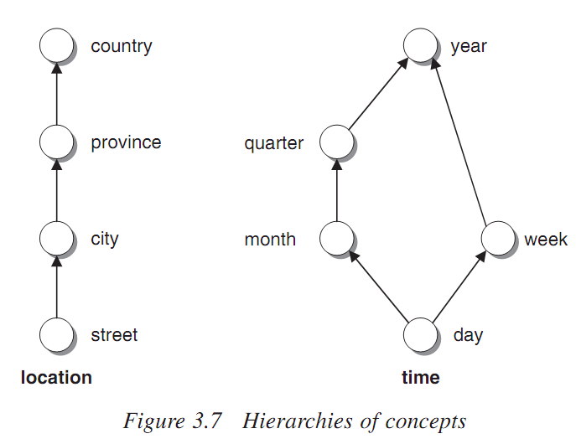
Hierarchies of concepts and OLAP operations
Drill-Down
Drill Up
Slice & Dice
Pivot

Slide 35
Materialization of cubes of data
OLAP analyses developed by knowledge workers may need to access the information associated with several cuboids, based on the speciﬁc queries and analyses being carried out.
In order to guarantee adequate response time, it might be useful to design a data warehouse where all (or at least a large portion of) values of the measures of interest associated with all possible cuboids are pre-calculated.
This approach is termed full materialization of the information relative to the data cubes.

