Slide 1
Performance Evalution and Prediction

Slide 2
Evaluating Predictive Performance
Ramesh Ragala
VIT Chennai

Slide 3
Introduction
Need for Evaluate:
Multiple methods are available to classify or predict
For each method, multiple choices are available for settings
To choose best model, need to assess each model’s performance

Slide 4
Introduction
In supervised learning, the users are interested in predicting the outcome variable for new record.
Three types of outcomes of interested:
Predicted numerical value → Outcome variable is numerical and continuous (Example: House Price)
Predicted class membership → Outcome variable is categorical (Buyer / non-buyer)
Propensity → Probability of class membership when the outcome variable is categorical (The propensity to default)

Slide 5
Introduction
Prediction methods are used for generating numerical predictions
Classification methods are used for generating propensities. → using cutoff value on the propensities, we can generate predicted class membership.
A subtle distinction to keep in mind is the two distinct predictive uses of classifier:
1. classification, aimed at predicting class membership for new record
2. Ranking, is detecting among a set of new records the ones most likely to belong to a class of interest

Slide 6
Evaluating predictive performance
Predictive accuracy is not the same as goodness-of-fit.
Classical statistical measures of performance are aimed at finding a model that fits well to the data on which the model was trained.
In data mining, we are interested in models which have high predictive accuracy when we applied on new records.
Measure such as, R² and standard error of estimate are used in classical regression model and residual analysis is used to gauge goodness-of-fit.
There are several measures are available for assessing prediction performance. → these measures are using validation set only.

Slide 7
Evaluating predictive performance
Average outcome is the benchmark criterion in prediction.
Simply, the prediction for new record is the average outcome of the records in the training set.
A good predictive model should outperform the benchmark criterion in terms of predictive accuracy.

Slide 8
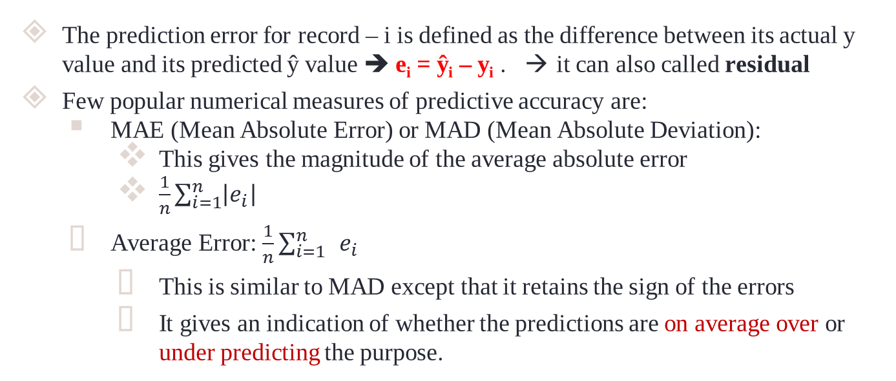
Prediction Accuracy Measures
The prediction error for record – i is defined as the difference between its actual y value and its predicted ŷ value ➔ e_{i} = ŷ_{i} – y_{i} . → it can also called residual
Few popular numerical measures of predictive accuracy are:
MAE (Mean Absolute Error) or MAD (Mean Absolute Deviation):
This gives the magnitude of the average absolute error
$\frac{1}{n}\sum_{i=1}^{n}{\left|e_{i}\right| }$
Average Error: $\frac{1}{n}\sum_{i=1}^{n}{ }e_{i}$
This is similar to MAD except that it retains the sign of the errors
It gives an indication of whether the predictions are on average over or under predicting the purpose.

Slide 9
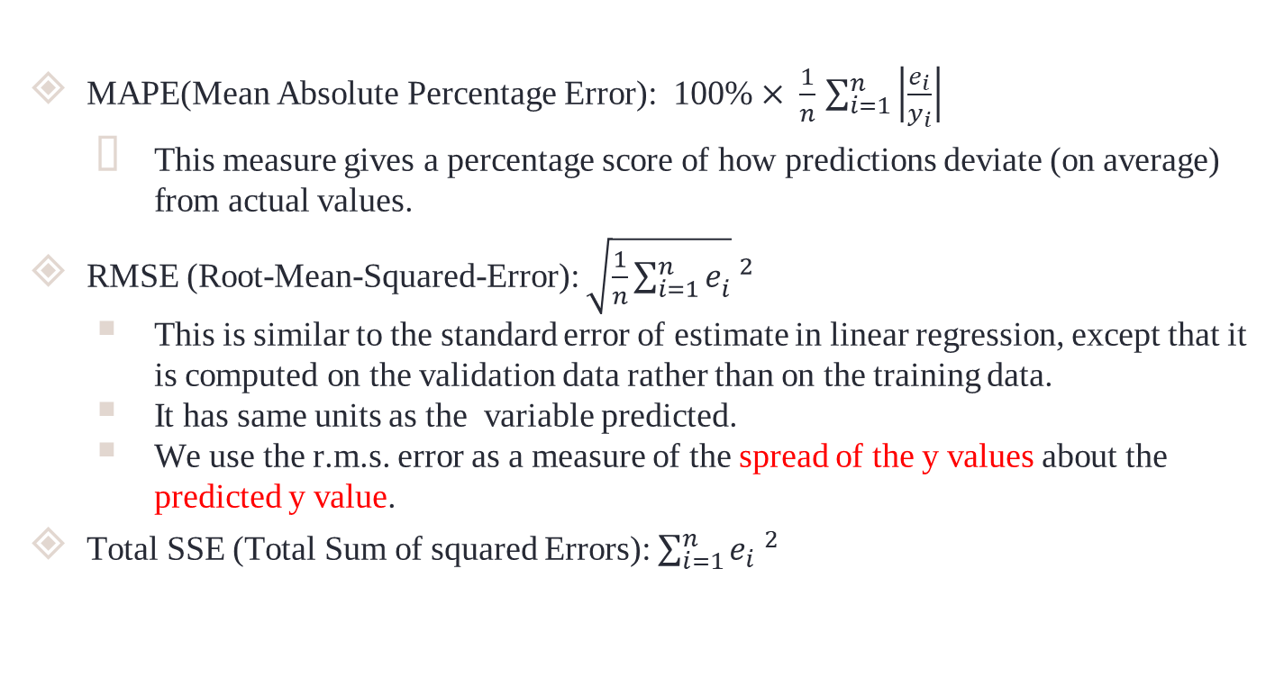
Prediction Accuracy Measures
MAPE(Mean Absolute Percentage Error): 100% $× \frac{1}{n}$ $\sum_{i=1}^{n}{\left|\frac{e_{i}}{y_{i}}\right|}$
This measure gives a percentage score of how predictions deviate (on average) from actual values.
RMSE (Root-Mean-Squared-Error): $\sqrt{\frac{1}{n}\sum_{i=1}^{n}{e_{i}^{}}} ^{2}$
This is similar to the standard error of estimate in linear regression, except that it is computed on the validation data rather than on the training data.
It has same units as the variable predicted.
We use the r.m.s. error as a measure of the spread of the y values about the predicted y value.
Total SSE (Total Sum of squared Errors): $\sum_{i=1}^{n}{e_{i} ^{2}}$

Slide 10
Prediction Accuracy Measures
These models are used to compare models and to asses their degree of prediction accuracy.
All these measure are influenced by outliers.
Median – base measures or histograms or boxplot errors are used to check outlier influence.
Plotting the prediction error’s distribution is useful and highlight more information than the metrics alone.

Slide 11
Prediction Accuracy Measures
Prediction Accuracy Measure and Charts of Prediction Error Distribution
Dataset → Used Toyota Corolla Cars
Training dataset → 600 cars
Testing dataset → 400 cars
The results of fitting a certain predictive model to prices of used Toyota cars.
Residuals based on training set informs about model fit.
Residuals based on the validation set predicts the model ability to predict new data.
Usually, we except training errors to be smaller than the validation errors.
More complex model → more possibility that, it will overfit the training data (Indicated by a greater difference between training and validation errors)
In an extreme case of overfitting, the training error would be zero → i.e perfect fit of the model to the training data → and validation errors would be zero and nonnegligible.

Slide 12
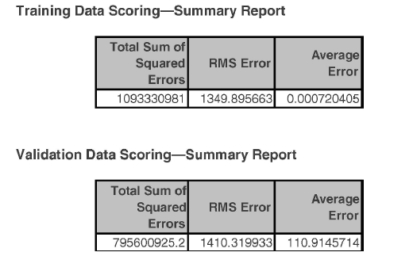
Prediction Accuracy Measures

Slide 13
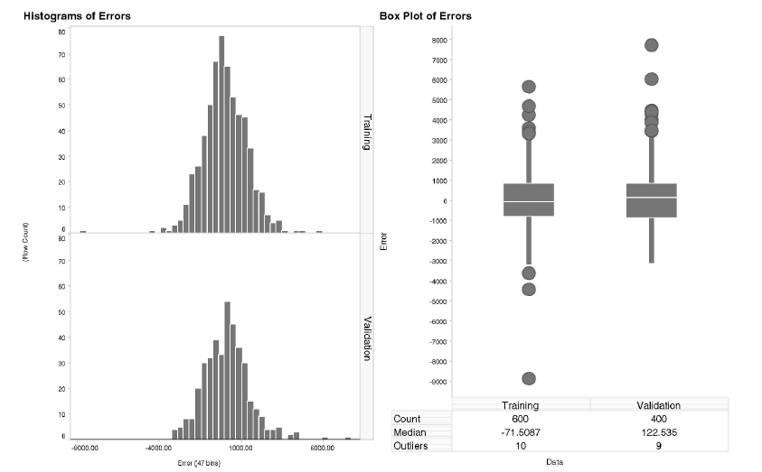
Prediction Accuracy Measures

Slide 14
Prediction Accuracy Measures
Comparing Training and Validation Performance:
Residuals based on training set informs about model fit.
Residuals based on the validation set predicts the model ability to predict new data.
Residuals based on the validation set is called “Prediction errors”
Model ability to predict new data is called “Predictive performance”
Usually, we except training errors to be smaller than the validation errors.
More complex model → more possibility that, it will overfit the training data (Indicated by a greater difference between training and validation errors)
In an extreme case of overfitting, the training error would be zero → i.e perfect fit of the model to the training data → and validation errors would be zero and non-negligible. → so we need to compare error plots and metrics (RMSE,etc) of the training and validation datasets.

Slide 15
Prediction Accuracy Measures
Comparing Training and Validation Performance:
The charts are more useful to give information about errors or outliers than metrics
The boxplot of Toyoto car dataset shows that, the discrepancies are also due to outliers, and especially large negative training error.
The validation errors have slightly more high positive errors (underpredictions) than the training errors, as reflected by the medians and outliers.

Slide 16
Prediction Accuracy Measures
Lift Charts:
In some applications, the goal is to search, among the set of new records, for a subset of records that gives the highest cumulative predicted values.
Lift is a measure of the effectiveness of a predictive model calculated as the ratio between the results obtained with and without the predictive model.
Cumulative gains and lift charts are visual aids for measuring model performance.
Both charts consist of a lift curve and a baseline (that does not have any predictors).
The greater the area between the lift curve and the baseline, the better the model.
A lift chart for a continuous response is relevant only when we are searching for a set of records that gives the highest cumulative predicted values.

Slide 17
Prediction Accuracy Measures
Lift Charts: CASE STUDY
Consider a car rental firm that renews its fleet so that customers drive late-model cars. This entails disposing of a large quantity of used vehicles on a continuing basis. Since the firm is not primarily in the used car sales business, it tries to dispose of as much of its fleet as possible through volume sales to used car dealers. However, it is profitable to sell a limited number of cars through its own channels. Its volume deals with the used car dealers allow it flexibility to pick and choose which cars to sell in this fashion, so it would like to have a model for selecting cars for resale through its own channels. Since all cars were purchased some time ago and the deals with the used car dealers are for fixed prices (specifying a given number of cars of a certain make and model class), the cars’ costs are now irrelevant and the dealer is interested only in maximizing revenue. This is done by selecting for its own resale, the cars likely to generate the most revenue

Slide 18
Prediction Accuracy Measures
Lift Charts:
The lift chart is based on ordering the set of records of interest (validation data) by their predicted value, from high to low.
Then, accumulate the actual values and plot their cumulative value on the y-axis as a function of the number of records accumulated (the x-axis value).
This curve is compared to assigning a naive prediction (ẏ) to each record and accumulating these average values, which results in a diagonal line.
The further away the lift curve from the diagonal benchmark line, the better the model is doing in separating records with high value outcomes from those with low value outcomes.

Slide 19
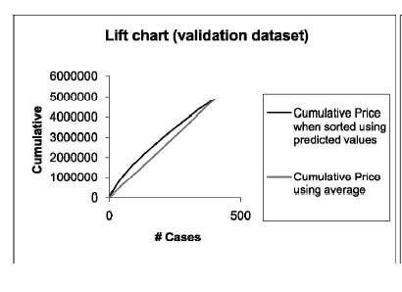
Prediction Accuracy Measures
Lift charts based on fitting a linear regression model to the Toyota data.
The charts are based on validation dataset only.
Observation: Model’s predictive performance in terms of lift is better than the baseline model → lift curve is higher than the baseline model.
Lift chart based on fitting a linear regression model to Toyota Dataset.

Slide 20

Prediction Accuracy Measures
Lift Charts: CASE STUDY – 2
A company wants to do a mail marketing campaign. It costs the company $1 for each item mailed. They have information on 100,000 customers. Create a cumulative gains and a lift chart from the following data.
Overall Response Rate: If we assume we have no model other than the prediction of the overall response rate, then we can predict the number of positive responses as a fraction of the total customers contacted. Suppose the response rate is 20%. If all 100,000 customers are contacted we will receive around 20,000 positive responses.

Slide 21
Prediction Accuracy Measures
Cost($) | Total Customers Contacted | Positive Responses(x) | Responses in % (x/20000)
10000 | 10000 | 6000 | 30
20000 | 20000 | 10000 | 50
30000 | 30000 | 13000 | 65
40000 | 40000 | 15800 | 79
50000 | 50000 | 17000 | 85
60000 | 60000 | 18000 | 90
70000 | 70000 | 18800 | 94
80000 | 80000 | 19400 | 97
90000 | 90000 | 19800 | 99
100000 | 100000 | 20000 | 100
Lift Charts: CASE STUDY – 2
Prediction of Response Model: A response model predicts who will respond to a marketing campaign. If we have a response model, we can make more detailed predictions. For example, we use the response model to assign a score to all 100,000 customers and predict the results of contacting only the top 10,000 customers, the top 20,000 customers, etc.

Slide 22
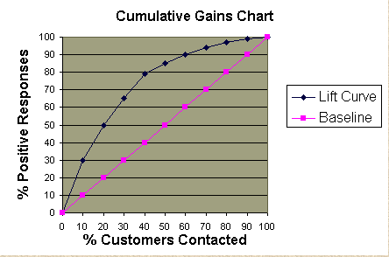
Prediction Accuracy Measures
Cumulative Gains Chart:
The y-axis shows the percentage of positive responses. This is a percentage of the total possible positive responses (20,000 as the overall response rate shows).
The x-axis shows the percentage of customers contacted, which is a fraction of the 100,000 total customers.
Baseline (overall response rate): If we contact X% of customers then we will receive X% of the total positive responses.
Lift Curve: Using the predictions of the response model, calculate the percentage of positive responses for the percent of customers contacted and map these points to create the lift curve.

Slide 23
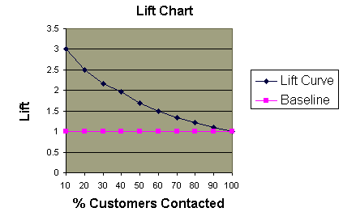
Prediction Accuracy Measures
Lift Chart:
Shows the actual lift
Calculate the points on the lift curve by determining the ratio between the result predicted by our model and the result using no model.
Example: For contacting 10% of customers, using no model we should get 10% of responders and using the given model we should get 30% of responders. The y-value of the lift curve at 10% is
30 / 10 = 3

Slide 24
Prediction Accuracy Measures
Lift Chart: CASE STUDY – 2 → Observation
Analyzing the Charts:
Cumulative gains and lift charts are a graphical representation of the advantage of using a predictive model to choose which customers to contact.
The lift chart shows how much more likely we are to receive respondents than if we contact a random sample of customers. → Example: by contacting only 10% of customers based on the predictive model we will reach 3 times as many respondents as if we use no model.
Evaluating the model:
We can assess the value of a predictive model by using the model to score a set of customers and then contacting them in this order.
The actual response rates are recorded for each cutoff point, such as the first 10% contacted, the first 20% contacted, etc

Slide 25
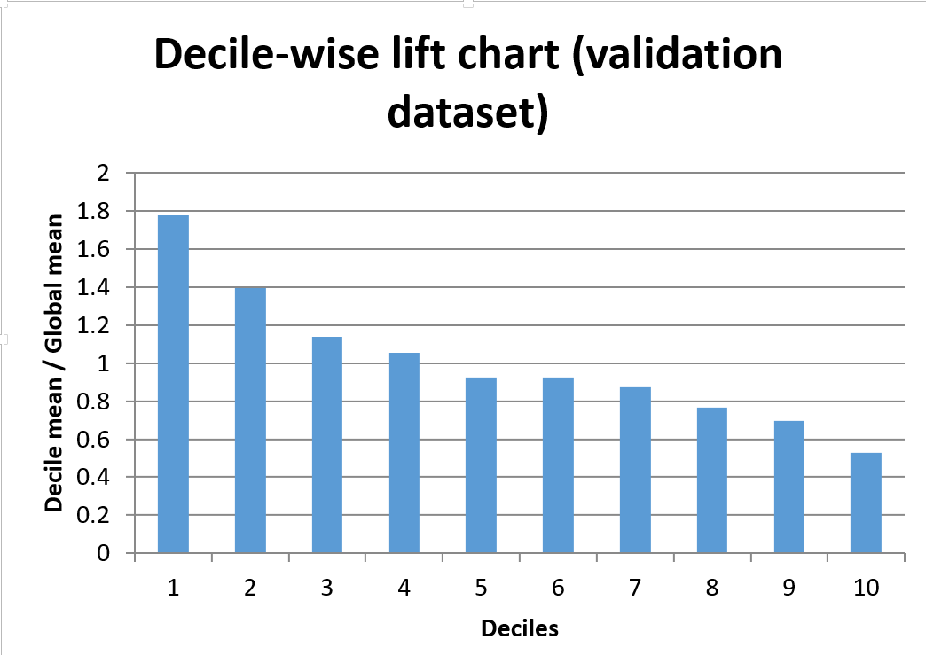
Prediction Accuracy Measures
Decile-wise lift Chart:
Order predicted y-value from highest to lowest
X-axis = % of cases from 10% to 100%
i.e. 1st decile to 10th decile
Y-axis = Cumulative predicted value of Y
For each decile the ratio of sum of ŷ and sum of  is potted
Decile-wise chat based on fitting a linear regression model to Toyota Dataset.

Slide 26
Prediction Accuracy Measures
The Lift and Decile-wise Charts are helpful in following scenario:
Choosing the top 10% of the cars that gave the highest predicted sales.
Example: we would gain 1.7 times the amount of revenue, compared to choosing 10% of the cars at random → This can be seen from the decile chart.
This number can also be computed from the lift chart by comparing the sales for 40 random cars (the value of the baseline curve at x = 40), which is $486,871 (= the sum of the actual sales for the 400 validation set cars divided by 10) with the actual sales of the 40 cars that have the highest predicted values (the value of the lift curve at x = 40), $835,883. The ratio between these numbers is 1.7.

Slide 27
Judging Classifier Performance
Many choice of classifiers and predictive methods → need for performance
Many options in a single method (predictive / classification methods) which can leads to different results
Example: Choice of predictors used within a particular predictive algorithm
Natural Criteria:
Judging the performance of a classifier is the probability of making a misclassification error.
Misclassification:
It means that the record belongs to one class but the model classifies it as a member of a different class.
Due to noise and lack in all information needed for classification, classifier can makes errors.

Slide 28
Judging Classifier Performance
Benchmark: The Naïve Rule
A simple rule for classifying a record into one of m – classes, ignoring all predictor information (x₁; x₂; …; x_{p}) that we may have, is to classify the record as a member of the majority class.
Simply → “ classify as belonging to the most prevalent class”
This rules is used for evaluating more complicated classifiers.
Classifier that uses external predictor information should outperform the naive rule.
There are various performance measures based on the naive rule that measure how much better than the naïve rule a certain classifier performs.
Example: Multiple R² →which measures the distance between the fit of the classifier to the data the fit of the naïve rule to the data
The naïve rule for classification relies solely on the y information and excludes any additional predictor information.

Slide 29
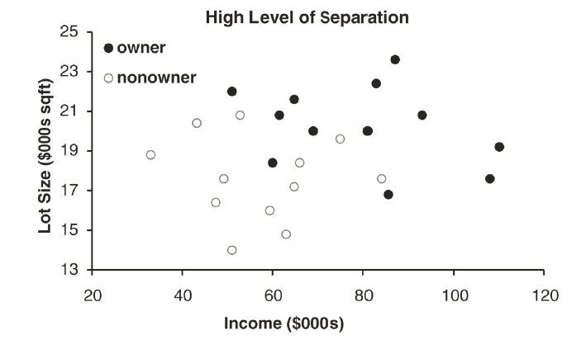
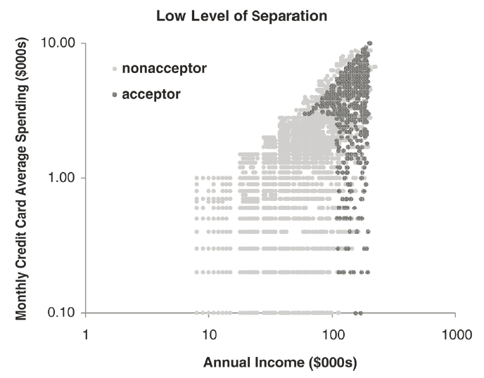
Judging Classifier Performance
Benchmark: The Naïve Rule :: Class Separation
If the classes are well separated by the predictor information, even a small dataset will suffice in finding a good classifier.
if the classes are not separated at all by the predictors, even a very large dataset will not help.

Slide 30
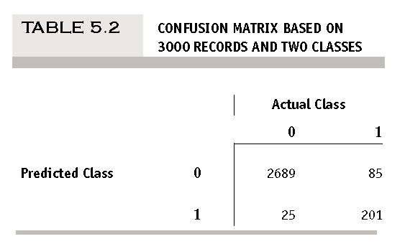
Judging Classifier Performance
Benchmark: The Naïve Rule :: Confusion (Classification) Matrix
Generally, most accuracy measures are derived from the confusion matrix.
This matrix summarizes the correct and incorrect classifications that a classifier produced for a certain dataset.
Rows of the confusion matrix corresponds to the predicted classes.
Columns of the confusion matrix corresponds to the true (actual) classes.
Two diagonal cells (upper left, lower
right) gives the # of correct classification
Off-diagonal cells gives # of misclassification
It gives the estimation of the true
classification and misclassification

Slide 31
Judging Classifier Performance
Benchmark: The Naïve Rule :: Using Validation Data
To get honest estimate of future classification error, we use the confusion matrix that is computed from the validation data.
Simply, partition the data into training and validation sets by randomly.
Construct the classifier using the training data and then apply it to the validation data. → it gives the predicted classifications for records in validation data. → now construct the confusion matrix.
We can construct confusion matrix for training data also. But it is not useful for getting honest estimation of the misclassification rate for new data due to the danger of overfitting.
To detect overfitting → compare confusion matrix on validation dataset summary with confusion matrix on training dataset → large discrepancy.

Slide 32
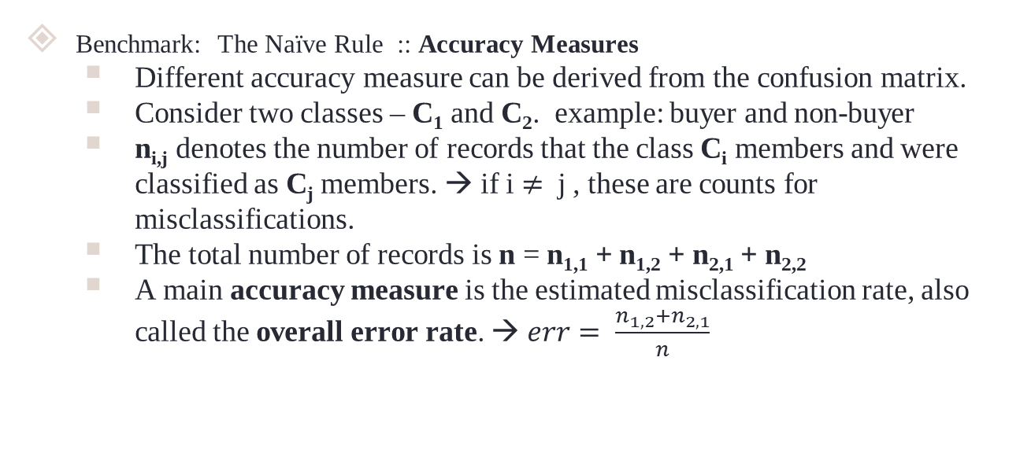
Judging Classifier Performance
Benchmark: The Naïve Rule :: Accuracy Measures
Different accuracy measure can be derived from the confusion matrix.
Consider two classes – C₁ and C₂. example: buyer and non-buyer
n_{i,j} denotes the number of records that the class C_{i} members and were classified as C_{j} members. → if i $≠$ j , these are counts for misclassifications.
The total number of records is n = n_{1,1} + n_{1,2} + n_{2,1} + n_{2,2}
A main accuracy measure is the estimated misclassification rate, also called the overall error rate. → $err= \frac{n_{1,2}+n_{2,1}}{n}$

Slide 33
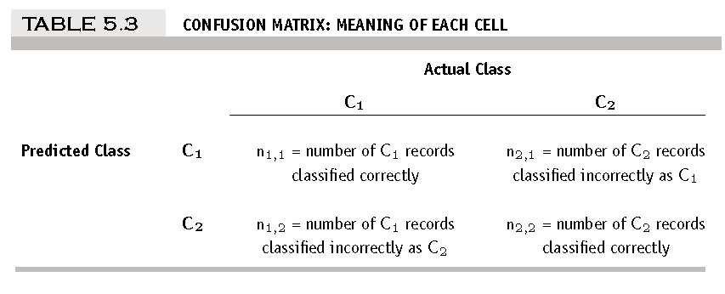
Judging Classifier Performance
Benchmark: The Naïve Rule :: Accuracy Measures

Slide 34
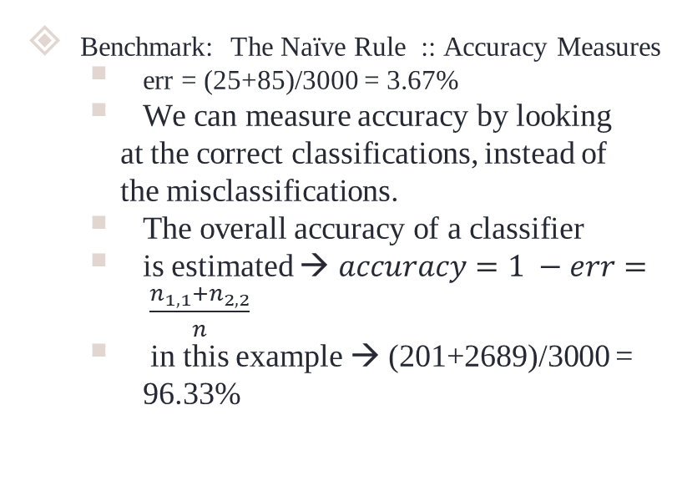
Judging Classifier Performance
Benchmark: The Naïve Rule :: Accuracy Measures
err = (25+85)/3000 = 3.67%
We can measure accuracy by looking
at the correct classifications, instead of
the misclassifications.
The overall accuracy of a classifier
is estimated → $accuracy=1 −err= \frac{n_{1,1}+n_{2,2}}{n}$
in this example → (201+2689)/3000 = 96.33%

Slide 35
Judging Classifier Performance
Propensities and Cutoff for Classification:
The first step in classification algorithms is to estimate the probability that a record belongs to each of the classes. → These probabilities are also called propensities.
Propensities are typically used either as
1. An interim step for generating predicted class membership (classification)
2. For rank-ordering the records by their probability of belonging to a class of interest.
If overall classification accuracy (involving all the classes) is of interest, the record can be assigned to the class with the highest probability.

Slide 36
Judging Classifier Performance
Propensities and Cutoff for Classification:
In many records, a single class is of special interest, so we will focus on that particular class and compare the propensity of belonging to that class to a cutoff value set by the analyst.
This approach can be used with two classes or more than two classes.
If the probability of belonging to the class of interest is above the cutoff, the record is assigned to that class.
The default cutoff value in two-class classifiers is 0.5.
If the probability of a record being a class C₁ member is greater than 0.5, that record is classified as a C₁.
Any record with an estimated probability of less than 0.5 would be classified as a C₂.
The misclassification rate will rise in either case.

Slide 37
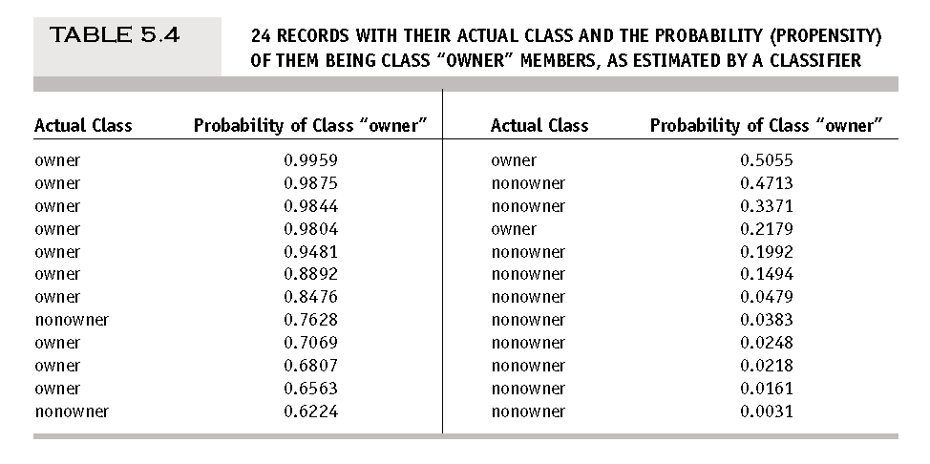
Judging Classifier Performance

Slide 38
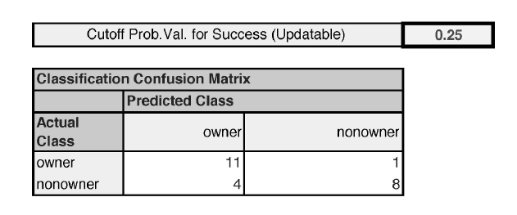
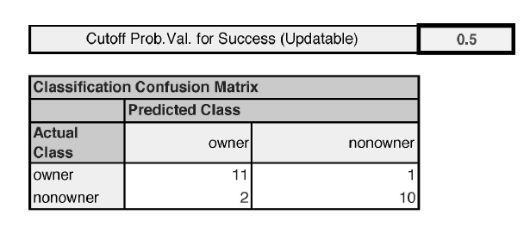
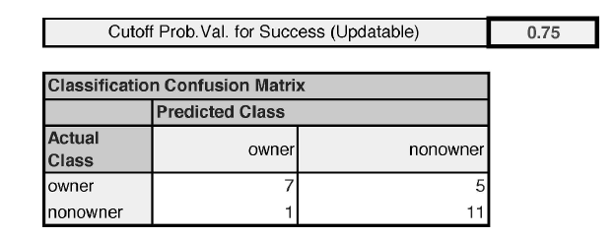
Judging Classifier Performance

Slide 39
Judging Classifier Performance
If we adopt the standard 0.5 as the cutoff, our misclassification rate is 3/24.
if we adopt a cutoff of 0.25, we can classify more records as owners and the misclassification rate goes up to 5/24.
if we adopt a cutoff of 0.75, we classify fewer records as owners. → misclassification rate goes up to 6/24.

Slide 40
Performance in Unequal Importance of Classes
Suppose that it is more important to predict membership correctly in class C₁ than in class C₂
Example: predicting the financial status → (bankrupt/solvent)
In such a case, the overall accuracy is not a good measure for evaluating the classifier.
The pair of accuracy measures are the most popular:
Sensitivity (Recall):
a classifier is its ability to detect the important class members correctly → This is measure by n_{1,1} / (n_{1,1} + n_{2,2}) , the percentage of C₁ members classified correctly. →Hit rate = True Positive rate
Specificity:
a classifier is its ability to rule out C₂ members correctly. → This is measure by n_{2,2} / (n_{2,1} + n_{2,2}) , the percentage of C₂ members classified correctly. → 1 – Specificity = False Positive rate

Slide 41
Performance in Unequal Importance of Classes
ROC Curve: (Receiver Operating Characteristic)
A more popular method for plotting the two measures is through ROC
Starting from the lower left, the ROC curve plots the pairs {sensitivity, specificity} as the cutoff value descends from 1 to 0.
Better performance is reflected by curves that are closer to the top-left corner.
The comparison curve is the diagonal, which reflects the performance of the naive rule, using varying cutoff values
A common metric to summarize an ROC curve is “area under the curve (AUC),” which ranges from 1 (perfect discrimination between classes) to 0.5 (no better than the naïve rule).

Slide 42
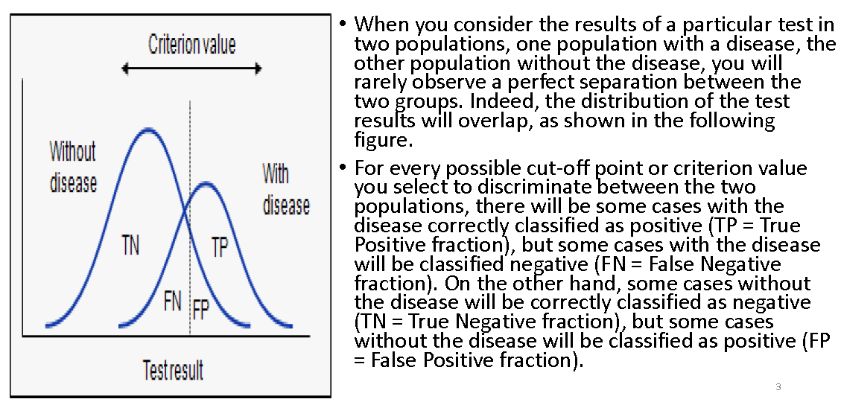
Performance in Unequal Importance of Classes
ROC Curve: (Receiver Operating Characteristic)

Slide 43
Performance in Unequal Importance of Classes
ROC Curve: (Receiver Operating Characteristic)
It is a plot of the true positive rate against the false positive rate.
The relationship between sensitivity and specificity. → a decrease in sensitivity results in an increase in specificity.
Test accuracy; the closer the graph is to the top and left-hand borders, the more accurate the test. Likewise, the closer the graph to the diagonal, the less accurate the test.
A perfect test would go straight from zero up the top-left corner and then straight across the horizontal.
The likelihood ratio; given by the derivative at any particular cut point.

Slide 44
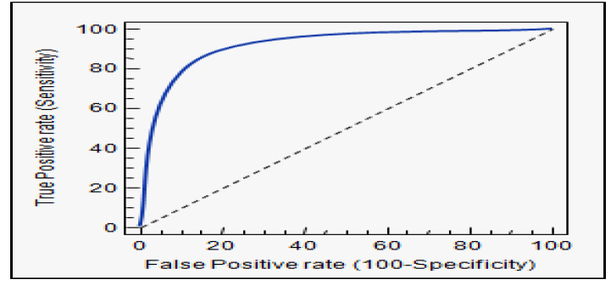
Performance in Unequal Importance of Classes
ROC Curve: (Receiver Operating Characteristic)

Slide 45
Performance in Unequal Importance of Classes
ROC Curve: (Receiver Operating Characteristic)
Specificity is a performance measure of the whole negative part of a dataset.
Sensitivity is a performance measure of the whole positive part.
The ROC plot uses 1 – specificity on the x-axis and sensitivity on the y-axis.
False positive rate (FPR) is identical with 1 – specificity, and true positive rate (TPR) is identical with sensitivity.
A ROC point is a point with a pair of x and y values in the ROC space where x is 1 – specificity and y is sensitivity.
A ROC curve is created by connecting all ROC points of a classifier in the ROC space.
Two adjacent ROC points can be connected by a straight line, and the curve starts at (0.0, 0.0) and ends at (1.0, 1.0).

Slide 46
Performance in Unequal Importance of Classes
ROC Curve: (Receiver Operating Characteristic) : Example
We show a simple example to make a ROC curve by connecting several ROC points. Let us assume that we have calculated sensitivity and specificity values from multiple confusion matrices for four different threshold values.
Threshold | Sensitivity | Specificity | 1-Specificity
1 | 0.0 | 1.0 | 0.0
2 | 0.5 | 0.75 | 0.25
3 | 0.75 | 0.5 | 0.5
4 | 1.0 | 0.0 | 1.0

Slide 47
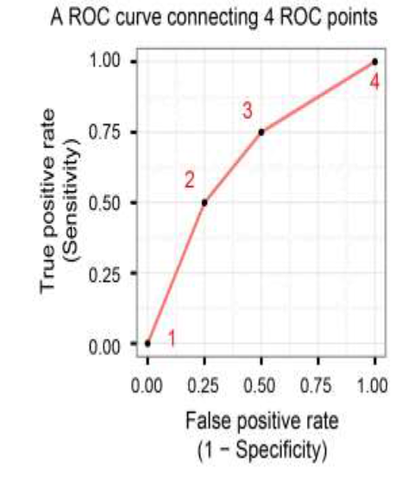
Performance in Unequal Importance of Classes
ROC Curve: (Receiver Operating Characteristic) :
We first added four points that matches with the pairs of sensitivity and specificity values and then connected the points to create a ROC curve.
The plot shows a ROC curve connecting four ROC points.

Slide 48
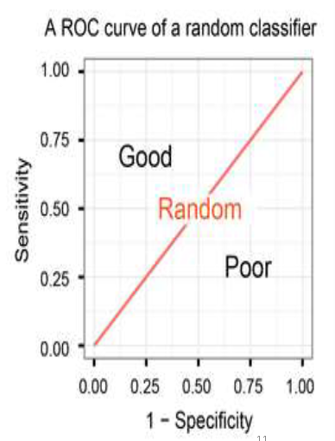
Performance in Unequal Importance of Classes
ROC Curve: (Receiver Operating Characteristic) :
A classifier with the random performance level always shows a straight line from the origin (0.0, 0.0) to the top right corner (1.0, 1.0).
Two areas separated by this ROC curve indicates a simple estimation of the performance level. ROC curves in the area with the top left corner (0.0, 1.0) indicate good performance levels, whereas ROC curves in the other area with the bottom right corner (1.0, 0.0) indicate poor performance levels
A ROC curve represents a classifier with the random performance level. The curve separates the space into two areas for good and poor performance levels.

Slide 49
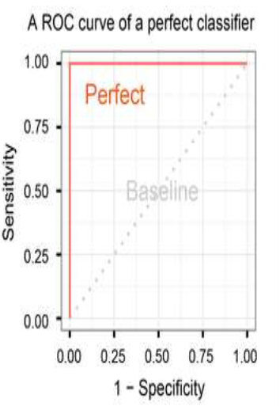
Performance in Unequal Importance of Classes
ROC Curve: (Receiver Operating Characteristic) :
A classifier with the perfect performance level shows a combination of two straight lines – from the origin (0.0, 0.0) to the top left corner (0.0, 1.0) and further to the top right corner (1.0, 1.0).
It is important to notice that classifiers with meaningful performance levels usually lie in the area between the random ROC curve (baseline) and the perfect ROC curve.

Slide 50
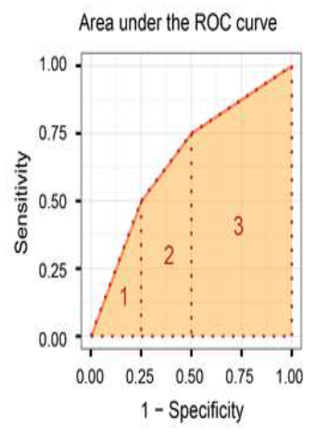
Performance in Unequal Importance of Classes
ROC Curve: (Receiver Operating Characteristic) :
AUC (Area under the ROC curve) score:
Another advantage of using the ROC plot is a single measure called the AUC (area under the ROC curve) score. As the name indicates, it is an area under the curve calculated in the ROC space.
One of the easy ways to calculate the AUC score is using the trapezoidal rule, which is adding up all trapezoids under the curve.
The AUC score can be calculated by the trapezoidal rule, which is adding up all trapezoids under the curve. The areas of the three trapezoids 1, 2, 3 are 0.0625, 0.15625, and 0.4375. The AUC score is then 0.65625.

Slide 51
Asymmetric misclassification cost
lift curve: measures how effective we are in identifying the members of one particular class → the assumption that the error of misclassifying a record belonging to one class is more serious than for the other class.
The cost of making a misclassification error may be higher for one class than the other(s)
Looked at another way, the benefit of making a correct classification may be higher for one class than the other(s)

Slide 52
Asymmetric misclassification cost
Example:
Consider the situation where the sales offer is mailed to a random sample of people for the purpose of constructing a good classifier. Suppose that the offer is accepted by 1% of those households. For these data, if a classifier simply classifies every household as a non-responder, it will have an error rate of only 1% but it will be useless in practice. A classifier that misclassifies 2% of buying households as non-buyers and 20% of the non-buyers as buyers would have a higher error rate but would be better if the profit from a sale is substantially higher than the cost of sending out an offer. In these situations, if we have estimates of the cost of both types of misclassification, we can use the confusion matrix to compute the expected cost of misclassification for each record in the validation data. This enables us to compare different classifiers using overall expected costs (or profits) as the criterion.

Slide 53
Asymmetric misclassification cost
Example:
Suppose that we are considering sending an offer to 1000 more people, where on average 1% of whom respond (1). Naively classifying everyone as a 0 has an error rate of only 1%. Using a data mining routine, suppose that we can produce these classifications:
Confusion Matrix:
Error rate = (2+20) = 2.2% (higher than naïve rate)

Slide 54
Asymmetric misclassification cost
Example:
Introducing Costs and Benefits:
Suppose:
Profit from a “1” is $10
Cost of sending offer is $1
Then:
Under naïve rule, all are classified as “0”, so no offers are sent: no cost, no profit
Under DM predictions, 28 offers are sent.
8 respond with profit of $10 each
20 fail to respond, cost $1 each
972 receive nothing (no cost, no profit)
Net profit = $60
Profit Matrix
COSTS | Actual 0 | Actual 1
Predicted 0 | 0 | $20
Predicted 1 | $20 | $8

Slide 55
Asymmetric misclassification cost
Example:
Looked at purely in terms of costs.
when everyone is classified as a 0, there are no costs of sending the offer; the only costs are the opportunity costs of failing to make sales to the ten 1’s = $100.
The cost of using the data mining routine to select people to send the offer to is only $48, as follows
However, this does not improve the actual classifications themselves → A better
method is to change the classification rules to reflect the asymmetric costs.
COSTS | Actual 0 | Actual 1
Predicted 0 | 0 | $20
Predicted 1 | $20 | $8
Pure cost matrix

Slide 56

Asymmetric misclassification cost
A popular performance measure that includes costs is the average misclassification cost, which measures the average cost of misclassification per classified record.
Denote by q₁ the cost of misclassifying a class C₁ record (as belonging to class C₂) and by q₂ the cost of misclassifying a class C₂ record (as belonging to class C₁). The average misclassification cost is
Thus, we are looking for a classifier that minimizes this quantity. This can be computed, for instance, for different cutoff values.
It turns out that the optimal parameters are affected by the misclassification costs only through the ratio of these costs.

Slide 57
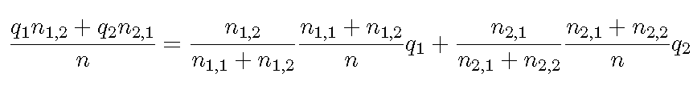
Asymmetric misclassification cost
This can be seen if we write the foregoing measure slightly differently:

Slide 58
Generalization to More Than Two Classes
Let us suppose that we have m classes C₁;C₂; : : : ;C_{m}.
For m classes, confusion matrix has m rows and m columns
Theoretically, there are m(m-1) misclassification costs, since any case could be misclassified in m-1 ways
Practically too many to work with
In decision-making context, though, such complexity rarely arises – one class is usually of primary interest

Slide 59
Judging Ranking Performance
To the predictive goal of detecting, among a set of new records, the ones most likely to belong to a class of interest.
This differs from the goal of predicting class membership for each new record.
Lift Charts for Binary Data
lift charts, also called lift curves, gains curves, or gains charts, for a binary outcome
This is a more common usage than for predicted continuous outcomes.
The lift curve helps us determine how effectively we can “skim the cream” by selecting a relatively small number of records and getting a relatively large portion of the responders.
The input required to construct a lift curve is a validation dataset that has been “scored” by appending to each record the propensity that it will belong to a given class.

Slide 60
Judging Ranking Performance
Lift Charts for Binary Data: Case Study:
Let’s continue with the case in which a particular class is relatively rare and of much more interest than the other class: tax cheats, debt defaulters, or responders to a mailing.
We would like our classification model to sift through the records and sort them according to which ones are most likely to be tax cheats, responders to the mailing, and so on. We can then make more informed decisions.
For example, we can decide how many and which tax returns to examine if looking for tax cheats.
The model will give us an estimate of the extent to which we will encounter more and more non-cheaters as we proceed through the sorted data starting with the records most likely to be tax cheats.
We can use the sorted data to decide to which potential customers a limited-budget mailing should be targeted.
In other words, we are describing the case when our goal is to obtain a rank ordering among the records according to their class membership propensities.

Slide 61
Judging Ranking Performance
Sorting by Propensity:
To construct a lift chart, we sort the set of records by propensity, in descending order.
This is the propensity to belong to the important class, say C1. → Then, in each row, we compute the cumulative number of C1 members
Dataset → 24 records → ordered in descending class “1” propensity
The right-most column accumulates the number of actual 1’s.
The lift chart then plots this cumulative column against the number of records.

Slide 62
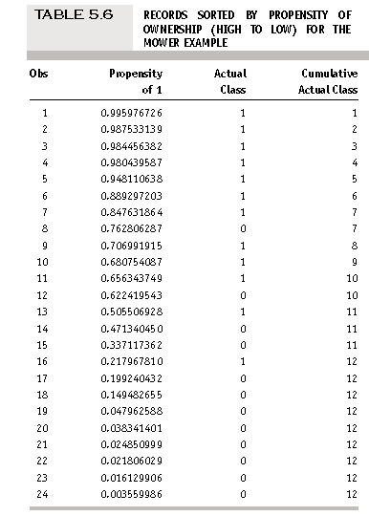
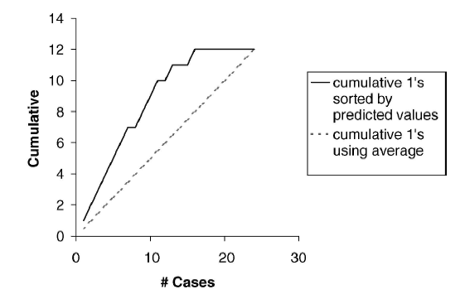
Judging Ranking Performance
Sorting by Propensity:

Slide 63
Judging Ranking Performance
Interpretation of Lift chart:
What is considered good or bad performance?
The ideal ranking performance would place all the 1’s at the beginning and all the 0’s at the end.
A lift chart corresponding to this ideal case would be a diagonal line with slope 1 which turns into a horizontal line.
Best possible classifier — a classifier that makes no errors—would overlap the existing curve at the start, continue with a slope of 1 until it reached then continue horizontally to the right.
In contrast, a useless model would be one that randomly assigns propensities.
Such behavior would increase the cumulative number of 1’s, on average, by #1’s / n in each row.

Slide 64
Judging Ranking Performance
Interpretation of Lift chart:
For a given number of records (x-axis), the lift curve value on the y-axis tells us how much better we are doing compared to random assignment.
if we use our model to choose the top 10 records, the lift curve tells us that we would be right for about nine of them
If we simply select 10 records at random, we expect to be right for 10 X 12/24 = 5 records.
The model gives us a “lift” in detecting class 1 members of 9/5 = 1.8.
The lift will vary with the number of records we choose to act on.
A good classifier will give us a high lift when we act on only a few records.
As we include more records, the lift will decrease.

Slide 65
Judging Ranking Performance
Interpretation of Lift chart:
What is considered good or bad performance?
The ideal ranking performance would place all the 1’s at the beginning and all the 0’s at the end.
A lift chart corresponding to this ideal case would be a diagonal line with slope 1 which turns into a horizontal line.
Best possible classifier — a classifier that makes no errors—would overlap the existing curve at the start, continue with a slope of 1 until it reached then continue horizontally to the right.

Slide 66
Judging Ranking Performance
Decile Lift Charts:
The information from the lift chart can be portrayed as a decile chart → which is widely used in direct marketing predictive modeling.
The decile chart aggregates all the lift information into 10 buckets.
The bars show, on the y-axis, the factor by which our model outperforms a random assignment of 0’s and 1’s, taking one decile at a time.
Reading the bar on the left, we see that taking 10% of the records that are ranked by the model as “the most probable 1’s” (having the highest propensities) yields twice as many 1’s as would a random selection of 10% of the records.

Slide 67
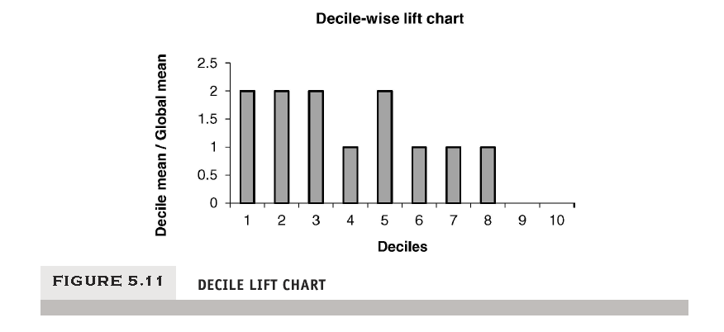
Judging Ranking Performance
Decile Lift Charts:

Slide 68
Judging Ranking Performance
Beyond Two classes:
A lift chart cannot be used with a multiclass classifier unless a single “important class” is defined and the classifications are reduced to “important” and “unimportant” classes.

Slide 69
Judging Ranking Performance
Lift Charts Incorporating Costs and Benefits :
When the benefits and costs of correct and incorrect classification are known or can be estimated, the lift chart is still a useful presentation and decision tool
we need a classifier that assigns to each record a propensity that it belongs to a particular class. → The procedure is then follows:
1.Sort the records in descending order of predicted probability of success.
2. For each record, record the cost (benefit) associated with the actual outcome.
3. For the highest propensity (i.e., first) record, its x-axis value is 1 and its y-axis value is its cost or benefit (computed in Step 2) on the lift curve.
4. For the next record, again calculate the cost (benefit) associated with the actual outcome. Add this to the cost (benefit) for the previous record. This sum is the y-axis coordinate of the second point on the lift curve. Its x-axis value is 2.

Slide 70
Judging Ranking Performance
Lift Charts Incorporating Costs and Benefits :
5. Repeat Step 4 until all records have been examined. Connect all the points, and this is the lift curve.
6. The reference line is a straight line from the origin to the point y = total net benefit and x = n(n = number of records).
Possibility of Negative slope
Example:
if the cost of mailing to a person is $0.65.
the value of a responder is $25
the overall response rate is 2%
the expected net value of mailing to a list of 10,000 is (0.02 X 25 X 10000) – (0.65 X 10000) = 5000 – 6500 = -1500

Slide 71
Thank you

