Slide 1
Multiple Linear Regression

Slide 2
Simple Linear Regression
Consider the following three scenarios:
The CEO of the local Tourism Authority would like to know whether a family’s annual expenditure on recreation is related to their annual income. This information could be used to tailor marketing campaigns to certain consumer segments.
A food company is interested in determining a shelf-life for a new chilled food product and hence they would like to quantify the relationship between microbial activity and time.
A car buyer is interested in purchasing a second hand car and would like to ascertain the relationship between a car’s age and advertised purchase price.

Slide 3
Simple Linear Regression
What do these three scenarios have in common?
The answer is that they all involve the quantification of the relationship between two variables.
This relationship is of interest as it allows us
To gain an understanding of the problem
To make predictions
To assess new data in light of the relationship
Applications:
Business
Genetics
Food Science, etc

Slide 4
Simple Linear Regression
Data:
Suppose you are a consultant to the local Tourism Authority and the CEO of the Authority would like to know whether a family’s annual expenditure on recreation is related to their annual income.
In addition, if there is a relationship, he would like you to build a statistical model which quantifies the relationship between the two variables
A data set consisting of a random sample of 20 families, collected last year is available to help you with the assessment.
two quantitative variables → family’s annual expenditure on recreation and annual income
Dependent Variable (Y) → Expenditure
Independent Variable (X) → Income

Slide 5
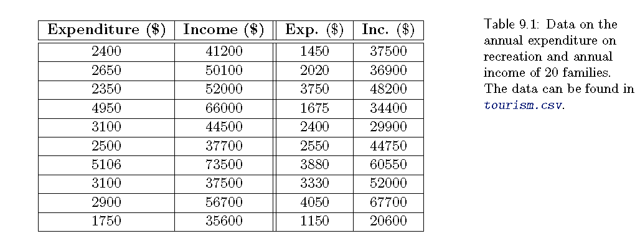
Simple Linear Regression

Slide 6
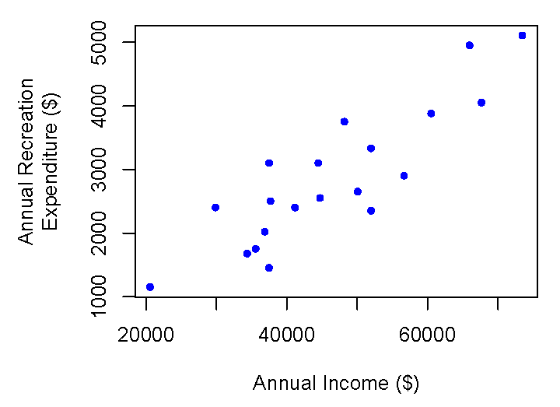
Simple Linear Regression
Graphical Summary of Data: Scatter plot → relation between two variables
Dependent Variable (Y) → vertical axis
Independent Variable (X) → Horizontal Axis
A scatter plot is frequently also referred to as a plot of Y versus X.
Relation between income and expenditure:
Direction: Positive → as income increases so does recreation expenditure;
Shape: Roughly linear → the points appear to fall along a straight line
Strength: Reasonably strong → there is considerable scatter about a straight line.

Slide 7
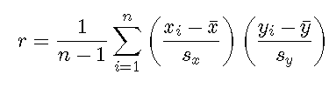
Simple Linear Regression
Numerical summary of the data — Correlation:
A numerical summary of the strength of the association between the two variables is often desired. → population correlation coefficient, ρ. → it measures which measures the strength of the linear association between two variables X and Y.
Since X and Y are quantitative variables, ρ is also known as Pearson correlation coefficient.
The sample correlation coefficient r can be as follows
ẋ and ẏ are sample means and s_{x} and s_{y} are standard deviations

Slide 8
Simple Linear Regression
Numerical summary of the data — Correlation:
The ρ can take values between −1 and 1 and the interpretation of ρ is as follows
A negative value indicates a decreasing relationship between X and Y , that is, as X increases, Y decreases.
A positive value indicates an increasing relationship between X and Y , that is, as X increases, so does Y .\
A value of 0 indicates that there is no linear relationship between the two variables — this however does not imply that there is no relationship.
The correlation does not give an indication about the value of the slope of any linear relationship.
Whole population can not be measured → only few samples can be measured.

Slide 9

Simple Linear Regression
The Simple Linear Regression Model:
“What is the equation of the linear relationship between the explanatory and response variables?”
Quantifying the relationship will allow us to
better understand the functional relationship between X and Y → how quickly does Y increase for every unit increase in X
make predictions about Y for a new value of X.
The linear regression has the form:
Where Y denotes the dependent variable
X denotes the independent variable;
β₀ denotes the y-intercept;
β₁ denotes the slope of the line; and
E denotes a random error.

Slide 10
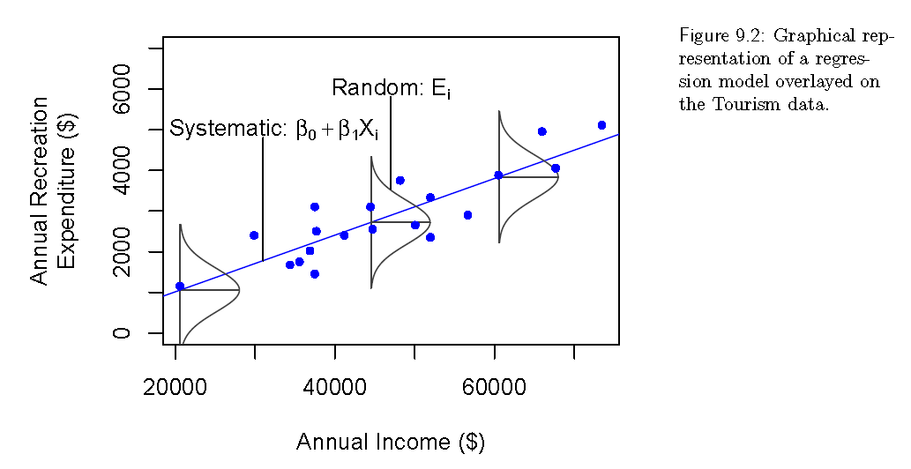
Simple Linear Regression

Slide 11

Simple Linear Regression
Any straight line fitted to the data will take the form y = b₀ + b₁ x
where b₀ and b₁ denote the intercept and the slope of the fitted line.
How good this line fits the data is determined by how close the data points (x_{i}, y_{i}) are to the corresponding points on the line, which are given by
for a given value xi, the observed value of the dependent variable is y_{i} and the corresponding prediction from the line is ˆyi
The residual is calculated as the difference between the two is
If the residual is negative then the observed value lies below the prediction
If the residual is positive then the observed value lies above the prediction.
The residuals need to be combined in some way to give an overall measure of how well the particular line fits the data
positive and negative residuals need add to the lack of fit.

Slide 12


Simple Linear Regression
A commonly used measure of lack-of-fit is the Residual Sum of Squares, RSS, which is also known as Sum of Squared Errors
The best line will result in the smallest RSS from all possible candidate lines b₀ + b₁x.
This smallest RSS indicates that the correspondence between the data and the fitted line is as good as it can possibly be. → this line is called least squares regression (LSR) line and the estimates of the intercept and slope obtained from the LSR line are denoted by and .
The RSS is

Slide 13
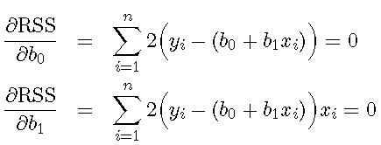
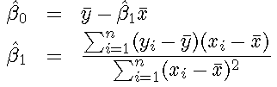
Simple Linear Regression
The aim is to find values for b₀ and b₁ such that RSS is minimized. → In order to do this, the partial derivative of RSS with respect to each b₀ and b₁ are taken and equated to zero.
The solution to these equations yields the least squares regression estimates
where ¯y and ¯x denote the mean of y and x.

Slide 14
Multiple Linear Regression
Linear Regression model for the purpose of prediction.
A form of statistical modeling that attempts to evaluate the relationship between one variable (termed the dependent variable) and one or more other variables (termed the independent variables).
It is a form of global analysis as it only produces a single equation for the relationship.
A model for predicting one variable from another.

Slide 15

Multiple Linear Regression
Most popular model for making predictions is the multiple linear regression model.
This model is used to fit a relationship between a numerical outcome variable Y (also called response, target, or dependent variable) and a set of predictors X₁, X₂,…,X_{p} (also referred as independent variables, input variables, repressors, covariates).
The assumption is that the following function approximates the relationship between the predictors and outcome variable:
where β₀,…, β_{p} are coefficients and ϵ is the noise or unexplained part.
Data are then used to estimate the coefficients and to quantify the noise.
In predictive modeling, the data are also used to evaluate model performance.

Slide 16
Multiple Linear Regression
Regression modeling means not only estimating the coefficients but also choosing which predictors to include and in what form.
Example: numerical predictor can be included as is, in logarithmic form, etc.
Choosing the right form of numerical predictor is depends on domain knowledge, data availability, and needed predictive power.
Applications:
predicting customer activity on credit cards
Their demographics and historical activity patterns
predicting expenditures on vacation travel based on historical frequent flyer data, etc

Slide 17
Explanatory vs. Predictive Modeling
Two popular but different objectives behind fitting a regression model are:
Explaining or quantifying the average effect of inputs on an outcome → explanatory task → statistical approach
data are treated as a random sample from a larger population of interest.
regression model estimated from this sample is an attempt to capture the average relationship in the larger population.
Used in decision making.
When the causal structure is unknown, then this model quantifies the degree of association between the inputs and outcome variable, and the approach is called descriptive modeling.
Predicting the outcome value for new records, given their input values → predictive task
Micro decision making

Slide 18
Explanatory vs. Predictive Modeling
Both explanatory and predictive modeling involve
Using dataset to fit a model
Checking model validity
Assessing its performance
Compare other models
In explanatory and descriptive modeling, the focus is
on modeling the average record
try to fit the best model to the data in an attempt to learn about the underlying relationship in the population.
In predictive Modelling, the goal is to find
A regression model that best predicts new individual records.
Search for a model that has highest predictive power by evaluating it on holdout set and using predictive metrics.

Slide 19
Explanatory vs. Predictive Modeling
Main differences in using a linear regression in these two scenarios
1. Good explanatory model that fits the data closely. Good predictive model that predicts new records accurately. The choice of the input variables and their form can therefore differ.
2. In Explanatory, the entire dataset can be used for estimating best fit model. In predictive, dataset is divided into training and validation datasets.
3. In Explanatory, performance measure is about how close the data fit the model and how strong the average relationship is. In Predictive, performance is measured by predictive accuracy.
4. More focus on coefficients in explanatory models, where as predictive models are focusing on the predictions.

Slide 20



Estimating the Regression Equation and Prediction
Once we determine the predictors to include and their form, we estimate the coefficients of the regression formula from the data using a method called ordinary least squares (OLS).
This method finds values that minimize the sum of squared deviations between the actual outcome values (Y) and their predicted values based on that model .
To predict the value of the outcome variable for a record with predictor values x₁; x₂; : : : ; x_{p}, we use the equation as

Slide 21
Estimating the Regression Equation and Prediction
Assumptions to get smallest mean squared error
The noise ϵ (or equivalently, Y ) follows a normal distribution.
The choice of predictors and their form is correct (linearity).
The records are independent of each other
The variability in the outcome values for a given set of predictors is the same regardless of the values of the predictors (homoskedasticity).
even if we drop the first assumption and allow the noise to follow an arbitrary distribution, these estimates are very good for prediction → least squares estimates

Slide 22
Multiple Linear Regression
Example in Class

Slide 23
Variable Selection in Linear Regression
Reducing Number of Predictors:
Problem: many variables are available to choose as predictors.
Kitchen – sink approach: no need to worry while selecting a subset. Use all variables in the model.
However, there are several reasons for exercising caution before throwing all possible variables into a model.
It may be expensive or not feasible to collect a full complement of predictors for future predictions.
We may be able to measure fewer predictors more accurately
The more predictors, the higher the chance of missing values in the data.
If we delete or impute records with missing values, multiple predictors will lead to a higher rate of record deletion or imputation.

Slide 24
Variable Selection in Linear Regression
Parsimony :
It is an important property of good models.
We obtain more insight into the influence of predictors in models with few parameters.
Estimates of regression coefficients are likely to be unstable, due to Multicollinearity in models with many variables.
Multicollinearity is the presence of two or more predictors sharing the same linear relationship with the outcome variable
One very rough rule of thumb is to have a number of records n larger than 5(p + 2), where p is the number of predictors.
It can be shown that using predictors that are uncorrelated with the outcome variable increases the variance of predictions.
It can be shown that dropping predictors that are actually correlated with
the outcome variable can increase the average error (bias) of predictions.

Slide 25
Variable Selection in Linear Regression
How to Reduce the number of Predictors:
Domain knowledge is required to reduce the number of predictors
It is important to understand what the various predictors are measuring and why they are relevant for predicting the outcome variable.
Some practical reasons for predictor eliminations are
Expense of collecting information in future
Inaccuracy
High correlation with another predictor
Many missing values
Helpful in examine predictors summary statistics and graphs.

Slide 26
Variable Selection in Linear Regression
How to Reduce the number of Predictors:
Two types of methods
Exhaustive Search
It is searching for the “best” subset of predictors by fitting regression models with all the possible combinations of predictors.
The exhaustive search approach is not practical in many applications
Search through a partial set of models

Slide 27
Variable Selection in Linear Regression
How to Reduce the number of Predictors: Exhaustive Search
The idea is to evaluate all subsets of predictors.
Since the number of subsets for even moderate values of p is very large.
After creating the subsets and runs all models, we need some way to examine the most promising subsets and to select from them.
Challenge: Under – fit (select a model that is not too simplistic in terms of excluding important parameters) and over-fit (overly complex thereby modeling random noise)
Several criteria for evaluating and comparing models are based on metrics computed from the training data:

Slide 28

Variable Selection in Linear Regression
How to Reduce the number of Predictors: Exhaustive Search
One of the popular approach is adjusted R²
where R² is the proportion of explained variability in the model.
Better fit → Higher values of adjusted R².
It uses penalty on the number of predictors.
A second popular set of criteria for balancing under-fitting and over-fitting are
Akaike Information Criterion (AIC)
Schwartz’s Bayesian Information Criterion (BIC).
AIC and BIC measure the goodness of fit of a model.
It also includes a penalty that is a function of number of parameters in the model
AIC and BIC are estimates of prediction error based in information theory.

Slide 29

Variable Selection in Linear Regression
How to Reduce the number of Predictors: Exhaustive Search
A third criterion often used for subset selection is Mallow’s C_{p}.
This criterion assumes that the full model (with all predictors) is unbiased, although it may have predictors that if dropped would reduce prediction variability
With this assumption, we can show that if a subset model is unbiased, the average C_{p} value equals (p + 1), the size of the subset.
large samples Mallows’s Cp is equivalent to AIC

Slide 30
Variable Selection in Linear Regression
How to Reduce the number of Predictors: Popular Subset Selection Algorithms
Finding the best subset of predictors relies on a partial, iterative search through the space of all possible regression models.
This approach is computationally cheaper, but it has the potential of missing “good” combinations of predictors.
Three Popular Iterative search algorithms are
Forward Selection
Backward Elimination
Stepwise Regression

Slide 31
Variable Selection in Linear Regression
How to Reduce the number of Predictors: Popular Subset Selection Algorithms
Forward Selection
It starts with no predictors and then add predictors one by one.
The algorithm stops when the contribution of additional predictors is not statistically significant
It will miss pairs of predictors that performs very well together but performs poorly as a single predictors.
Backward Elimination
It starts with all predictors and then at each step, eliminate the least useful predictor.
The algorithm stops when all the remaining predictors have significant contributions.
Time consuming and unstable

Slide 32
Variable Selection in Linear Regression
How to Reduce the number of Predictors: Popular Subset Selection Algorithms
Stepwise Regression
It is like forward selection except that at each step, we consider dropping predictors that are not statistically significant, as in backward elimination.

Slide 33
Thank you

