Slide 1
K-Nearest Neighbors (k-NN)

Slide 2
K – Nearest Neighbors (k-NN)
It can be used for classification (of a categorical outcome)
It can also used to prediction (of a numerical outcome)
This method relies on finding “similar” records in the training data for classify or prediction purpose
The neighbors are then used to derive a classification or prediction for the new record by voting or averaging.
How similarity is measured
How the number of neighbors are chosen
How classification or prediction is computed

Slide 3
K – Nearest Neighbors (k-NN)
The idea behind the k-Nearest Neighbor algorithm is to build a classification method using no assumptions about the form of the function, y = f(x₁,x₂,…x_{p}) that relates the dependent (or response) variable, y, to the independent (or predictor) variables x₁,x₂,…x_{p.}
This is a non-parametric method because it does not involve estimation of parameters in an assumed function form such as the linear form, etc.
The only assumption we make is that it is a ”smooth” function.
We have training data in which each observation has a y value which is just the class to which the observation belongs.
if we have two classes → y is a binary variable.

Slide 4
K – Nearest Neighbors (k-NN)
The idea in k-Nearest Neighbor methods is to dynamically identify k observations in the training data set that are similar to a new observation (u₁,u₂,...u_{p}) that we wish to classify and to use these observations to classify the observation into a class ŷ.
If we knew the function f, we would simply compute ŷ = f(u₁,u₂,…u_{p}).
If all we are prepared to assume is that f is a smooth function, a reasonable idea is to look for observations in our training data that are near it and then to compute ŷ from the values of y for these observations.
When we talk about neighbors we are implying that there is a distance or dissimilarity measure that we can compute between observations based on the independent variables.

Slide 5
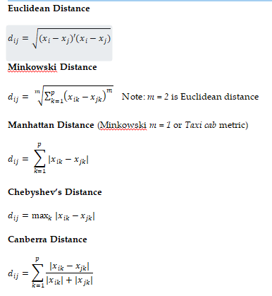
K – Nearest Neighbors (k-NN)
Distances between observations based on numeric variables:

Slide 6

K – Nearest Neighbors (k-NN)
The Euclidean distance between the points (x₁,x₂,…x_{p}) and (u₁,u₂,…u_{p}) is
Computationally cheap and most popular in k-NN.
After computing the distances between the record to be classified and existing records, we need a rule to assign a class to the record to be classified, based on the classes of its neighbors.
Classification Rule:
Simple Case is k = 1 → where we look for the record that is closest (the nearest neighbor) and classify the new record as belonging to the same class as its closest neighbor.

Slide 7
K – Nearest Neighbors (k-NN)
It is a remarkable fact that this simple, intuitive idea of using a single nearest neighbor to classify records can be very powerful when we have a large number of records in our training set.
It turns out that the misclassification error of the 1-nearest neighbor scheme has a misclassification rate that is no more than twice the error when we know exactly the probability density functions for each class.
The idea of the 1-nearest neighbor can be extended to k > 1 neighbors as follows:
Find the nearest k neighbors to the record to be classified.
Use a majority decision rule to classify the record, where the record is classified as a member of the majority class of the k neighbors

Slide 8
K – Nearest Neighbors (k-NN)
It is a remarkable fact that this simple, intuitive idea of using a single nearest neighbor to classify records can be very powerful when we have a large number of records in our training set.
It turns out that the misclassification error of the 1-nearest neighbor scheme has a misclassification rate that is no more than twice the error when we know exactly the probability density functions for each class.
The idea of the 1-nearest neighbor can be extended to k > 1 neighbors as follows:
Find the nearest k neighbors to the record to be classified.
Use a majority decision rule to classify the record, where the record is classified as a member of the majority class of the k neighbors

Slide 9
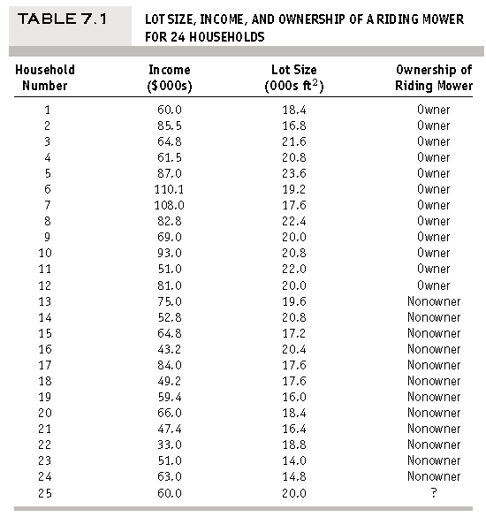
K – Nearest Neighbors (k-NN) Example
A riding-mower manufacturer would like to find a way of classifying families in a city into those likely to purchase a riding mower and those not likely to buy one. A pilot random sample is undertaken of 12 owners and 12 non-owners in the city.
First partition the data into training data (14 households) and validation data (10 households).

Slide 10
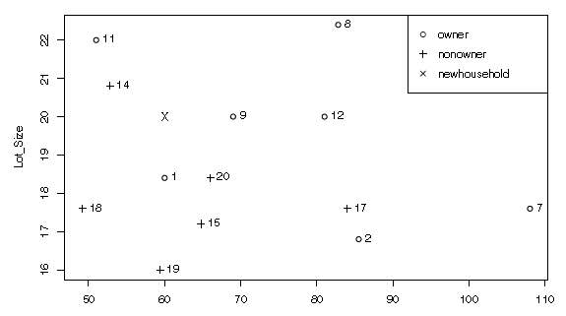
K – Nearest Neighbors (k-NN) Example
Scatter plot:
Now consider a new household with $60,000 income and lot size 20,000ft
Among the households in the training set, the one closest to the new household is household 9 with $69,000 income and lot size 20,000ft.
If we use a 1-NN classifier, we would classify the new household as an owner, like household 9
If we use k = 3, the three nearest households are 9, 14, and 1.
Two of these neighbors are owners of riding mowers and the last is a nonowner.
The majority vote is therefore owner, and the new household would be classified as an owner

Slide 11
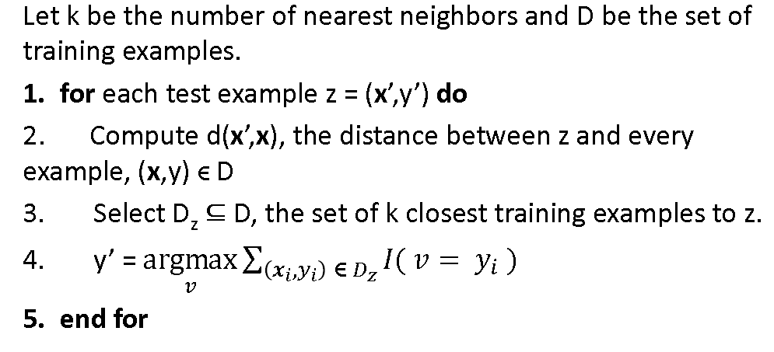
K – Nearest Neighbors (k-NN) : Algorithm

Slide 12
K – Nearest Neighbors (k-NN) :
Choosing k:
The advantage of choosing k > 1 is that higher values of k provide smoothing that reduces the risk of overfitting due to noise in the training data.
if k is too low, we may be fitting to the noise in the data.
if k is too high → miss out on the method’s ability to capture the local structure in the data.
In the extreme, k = n → over-smoothing in the absence of useful information in the predictors about the class membership.
Choose K in such a way to balance between overfitting to the predictor information and ignoring this information completely.
Typically, values of k fall in the range 1 to 20.

Slide 13
K – Nearest Neighbors (k-NN) :
Choosing k:
We choose the k with the best classification performance.
We use the training data to classify the records in the validation data, then compute error rates for various choices of k.
Setting the cutoff value:
k-NN uses a majority decision rule to classify a new record, where the record is classified as a member of the majority class of the k neighbors.
“majority” → directly linked to the notion of a cutoff value applied to the class membership probabilities
changing the cutoff value affects the confusion matrix (i.e., the error rates).
In some cases we might want to choose a cutoff other than the default for the purpose of maximizing accuracy or for incorporating misclassification costs.

Slide 14
K – Nearest Neighbors (k-NN) :
k-NN with More Than Two Classes:
The k-NN classifier can easily be applied to an outcome with m classes, where m > 2.
The “majority rule” means that a new record is classified as a member of the majority class of its k neighbors.
Alternative Approach: when there is a specific class that we are interested in identifying, is to calculate the proportion of the k neighbors that belong to this class of interest, use that as an estimate of the probability (propensity) that the new record belongs to that class, and then refer to a user specified cutoff value to decide whether to assign the new record to that class.

Slide 15
K – Nearest Neighbors (k-NN) :
Converting Categorical Variables to Binary Dummies:
Euclidean distance between two nonnumeric categories is not possible.
So, categorical variables must be converted to binary dummies before applying k-NN classification on dataset.
All m-binaries should be created before using k-NN.
Mathematically, this is redundant. → m-1 dummies contain the same information as m-dummies.

Slide 16
K – Nearest Neighbors (k-NN) :
k-NN for a Numerical Outcome:
The idea of k-NN can be extended to predicting a continuous value.
The first step of determining neighbors by computing distances remains unchanged.
The second step, where a majority vote of the neighbors is used to determine class, is modified such that we take the average outcome value of the k-nearest neighbors to determine the prediction.
The average is used in k-NN is a weighted average, with the weight decreasing with increasing distance from the point at which the prediction is required
Another modification is in the error metric used for determining the “best k.” → Rather than the overall error rate used in classification, RMS error or another prediction error metric should be used in prediction

Slide 17
K – Nearest Neighbors (k-NN) :
Advantages and Shortcomings of k-NN Algorithms:
Advantages:
Simplicity and lack of parametric assumptions
Good classification if the number of samples is large enough.
Can be applied to the data from any distribution.
Shortcomings:
Takes more time to classify a new example.
need to calculate and compare distance from new example to all other examples.
Choosing k may be tricky
Need large number of samples for accuracy.

Slide 18
Thank you

