Slide 1
Classification and Regression Trees

Slide 2
Introduction
Among the data-driven methods, trees are the most transparent and easy to interpret.
Trees are based on separating records into subgroups by creating splits on predictors.
These splits create logical rules that are transparent and easily understandable.
The resulting subgroups should be more homogeneous in terms of the outcome variable → creating useful prediction or classification rules.
Two key ideas underlying tree:
Recursive Partitioning (For Constructing the tree)
Pruning (For Cutting the tree back)
Few metrics of homogeneity that are popular in tree algorithms, while construction of tree
pruning is a useful → to avoid overfitting

Slide 3
Introduction
Advantages:
highly automated.
robust to outliers
able to handle missing values

Slide 4
Introduction
If one had to choose a classification technique that performs well across a wide range of situations without requiring much effort from the analyst while being readily understandable by the end-user a strong contender would be the tree methodology developed by Brieman, Friedman, Olshen and Stone (1984).
The program that Breiman et al. created to implement these procedures was called CART (Classification And Regression Test). → A related procedure is called C4.5.

Slide 5
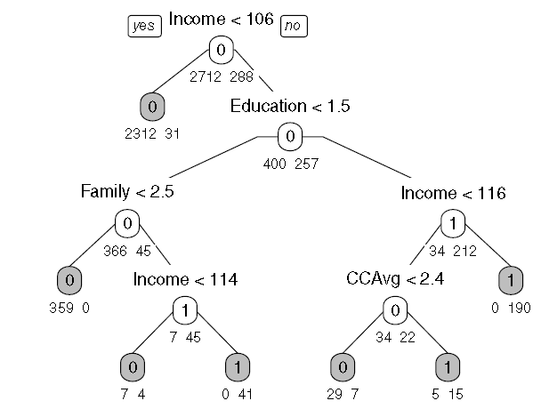
Introduction

Slide 6
Classification Tree
Let us denote the outcome variable by Y and the input (predictor) variables by X₁;X₂;X₃; …;X_{p}.
In classification, the outcome variable will be a categorical variable.
Recursive partitioning divides up the p-dimensional space of the X predictor variables into non-overlapping multidimensional rectangles.
The predictor variables here are considered to be continuous, binary, or ordinal.
This division is accomplished recursively.
The idea is to divide the entire X-space up into rectangles such that each rectangle is as homogeneous or “pure” as possible.
By pure, we mean containing records that belong to just one class.

Slide 7
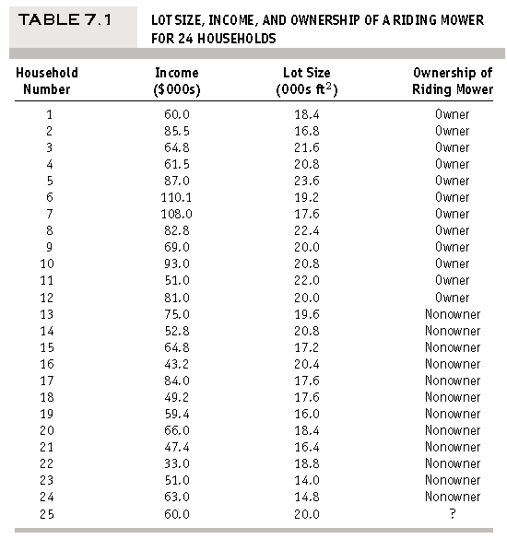
Introduction
A riding-mower manufacturer would like to find a way of classifying families in a city into those that are likely to purchase a riding mower and those who are not likely to buy one.
A pilot random sample of 12 owners and 12 non-owners in the city is undertaken.
The independent variables here are Income (x1) and Lot Size (x2).
The categorical variable has two classes: owner and non-owner

Slide 8
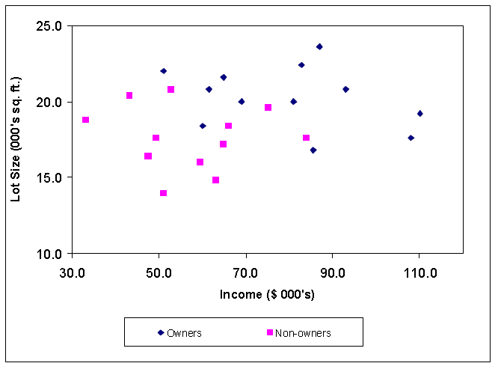
Introduction

Slide 9
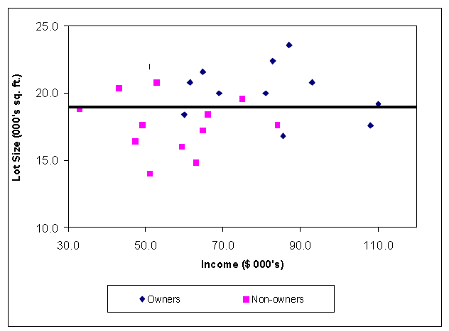
Introduction
If we apply CART to this data it will choose x2 for the first split with a splitting value of 19.
The (x1,x2) space is now divided into two rectangles, one with the Lot Size variable, x2 <= 19 and the other with x2> 19.

Slide 10
Introduction
How the split into two rectangles has created two rectangles each of which is much more homogenous than the rectangle before the split.
The upper rectangle contains points that are mostly owners (9 owners and 3 non-owners) while the lower rectangle contains mostly non-owners (9 non-owners and 3 owners).
How did CART decide on this particular split?
It examined each variable and all possible split values for each variable to find the best split.
What are the possible split values for a variable?
They are simply the mid-points between pairs of consecutive values for the variable
These split points are ranked according to how much they reduce impurity (heterogeneity of composition).

Slide 11
Introduction
The reduction in impurity is defined as the impurity of the rectangle before the split minus the sum of the impurities for the two rectangles that result from a split.
Categorical Predictors:
categorical predictors can also be used in the recursive partitioning context
To handle categorical predictors, the split choices for a categorical predictor are all ways in which the set of categories can be divided into two subsets
Example:
a categorical variable with four categories → { a; b; c; d} ➔ seven ways into two subsets → {a} and {b,c,d}, {b} and {a,c,d}, {c} and {a,b,d}, {a,b} and {c,d}, {a,c} and {b,d} and {a,d} and {b,c}.

Slide 12

Introduction
Measure of Impurity:
There are a number of ways we could measure impurity
Gini Index
Entropy measure
If we denote m – classes of response variable by , k=1, 2, … , m,
The Gini impurity index for a rectangle A is defined by
Where p_{k} is the proportion of records in rectangle A that belong to class k.
This measure takes values between 0 and (m-1)/m [when all m classes are equally represented]

Slide 13
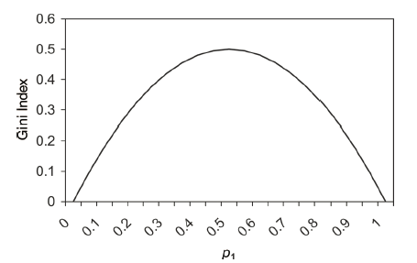
Introduction
Measure of Impurity:
The values of the Gini index for a two-class case as a function of p_{k}.
It can be seen that the impurity measure is at its peak when p_{k} = 0.5

Slide 14

Introduction
Measure of Impurity:
The entropy for a rectangle A is defined by
This measure ranges between 0 and log₂(m)
In the two-class case, the entropy measure is maximized at p_{k} = 0.5
By comparing the reduction in impurity across all possible splits in all possible predictors, the next split is chosen
The next split is on the Income variable, x1 at the value 84.75.

Slide 15
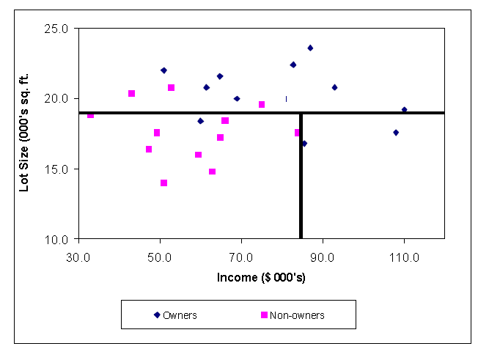
Introduction
The left lower rectangle which contains data points with x1<=84.75 and x2<=19 has all but one points that are non-owners.
The right lower rectangle which contains data points with x1 > 84.75 and x2<=19 consists exclusively of owners.

Slide 16
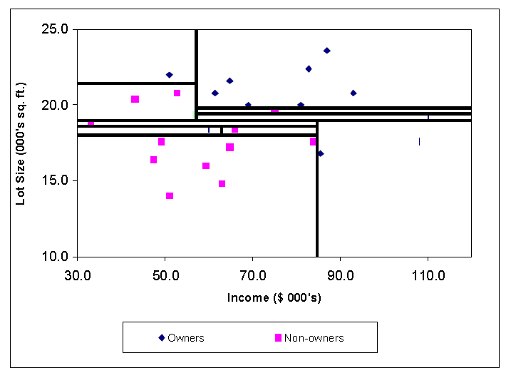
Introduction

Slide 17
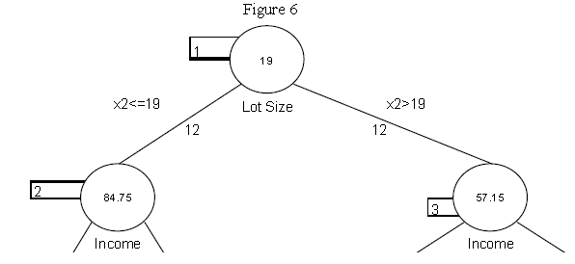
Introduction
Notice that each rectangle is pure – it contains data points from just one of the two classes.
The reason the method is called a classification tree algorithm is that each split can be depicted as a split of a node into two successor nodes.
The first split is shown as a branching of the root node of a tree

Slide 18
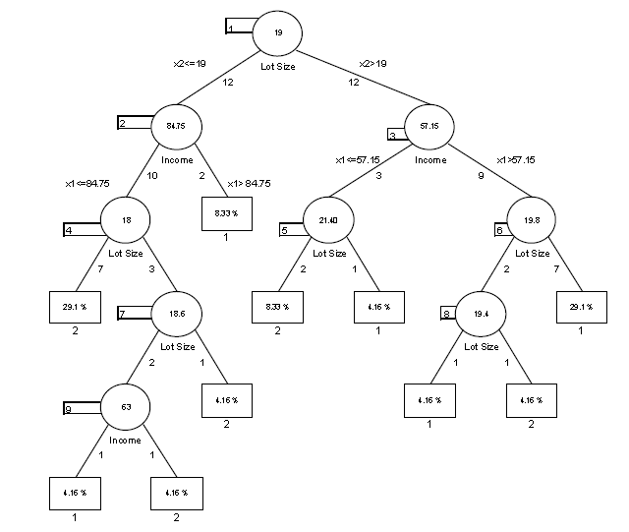
Introduction
Full Tree

Slide 19
Introduction
Pruning:
The second key idea in the CART procedure, that of using the validation data to prune back the tree that is grown from the training data using independent validation data, was the real innovation.
Previously, methods had been developed that were based on the idea of recursive partitioning but they had used rules to prevent the tree from growing excessively and over-fitting the training data.
For example, CHAID (Chi-Squared Automatic Interaction Detection) is a recursive partitioning method that predates CART by several years and is widely used in database marketing applications to this day.
It uses a well-known statistical test (the chi-square test for independence) to assess if splitting a node improves the purity by a statistically significant amount.

Slide 20
Introduction
Pruning:
If the test does not show a significant improvement the split is not carried out.
By contrast, CART uses validation data to prune back the tree that has been deliberately overgrown using the training data.
The idea behind pruning is to recognize that a very large tree is likely to be over-fitting the training data.
In our example, the last few splits resulted in rectangles with very few points.
We can see intuitively that these last splits are likely to be simply capturing noise in the training set rather than reflecting patterns that would occur in future data such as the validation data.
Pruning consists of successively selecting a decision node and re-designating it as a leaf node
The pruning process trades off misclassification error in the validation data set against the number of decision nodes in the pruned tree to arrive at a tree that captures the patterns but not the noise in the training data

Slide 21
Introduction
Pruning:
The pruning process trades off misclassification error in the validation data set against the number of decision nodes in the pruned tree to arrive at a tree that captures the patterns but not the noise in the training data.
It uses a criterion called the “cost complexity” of a tree to generate a sequence of trees which are successively smaller to the point of having a tree with just the root node
We then pick as our best tree the one tree in the sequence that gives the smallest misclassification error in the validation data.

Slide 22
Thank you

