Slide 1
Discriminant Analysis

Slide 2
Discriminant Analysis : Background
It is a model based approach to classification.
where classification is based on the distance of an observation from each class average.
A classical statistical technique used for classification and profiling.
Used for classification long before data mining
Classifying organisms into species
Classifying skulls
Fingerprint analysis
And also used for business data mining (loans, customer types, etc.)
Can also be used to highlight aspects that distinguish classes (profiling)

Slide 3
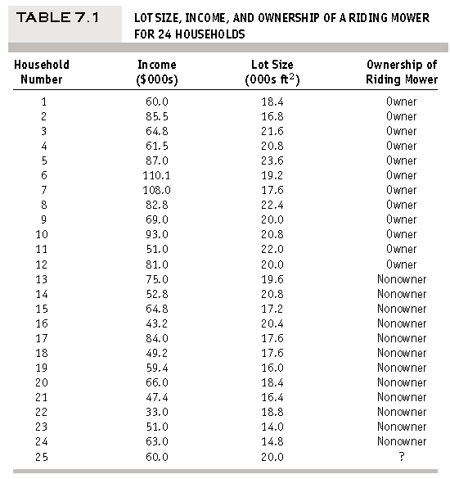
Discriminant Analysis : Background
Example: Riding Movers
A riding-mower manufacturer would like to find a way of classifying families in a city into those likely to purchase a riding mower and those not likely to buy one. A pilot random sample is undertaken of 12 owners and 12 non-owners in the city.
First partition the data into training data (14 households) and validation data (10 households).

Slide 4
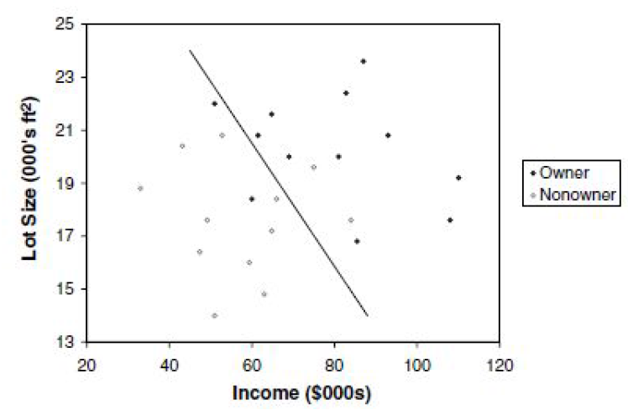
Discriminant Analysis : Background
Example: Riding Movers
Scatter plot
A good classification rule would separate the data so that the fewest points are misclassified
4 misclassifications out of 24 points → can we do better.

Slide 5
Discriminant Analysis : Background
Example: Riding Movers
Goal: classify purchase behavior (buy/no-buy) of riding mowers based on income and lot size
Outcome: owner or non-owner (0/1)
Predictors: lot size, income

Slide 6
Discriminant Analysis : Background
Example: Loan Acceptance
Previous example is small → separation is clear.
In data mining applications, there will be more records, more predictors, and less clear separation.
Consider Universal Bank example with only 2 predictors:
Outcome: accept/don’t accept loan
Predictors:
Annual income (Income)
Avg. monthly credit card spending (CCAvg)

Slide 7
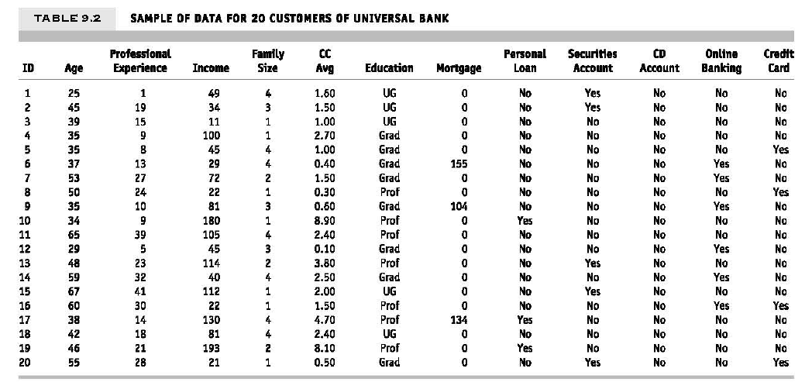
Discriminant Analysis : Background

Slide 8
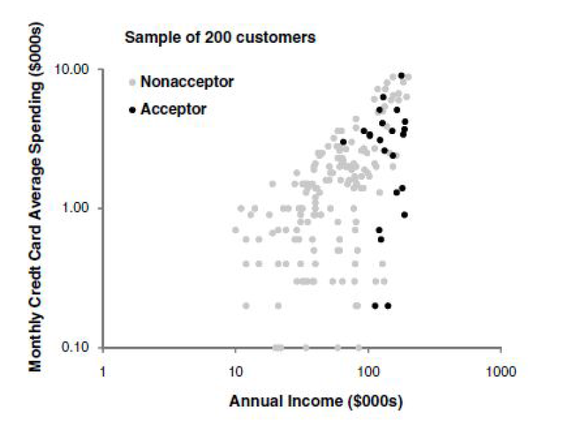
Discriminant Analysis : Background

Slide 9
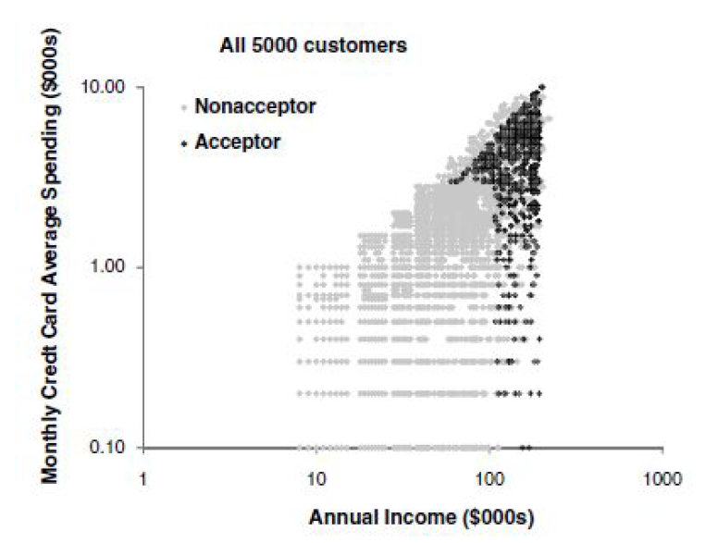
Discriminant Analysis : Background

Slide 10
Discriminant Analysis : Background
Algorithm for Discriminant Analysis
To classify a new record, measure its distance from the center of each class
Then, classify the record to the closest class

Slide 11

Discriminant Analysis : Background
Algorithm for Discriminant Analysis
Step – I: Measuring Distance
Need to measure each record’s distance from the center of each class
The center of a class is called a centroid
The centroid is simply a vector (list) of the means of each of the predictors.
This mean is computed from all the records that belong to that class.
A popular distance metric is Euclidean Distance.

Slide 12

Discriminant Analysis : Background
Algorithm for Discriminant Analysis
Step – I: Measuring Distance
Drawbacks:
Sensitive to scale, variance (can normalize to correct)
Ignores correlation between variables
Use , statistical distance → Mahalanobis distance
Where S is a covariance matrix.
For a single predictor (p=1), this reduces to a z-score
When p > 1, statistical distance takes account of correlations among predictors (z-score doesn’t)

Slide 13
Discriminant Analysis : Background
Algorithm for Discriminant Analysis
Step – 2: Classification Functions
The idea is to create classification score that reflects the distance from each class
This is done by estimating “classification functions”, which are a function of the statistical distances.
The estimation maximizes the ratio of between-class to within-class variability
Fisher’s linear classification functions:
one for each class.
Used to compute a classification score.
Classify a record to class with highest score

Slide 14
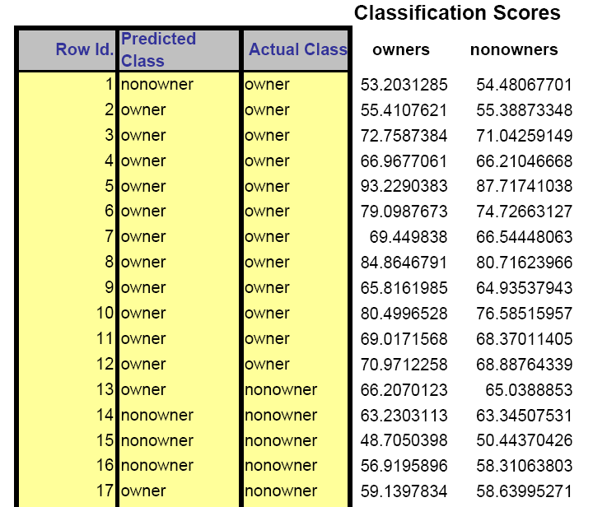
Discriminant Analysis : Background
Classification scores for part of movers data:

Slide 15
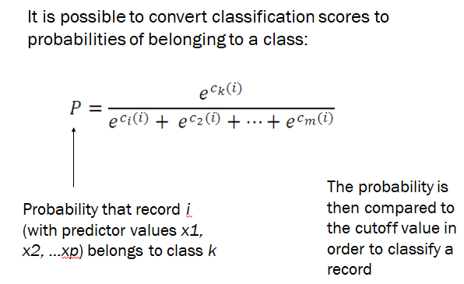
Discriminant Analysis : Background
Algorithm for Discriminant Analysis
Step – 3: Converting to Probabilities

Slide 16
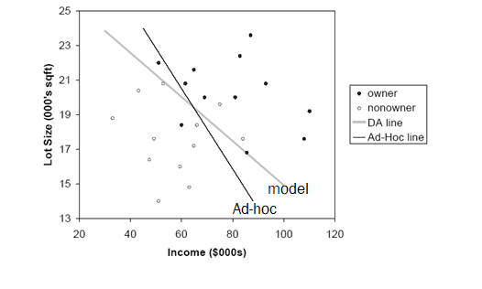
Discriminant Analysis : Background
Line from the model is:

Slide 17
Discriminant Analysis : Background
Assumptions & Caveats of Discriminant Analysis
Assumes multivariate normality of predictors
When this condition is met, DA is more efficient than other methods (i.e. needs less data to obtain similar accuracy) Even when it is not met, DA is robust when we have enough cases in smallest class (> 20) . This means it can be used with dummy variables!
Assumes correlation among predictors within a class is the same across all classes. (Compare correlation tables of each class by eye.)
Sensitive to outliers

Slide 18
Discriminant Analysis : Background
Assessing Predictive Performance
As in other classification methods:
Confusion matrix
Lift
Based on validation data

Slide 19
Discriminant Analysis : Background
Improving Classification
Prior Probabilities
If classes are not equally frequent, or their frequency in the sample does not reflect reality, then classification functions can be improved
Incorporate prior (or real) probabilities of class membership:
Add log(pj) to the classification function for class j
Pj is probability a case belongs to class j

Slide 20
Discriminant Analysis : Background
Unequal Misclassification costs:
For the two-class (buyer/non-buyer) case, we can account for asymmetric costs of misclassification (C1, C2) in same fashion as for unequal prior probabilities
How?
Add log(C1) and log (C2) to constants
Often absolute costs are unknown. Instead, use cost ratio:
Set C1 = 1, C2 = ratio
Add log (C2/C1) to class 2’s constant

Slide 21
Discriminant Analysis : Background
Multiple classes:
Same procedure is used for multiple classes
One classification function for each class
Whichever function has highest value, case is assigned to that class

