Slide 1
Association Rule Mining

Slide 2
Association Rule Mining: Background
unsupervised learning
Association Rule Mining → market basket Analysis → its aim is to discover which groups of products tend to be purchased together
affinity analysis → the goal is to identify item clustering in transaction-type databases

Slide 3
Association Rule Mining: Background
Study of “what goes with what”
“Customers who bought X also bought Y”
What symptoms go with what diagnosis
Transaction-based or event-based
Also called “market basket analysis” and “affinity analysis”
Originated with study of customer transactions databases to determine associations among items purchased

Slide 4
Association Rule Mining:
Generating Rules:
“IF” part = antecedent
“THEN” part = consequent
“Item set” = the items (e.g., products) comprising the antecedent or consequent
Antecedent and consequent are disjoint (i.e., have no items in common)

Slide 5
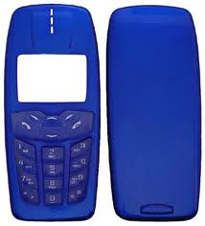
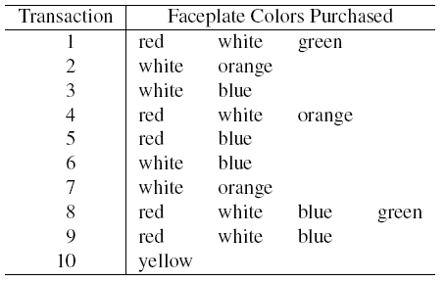
Association Rule Mining:
Simple Example:

Slide 6
Association Rule Mining:
Simple Example: Many Rules are Possible
For example: Transaction-1 supports several rules, such as
“If red, then white” (“If a red faceplate is purchased, then so is a white one”)
“If white, then red”
“If red and white, then green”
+ several more

