Slide 1
Forecasting Time Series

Slide 2
Forecasting
Process of predicting a future event
Underlying basis of all business decisions
Production
Inventory
Personnel
Facilities
Forecasting Approaches
Qualitative Methods
Quantitative Methods

Slide 3
Forecasting Methods
Qualitative Methods
Used when situation is vague & little data exist
New Products
New Technology
Involve intuition, experience
e.g., forecasting sales on Internet
Quantitative Methods
Used when situation is ‘stable’ & historical data exist
Existing products
Current technology
Involve mathematical techniques
e.g., forecasting sales of LED televisions

Slide 4
Forecasting Approaches
Qualitative Methods
Used when situation is vague & little data exist
New Products
New Technology
Involve intuition, experience
e.g., forecasting sales on Internet
Quantitative Methods
Used when situation is ‘stable’ & historical data exist
Existing products
Current technology
Involve mathematical techniques
e.g., forecasting sales of LED televisions

Slide 5
Quantitative Forecasting
Select several forecasting methods
‘Forecast’ the past
Evaluate forecasts
Select best method
Forecast the future
Monitor continuously forecast accuracy

Slide 6
Quantitative Forecasting Methods
Time Series Models
Moving Average
Exponential Smoothing
Trend Models
Causal Models
Regression

Slide 7
Time Series
Time series forecasting is performed in nearly every organization that works with quantifiable data..
Retail stores
Energy Companies
Educational Institutions
International Financial Organizations
Transportation companies
Banks

Slide 8
Time Series
Set of evenly spaced numerical data
Obtained by observing response variable at regular time periods
Forecast based only on past values
Assumes that factors influencing past, present, & future will continue
Example
Year: 1995 1996 1997 1998 1999
Sales: 78.7 63.5 89.7 93.2 92.1
Single Time Series
Multiple Time Series (e.g: Monthly sales of Multiple products) → forecast each series individually.

Slide 9
Descriptive vs. Predictive Modeling
In descriptive modeling, or time series analysis, a time series is modeled to determine its components in terms of seasonal patterns, trends, relation to external factors, etc. → These can then be used for decision making and policy formulation
Time series forecasting uses the information in a time series to forecast future values of that series.
The goals of these two methods leads to use different methods.
The descriptive models might use “future” information, whereas forecasting models cannot.

Slide 10
Popular Forecasting Methods in Business
Two main types of forecasting methods are popular in business
Both methods are versatile and powerful.
1. Multiple Linear Regression:
The user specifies a certain model and then estimates it from the time series.
2. data-driven tool of smoothing:
the method learns patterns from the data.

Slide 11
Time Series Components
In both types of forecasting methods, regression models and smoothing, and in general, it is customary to dissect a time series into four components
1. Level
Average value of the series
2. Trend
Change in the series from one period to the next
3. Seasonality
It describes a short-term cyclical behavior of the series which can be observed several times within the given series.
4. Noise
It is the random variation that results from measurement error or other causes not accounted for.

Slide 12
Time Series Components
Trend Component:
Persistent, overall upward or downward pattern
Due to population, technology etc.
Several years duration
Response
Mo., Qtr., Yr.

Slide 13
Time Series Components
Trend Component
Sales
Upward trend
Time

Slide 14
Time Series Components
Seasonal Component:
Regular pattern of up & down fluctuations
Due to weather, customs etc.
Occurs within one year
Summer
Response
Mo., Qtr.

Slide 15
Time Series Components
Seasonal Component:
Upward or Downward Swings
Regular Patterns
Observed Within One Year
Sales
Winter
Time (Monthly or Quarterly)

Slide 16
Time Series Components
Time plot → to identify the components of a time series.
A time plot is a line chart of the series values over time, with temporal labels on the horizontal axis.
Example: Ridership on Amtrak Trains
Amtrak, a US railway company, routinely collects data on ridership. Here we focus on forecasting future ridership using the series of monthly ridership between January 1991 and March 2004. A time plot for the monthly Amtrak ridership series

Slide 17
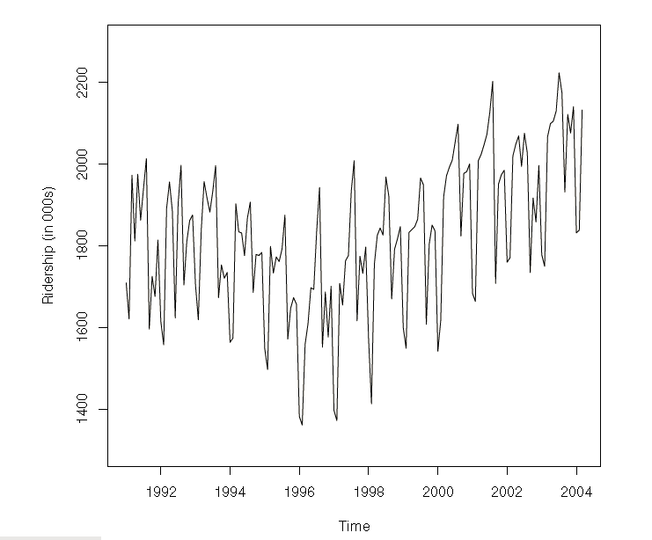
Time Series Components
Example: Ridership on Amtrak Trains

Slide 18
Time Series Components
Example: Ridership on Amtrak Trains
Looking at the time plot reveals the nature of the series components:
The overall level is around 1,800,000 passengers per month
A slight U-shaped trend is discernible during this period, with pronounced annual seasonality, with peak travel during summer (July and August).
Few tools are required to examine it more carefully.
Zoom in
Change scale of series → for better identification of shape of a trend
Add trend lines → for better discerning the shape of the trend is to add a trend line
Suppress seasonality → It is often easier to see trends in the data when seasonality is suppressed.

Slide 19
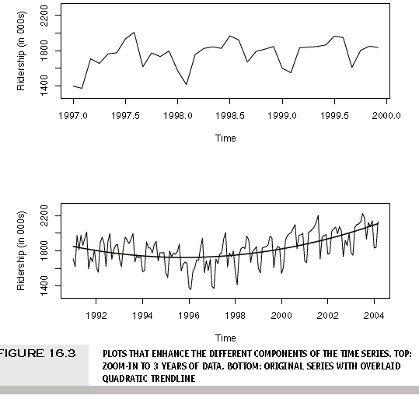
Time Series Components
Example: Ridership on Amtrak Trains

Slide 20
Time Series Components
Some forecasting methods directly model these components by making assumptions about their structure.
Assumption of Trend Line → linear or exponential over time
Assumption of noise structure → normal distribution
Model Driven Models
Data Driven Models → good if the assumptions are violated, etc
key criterion for deciding of a model → the nature of the series in terms of global vs. local patterns.
A global pattern is one that is relatively constant throughout the series.
e.g Linear trend throughout the entire data
A local pattern is one that occurs only in a short period of the data, and then changes → e.g slope of trend line changes for every four points

Slide 21
Time Series Components
Some forecasting methods directly model these components by making assumptions about their structure.
Assumption of Trend Line → linear or exponential over time
Assumption of noise structure → normal distribution
Model Driven Models → suited for Local patterns
Data Driven Models → suited for global patterns → good if the assumptions are violated, etc
key criterion for deciding of a model → the nature of the series in terms of global vs. local patterns.
A global pattern is one that is relatively constant throughout the series.
e.g Linear trend throughout the entire data
A local pattern is one that occurs only in a short period of the data, and then changes → e.g slope of trend line changes for every four points

Slide 22
Time Series Components
Some forecasting methods directly model these components by making assumptions about their structure.
Assumption of Trend Line → linear or exponential over time
Assumption of noise structure → normal distribution
Model Driven Models → suited for Local patterns
Data Driven Models → suited for global patterns → good if the assumptions are violated, etc
key criterion for deciding of a model → the nature of the series in terms of global vs. local patterns.
A global pattern is one that is relatively constant throughout the series.
e.g Linear trend throughout the entire data
A local pattern is one that occurs only in a short period of the data, and then changes → e.g slope of trend line changes for every four points

Slide 23
Data-Partitioning
In order to avoid overfitting and to be able to assess the predictive performance of the model on new data, the data has to be partitioned into two parts
Training Set
Validation Set
Random partition is done at cross-sectional data
However, in time series, a random partition would create two time series with “holes.” → missing values → so methods are not able to handle these data → different approach is required to partitioning the data
The series is trimmed into two periods:
Earlier period → training set
Later period → validation set

Slide 24
Regression – Based Forecasting
A popular forecasting tool is based on multiple linear regression models.
It uses suitable predictors to capture trend and/or seasonality.

Slide 25
Regression – Based Forecasting
A Model with Trend: Linear Trend
To create a linear regression model that captures a time series with a global linear trend
the outcome variable (Y ) is set as the time series values or some function of it
the predictor (X) is set as a time index.

Slide 26
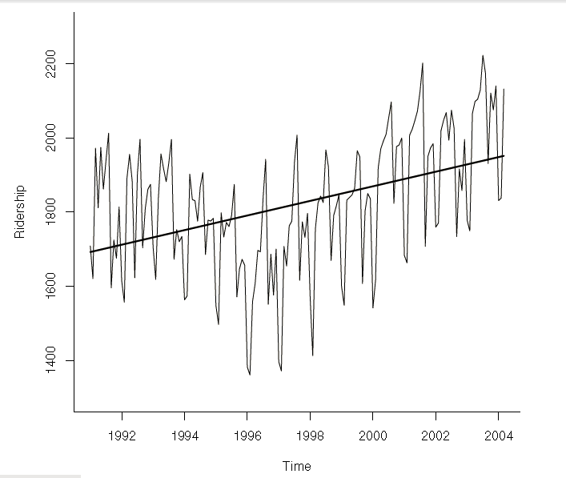
Regression – Based Forecasting
A Model with Trend: Amtrak Ridership Example
fitting a linear trend to the Amtrak ridership data.

Slide 27

Regression – Based Forecasting
A Model with Trend: Amtrak Ridership Example
From that plot:
global trend is not linear
To obtain a linear relationship between Ridership and Time,
output variable Y as the Amtrak Ridership
create a new variable that is a time index t = 1,2,3,..etc, as a single predictor
The regression model is
Where Y_{t} → Ridership at period t
ϵ is the standard noise term in linear regression
Model four time series components: level(β₀), trend(β₁) and noise (ϵ). Seasonality is not modelled.

Slide 28
Regression – Based Forecasting
A Model with Trend: Example – 2
You’re a marketing analyst for Hasbro Toys. Using coded years, you find Yi = .6 + .7Xi.
1995 1 1996 1 1997 2 1998 2 1999 4
Forecast 2000 sales

Slide 29
Regression – Based Forecasting
A Model with Trend: Example – 2
Year Coded Year Sales (Units) 1995 0 1 1996 1 1 1997 2 2 1998 3 2 1999 4 4 2000 5 ?
2000 forecast sales: Yi = .6 + .7·(5) = 4.1
The equation would be different if ‘Year’ used.

Slide 30
Regression – Based Forecasting
Year Coded Sales
94 0 2
95 1 5
96 2 2
97 3 2
98 4 7
99 5 6
Projected to year 2000
Excel Output

Slide 31
Regression – Based Forecasting
A Model with Trend: Example – 2
Year Coded Year Sales (Units) 1995 0 1 1996 1 1 1997 2 2 1998 3 2 1999 4 4 2000 5 ?
2000 forecast sales: Yi = .6 + .7·(5) = 4.1
The equation would be different if ‘Year’ used.

Slide 32

Regression – Based Forecasting
A Model with Trend: Exponential Trend
An exponential trend implies a multiplicative increase/decrease of the series over time
To fit an exponential trend, simply replace the outcome variable Y with log Y (where log is a natural logarithm) and fit a linear regression

Slide 33
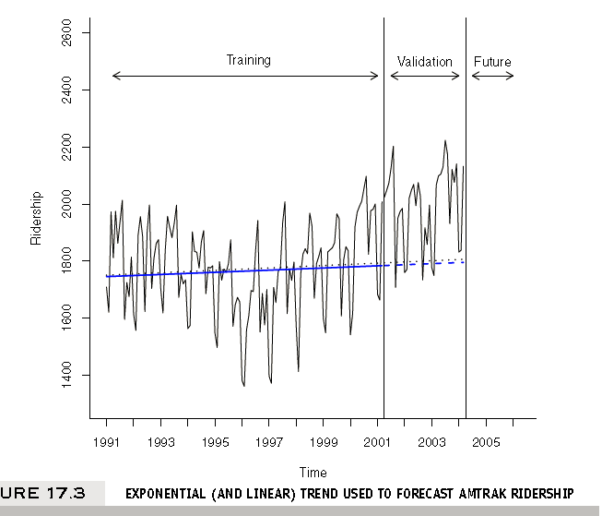
Regression – Based Forecasting
A Model with Trend: Exponential Trend → Example

Slide 34


Regression – Based Forecasting
A Model with Trend: Polynomial Trend
Another non-linear trend shape that is easy to fit via linear regression is a polynomial trend.
a quadratic relationship of the form
This is done by creating an additional predictor t² and fitting a multiple linear regression with the two predictors t and t².

Slide 35
Regression – Based Forecasting
A Model with Seasonality:
A seasonal pattern in a time series means that observations that fall in some seasons have consistently higher or lower values than those that fall in other seasons.
E.g:
day-of-week patterns
monthly patterns
quarterly patterns
The Amtrak ridership monthly time series, as can be seen in the time plot, exhibits strong monthly seasonality (with highest traffic during summer months).

Slide 36
Regression – Based Forecasting
A Model with Seasonality:
Seasonality is captured in a regression model by creating a new categorical variable that denotes the season for each value.
This categorical variable is then turned into dummies, which in turn are included as predictors in the regression model.
Example: Amtrak ridership data
Then, to include the Season categorical variable as a predictor in a regression model for Y (Ridership), we turn it into dummies (for m = 12 seasons we create 11 dummies, which are binary variables that take on the value 1 if the record falls in that particular season, and 0 otherwise3).

Slide 37
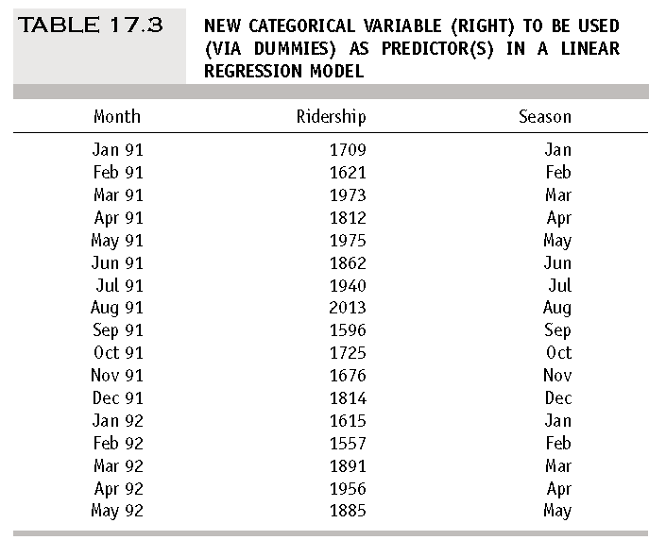
Regression – Based Forecasting
A Model with Seasonality:

Slide 38
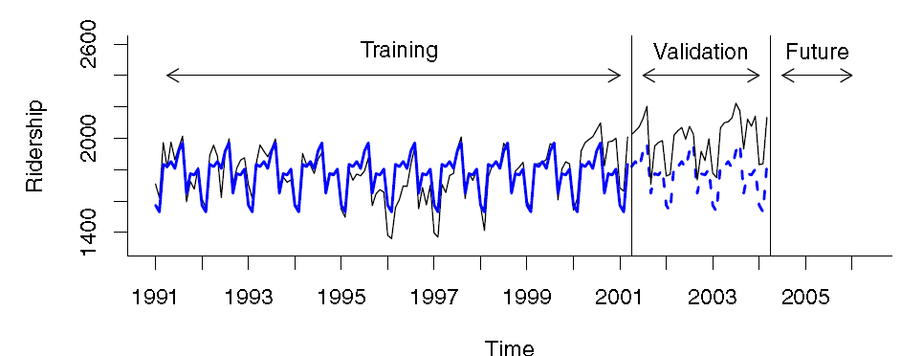
Regression – Based Forecasting
A Model with Seasonality:

Slide 39
Regression – Based Forecasting
A Model with Trend and Seasonality:
It capture both trend and seasonality by including predictors of both types.
Example:
from our exploration of the Amtrak Ridership data, it appears that a quadratic trend and monthly seasonality are both warranted
We therefore fit a model to the training data with 13 predictors: 11 dummies for month, and t and t² for trend.

Slide 40
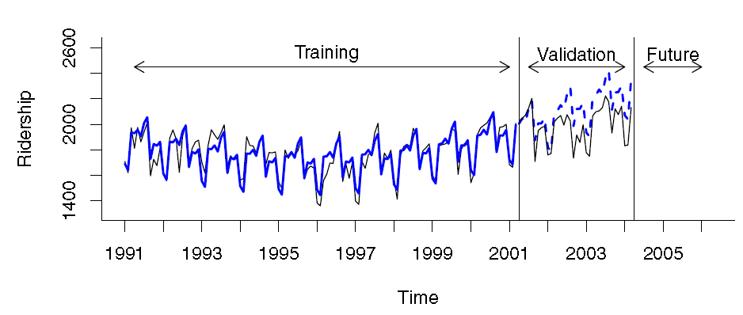
Regression – Based Forecasting
A Model with Trend and Seasonality:

Slide 41
Regression – Based Forecasting
Autocorrelation and ARIMA Models:
In the time series context, values in neighboring periods tend to be correlated → Such correlation, called autocorrelation.
It is informative and can help in improving forecasts.
If we know that a high value tends to be followed by high values (positive autocorrelation), then we can use that to adjust forecasts..
How to compute the autocorrelation of a series?
How best to utilize the information for improving forecasts?

Slide 42
Regression – Based Forecasting
Computing Autocorrelation:
Correlation between values of a time series in neighboring periods is called autocorrelation, because it describes a relationship between the series and itself.
To compute autocorrelation, we compute the correlation between the series and a lagged version of the series.
A lagged series is a “copy” of the original series which is moved forward one or more time periods.
A lagged series with lag-1 is the original series moved forward one time period.
A lagged series with lag-2 is the original series moved forward two time periods,

Slide 43
Regression – Based Forecasting
Computing Autocorrelation:
Next, to compute the lag-1 autocorrelation, which measures the linear relationship between values in consecutive time periods, we compute the correlation.

Slide 44
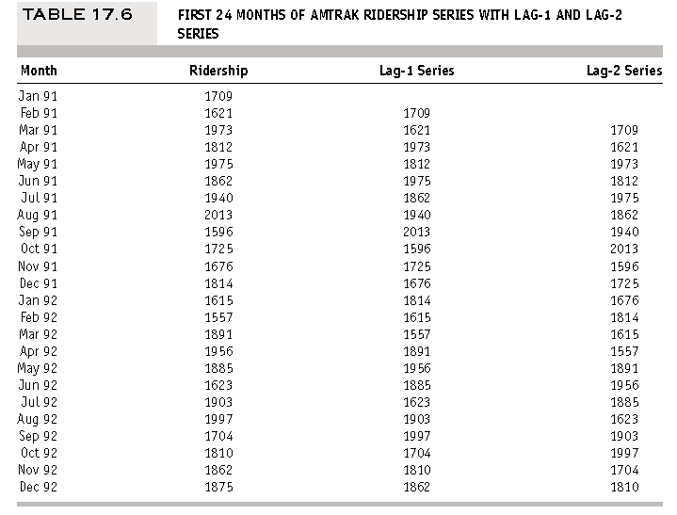
Regression – Based Forecasting

Slide 45
Regression – Based Forecasting
Computing Autocorrelation:
A few typical autocorrelation behaviors that are useful to explore are:
Strong autocorrelation (positive or negative) at a lag k larger than 1:
It reflects a cyclical pattern
Positive lag-1 autocorrelation:
a series where consecutive values move generally in the same direction
Negative lag-1 autocorrelation:
It reflects swings in the series, where high values are immediately followed by low values and vice versa.

Slide 46
Thank you

