Slide 1
PCA: General
From k original variables: x₁,x₂,...,x_{k}:
Produce k new variables: y₁,y₂,...,y_{k}:
y₁ = a₁₁x₁ + a₁₂x₂ + ... + a_{1k}x_{k}
y₂ = a₂₁x₁ + a₂₂x₂ + ... + a_{2k}x_{k}
...
y_{k} = a_{k1}x₁ + a_{k2}x₂ + ... + a_{kk}x_{k}
such that:
y_{k}'s are uncorrelated (orthogonal)
y₁ explains as much as possible of original variance in data set
y₂ explains as much as possible of remaining variance
etc.

Slide 2
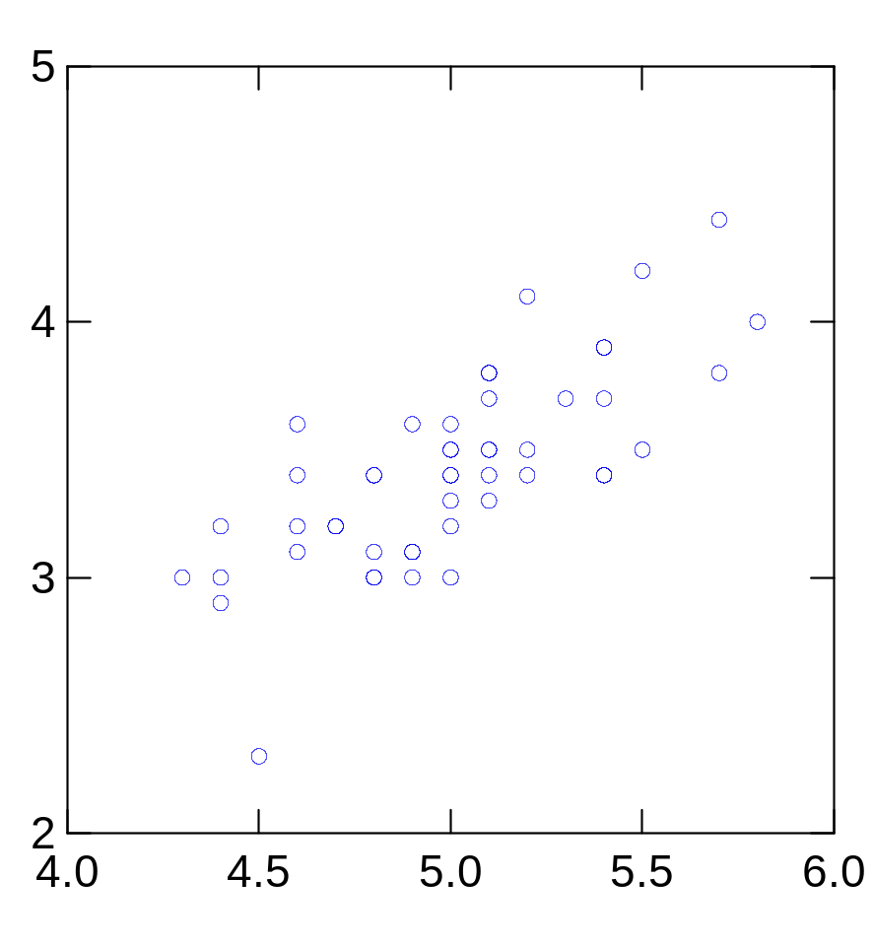
2nd Principal
Component, y₂
1st Principal
Component, y₁

Slide 3
PCA Scores
x_{i2}
y_{i,1}
y_{i,2}
x_{i1}

Slide 4
PCA Eigenvalues
λ₂
λ₁

Slide 5
PCA: Another Explanation
From k original variables: x₁,x₂,...,x_{k}:
Produce k new variables: y₁,y₂,...,y_{k}:
y₁ = a₁₁x₁ + a₁₂x₂ + ... + a_{1k}x_{k}
y₂ = a₂₁x₁ + a₂₂x₂ + ... + a_{2k}x_{k}
...
y_{k} = a_{k1}x₁ + a_{k2}x₂ + ... + a_{kk}x_{k}
y_{k}'s are
Principal Components
such that:
y_{k}'s are uncorrelated (orthogonal)
y₁ explains as much as possible of original variance in data set
y₂ explains as much as possible of remaining variance
etc.

Slide 6
Principal Components Analysis on:
Covariance Matrix:
  Variables must be in same units
  Emphasizes variables with most variance
  Mean eigenvalue ≠1.0
Correlation Matrix:
  Variables are standardized (mean 0.0, SD 1.0)
  Variables can be in different units
  All variables have same impact on analysis
  Mean eigenvalue = 1.0

Slide 7
PCA: General
{a₁₁,a₁₂,...,a_{1k}} is 1st Eigenvector of correlation/covariance matrix, and coefficients of first principal component
{a₂₁,a₂₂,...,a_{2k}} is 2nd Eigenvector of correlation/covariance matrix, and coefficients of 2nd principal component
…
{a_{k1},a_{k2},...,a_{kk}} is kth Eigenvector of correlation/covariance matrix, and coefficients of kth principal component

Slide 8
PCA Summary until now
Rotates multivariate dataset into a new configuration which is easier to interpret
Purposes
  simplify data
  look at relationships between variables
  look at patterns of units

Slide 9
PCA: Yet Another Explanation

Slide 10
PCA Example –STEP 1
Subtract the mean
from each of the data dimensions. All the x values have x subtracted and y values have y subtracted from them. This produces a data set whose mean is zero.
Subtracting the mean makes variance and covariance calculation easier by simplifying their equations. The variance and co-variance values are not affected by the mean value.

Slide 11
PCA Example –STEP 1
http://kybele.psych.cornell.edu/~edelman/Psych-465-Spring-2003/PCA-tutorial.pdf
ZERO MEAN DATA:
x y
.69 .49
-1.31 -1.21
.39 .99
.09 .29
1.29 1.09
.49 .79
.19 -.31
-.81 -.81
-.31 -.31
-.71 -1.01
DATA:
x y
2.5 2.4
0.5 0.7
2.2 2.9
1.9 2.2
3.1 3.0
2.3 2.7
2 1.6
1 1.1
1.5 1.6
1.1 0.9

Slide 12
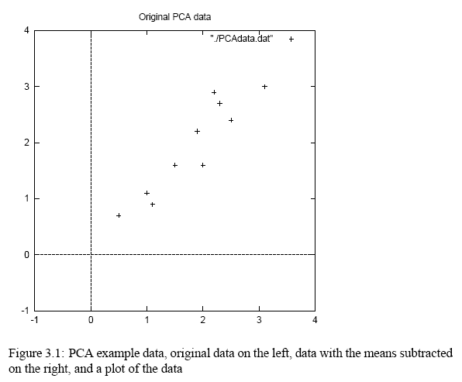
PCA Example –STEP 1
http://kybele.psych.cornell.edu/~edelman/Psych-465-Spring-2003/PCA-tutorial.pdf

Slide 13
PCA Example –STEP 2
Calculate the covariance matrix
cov = .616555556 .615444444
.615444444 .716555556
since the non-diagonal elements in this covariance matrix are positive, we should expect that both the x and y variable increase together.

Slide 14
PCA Example –STEP 3
Calculate the eigenvectors and eigenvalues of the covariance matrix
eigenvalues = .0490833989
1.28402771
eigenvectors = -.735178656 -.677873399
.677873399 -.735178656

Slide 15
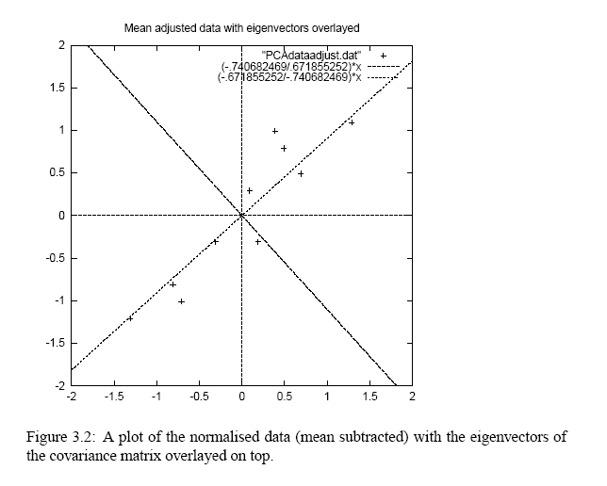
PCA Example –STEP 3
http://kybele.psych.cornell.edu/~edelman/Psych-465-Spring-2003/PCA-tutorial.pdf
eigenvectors are plotted as diagonal dotted lines on the plot.
Note they are perpendicular to each other.
Note one of the eigenvectors goes through the middle of the points, like drawing a line of best fit.
The second eigenvector gives us the other, less important, pattern in the data, that all the points follow the main line, but are off to the side of the main line by some amount.

Slide 16
PCA Example –STEP 4
Reduce dimensionality and form feature vector
the eigenvector with the highest eigenvalue is the principle component of the data set.
In our example, the eigenvector with the larges eigenvalue was the one that pointed down the middle of the data.
Once eigenvectors are found from the covariance matrix, the next step is to order them by eigenvalue, highest to lowest. This gives you the components in order of significance.

Slide 17
PCA Example –STEP 4
Now, if you like, you can decide to ignore the components of lesser significance.
You do lose some information, but if the eigenvalues are small, you don’t lose much
n dimensions in your data
calculate n eigenvectors and eigenvalues
choose only the first p eigenvectors
final data set has only p dimensions.

Slide 18
PCA Example –STEP 4
Feature Vector
FeatureVector = (eig₁ eig₂ eig₃ … eig_{n})
We can either form a feature vector with both of the eigenvectors:
-.677873399 -.735178656
-.735178656 .677873399
or, we can choose to leave out the smaller, less significant component and only have a single column:
- .677873399
- .735178656

Slide 19
PCA Example –STEP 5
Deriving the new data
FinalData = RowFeatureVector x RowZeroMeanData
RowFeatureVector is the matrix with the eigenvectors in the columns transposed so that the eigenvectors are now in the rows, with the most significant eigenvector at the top
RowZeroMeanData is the mean-adjusted data transposed, ie. the data items are in each column, with each row holding a separate dimension.

Slide 20
PCA Example –STEP 5
FinalData transpose: dimensions along columns
x y
-.827970186 -.175115307
1.77758033 .142857227
-.992197494 .384374989
-.274210416 .130417207
-1.67580142 -.209498461
-.912949103 .175282444
.0991094375 -.349824698
1.14457216 .0464172582
.438046137 .0177646297
1.22382056 -.162675287

Slide 21
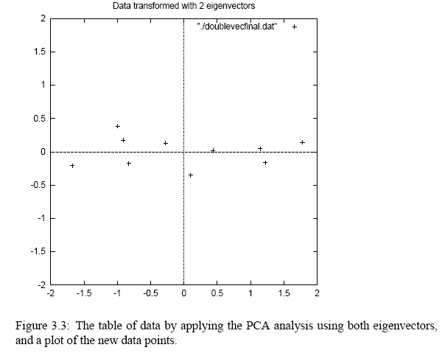
PCA Example –STEP 5
http://kybele.psych.cornell.edu/~edelman/Psych-465-Spring-2003/PCA-tutorial.pdf

Slide 22
Reconstruction of original Data
If we reduced the dimensionality, obviously, when reconstructing the data we would lose those dimensions we chose to discard. In our example let us assume that we considered only the x dimension…

Slide 23
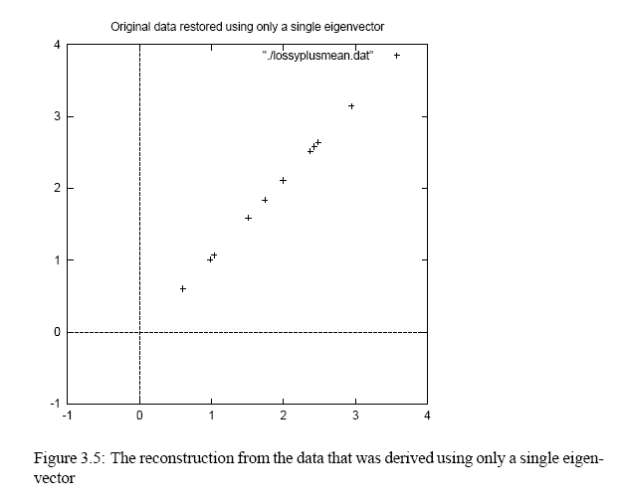
Reconstruction of original Data
http://kybele.psych.cornell.edu/~edelman/Psych-465-Spring-2003/PCA-tutorial.pdf
x
-.827970186
1.77758033
-.992197494
-.274210416
-1.67580142
-.912949103
.0991094375
1.14457216
.438046137
1.22382056

