Slide 1
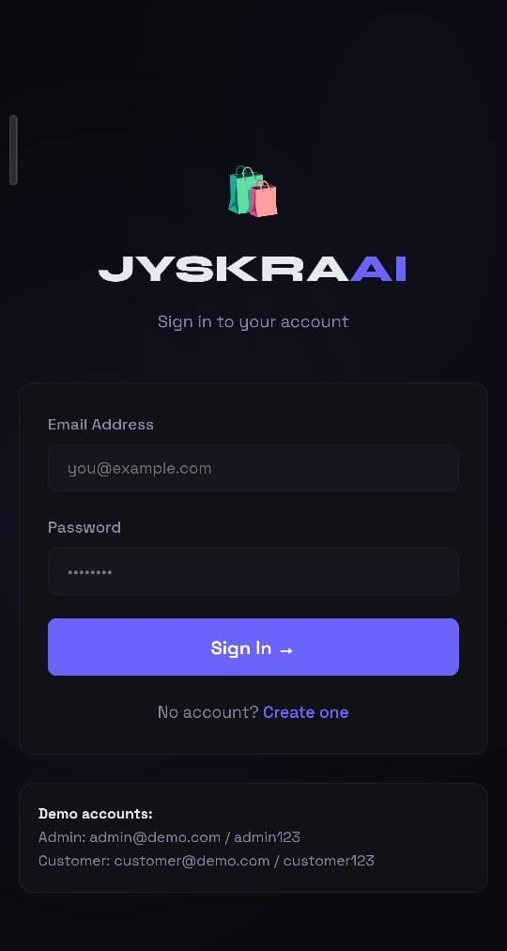
🛍️
JYSKRA
AI Assisted Coding — Course Project
Jyothi Nadipelli
2303a52115 | AI Assisted Coding Project
🌐 frontend-two-omega-2dj86yvkr8.vercel.app

Slide 2
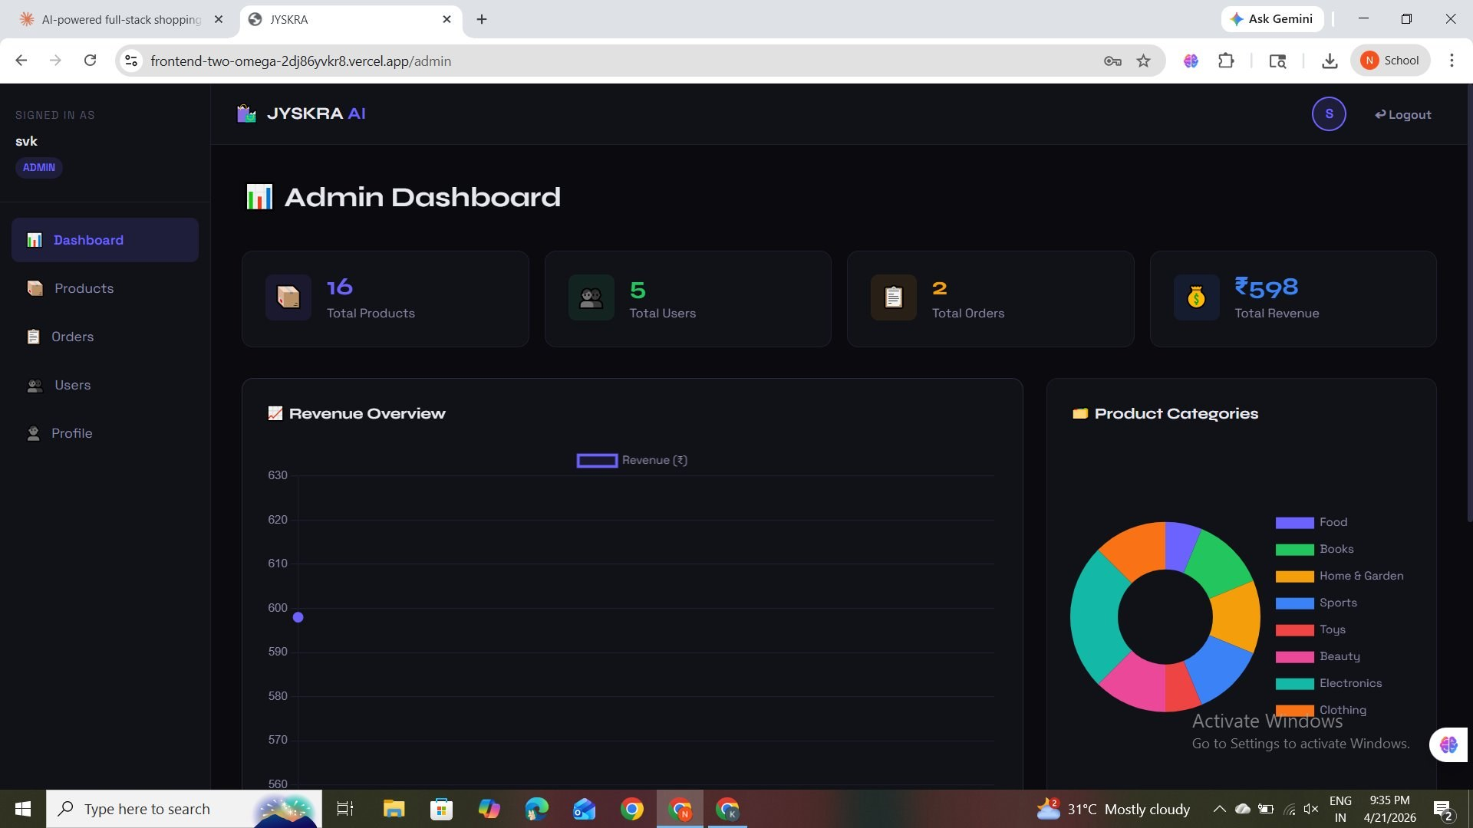
Introduction
JYSKRA is a full-stack AI-powered e-commerce platform built with Node.js, MongoDB, and React. It delivers accurate, personalized shopping experiences using a 3-layer AI recommendation engine.
The Problem
Manual product discovery is slow and irrelevant — customers miss products they'd love, and merchants lose sales. Generic browsing without personalization wastes time.
Our Solution
A fast, intelligent shopping platform that learns from user behavior — purchase history, browsing patterns, and trending data — to surface the right products instantly.

Slide 3
Project Objectives
1
2
Build a Full-Stack Web App
Integrate AI Recommendations
Develop a clean, responsive React frontend with Node.js/Express backend, allowing users to browse products, manage carts, and place orders seamlessly.
Implement a 3-layer AI engine combining category affinity, collaborative filtering, and trending fallback to deliver personalized product suggestions.
3
4
Demonstrate AI-Assisted Dev
Deploy & Document the System
Showcase how AI tools like Claude (Anthropic) and GitHub Copilot accelerated the development lifecycle — from scaffolding to deployment.
Deploy on Vercel (Frontend) + Railway (Backend), connect MongoDB Atlas, seed demo data, and document the entire architecture and API endpoints.

Slide 4
Stakeholders
Who This Project Serves
END USERS
ACADEMIC
EVALUATORS
→
End Users
Admin managers and customers who browse products, manage orders, and receive personalized AI-based recommendations.
PROJECT
→
Academic Evaluators
Professors and project judges assessing technical architecture, AI integration, and deployment quality.
→
AI Providers
Anthropic (Claude) — whose conversational AI was used to scaffold, debug, and refine the entire codebase.
DEVELOPMENT
TEAM
AI PLATFORM
PROVIDERS
→
Development Team
Student developer responsible for design, full-stack implementation, testing, and Vercel/Railway deployment.

Slide 5
Languages, Tools & Software
Node.js / Express
React 18 + Vite
Core backend runtime and web framework. Handles REST API routing, session management, file uploads, and middleware.
Frontend framework for building the responsive SPA with role-based routing, Context API state management, and Chart.js dashboards.
MongoDB Atlas
Claude (Anthropic AI)
Cloud-hosted NoSQL database with 4 collections (Users, Products, Orders, Cart), session store, and text search index.
AI pair programmer used throughout development to scaffold the entire full-stack codebase, debug errors, and optimize deployment.
Railway + Vercel (Docker)
bcryptjs + express-session
Backend deployed on Railway (Docker), frontend on Vercel. Both auto-deploy on GitHub push.
Password hashing and session-based authentication with MongoDB store, enabling secure login and role-based access control.

Slide 6
AI Prompts Used to Build JYSKRA
The entire project was scaffolded using Claude (Anthropic). Below are representative prompts submitted during development.
1
2
Full-Stack Scaffold
AI Recommendation Engine
"Build a complete full-stack AI shopping system with Node.js, MongoDB, and React. Include auth, cart, orders, admin dashboard, and AI recommendations."
"Implement a 3-layer recommendation engine: category affinity from purchase/browse history, collaborative filtering from similar users, and trending fallback."
3
4
Admin Dashboard Charts
Railway Deployment Fix
"Add Chart.js revenue line chart and product category doughnut chart to the admin dashboard, pulling data from MongoDB aggregation pipelines."
"Create a Dockerfile for the Node.js backend at /backend that installs dependencies and runs server.js, to deploy on Railway using Docker builder."

Slide 7
System Workflow & Architecture
Login / Register
AI Recommends
bcryptjs + express-session
authentication flow
3-layer engine analyses
history & trends
📤
🤖
🛍️
🛒
Browse Products
Add to Cart
Filter by category, search
sort by price/popularity
Server-side cart with
real-time total calculation
The hybrid architecture ensures high availability and shopping quality: the AI engine layer serves fast, personalized recommendations, while the REST API + session middleware handles authentication, cart persistence, and order management.

Slide 8
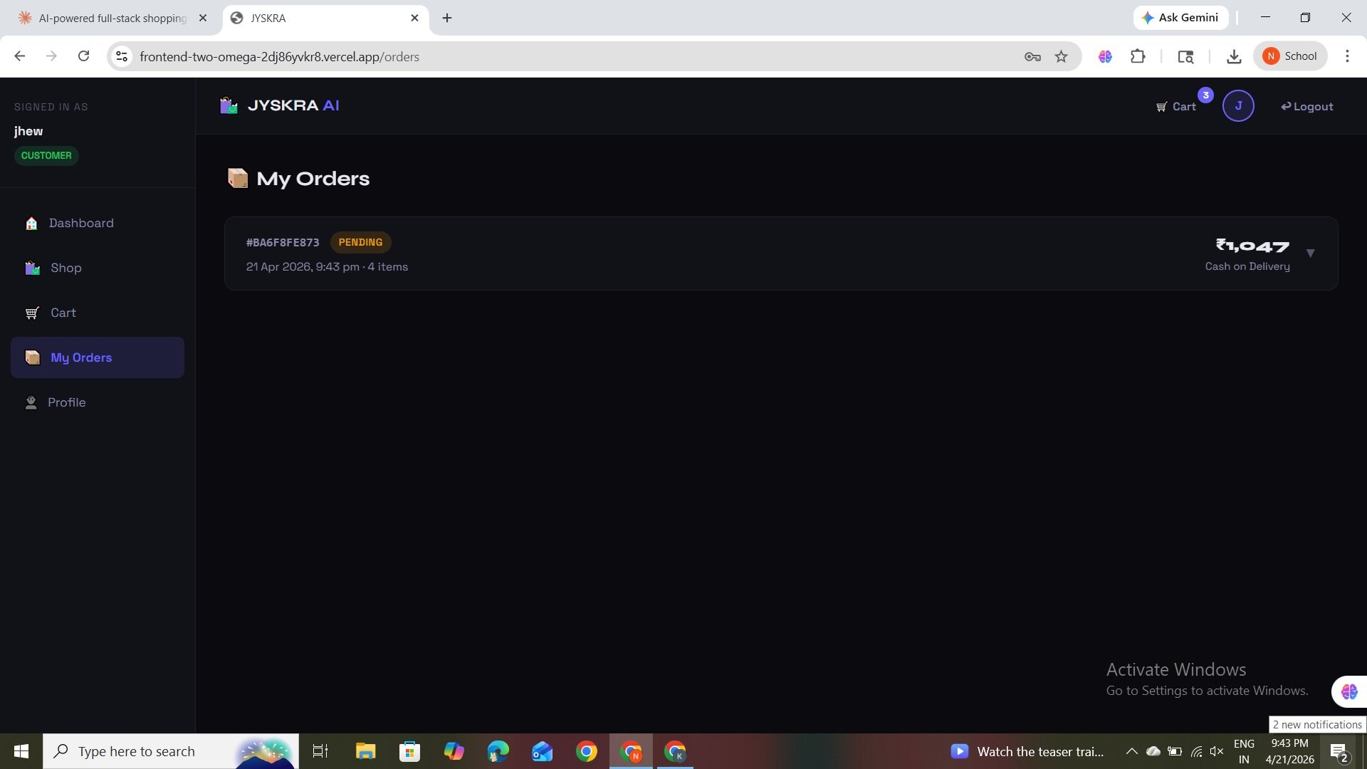
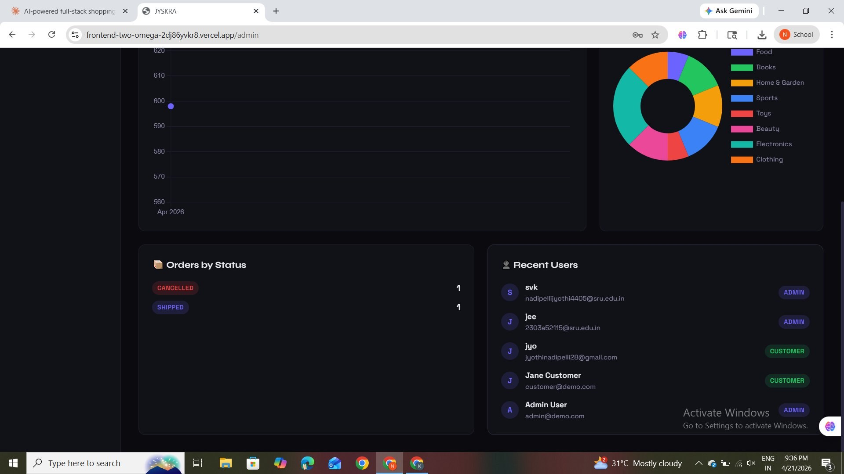
Admin Dashboard — Live Screenshots
Real screenshots from the deployed JYSKRA admin panel at frontend-two-omega-2dj86yvkr8.vercel.app
Admin Dashboard — Stats & Charts
Admin Dashboard — Orders by Status & Recent Users

Slide 9
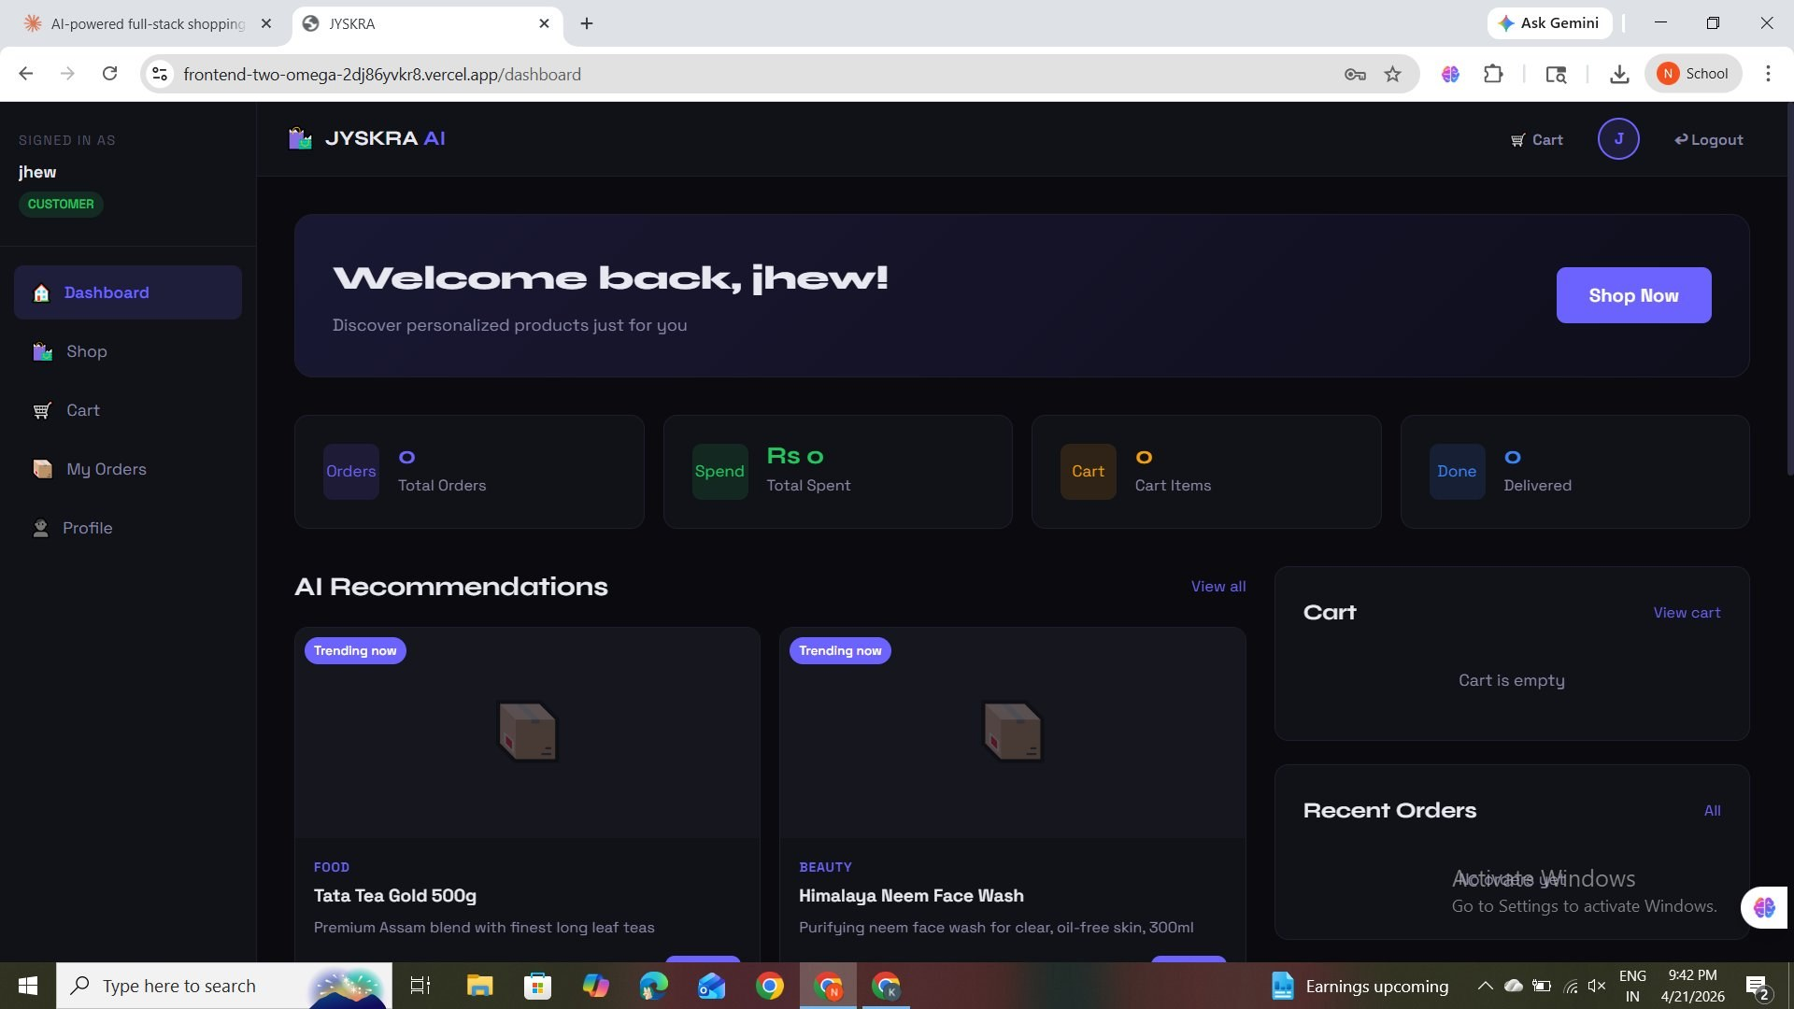
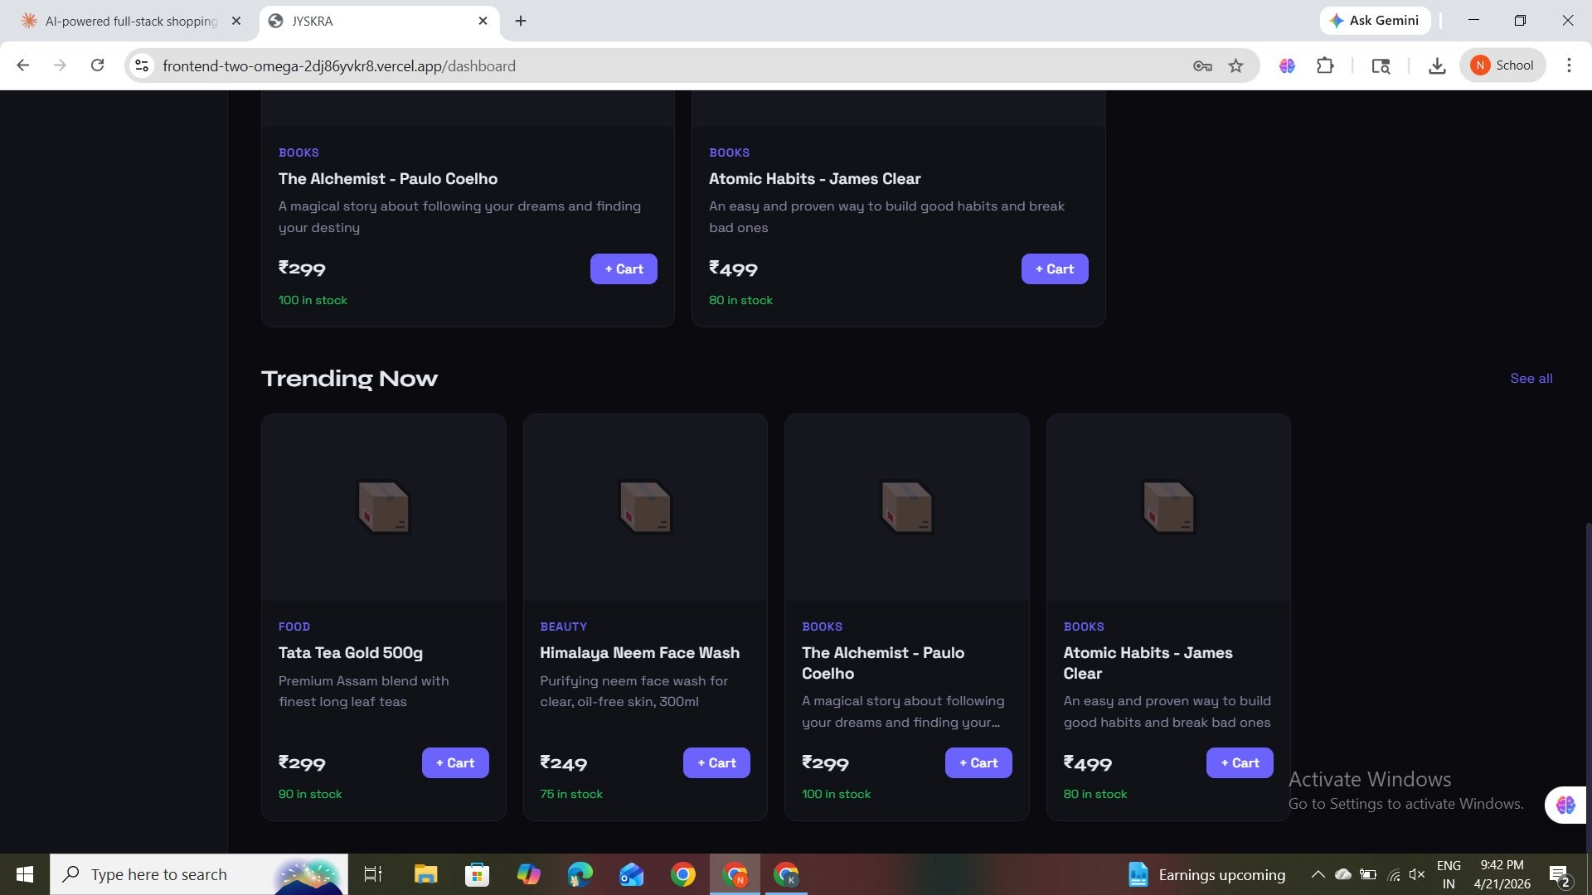
Customer Dashboard & Shop — Live Screenshots
Customer-facing pages showing AI recommendations, product browsing with filters, and trending items.
Customer Dashboard — AI Recommendations & Trending
Shop Page — Category Filters, Search & Product Grid

Slide 10
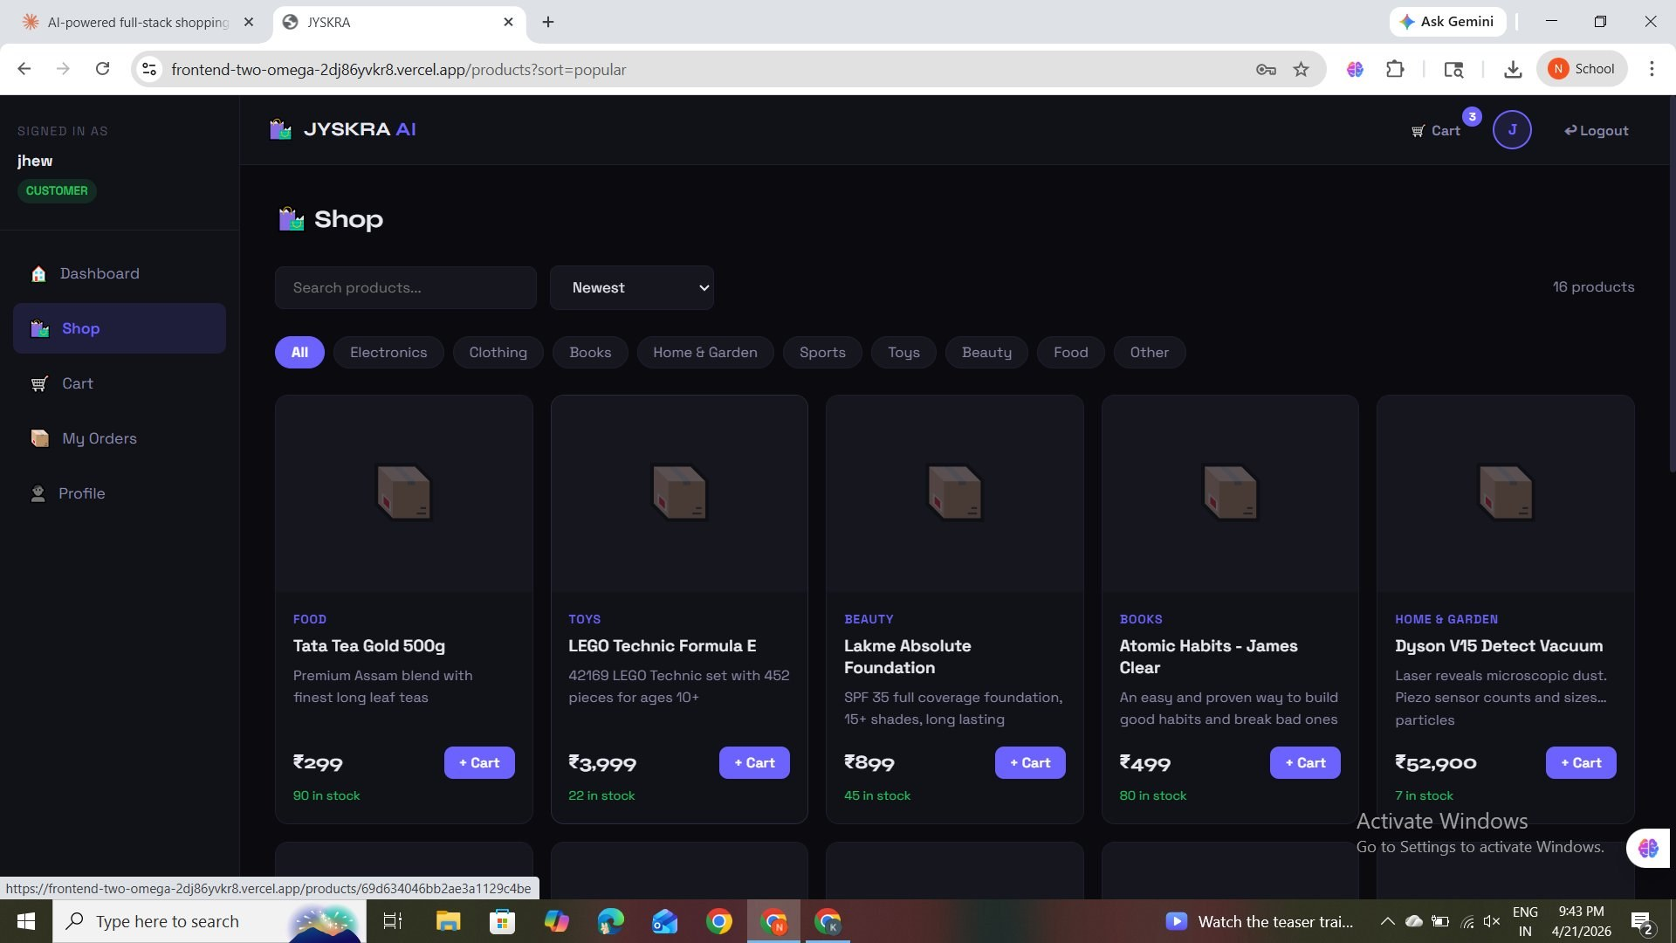
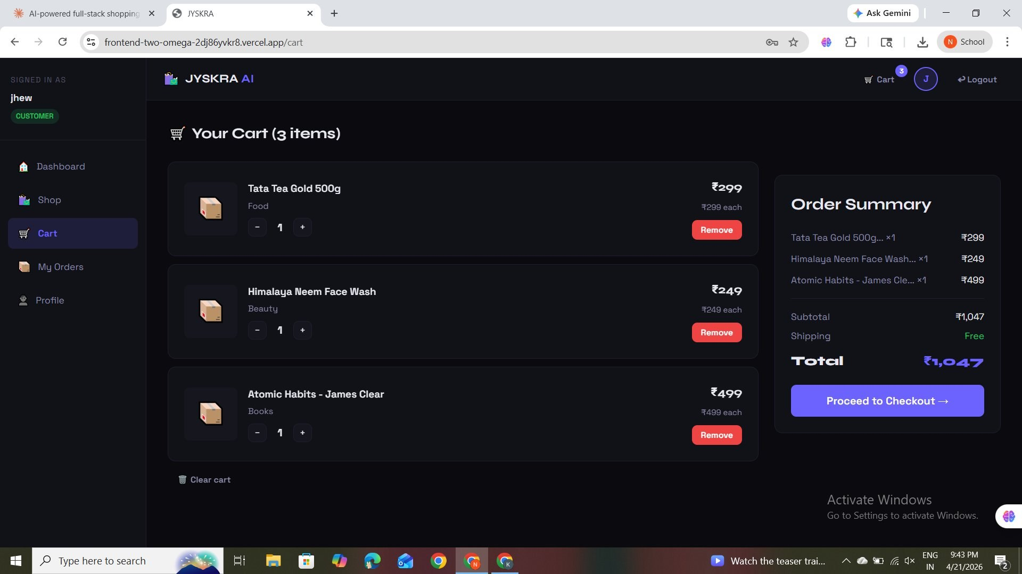
Cart & Order Management — Live Screenshots
Real cart with 3 items totalling ₹1,047 and order history showing live order #BA6F8FE873 placed on 21 Apr 2026.
Cart — 3 Items · ₹1,047 Total · Free Shipping
My Orders — Live Order History with Status Tracking

Slide 11
Proof of AI-Generated Code
The following demonstrates real Claude (Anthropic) sessions used during development — showing transparent, responsible use of AI-assisted coding throughout the project lifecycle.
Claude.ai — AI Conversation
What Was AI-Generated
You: Build a complete full-stack AI shopping system with Node.js, MongoDB, React. Include auth, cart, orders, admin dashboard with charts, and AI recommendations.
Full Backend API
Express server, all 6 route groups, controllers, session middleware, and Multer upload.
Claude: I'll build this production-ready full-stack app. Let me start with the backend models, then controllers, routes, and finally the React frontend...
AI Recommendation Engine
3-layer logic: category affinity, collaborative filtering, trending fallback.
You: Add a 3-layer AI recommendation engine based on purchase history and collaborative filtering.
React Frontend
All 11 pages, Context API, Sidebar, Navbar, ProductCard, and dark CSS design system.
Claude: Here's the recommendation controller with category affinity scoring, collaborative filtering logic, and trending product fallback...
Dockerfile Deployment
Docker configuration, Railway setup, MongoDB Atlas integration, and seed script.
Used Claude (Anthropic) to build the entire project

Slide 12
References
Anthropic Claude API
MongoDB Atlas
Railway Deployment
React 18 Documentation
Anthropic. (2025). Claude: AI Assistant for Software Development. https://claude.ai
MongoDB Inc. (2024). Atlas Cloud Database Documentation. https://www.mongodb.com/atlas
Railway.app. (2024). Railway — Deploy Code Live in Seconds. https://railway.app
Meta Open Source. (2024). React — The Library for Web and Native UI. https://react.dev
Express.js & Node.js
OpenJS Foundation. (2024). Express — Fast, Unopinionated, Minimalist Web Framework for Node.js. https://expressjs.com
Node.js. (2024). Node.js v18 LTS Documentation. https://nodejs.org/en/docs

