Slide 1
AI-Powered Retrieval-
Augmented Chatbot
NAME (BY) :- S. JYOTHIRADHITYA

Slide 2
Introduction :
Data-driven decision making is essential in every domain.
Traditional chatbots are limited to scripted answers.
Modern users expect context-aware, dynamic, and reliable responses
.
This project introduces an AI-powered Retrieval-Augmented Generation (RAG) chatbot

Slide 3
Problem Statement :
Users often struggle to extract insights from large datasets.
Generic chatbots provide inaccurate or incomplete answers.
Lack of explainability and data-grounding in responses.
Difficulty in integrating natural language queries with databases and visualization.

Slide 4
Proposed Solution :
Develop an Agent-based RAG system that:
Retrieves relevant context from documents/databases.
Uses LLM (Large Language Model) for generating human-like answers.
Built with Python, Streamlit, and modular AI agents.
Scalable and customizable for different domains.

Slide 5
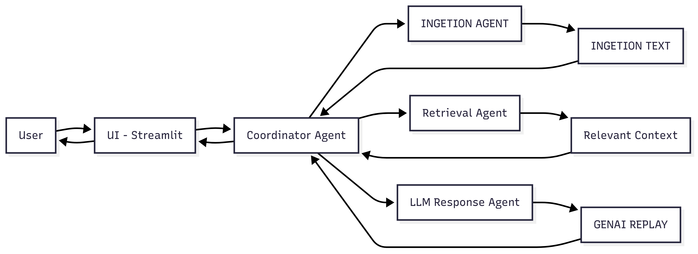
System Structure (Architecture)

