Slide 1
SMART SALINE SYSTEM
SUBMITTED BY
Jyothi Raju (11612830) (29)
Bharat Krishna (11601934) (03)
Revanth Krishna (11606873) (24)

Slide 2
OVERVIEW
INTRODUCTION
COMPONENTS
HOW DOES IT WORK
ALGORITHM
CIRCUIT DIAGRAM
T_I_C_F
APPLICATIONS
REFERENCES

Slide 3
INTRODUTION
The main theme of the project is to make the hosipitals a digital one. The secondary theme is save life of the people while injecting the saline into the patients.
The process includes GSM module, which can give the message alrets to hosipital ward management people.
The can operate the entire system from their phone by giving single message from phone.then the servo motor can come online and makes the saline to turn off.

Slide 4
COMPONENTS
GSM MODULE
LOAD CELL SENSOR
ARDUINO
HX711(AMPLIFIER)
JUMPER WIRES
SALINE BOTTLE
SALINE WATER
SERVO MOTOR

Slide 5
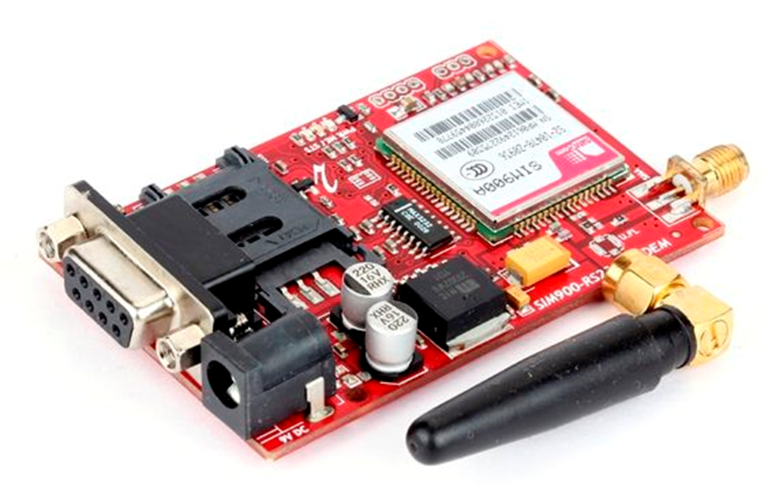
GSM MODULE
A GSM modem is a device which can be either a mobile phone or a modem device which can be used to make a computer or any other processor communicate over a network.
A GSM modem requires a SIM card to be operated and operates over a network range subscribed by the network operator. It can be connected to a computer through serial, USB or Bluetooth connection.

Slide 6
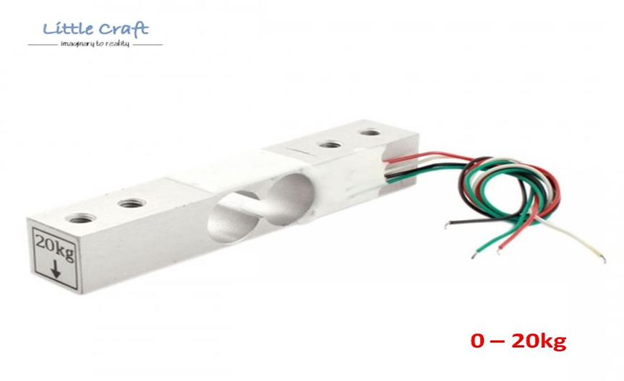
Load cell sensor
Load cell is a type of transducer which performs the functionality of converting force into an electric output which can be measured. You can find load cell at the heart of any weighing machine or electric scales.
This type of transducer is highly accurate which provides user with required information that is difficult to obtain by other technology owing to certain commercial

Slide 7
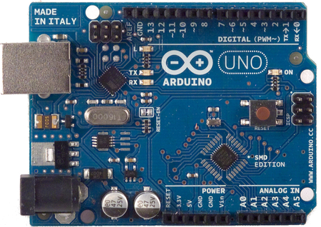
ARDUINO
The Arduino UNO is a widely used open-source microcontroller board based on the ATmega328P microcontroller and developed by Arduino. The board is equipped with sets of digital and analog input/output (I/O) pins that may be interfaced to various expansion boards (shields) and other circuits.
The board features 14 Digital pins and 6 Analog pins. It is programmable with the Arduino IDE (Integrated Development Environment) via a type B USB cable. It can be powered by a USB cable or by an external 9 volt battery, though it accepts voltages between 7 and 20 volts.

Slide 8
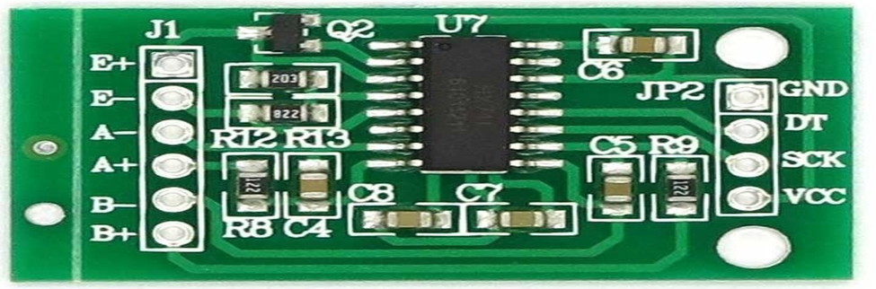
HX711(AMPLIFIER)
HX711 is a precision 24-bit analogto-digital converter (ADC) designed for weigh scales and industrial control applications to interface directly with a bridge sensor.
HX711 Load Cell Amplifier Module uses 24 high-precision ADC converter chip hx711, is designed for high-precision electronic scale and design, with two analog input channels, the internal programmable gain amplifier integrated multiplier 128.The HX711 uses a two wire interface (Clock and Data) for communication.

Slide 9
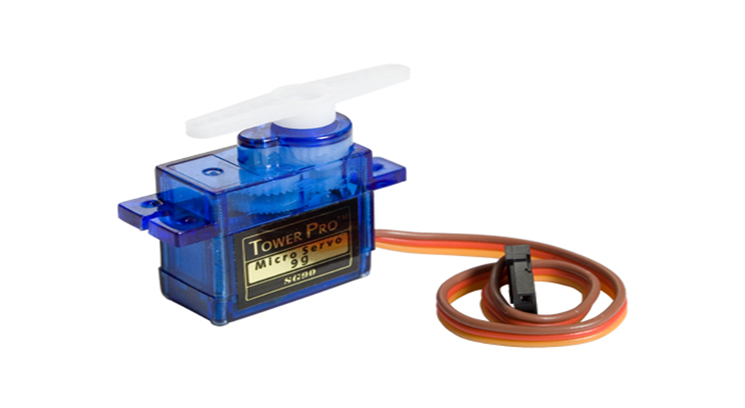
SERVO MOTOR
Tiny and light weight with high output power
Servo can rotate approximately 180 degrees(90 degrees in each direction), and works like standard kinds but smaller
A servomotor is a rotary actuator or linear actuator that allows for precise control of angular or linear position, velocity and acceleration. It consists of a suitable motor coupled to a sensor for position feedback. It also requires a relatively sophisticated controller, often a dedicated module designed specifically for use with servomotors.

Slide 10
HOW DOES IT WORK ???
LETS MAKE A QUICK REVIEW

Slide 11
ALGORITHM
For calculating weight we used algorithm :
count=count+1;
val=((count-1)/count)*val + (1/count)*cell.read();
val = cell.read();
estimatedWeight=(val-136601)/119.848f;
For calculating percentage we used algorithm :
percentage= map( estimatedWeight,0,500,0,100);
For GSM we used algorithm :
AT+CMGF=1
AT+CMGS=\"+919877614163\"\r
AT+CNMI=2,2,0,0,0
ATD+919877614163;

Slide 12
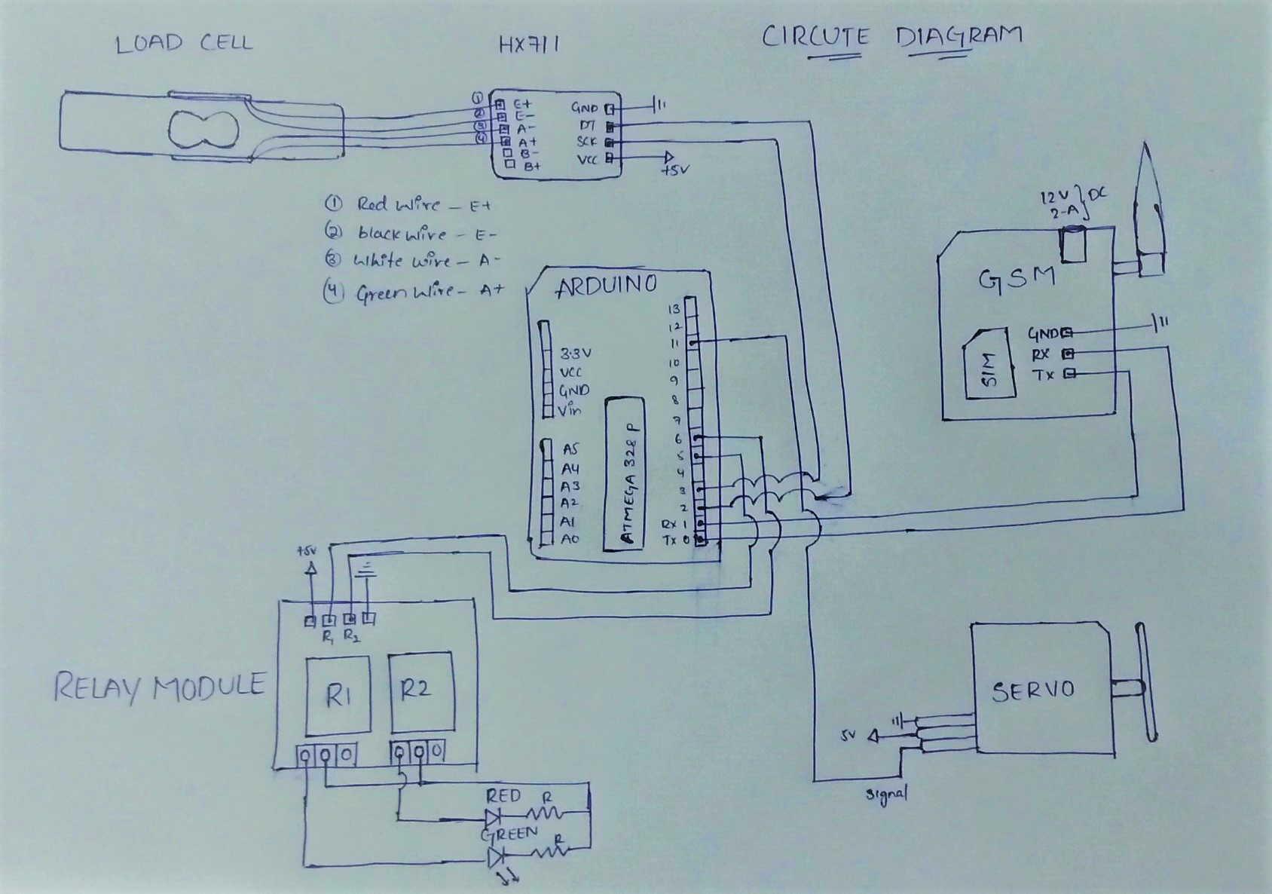
CIRCUIT DIAGRAM

Slide 13
T_I_C_F
T – TECHNOLOGY
I – INOVATION
C – CONCEPT
F - FEASIBILITY

Slide 14
APPLICATIONS
Smart Saline System
To make whole hospital devices smarter

Slide 15
REFERENCES
Load Cell : https://learn.sparkfun.com/tutorials/getting-started-with-load-cells
Load Cell tut : https://www.youtube.com/watch?v=nGUpzwEa4vg&t=15s

Slide 16
THANK YOU

