Slide 1
Interview Trainer Agent
IBM HACKATHON PROJECT
Presented By:
Student name : CHAPALA JYOTHIRMAI
College Name & Department : Vignan’s Foundation for Science Technology and Research guntur- a.p & CSE(Data science)

Slide 2
OUTLINE
Problem Statement
Technology used
Wow factor
End users
Result
Conclusion
Git-hub Link
Future scope
IBM Certifications

Slide 3
Problem Statement
Job seekers often face challenges in preparing effectively for interviews, especially when it comes to identifying role-specific questions, understanding industry expectations, and improving both technical and soft skills.
Manual preparation using generic content from the internet does not offer personalized or structured interview training. This leads to lack of confidence, inadequate answers, and missed opportunities in competitive hiring processes.

Slide 4
Proposed Solution:
An AI-powered Interview Trainer Agent, built using Retrieval-Augmented Generation (RAG) and IBM Cloud technologies, that provides customized interview preparation by analyzing the user’s resume, experience level, and target job role. It retrieves and generates:
Tailored technical & HR questions
Behavioral scenario responses
Role-based preparation tips
Improvement suggestions
Model answers & soft skill feedback
This intelligent assistant enhances user readiness and boosts success rates in interviews.

Slide 5
Technology used
IBM cloud lite services
Natural Language Processing (NLP)
Retrieval Augmented Generation (RAG)
IBM Granite model

Slide 6
IBM cloud services used
IBM Cloud Watsonx AI Studio
IBM Cloud Watsonx AI runtime
IBM Cloud Agent Lab
IBM Granite foundation model

Slide 7
Wow factors
Tailored Interview Preparation Automatically generates interview questions and answers based on the user’s job role, experience level.
Role-Specific Intelligence Retrieves real interview data from job portals and company databases to give realistic and current questions.
Soft Skill & HR Simulation Supports not just technical questions but also HR scenarios and behavioral questions, mimicking real-life interview rounds.

Slide 8
Wow factors
Instant Feedback System Provides model answers, performance tips, and areas for improvement—boosting user confidence and clarity.
Multi-Source Retrieval (RAG) Uses Retrieval-Augmented Generation to combine knowledge from various sources, making the training content highly accurate and contextual.
Future-Ready AI Model (IBM Granite) Uses IBM’s state-of-the-art foundation model for natural and human-like responses.
User-Friendly Interface Clean, interactive design that even non-technical users can operate easily.

Slide 9
End users
Fresh Graduates
Job Seekers
Career Switchers
Training & Placement Cells
Interview Coaching Centers
HR Departments
EdTech Platforms

Slide 10
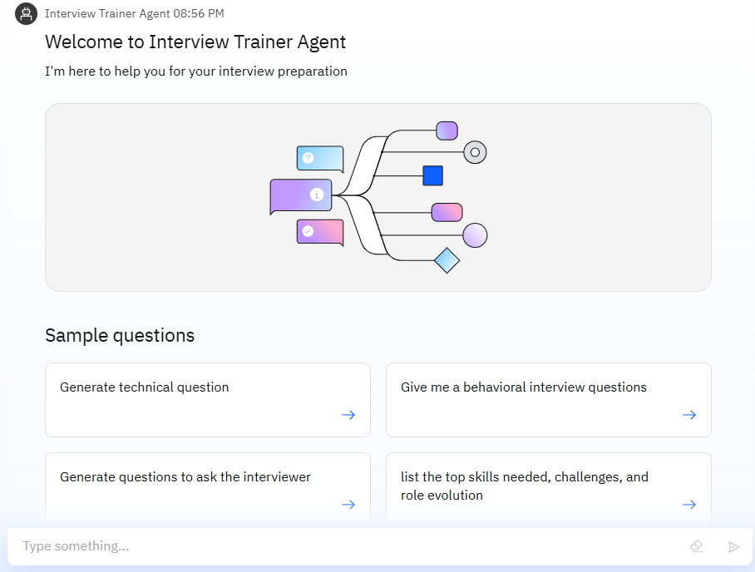
Results

Slide 11
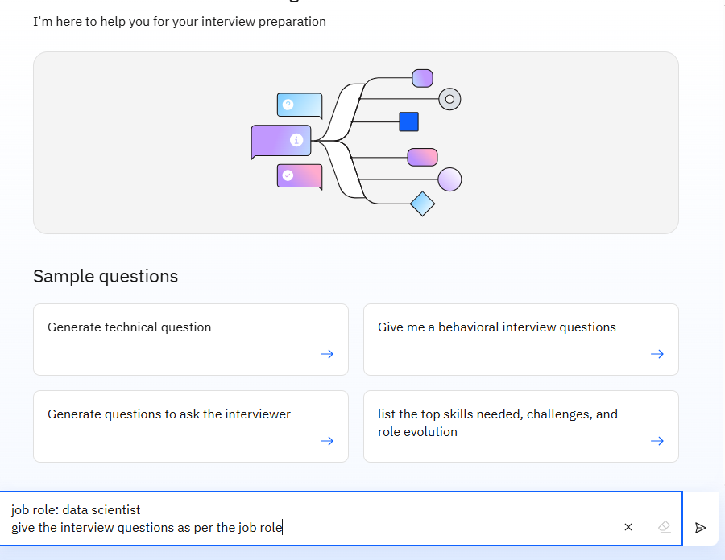
Results

Slide 12
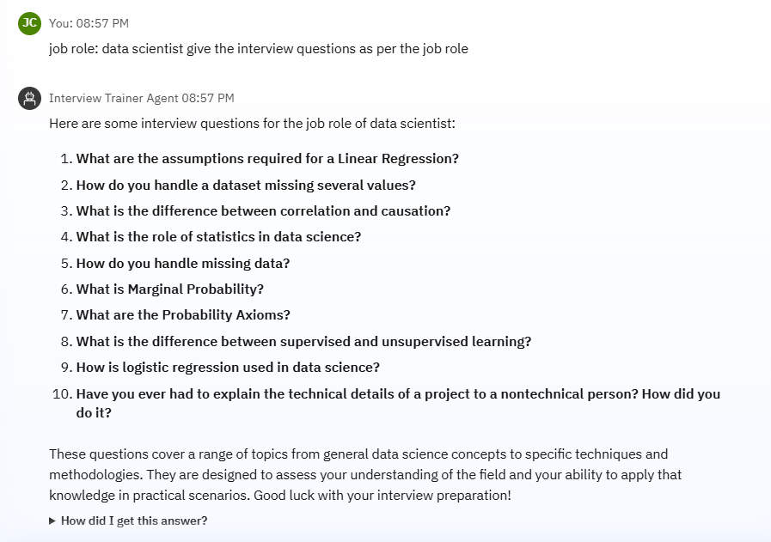
Results

Slide 13
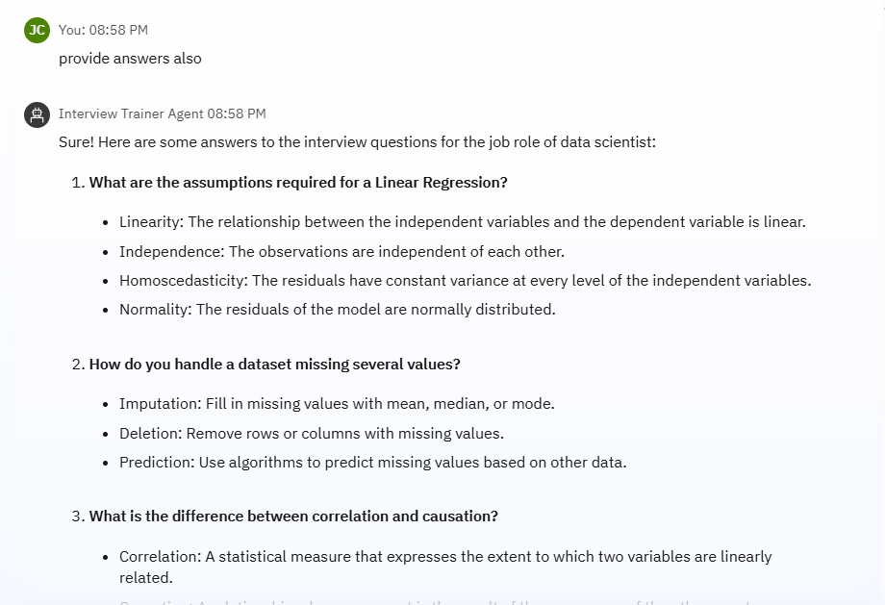
Results

Slide 14
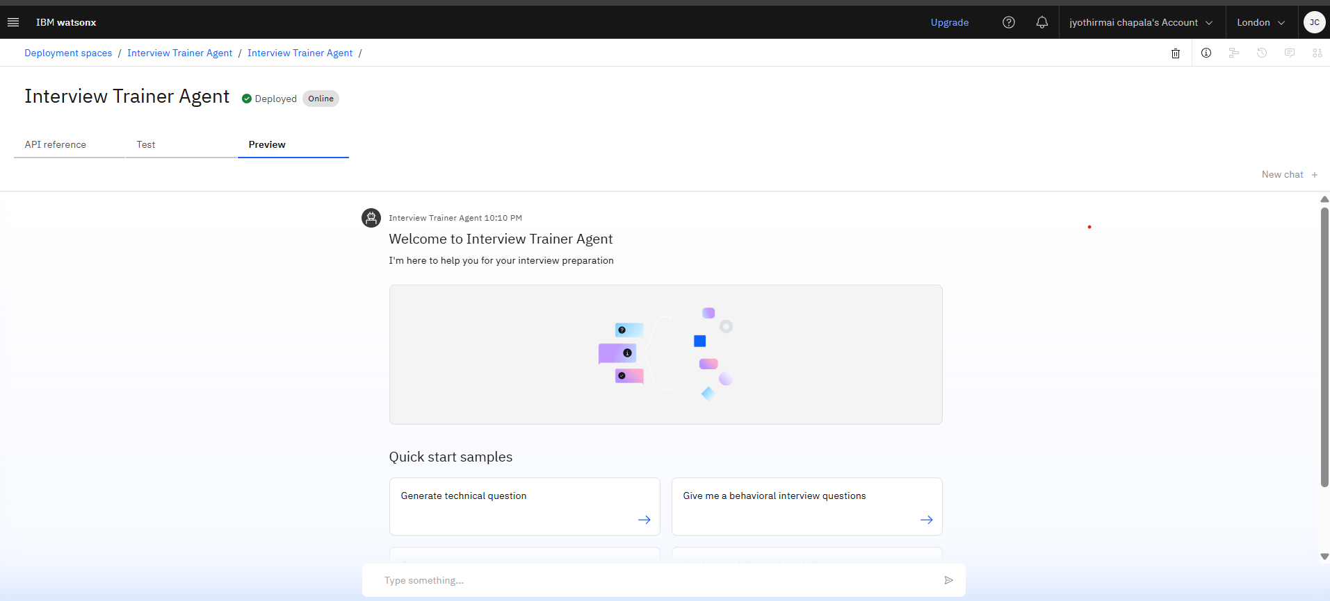
Results
Deployed AI Agent

Slide 15
Conclusion
The Interview Trainer Agent provides personalized and comprehensive interview preparation.
Enhances user confidence, clarity, and performance through AI-driven training.
Covers both technical and soft skills using real-time data and role-based customization.

Slide 16
Conclusion
Saves time, increases success rates, and improves readiness for competitive hiring.
Demonstrates the power of RAG + IBM Granite in solving real-world problems effectively.

Slide 17
GitHub Link
Github (or)
https://github.com/jyothirmai-chapala/Interview_Agent/blob/main/screenshot%281%29.png

Slide 18
Future scope
Voice-Based Interview Simulation
Multilingual Support
Integration with Job Portals
Resume Analysis Enhancements
Video Feedback System
Gamified Interview Challenges

Slide 19
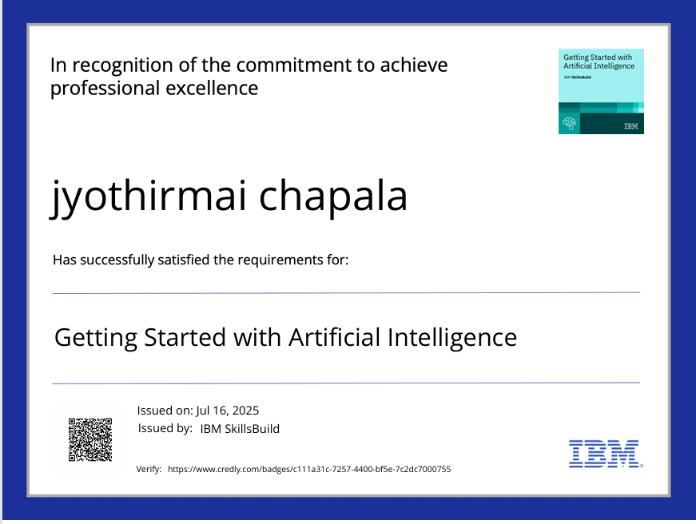
IBM Certifications
Screenshot/ credly certificate( getting started with AI)

Slide 20
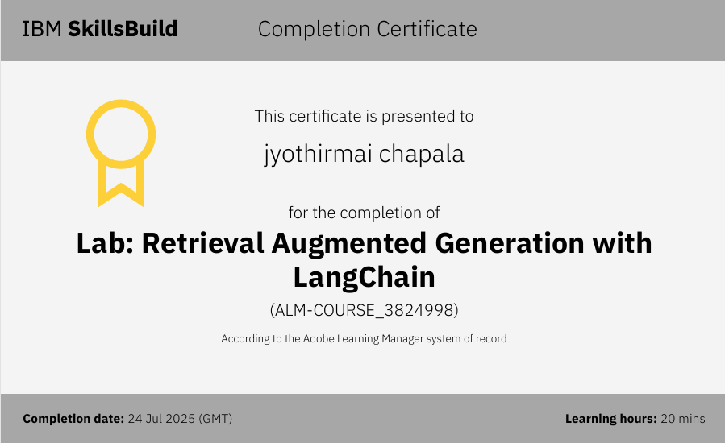
IBM Certifications
Screenshot/ credly certificate( getting started with AI)

Slide 21
THANK YOU

