Slide 1
Alphacom
A recommendation to “cloudify”

Slide 2
About Alphacom
30 successful years in the industry
50,000 employees
Financial Management System (FMS)
Loan Management System (LMS)
Resource Management System (RMS)

Slide 3
Why Cloud?
Elasticity
Optimum resource utilization
Lower costs
Higher computational efficiency
Reduced complexity
Increased agility
Mobility
Disaster recovery

Slide 4
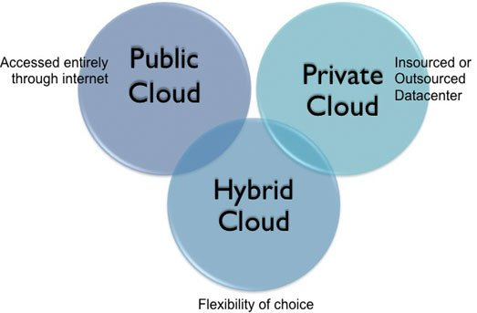
Private Cloud
Dedicated infrastructure
On site
Service provider’s data center
Security
Customization

Slide 5
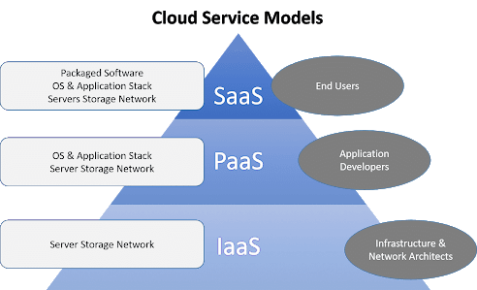
Service models
Infrastructure as a Service (IaaS)
Dynamic scaling
Platform virtualization
Platform as a Service (PaaS)
Development & deployment
Built on top of IaaS
Software as a Service (SaaS)

Slide 6
Recommendations
Private Cloud
IaaS
SaaS

Slide 7
Thank You
Team UST Global

