Slide 1

Firewall Technologies

Slide 2
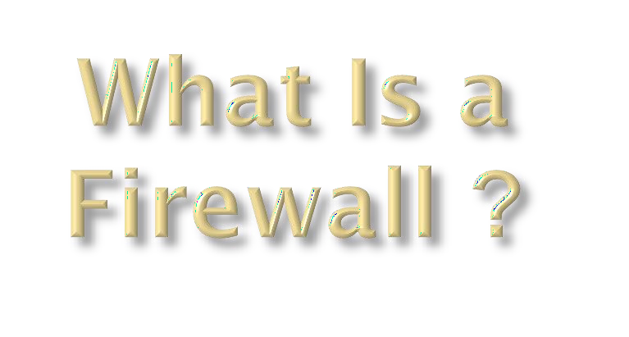
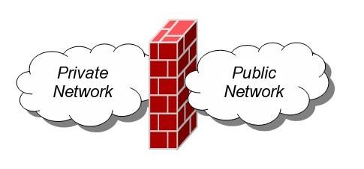
Definition: A Network Firewall is a system or group of systems used to control access between two networks -- a trusted network and an untrusted network -- using pre-configured rules or filters.

Slide 3
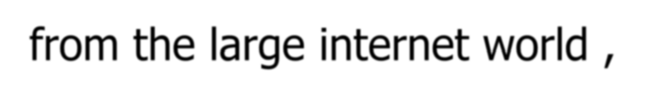
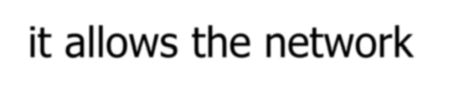
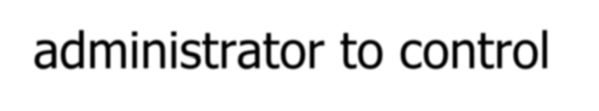
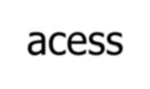
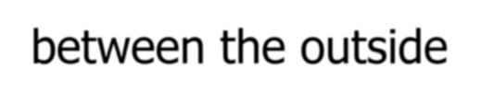
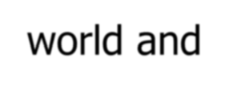

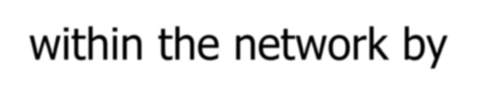
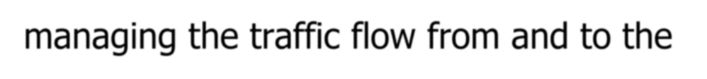

It is the combination of hardware and software
the method to access the network in an organization from the large internet world ,it allows the network administrator to control acess between the outside
world and resourses within the network by managing the traffic flow from and to the
resourses.

Slide 4
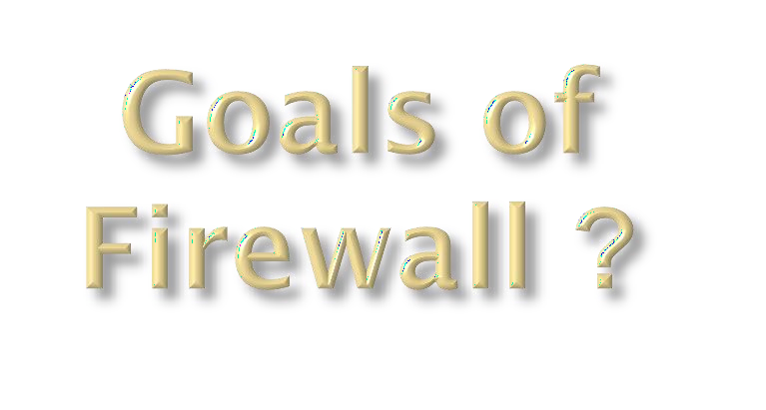
All traffic from outside to inside ,and vice versa,passes through the firewall
Only autorized traffic as defined by the local
security policy will be allowed to pass.
The firewall itself is resistant to penetration.

Slide 5

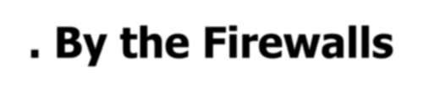



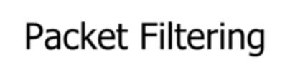
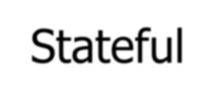
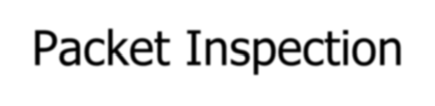
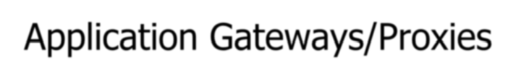
By the Firewalls methodology :
Packet Filtering
Stateful Packet Inspection
Application Gateways/Proxies

Slide 6

▣ As each packet passes through the firewall, it is examined and information contained in the header is compared to a pre-configured set of rules or filters.
An allow or deny decision is made based on the results of the comparison. Each packet is examined individually without regard to other packets that are part of the same connection.

Slide 7
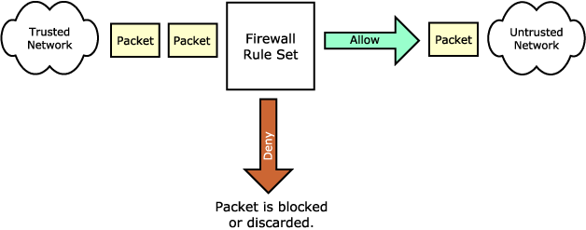




Packet Filtering Firewall
Trusted Network
Firewall rule set
Untrusted Network
Packet is Blocked or Discarded

Slide 8


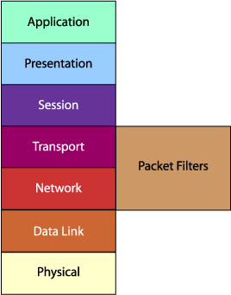
A packet filtering firewall is often called a network layer firewall because the filtering is primarily done at the network layer (layer three) or the transport layer (layer four) of the OSI reference model.

Slide 9
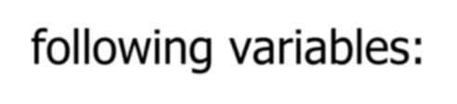

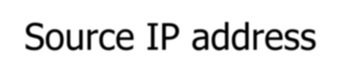
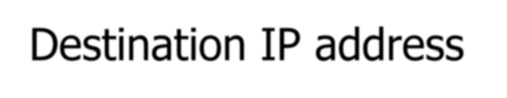
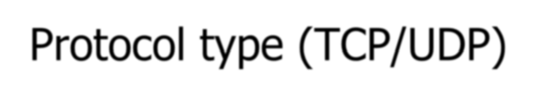
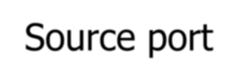
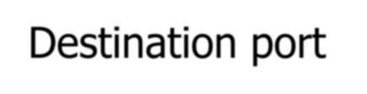
Packet filtering rules or filters can be configured to allow or deny traffic based on one or more of the following variables:
Source IP address
Destination IP address
Protocol type (TCP/UDP)
Source port
Destination port

Slide 10

▣ Strengths :
Packet filtering is typically faster than other packet screening methods. Because packet filtering is done at the lower levels of the OSI model, the time it takes to process a packet is much quicker.
Packet filtering firewalls can be implemented transparently. They typically require no additional configuration for clients.
Packet filtering firewalls are typically less expensive. Many hardware devices and software packages have packet filtering features included as part of their standard package.

Slide 11

Weaknesses
Lack of authentication
Defining rules and filters on a packet filtering firewall can be a complex task.

Slide 12

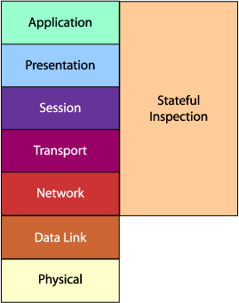
Stateful packet inspection uses the same fundamental packet screening technique that packet filtering does. In addition, it examines the packet header information from the network layer of the OSI model to the application layer to verify that the packet is part of a legitimate connection and the protocols are behaving as expected.

Slide 13
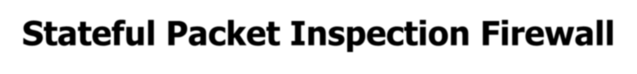
As packets pass through the firewall, packet header information is examined and fed into a dynamic state table where it is stored. The packets are compared to pre- configured rules or filters and allow or deny decisions are made based on the results of the comparison.
The data in the state table is then used to evaluate subsequent packets to verify that they are part of the same connection.

Slide 14
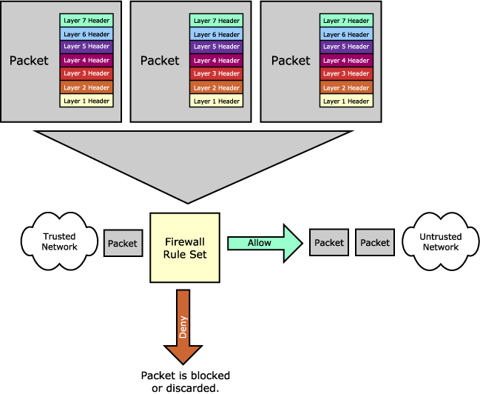



Trusted Network
Untrusted Network
Packet is Blocked or Discarded

Slide 15




Strengths :
More secure than basic packet filtering firewalls. Because stateful packet inspection digs deeper into the packet header information to determine the connection state between endpoints.
Usually it have some logging capabilities. Logging can help identify and track the different types of traffic that pass though the firewall.

Slide 16
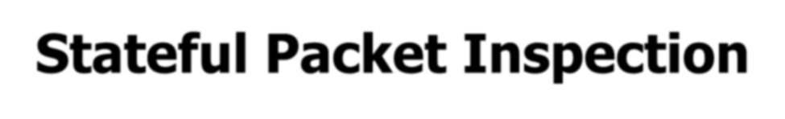
Weaknesses
Like packet filtering, stateful packet inspection does not break the client/server model and therefore allows a direct connection to be made between the two endpoints
Rules and filters in this packet screening method can become complex, hard to manage, prone to error and difficult to test.

Slide 17

The proxy plays middleman in all connection attempts.
The application gateway/proxy acts as an intermediary between the two endpoints. This packet screening method actually breaks the client/server model in that two connections are required: one from the source to the gateway/proxy and one from the gateway/proxy to the destination. Each endpoint can only communicate with the other by going through the gateway/proxy.

Slide 18
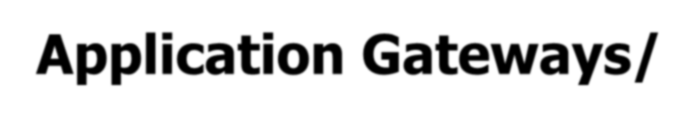

This type of firewall operates at the application level of the OSI model. For source and destination endpoints to be able to communicate with each other, a proxy service must be implemented for each application protocol.
The gateways/proxies are carefully designed to be reliable and secure because they are the only connection point between the two networks.

Slide 19
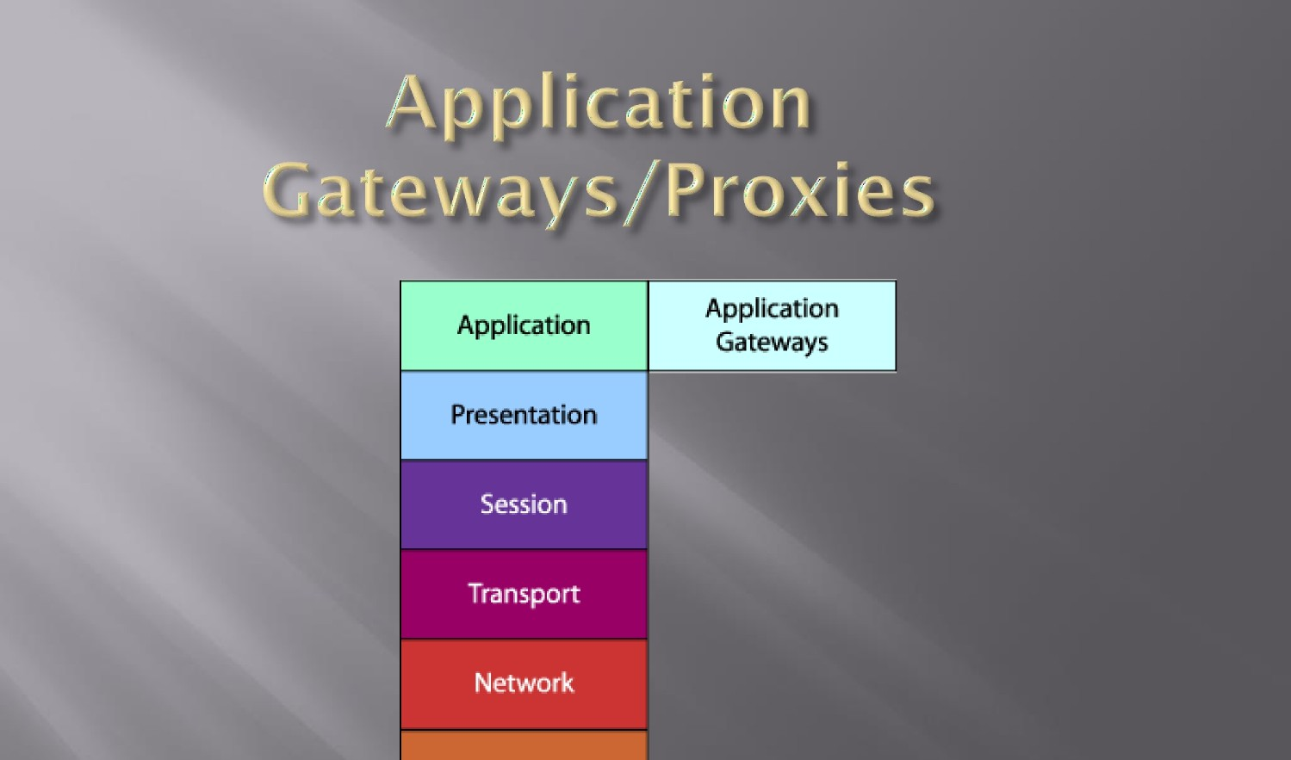
Data Link

Slide 20

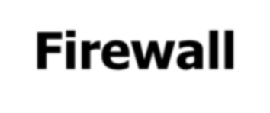








When a client issues a request from the untrusted network, a connection is established with the application gateway/proxy. The proxy determines if the request is valid (by comparing it to any rules or filters) and then sends a new request on behalf of the client to the destination. By using this method, a direct connection is never made from the trusted network to the untrusted network and the request appears to have originated from the application gateway/proxy.
Application
Gateway (Proxy
service)
Untrusted Network
Work Station

Slide 21
The response is sent back to the application gateway/proxy, which determines if it is valid and then sends it on to the client.
By breaking the client/server model, this type of firewall can effectively hide the trusted network from the untrusted network.
It is important to note that the application gateway/proxy only copying known acceptable commands before sending it on to the destination.

Slide 22
Strengths
Application gateways/proxies do not allow a direct connection to be made between endpoints. They actually break the client/server model.
Allow the network administrator to have more control over traffic passing through the firewall. They can permit or deny specific applications or specific features of an application.

Slide 23




Weaknesses
The most significant weakness is the impact they can have on performance.
it requires more processing power and has the potential to become a bottleneck for the network.
Typically require additional client configuration. Clients on the network may require specialized software or configuration changes to be able to connect to the application gateway/proxy.

Slide 24
