Slide 1


CRYPTO CURRENCY ANALYSIS DASHBOARD
20ADC33 – DATA ANALYSIS
TEAM MEMBERS
JYOTHI SHRI S (21ADR019)
HEMANTHH V V (21ADR018) HARIARASU R (21ADR014) PRADEEP R R (21ADR033)
DEPARTMENT OF AI
KONGU ENGINEERING COLLEGE, PERUNDURAI

Slide 2
Problem Statement
Cryptocurrency is a category of digital assets that may be bought, sold, or traded safely.
As of the end of 2021, there were 13,669 cryptocurrencies, according to Coin market cap.
People struggle to pick the best cryptocurrency to invest their money.
Many people have lost their investments by choosing the cryptocurrencies to invest in a wrong way.
Many people lose their investment by choosing untrusted cryptocurrencies.
Since cryptocurrency investment includes real time money, profit, loss, at first a better analysed overview of all those cryptocurrencies are required for every customer for choosing among those coins.

Slide 3
Introduction
Instead of being physical money carried around and exchanged in the real world, cryptocurrency payments exist purely as digital entries.
It is a digital payment system that doesn’t rely on banks to verify transactions.
It is not only disrupting the financial sectors but also other major sectors like information technology, health care, retail, tour and travel and many more.
Although cryptocurrency trading is different from stock market trading, some of the concepts of stock market trading can be considered in understanding cryptocurrency trading.
The top 4 cryptocurrencies after Bitcoin, based on their market capitalization are Ethereum, Tether, Binance Coin, XRP.
Analysis is made on those 4 coins to know about its market capitalisation and other factors.

Slide 4
Business Objective
To compare and analyze which coin has better performance among the 4 cryptocurrency coins.
To find the best coin to invest for according to the past data’s by finding the most transacted coin.
To analyze the role played by month of the year in profit and loss in the cryptocurrency investment.
To compare the highest , lowest and average value obtained by the coins

Slide 5
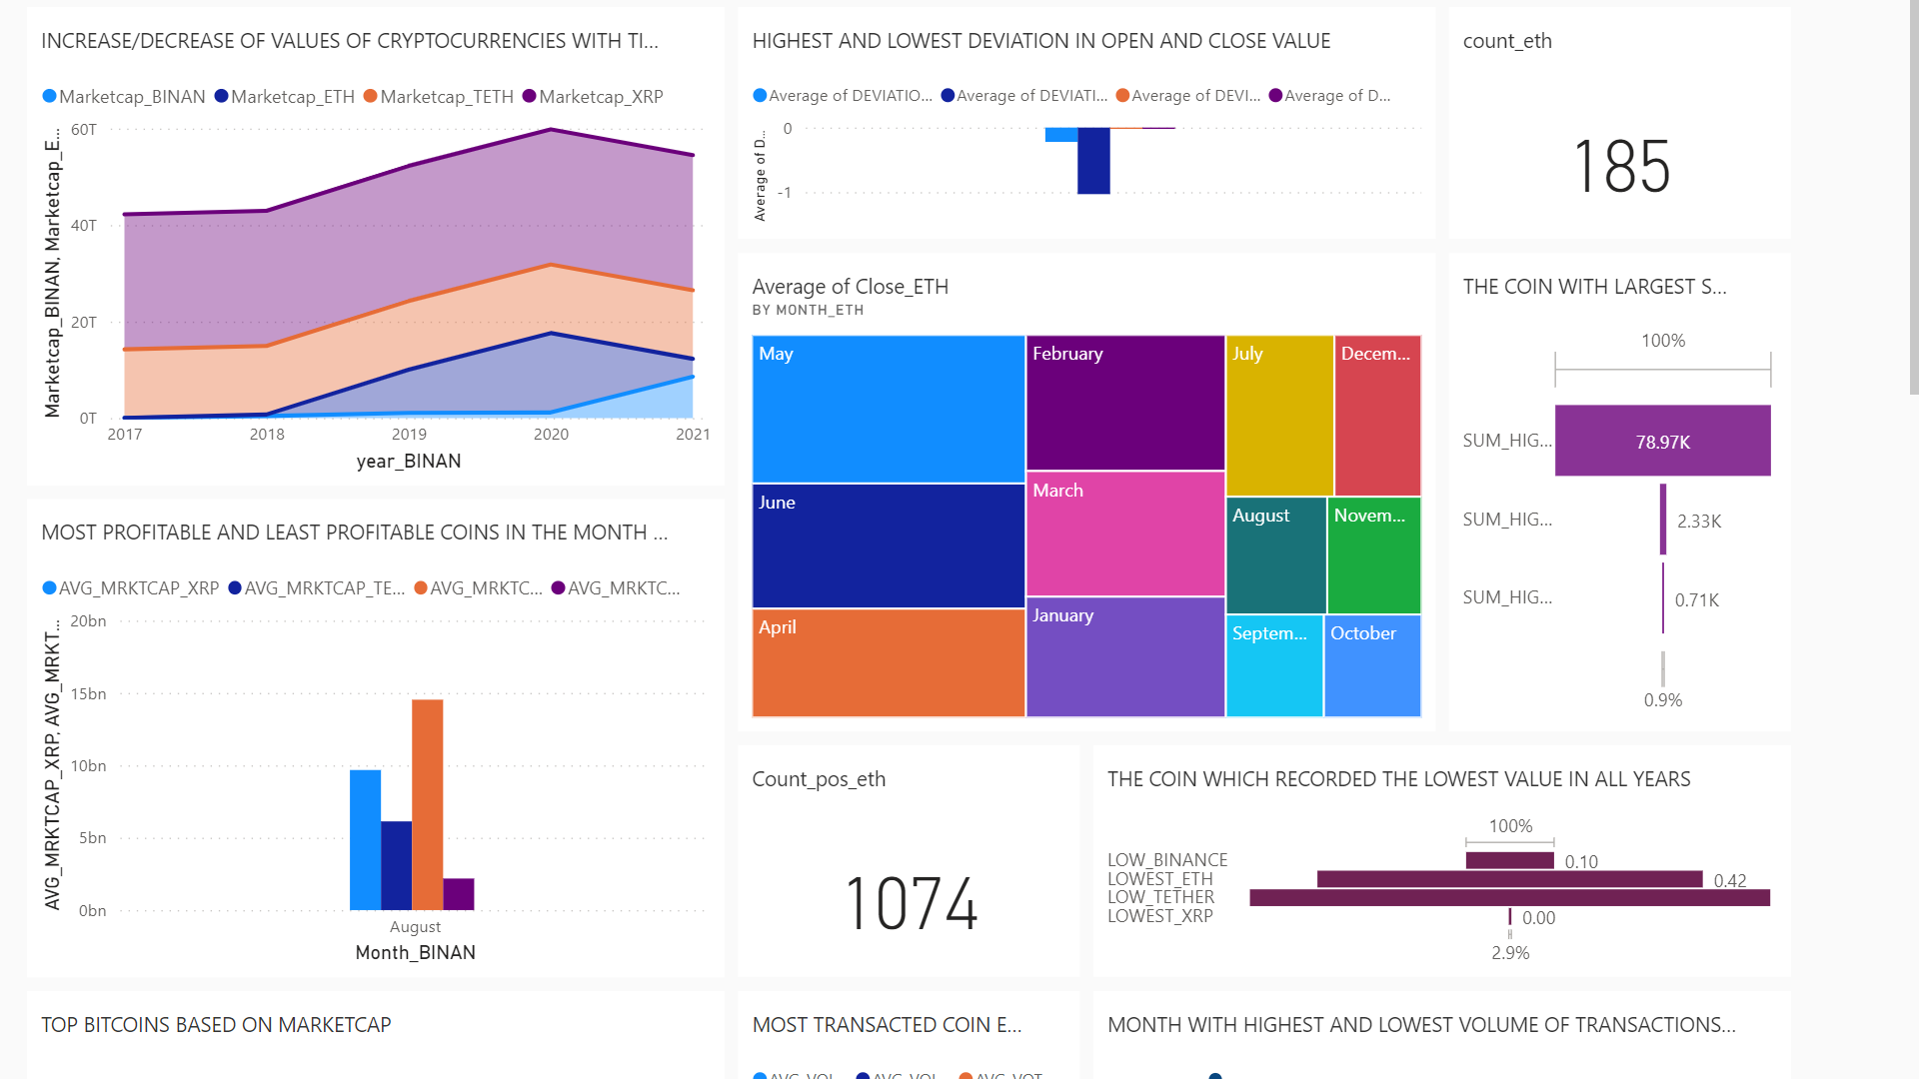
Dashboard

Slide 6
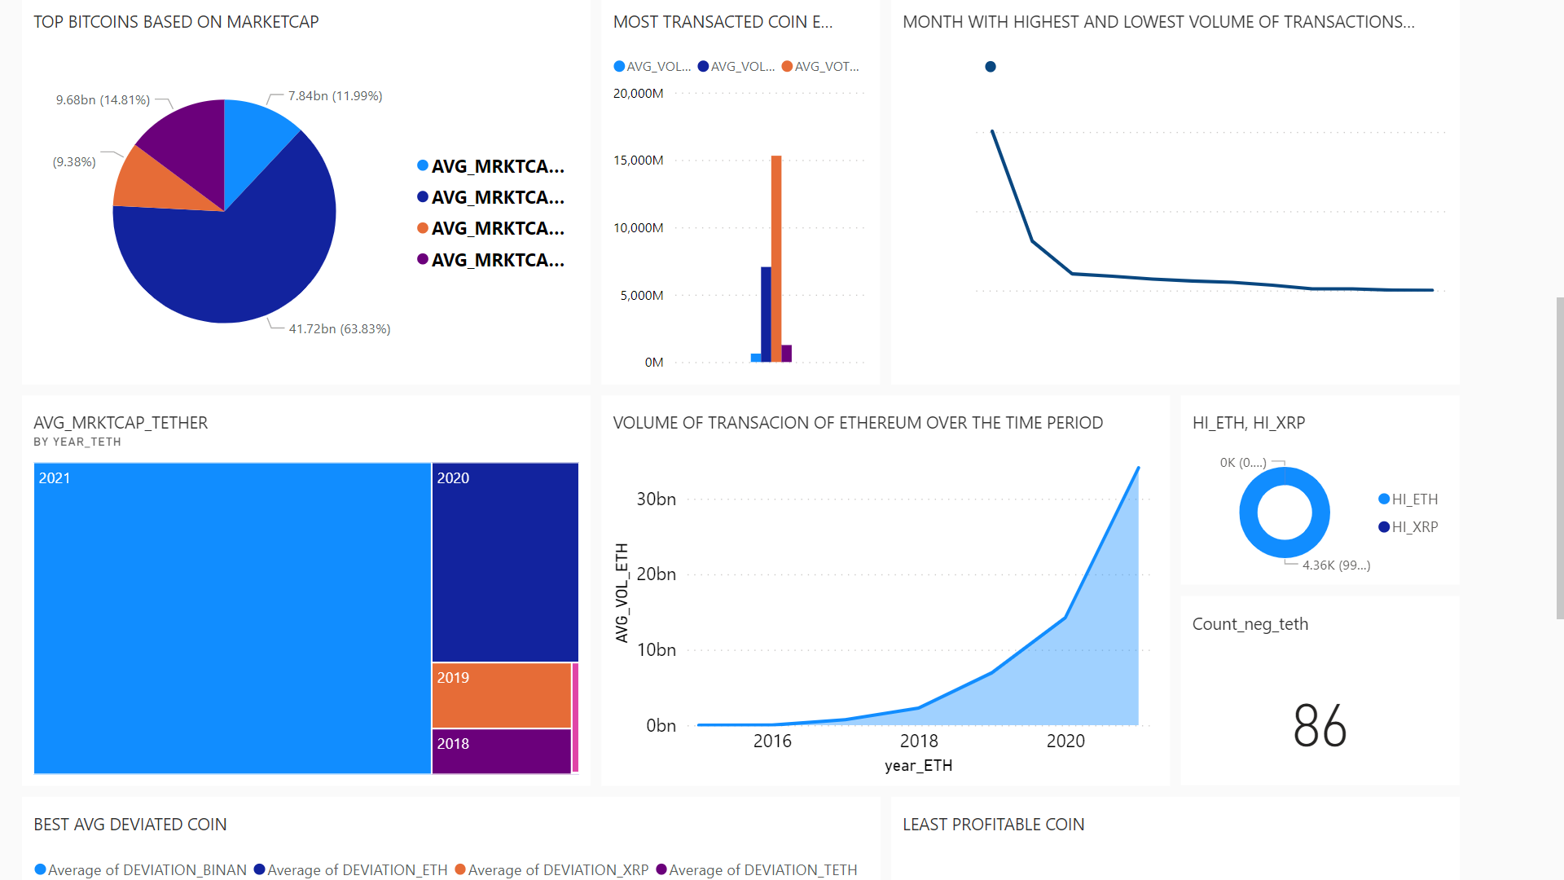
Dashboard

Slide 7
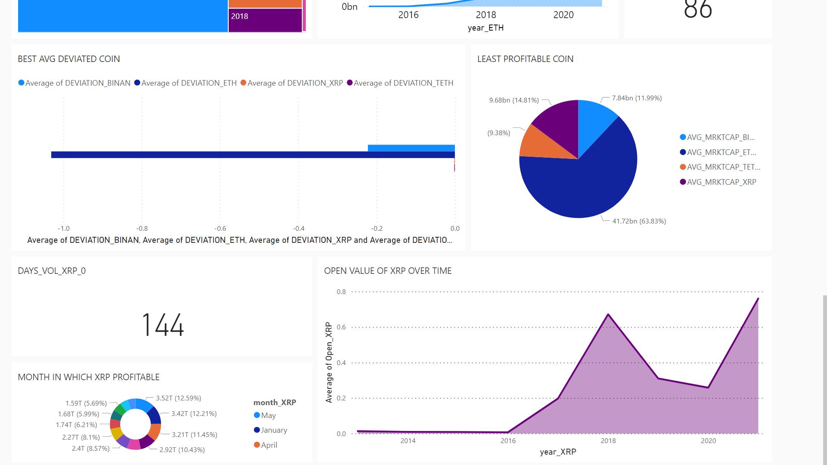
Dashboard

Slide 8
Inference
Among the 4 coins, some of the inference made were
The month in which XRP was most profitable is MAY.
Ethereum and XRP are the top 2 coins out of 4 based on market cap.
Tether is the least profitable coin among the 4.
DECEMBER month has the highest volume of transaction and FEBRUARY month has the lowest volume of transaction in the year 2017 for the coin tether.
The lowest value recorded among the All coins in all years is ‘XRP COIN’ with a lowest value of 0.00.
Tether coin is the most transacted coin for every month.
Binance coin has the largest value for the summation of high value of each day with a value of 78.97k

Slide 9
Conclusion
Many analysis have been done on the top 4 cryptocurrencies in the world and the analysis gave us many pros and cons, which will help us to choose the best cryptocurrency to invest for.
For choosing those cryptocurrencies to invest for, this analysis will be very useful.
Since the tether is the least profitable coin among the 4 and also the Tether coin is the most transacted coin for every month we have two types of conclusion on it.
The conclusion of which coin has to be selected should be done based on the requirement of the investor.

Slide 10
References
https://www.oswego.edu/cts/basics-about- cryptocurrency#:~:text=A%20cryptocurrency%20is%20a%20digital,you%20need%20 a%20cryptocurrency%20wallet.
https://www.kaspersky.com/resource-center/definitions/what-is-cryptocurrency
https://www.investopedia.com/terms/c/cryptocurrency.asp
https://www.investopedia.com/analyze-crypto- 6456223#:~:text=A%20cryptocurrency%20analysis%20involves%20examining,to%2 0determine%20its%20trends%20better.

