Slide 1
AI BASED FRUIT FRESHNESS IDENTIFICATION AND DISEASE PREDICTION USING AUTONOMOUS DRONE
GAJALAXMI S (420419104019)
JYOTHISRI P (420419104024)
KALAIVANI A (420419104025)
Guide Name,
Mr. K. Prasanna Kumar,
Assistant Professor / CSE
Adhiparasakthi Engineering College Melmaruvathur

Slide 2
Agenda
Abstract
Introduction
Literature Review
Analysis of Literature Review
Objectives
Problem Statement
YOLO Algorithm
Architecture diagram
Modules
Conclusion

Slide 3
Abstract
The nutritional value of perishable food items, such as fruits and depends on their freshness levels.
The existing approaches solve a binary class problem by classifying a known fruit class into fresh or rotten only.
We propose an automated fruits categorization approach that first recognizes the class of object in an image and then categorizes that fruit into one of the three categories: fresh, not fresh, and rotten , if rotten the remedy class will be displayed By using autonomous drone in any location.

Slide 4
Introduction
Hand-sorting rotten fruits from fresh ones in a batch of mixed fruits is a tedious and tiring job. Despite being time-consuming, most food processing factories carry out this method for making jams and other fruit-based products.
So to provide a much less demanding solution, today’s project focuses on creating a smart AI camera using a Raspberry Pi Development Board for Fresh and Rotten Fruit Detection if it’s rotten the remedy to the plant will be feed to the land and automatically sort it out.

Slide 5
Literature Review
PAPER NAME: T. Ilyas, A. Khan, M. Umraiz, Y. Jeong, and H.Kim,‘‘Multiscale context aggregation for strawberry fruit recognition and disease phenotyping,’’ IEEE Access, vol. 9, pp. 124491–124504, 2021,
PAPER DESCRIPTION :
Smart farming is a recently coined terminology to solve the problems in agriculture, related to production, environmental impact, and sustainability. With an increase in the global population, food demand is growing monotonically.

Slide 6
Continue...
PAPER NAME: QILIN AN 1,2, KAI WANG2 , ZHONGYANG LI1 , CHENGYUAN SONG2 , XIUYING TANG1 , AND JIAN SONG 2 "Real-Time Monitoring Method of Strawberry Fruit Growth State Based on YOLO Improved Model." Received 21 October 2022, accepted 3 November 2022, date of publication 7 November 2022, date of current version 1 December 2022.
PAPER DESCRIPTION :
Strawberries are one of the most popular fruits in the world, with worldwide production reaching more than 9 million tons in 2022 . However, the detection of strawberry fruit at the fruit growth state in the orchard is usually based on farmers’ experience and is highly subjective, which may lead to errors and affect the pollination, spraying, harvesting, and marketing of the fruit.

Slide 7
Continue...
PAPER NAME: Bolappa Gamage Kaushalya Madhavi 1 , Jayanta Kumar Basak 2 , Bhola Paudel 1 , Na Eun Kim 1 , Gyeong Mun Choi 2 and Hyeon Tae Kim 1,"Prediction of Strawberry Leaf Color Using RGB Mean Values Based on Soil Physicochemical Parameters Using Machine Learning Models(2022) ."
PAPER DESCRIPTION :
Intensively grown strawberries in a greenhouse require frequent and precise soil physicochemical constituents for optimal production. Strawberry leaf color analyses are the most effective way to evaluate soil status and protect against excess environmental nutrients and financial setbacks. Meanwhile, precision agriculture (PA) endorsements have been utilized to mimic solutions to these problems.

Slide 8
ANALYSIS OF LITERATURE REVIEW
Paper Name | YEAR | MERITS | DEMERITS
Multiscale context aggregation for strawberry fruit recognition and disease phenotyping | 2021 | F-Measure for CNN is 0.7and 0.8 for SVM, the accuracy of identification of leaf disease of CNN is 0.6 and SVM is 0.8 | Various segmentation algorithms can be implemented to improve accuracy.
Real-Time Monitoring Method of Strawberry Fruit Growth State Based on YOLO Improved Model | 2022 | The CNN has achieved an accuracy of 95.48. Used model has high rate along with better recognition of diseases. | Images in the dataset are very less.Train a dataset for at long time.
Prediction of Strawberry Leaf Color Using RGB Mean Values Based on Soil Physicochemical Parameters Using Machine Learning Models | 2022 | Best accuracy of 99.09% other models who have done the crop recommendation have the accuracy in the range between 92 to 96%. | More time to take for train the dataset.We should feed n number of dataset for traing process.

Slide 9
Objectives
To improve fruit health and yield by detecting and addressing nutrient deficiencies and other factors that contribute to the onset of plant diseases.
This can be accomplished through the following specific objectives:Disease detection,Nutrient assessment,Fertilizer recommendation.

Slide 10
Problem Statement
STATEMENT 1
To Collect a dataset of images of healthy and diseased fruits .
STATEMENT 2
To use the collected dataset to train a YOLOv5 model for detecting fruits diseases in images.
STATEMENT 3
To develop a fertilizer recommendation system.

Slide 11
YOLO (You Only Look Once) Algorithm
YOLO is a popular object detection algorithm that uses a single neural network to predict multiple bounding boxes and class probabilities in an image.
It can be trained on a large dataset of annotated images to recognize different objects and their locations within an image.
To use YOLO for fertilizers recommendation and disease prediction, the drone would need to capture images of the fruits from different angles and heights.

Slide 12
Continue...
These images would then be fed into a YOLOv5 model that has been trained on a dataset of annotated fruits images.
The YOLOv5 model would be able to detect and identify different fruits features, such as fruits color, texture, and shape, and use this information to make recommendations for the appropriate type and amount of fertilizer to apply.

Slide 13
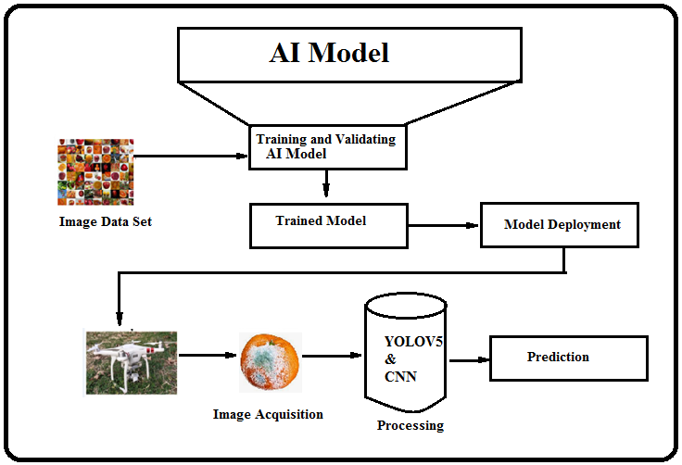
Architecture diagram

Slide 14
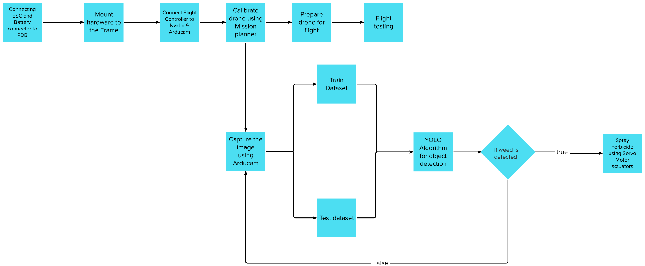
Design Methodology

Slide 15
Modules
Module -1 :
Data Collection
Data Preprocessing
Module - 2 :
Training
Evaluation
Testing
Module - 3 :
Fertilizer Recommendation

Slide 16
Module - 1
Data Collection: The first step is to collect a large dataset of images of healthy and diseased fruits.
Data Preprocessing: The collected images need to be preprocessed to enhance the quality and improve the model's accuracy.

Slide 17
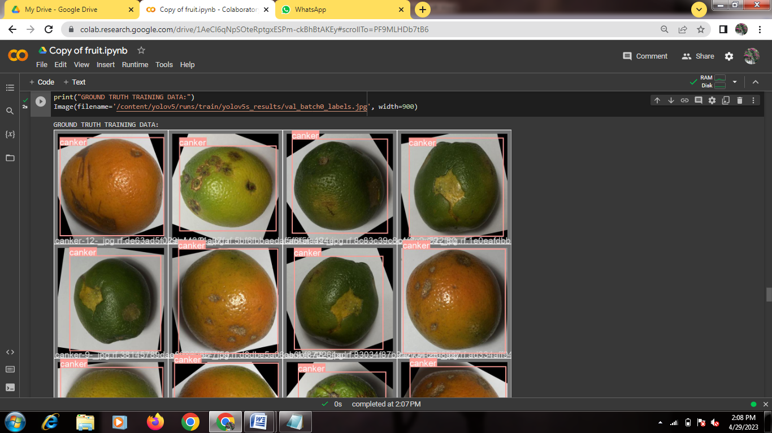
Module - 2
Training: The next step is to train the YOLOv5 model using the annotated dataset. During training, the model learns to detect and classify the different types of fruits diseases.
Annotation process

Slide 18
Continue...
Evaluation: After training, the model needs to be evaluated using a separate validation dataset to check its accuracy and performance.

Slide 19
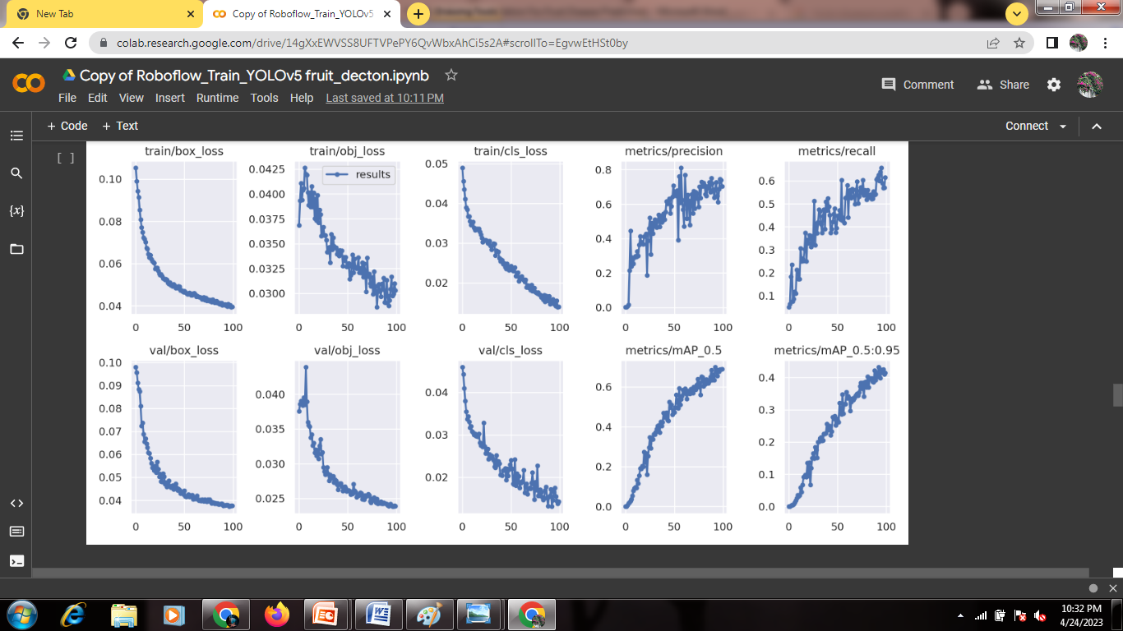
Graph view

Slide 20
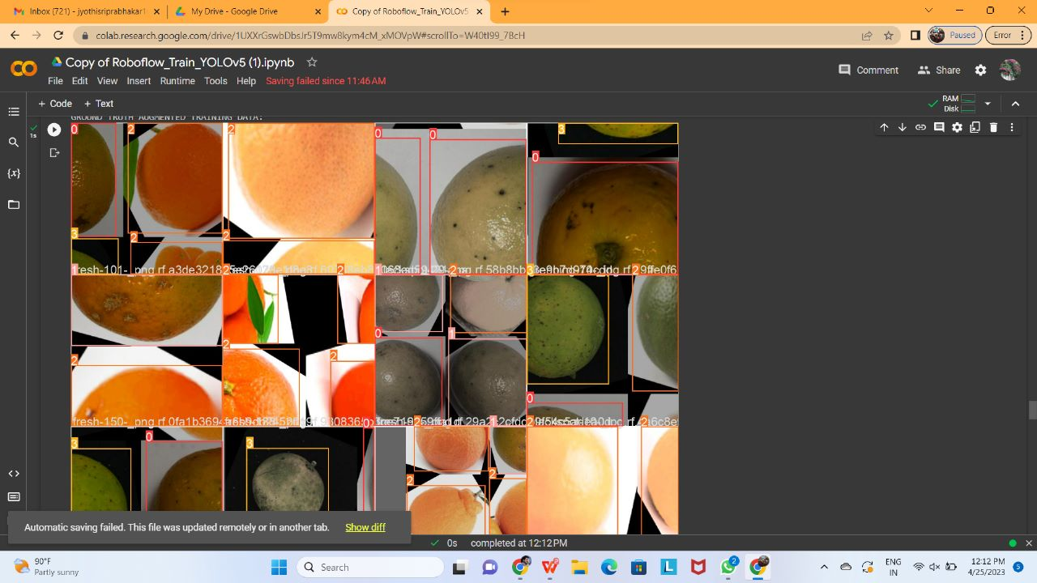
Continue...
Testing: Once the model is trained and evaluated, it can be used to test new images of fruits to identify and classify any diseases present.

Slide 21
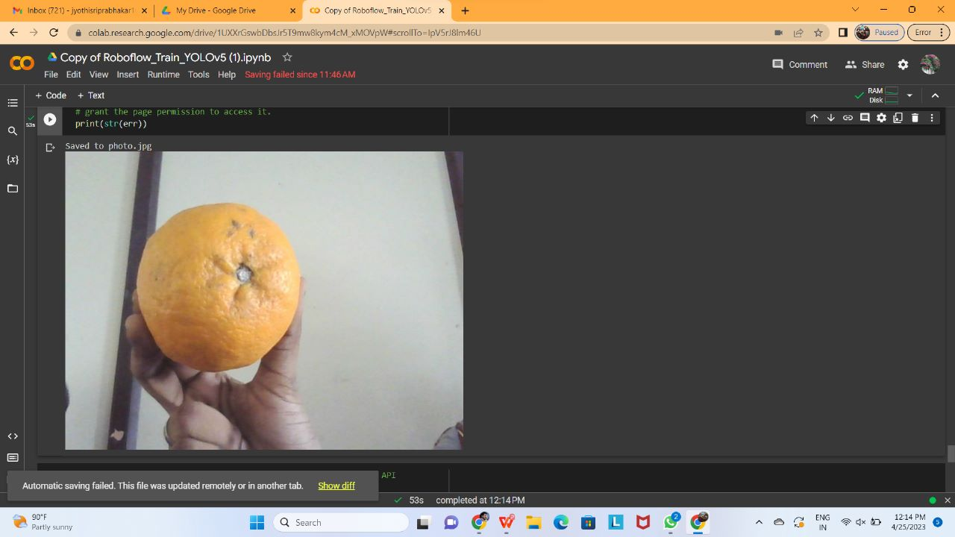

Slide 22
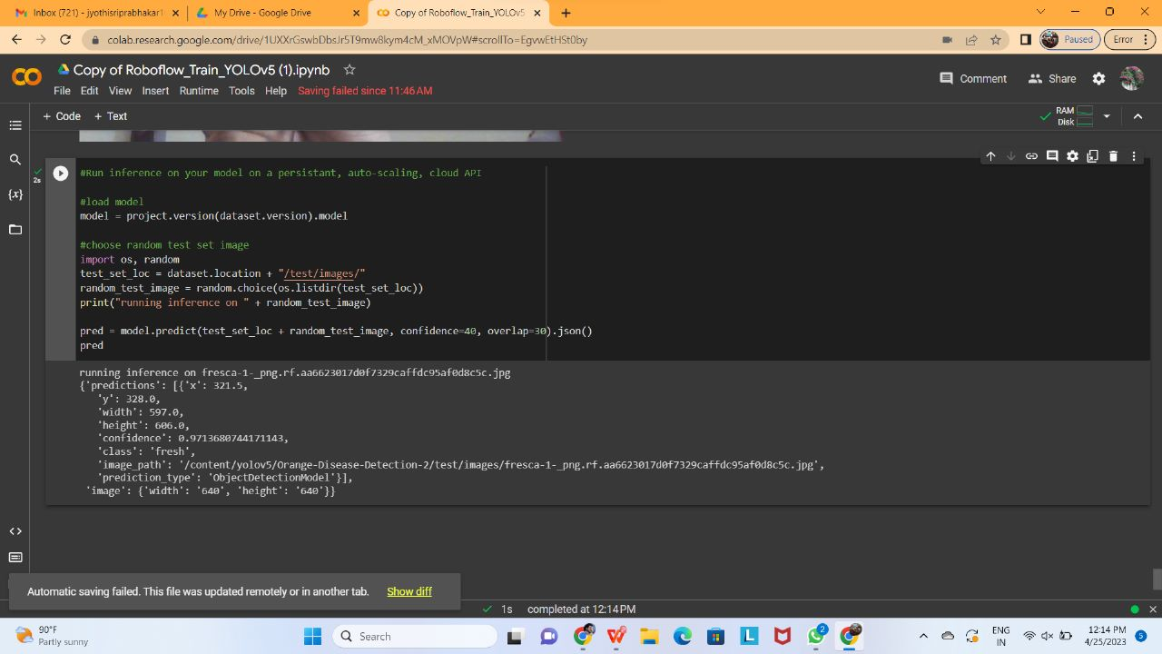

Slide 23
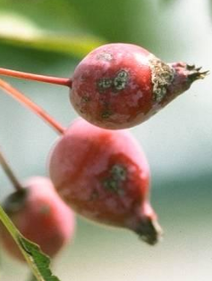
Fertilizer Recommendation
Diseases of Rice | Symptoms | Images | Recommended Fertilizers
Apple scab | Apple scab is a significant fungal disease of crabapple trees. A similar disease affects pears. Apple scab appears on expanding leaves in the spring as olive-green spots without distinct borders. These lesions grow and darken to a greenish-black color and develop black borders. |  | Plant resistant crabapple varieties, such as Ames White, Autumn Glory, Baskatong, Beauty, Coral Cascade, Gibb's Golden Gage, Gwendolyn, Harvest Gold, Henning, Molten Lava, Narragansett, Prof. Sprenger, Red Snow, or Sparkler. Check nursery catalogs and local garden centers, as there are many other resistant varieties. Rake up and discard all infected and fallen leaves. Prune trees to promote good air circulation.

Slide 24
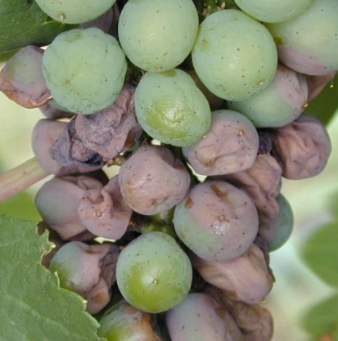
Diseases of Rice | Symptoms | Images | Recommended Fertilizers
Black rot on grapes | Black rot is a fungal disease that causes brown, circular leaf spots and reduces many berries to black, shriveled, raisin-like mummies. The fungus pathogen overwinters in mummified berries from the previousseason’s crop. Spores are released during wet periods before bloom when new shoots first emerge. Young leaves are infected first. |  | Preventative fungicide sprays are a necessity to ensure a crop of edible fruit. If using organic sprays, be aware that sulfur may burn the foliage of certain varieties (e.g. Concord) and is not as effective as Bordeaux.

Slide 25
Conclusion
This study tested the improvement of different modules on the performance of the YOLOX algorithm and verified the effectiveness of the improved model. For example, the CSP block is replaced by a self-designed C3HB block in the backbone part; the normalized attention module (NAM) is introduced in the neck and the latest SIOU loss function is embedded. The mAP, precision, and recall are improved by 4.08%, 3.64%, and 2.04%, respectively. And compared with five popular detection algorithms, SDNet has the best detection
results. SD Net also meets the requirement of real-time
monitoring.

Slide 26
Reference works
T. Ilyas, A. Khan, M. Umraiz, Y. Jeong, and H.Kim,‘‘Multiscale context aggregation for strawberry fruit recognition and disease phenotyping,’’ IEEE Access, vol. 9, pp. 124491–124504, 2021,
A. Subeesh, S. Bhole, K. Singh, N. S. Chandel, Y. A. Rajwade,
K. V. R. Rao, S. P. Kumar, and D. Jat, ‘‘Deep convolutional
neural network models for weed detection in polyhouse grown
bell peppers,’’ Artif. Intell.Agricult., vol. 6, pp. 47–54, Jan. 2022.

Slide 27
THANK YOU

