Slide 1


UNIVERSAL BIOMETRIC
VOTING SYSTEM
“Vote Smart, Vote Secure, Vote Biometric"
Jithendra Boodati-22BCE1947

Slide 2

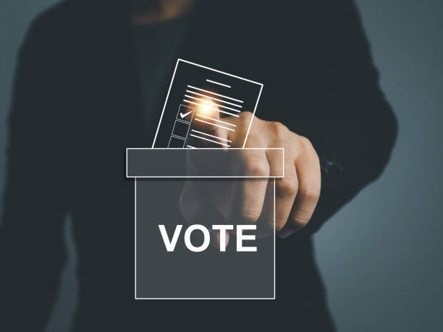
INTRODUCTION
Problem
In today's fast-paced world, voters often find themselves away from their designated polling booths during elections, leading to disenfranchisement.
Current voting systems lack secure mechanisms for biometric verification, especially for those voting from different states, making it difficult for them to participate in the democratic process.
Solution
Introducing universal biometric voting system a pioneering system that enables secure biometric-based voting for citizens, regardless of their location.
By allowing voters to authenticate their identity through biometric verification and requiring additional officer verification for remote voting, UBVS ensures that every eligible citizen can confidently exercise their right to vote, no matter where they are.

Slide 3
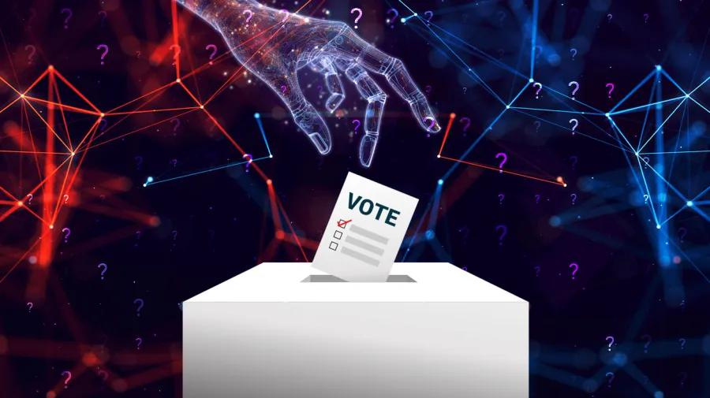
PRODUCT DESCRIPTION ABSTRACT
Our UBVS System offers :
Secure Biometric Voting: Utilizes biometric verification to ensure the identity of voters.
Database Integration: Cross-references voter biometrics with a secure database registered during voter card registration.
Dual Authentication for Remote Voting: Requires biometric verification from the voter and an authorized polling officer for added security when voting from a different location.
Mobile Accessibility: Supports voting from any location, increasing voter participation and accessibility.
Real-Time Data Verification: Ensures immediate validation of biometrics to enhance security and trust in the voting process.

Slide 4
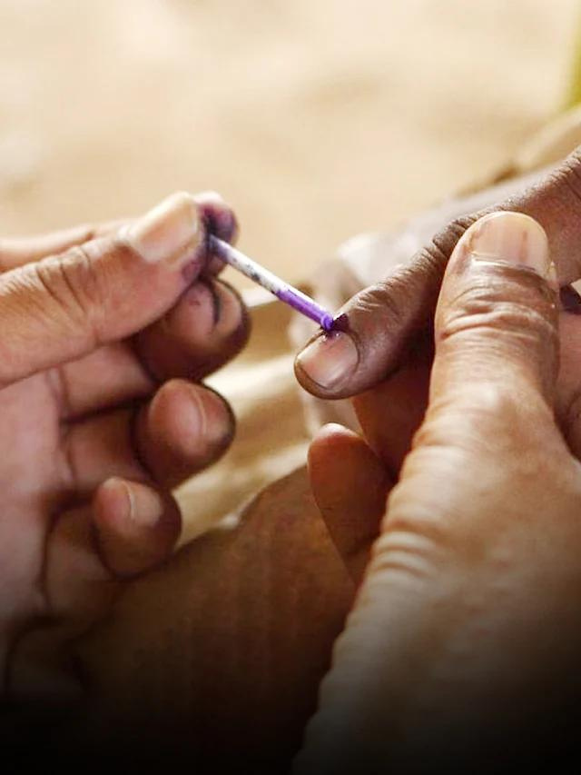
DISADVANTAGES OF EXISTING SOLUTIONS
Limited Scope: Most current biometric voting systems are restricted to local polling stations, preventing voters from casting their ballots when they are away from their designated locations.
Lack of Remote Voting Security: Existing remote voting options often do not incorporate secure biometric authentication, leaving them vulnerable to identity fraud and unauthorized voting.
Absence of Dual Verification: Many systems fail to implement a dual verification process, which is crucial for ensuring the legitimacy of votes cast from different locations.

Slide 5
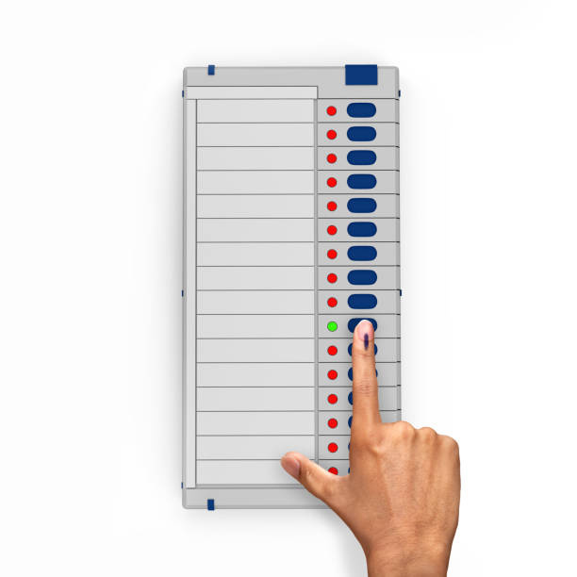

OUR SYSTEM'S
ADVANTAGES
Comprehensive Voting Solution : Universal Biometric Voting System (UBVS) bridges the gap by enabling both local and remote voting.
User-Centric Design:: Offers a seamless experience for voters, promoting participation and accessibility while maintaining stringent security measures.
Enhanced security features : Incorporates dual biometric verification—requiring both the voter and an authorized polling officer to authenticate—to ensure the integrity of the voting process.
Real-Time Biometric Matching: Utilizes advanced biometric matching technology to provide immediate verification of voter identities, reducing wait times and improving the overall voting experience.

Slide 6
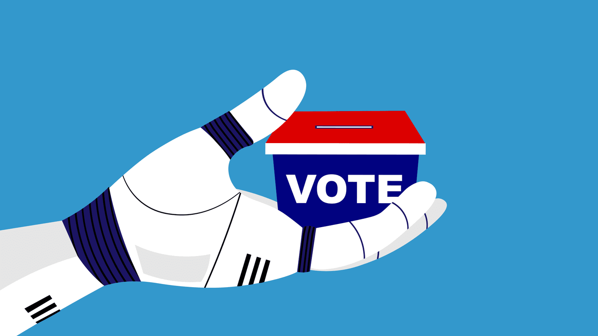
NOVELTY
"Empowering Voter Participation: The pressing need for a secure and reliable remote voting solution drives the development of the UBVS.
Facilitating Access: This system enables voters to confidently cast their ballots from anywhere, ensuring that every citizen has the opportunity to participate in the democratic process, even when away from their home polling booths.
Gaps Addressed:
Limited Remote Voting Mechanisms: Current biometric voting systems do not offer robust solutions for remote voting, often restricting participation to local polling stations.
Security Vulnerabilities: Existing remote voting options are fraught with risks, lacking secure biometric authentication and dual verification, which are essential for safeguarding the voting process.

Slide 7
EXHIBITION OF
SOFTWARE PRINCIPLES
1. Single Responsibility Principle (SRP):
Principle: A class should have only one reason to change, meaning it should only have one responsibility or job.
Exhibition in UBS:
The BiometricDevice class is responsible only for capturing biometric data, while the User class focuses on user details and their associated biometric data.
The AuthenticationSystem class is solely responsible for authenticating users based on their biometrics.
By adhering to SRP, the code becomes easier to manage, as changes in user management, biometric data, or authentication are isolated to their respective classes.

Slide 8
EXHIBITION OF
SOFTWARE PRINCIPLES
2. Open/Closed Principle (OCP):
Principle: Software entities (classes, methods, etc.) should be open for extension but closed for modification.
Exhibition in UBS:
We can extend the system by adding new biometric devices (e.g., VoiceRecognitionDevice) without modifying the existing BiometricDevice class or the AuthenticationSystem.
This is done by creating new subclasses from the BiometricDevice base class while keeping the existing functionality intact.

Slide 9
EXHIBITION OF
SOFTWARE PRINCIPLES
3. Don't Repeat Yourself (DRY):
Principle: Avoid duplicating code by using abstractions or functions. Every piece of knowledge or logic must have a single, unambiguous representation in the system.
Exhibition in UBS:
Common functionality, like capturing biometric data, is abstracted into the BiometricDevice class, and specialized devices (e.g., FingerprintScanner, IrisScanner) only implement the specific capture mechanism. This avoids repeating capture logic across multiple device classes.
Authentication logic is centralized in the AuthenticationSystem, and it does not need to be re-implemented for each type of biometric data.

Slide 10
OOPS IMPLEMENTATION
Object-Oriented Programming System principles can play a vital role in designing and implementing a Universal Biometric System (UBS). OOP principles help organize the code in a structured and modular way, making the system easier to maintain, scale, and debug. Here's how OOPS principles can be applied to a Universal Biometric System project:
1)Encapsulation:
Encapsulation is the process of bundling the data (attributes) and the methods (functions) that operate on the data into a single unit, i.e., a class.
In UBS:
Creating classes like BiometricData, User, Device, and AuthenticationSystem.
Each class will have its own attributes and methods. For example, the BiometricData class could encapsulate details like fingerprint data, iris scan, facial recognition data, etc.
These data will be private and only accessible or modifiable through public methods, ensuring that sensitive biometric data is secure.

Slide 11
OOPS IMPLEMENTATION
2. Inheritance:
Inheritance allows a class to inherit attributes and methods from another class, promoting code reusability.
In UBS:
We have a base class BiometricDevice, and subclasses like FingerprintScanner, IrisScanner, and FaceRecognitionDevice.
These subclasses will inherit the common properties and methods from the base class, but each can also have its own specific implementation.
3. Polymorphism:
Polymorphism allows different classes to be treated as instances of the same class through inheritance, where they can override or provide their own implementation of the same method.
In UBS:
Different biometric devices (fingerprint scanner, iris scanner, face recognition system) may have their own ways of capturing data, but all can be treated as a BiometricDevice for consistency in the system.

Slide 12
OOPS IMPLEMENTATION
4. Abstraction:
Abstraction means hiding complex implementation details and exposing only essential functionalities.
In UBS:
For example, we can hide the specific details of how biometric data is processed and stored, providing only a high-level method like store_biometric_data() for the users of the system.
Users of the AuthenticationSystem class don't need to know how fingerprint matching or face recognition is done—they just call a method like authenticate_user()
IMPLEMENTATION:
https://github.com/Jithendra672/Fingerprint-Based-voting-System/blob/133c38c78fb9330b7db7c78e9bcc6c5e40bbc9ba/oops.py

Slide 13

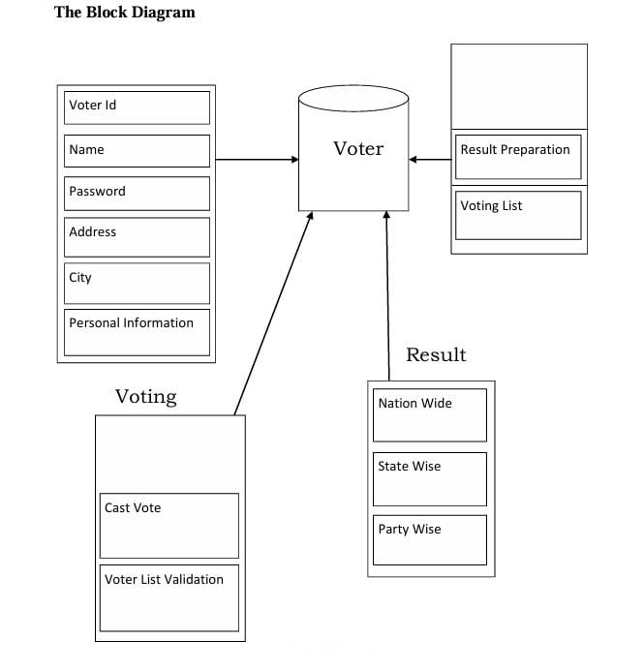
DESIGN
BLOCK DIAGRAM

Slide 14
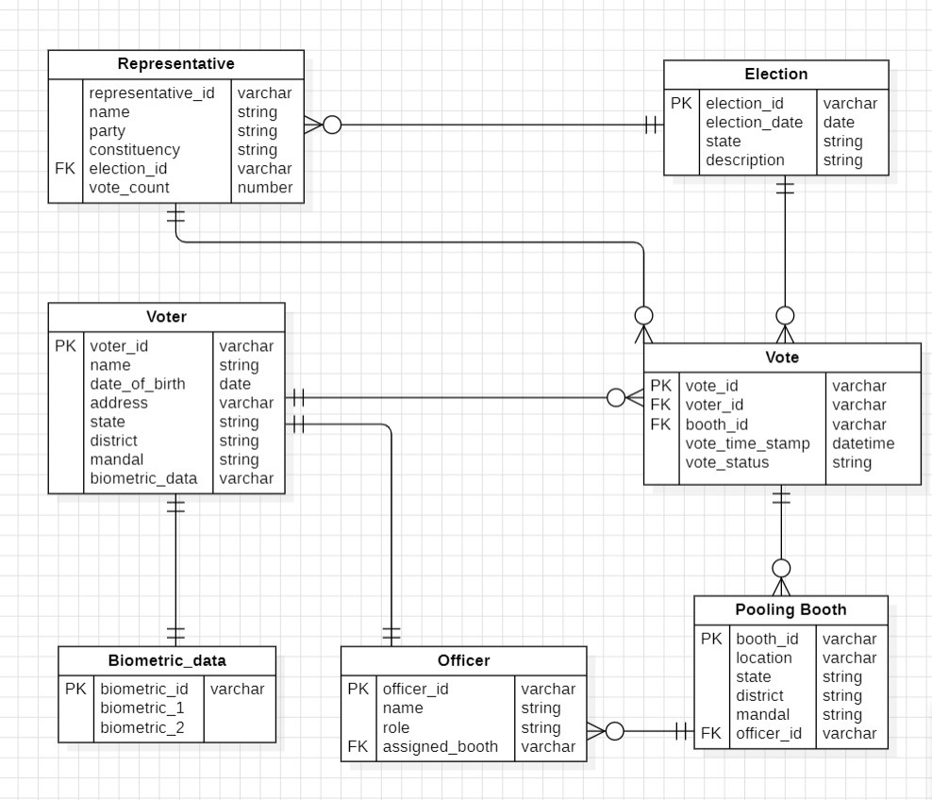
DESIGN
ER DIAGRAM

Slide 15
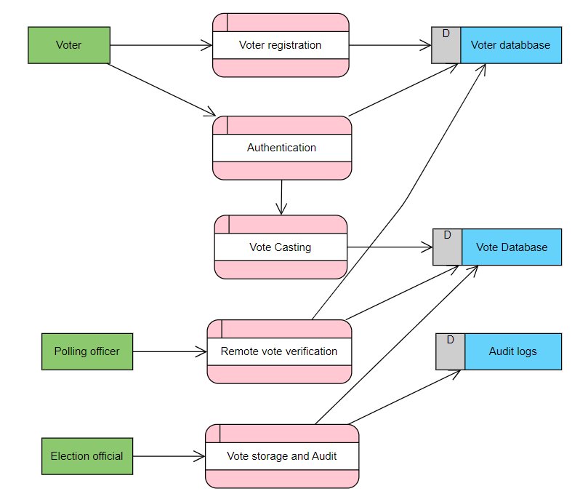
LEVEL-0 DATA FLOW DIAGRAM

Slide 16
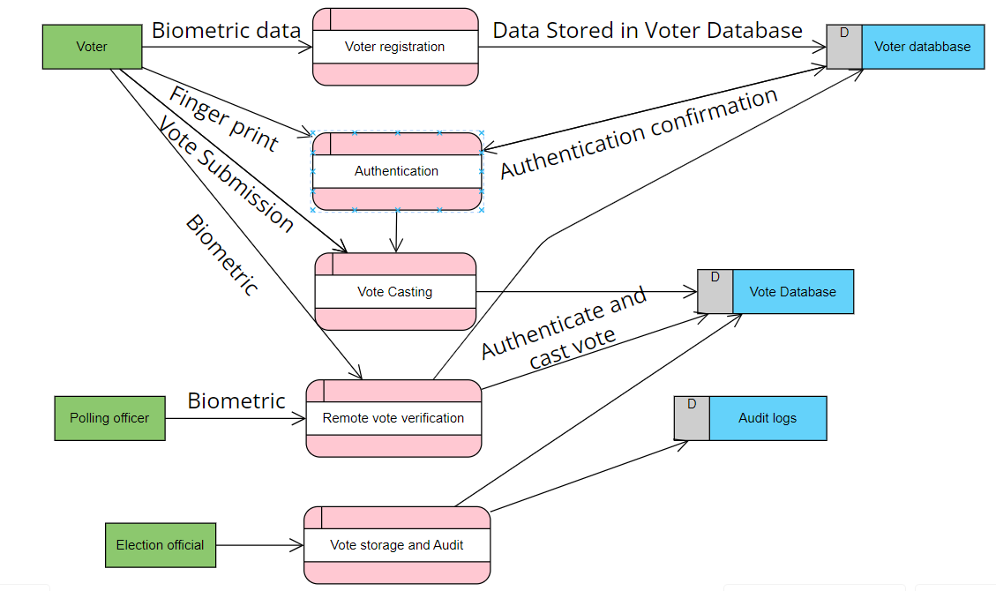
LEVEL-1 DATA FLOW DIAGRAM

Slide 17
THANK YOU

