Slide 1

Peakflo Competitive Review Analysis
Jyothi | Data Analyst
June 2026
316
Total customer reviews analyzed
4 companies
Peakflo vs. 3 competitors
6%
Peakflo negative-review rate
Core message
Peakflo is positioned around stronger customer trust than key competitors.
The clearest market pain is poor support and payment reliability.
Those failures are recurring across competitor reviews and are highly actionable for sales and messaging.
Peakflo Competitive Review Analysis

Slide 2
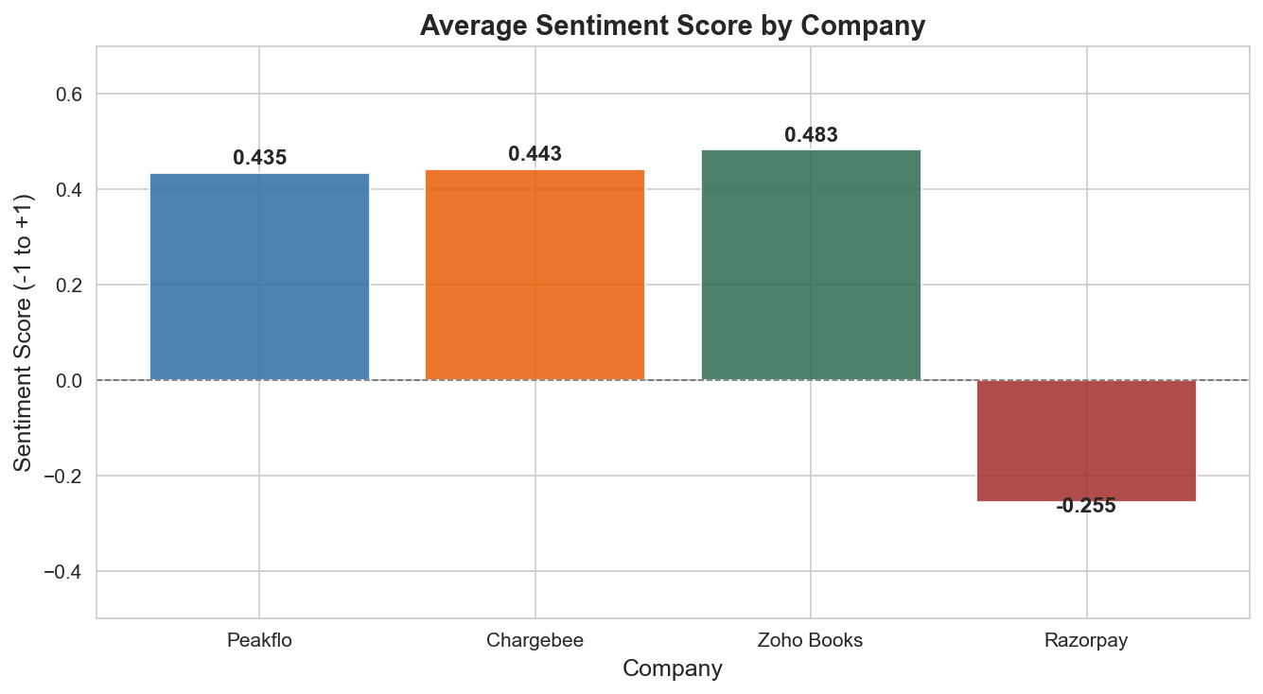
Executive Summary
What the analysis says in business terms
10x better
Negative-review rate vs. Razorpay
4x better
Negative-review rate vs. Chargebee
Support trust
Main buying criterion reflected in reviews
Peakflo Competitive Review Analysis

Slide 3
Methodology
How the notebook was built
Data note: Peakflo reviews were sourced from G2, a B2B software platform, while competitor reviews came from Trustpilot, which attracts a broader consumer audience and may surface more negative reviews naturally. This has been accounted for throughout the analysis.
Data note: Peakflo reviews were sourced from G2, a B2B software platform, while competitor reviews came from Trustpilot, which attracts a broader consumer audience and may surface more negative reviews naturally. This has been accounted for throughout the analysis.
Peakflo Competitive Review Analysis

Slide 4
Data Pipeline
From review scraping to executive insight
Scrape public reviews
G2 for Peakflo; Trustpilot for competitors
Clean the dataset
Remove duplicates, blanks, and very short reviews
Score sentiment
Label each review as positive, neutral, or negative
Compare competitors
Review volume, negative rate, and sentiment score
316
Final cleaned review count
51 / 98 / 92 / 78
Peakflo / Chargebee / Zoho / Razorpay review counts
1 story
Unified competitive narrative
Peakflo Competitive Review Analysis

Slide 5
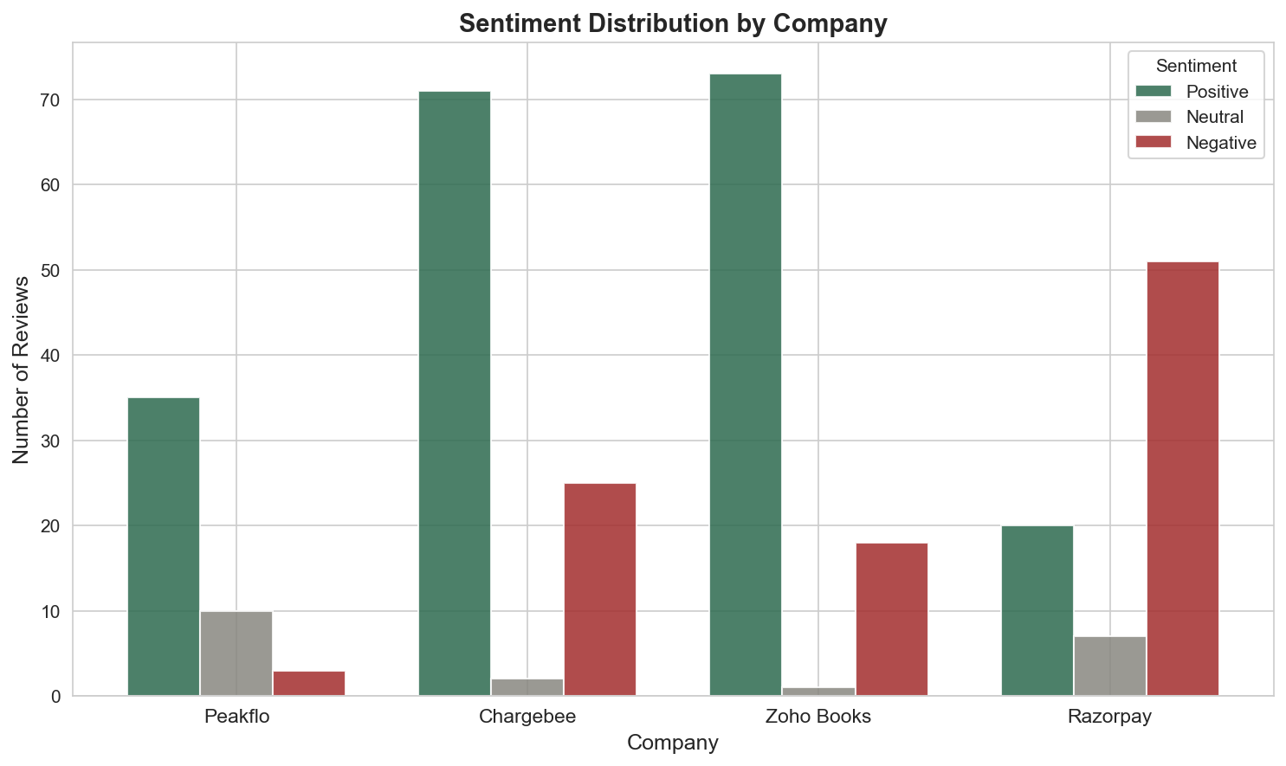
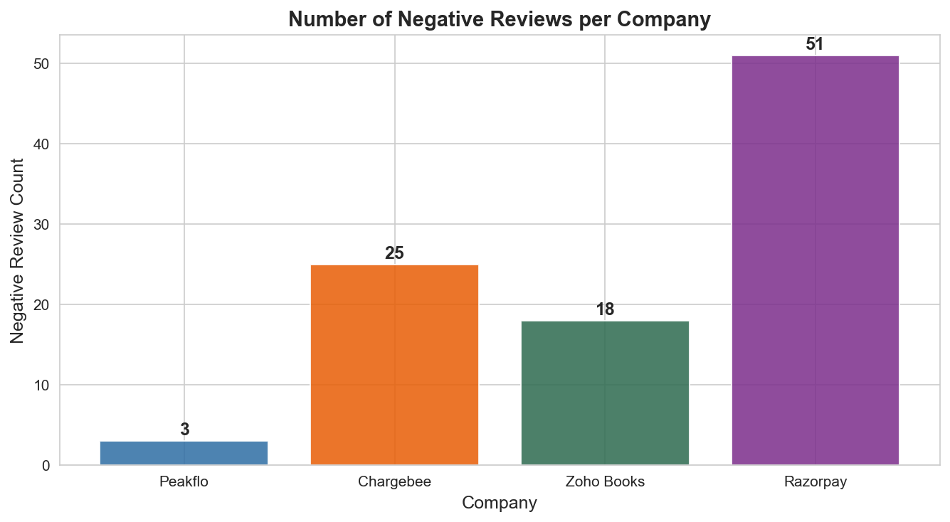
Key Insights
The most important findings from the notebook
Razorpay
Only company with negative average sentiment (-0.255)
Chargebee
Long-term users complain about support and pricing fairness
Zoho Books
Support handoffs and slow resolution dominate complaints
Peakflo Competitive Review Analysis

Slide 6
Business Impact
What this means for revenue and execution
Commercial impact
Lead sales conversations with support speed and payment reliability as proof points
Use competitor complaint themes to handle objections before they are raised
Highlight the 6% negative rate in hiring conversations as a culture signal
Position Peakflo as the trusted alternative where competitors keep failing
10x
Lower negative-review rate vs. Razorpay
4x
Lower negative-review rate vs. Chargebee
3 / 51
Peakflo negative reviews
65%
Razorpay negative rate
Peakflo Competitive Review Analysis

Slide 7
Recommendations
What Peakflo should do next
Build competitor battle cards from Razorpay, Chargebee and Zoho Books complaint patterns — sales team can use these in every live conversation
Feature the 6% negative rate and support quality prominently in website copy, case studies and outbound messaging
Repeat this analysis every quarter — review sentiment shifts faster than analyst reports and costs nothing to track
Peakflo Competitive Review Analysis

Slide 8
Closing Message
The business story in one line
Peakflo’s strongest competitive proof point is exactly where competitors are failing.
Analysis by Jyothi — 316 real customer reviews — June 2026
Analysis by Jyothi — 316 real customer reviews — June 2026
316 reviews
Evidence base
3 negatives
Peakflo outcome
1 message
What to lead with
Peakflo Competitive Review Analysis

