Slide 1

Comparative Analysis of TCP Variants for Audio Transmission
and File Transmission Over Multi-Hop Mobile Ad Hoc Networks
Suggula Jyothsna
123003243
Guided by
Prof. Sasikala Devi. N

Slide 2
Agenda
Problem statement , Tools used , Implemented modules
Implementation design diagram
Introduction
Results

Slide 3
Problem statement
To choose a routing protocol with an acceptable TCP variant for audio and file transmission over MANET, a comparative analysis with simulation should be performed.
Tools used Network Simulator (NS-2)
Implemented modules
NAM , gnuplot , ns-allinone

Slide 4
Implementation design diagram
Senario 1
Senario 2
Result
Determining the best routing protocol in MANET
TCP variants are examined using the appropriate routing protocol.
The optimal routing protocol/TCP variant combination is determined.

Slide 5
Introduction
Mobile Ad hoc Networks (MANET) are the collection of mobile nodes that can be dynamically setup anywhere, anytime without the use of preexisting infrastructure.
There are three types different of MANET routing protocols: Proactive, Reactive, Hybrid.
AODV-Ad-hoc On-demand Multipath Distance Vector Routing protocol
AOMDV -Ad-Hoc On Demand Vector Routing protocol
DSR - Dynamic Source Routing protocol
DSDV-Destination Sequenced Distance Vector Routing Protocol
The Transmission Control Protocol (TCP) is one of the most important protocols of Internet Protocols suite. It is most widely used protocol for data transmission in communication network such as internet. The five basic TCP variants
TCP Tahoe
TCP Reno
TCP NewReno
TCP Sack
TCP Vegas

Slide 6
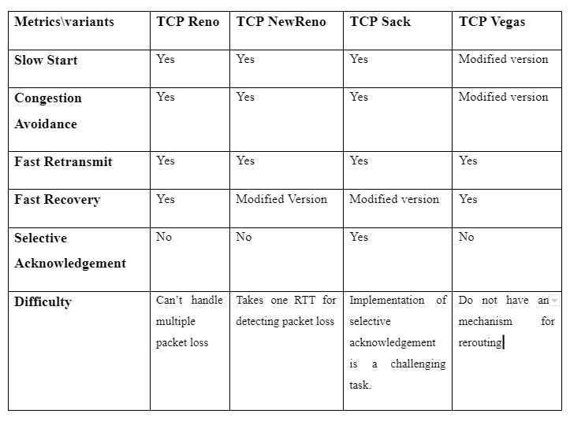

Slide 7
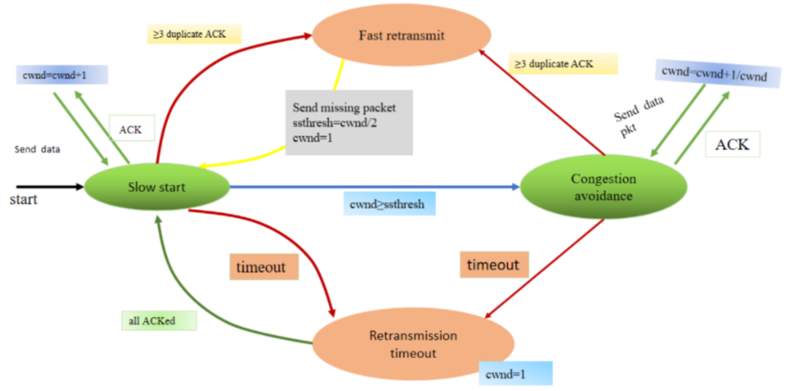
TCP Tahoe

Slide 8
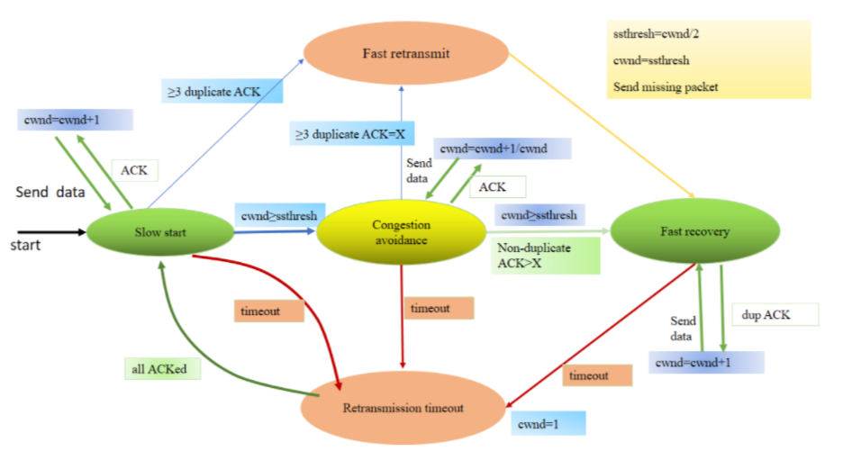
TCP Reno

Slide 9
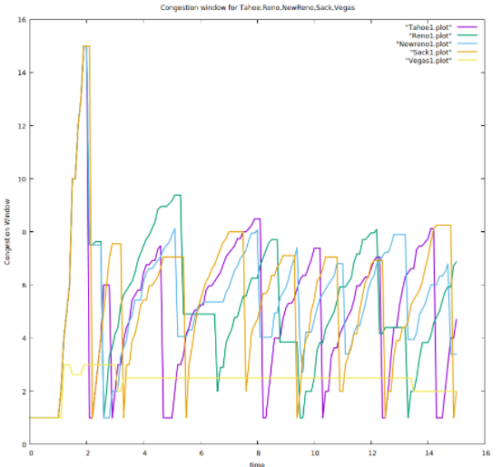
Congestion window for Tahoe,Reno,Newreno,Sack,Vegas

Slide 10
Results with Audio Transmission
Comaparison b/w Routing Protocols
 | AODV | AOMDV | DSR | DSDV
Avg. Throughput(Kbps) | 642.740 | 690.711 | 645.400 | 548.893
Avg. End-to-End Delay(ms) | 179.088 | 160.259 | 208.809 | 147.306
PDR | 0.970 | 0.972 | 0.979 | 0.971
AOMDV protocol with TCP Variants
 | Tahoe | Reno | Newreno | Sack | Vegas
Avg. Throughput(Kbps) | 408.57 | 353.84 | 383.78 | 357.58 | 410.97
Avg. End-to-End Delay(ms) | 135.46 | 134.04 | 148.46 | 114.49 | 69.81
PDR | 0.93 | 0.94 | 0.94 | 0.94 | 0.97

Slide 11
Results with File Transmisson
Comaparison b/w Routing Protocols
 | AODV | AOMDV | DSR | DSDV
Avg. Throughput(Kbps) | 599.52 | 716.01 | 529.09 | 610.35
Avg. End-to-End Delay(ms) | 198.59 | 179.09 | 419.75 | 191.36
PDR | 0.96 | 0.97 | 0.95 | 0.98
AOMDV protocol with TCP Variants
 | Tahoe | Reno | Newreno | Sack | Vegas
Avg. Throughput(Kbps) | 383.25 | 362.73 | 382.51 | 358.62 | 388.53
Avg. End-to-End Delay(ms) | 181.54 | 148.10 | 184.7 | 162.5 | 93.63
PDR | 0.952 | 0.954 | 0.959 | 0.952 | 1

Slide 12
CONCLUSION
AOMDV gives maximum throughput of 690 Kbps for Audio transmission and 716 Kbps for File transmission. Average end-to-end delay for AOMDV is more minor when compared with all protocols, by analyzing all metrics AOMDV is chosen to be the proper protocol.
The AOMDV routing protocol was used to compare five TCP variants.When compared to other variations, TCP Vegas has a good packet delivery ratio and less minor delay, implying that Vegas has good throughput, less uncertainty, and more PDR with good congestion management. As a result, TCP Vegas works better with the AOMDV protocol for both Audio transmission and File Transmission

