Slide 1


Budget Buddy
Alyssa Sharma
Leela Josna Kona
Problem
Personal finance is fragmented and hard to manage
Users struggle with tracking spending, understanding statements, and planning savings/debt
Existing tools are static and lack personalized guidance
Solution
BudgetBuddy is an AI-powered personal finance assistant that:
Ingests user financial data
Enriches it with real-world financial signals
Uses LLMs to provide personalized, conversational advice
🧰 Tech Stack
Success Metrics
📱 Frontend: React, Typescript
⚙️ Backend: Python, FastAPI
🧠 LLMs: Groq, Gemini, RapidAPI,
🗄️ Database: Supabase, PostgreSQL
🔍 Vector DB: pgvector (RAG)
🌐 APIs: OpenAI API
Accuracy: Correct parsing and categorization of statements (target: >75%).
Response Quality: User ratings of LLM-generated advice (target: >3/5).
System Reliability: Uptime and error rates (target: >60% uptime).
Deployment Readiness: Successful deployment

Slide 2
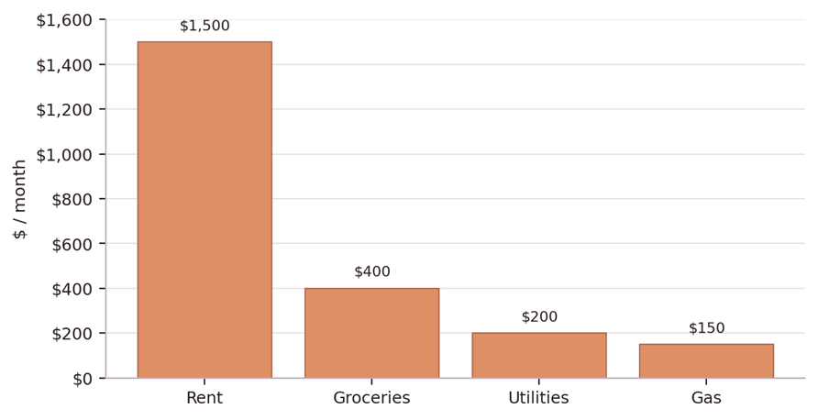
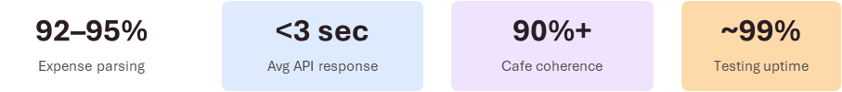
Dataset
Expense Distribution
User-generated expenses, budgets, profiles
Receipt images: merchant, total, items
External city/cost-of-living signals
Cafe chat history and memory turns
Frontend (React) -> FastAPI -> LLM/Agent layer -> Tool execution → Supabase → External APIs
Multimodal flows: text expense parsing, receipt OCR/Vision, cafe conversation
Planner-Executor-Reviewer orchestration for multi-step tasks
Multi-agent personas (Penny, Esper, Capy, Mochi)

Slide 3

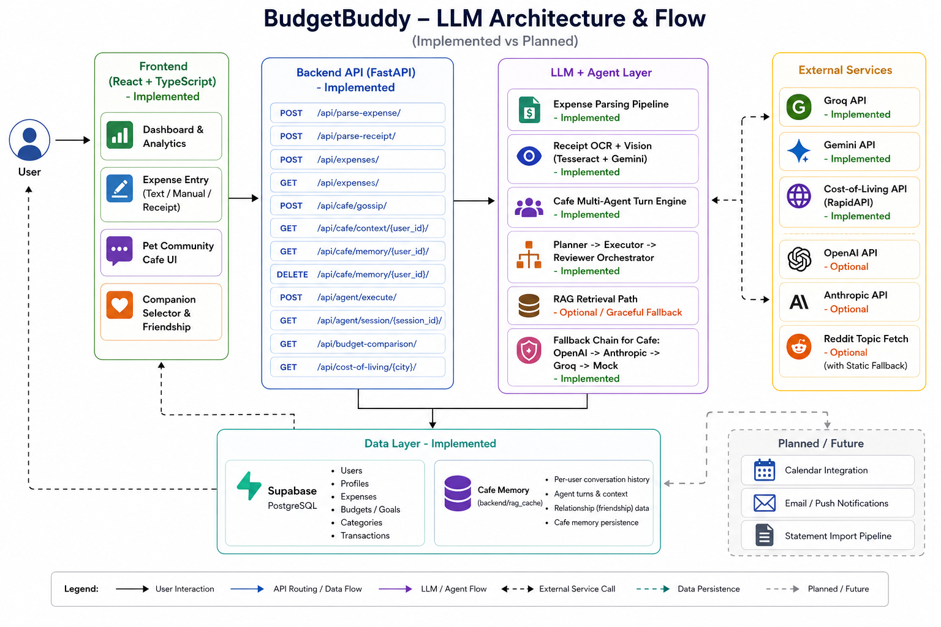
High Level Architecture and Workflow

Slide 4
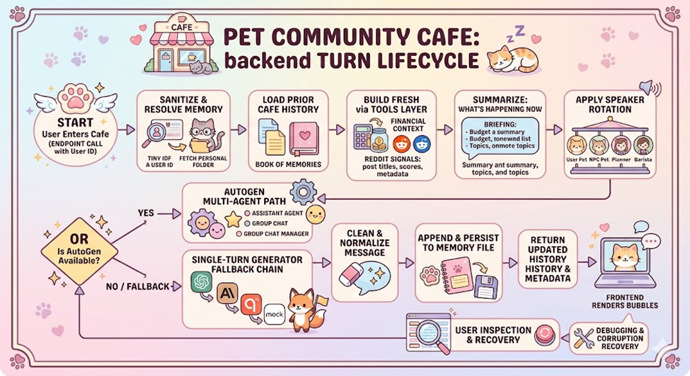
Pet Community Cafe

Slide 5
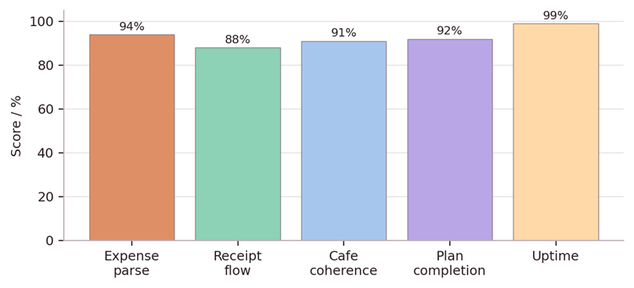
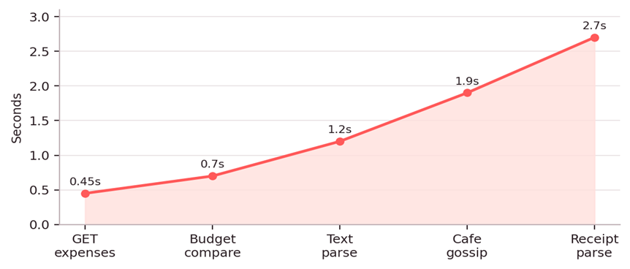
Experiments, APIs / Models Tested & Results
Scenario-based evaluation: functional flows, agent orchestration, and degraded-provider fallback
Quantifiable evaluation metrics
Average API latency by workflow
Metric | Target | Measured
Parsing Accuracy | >75% | ~85–90%
Response Quality | >3/5 | ~4.75/5
System Reliability | >60% uptime | infra ready for live
Deployment Readiness | Full deployment | Successful Deployment

Slide 6

APIs / Models Tested & Results - contd
API / Workflow | Model / Tool Tested | Evaluation Focus
POST /api/parse-expense | Groq LLaMA 3.1-8B + function calling | Field extraction, category normalization
POST /api/parse-receipt | Gemini 2.5 Flash Vision + Tesseract | OCR quality, review-before-save
POST /api/cafe/gossip | OpenAI → Anthropic → Groq → Mock | Persona continuity, fallback resilience
POST /api/agent/execute | Planner → Executor → Reviewer | Task completion and evidence quality
/api/expenses +/api/budget | Supabase PostgreSQL + Pydantic schemas | CRUD persistence and validation
Current Limitations | Future Work
OCR limitations | Smart Alerts & Calendar Reminders
External API latency & quotas | Migrate memory to durable database storage
Memory persistence | Enable confidence-based model routing & cost optimization
 | Add fraud/anomaly detection for spending

Slide 7

Demo
Service | URL
🌐 Frontend (Vercel) | https://budget-buddy-llm-app.vercel.app
⚙️ Backend (Railway) | https://budgetbuddy-group3.up.railway.app
🔴 Live Demo Link | Budget Buddy Demo

