Slide 1


Budget Buddy
Alyssa Sharma
Leela Josna Kona
Problem
Personal finance is fragmented and hard to manage
Users struggle with tracking spending, understanding statements, and planning savings/debt
Existing tools are static and lack personalized guidance
Solution
BudgetBuddy is an AI-powered personal finance assistant that:
Ingests user financial data
Enriches it with real-world financial signals
Uses LLMs to provide personalized, conversational advice
🧰 Tech Stack
Success Metrics
📱 Frontend: Kotlin, Jetpack Compose
⚙️ Backend: Python, FastAPI
🧠 LLMs: GPT-4o
🗄️ Database: Supabase, PostgreSQL
🔍 Vector DB: Supabase, pgvector (RAG)
🌐 APIs: OpenAI API
Accuracy: Correct parsing and categorization of statements (target: >75%).
Response Quality: User ratings of LLM-generated advice (target: >3/5).
System Reliability: Uptime and error rates (target: >60% uptime).
Deployment Readiness: Successful deployment

Slide 2
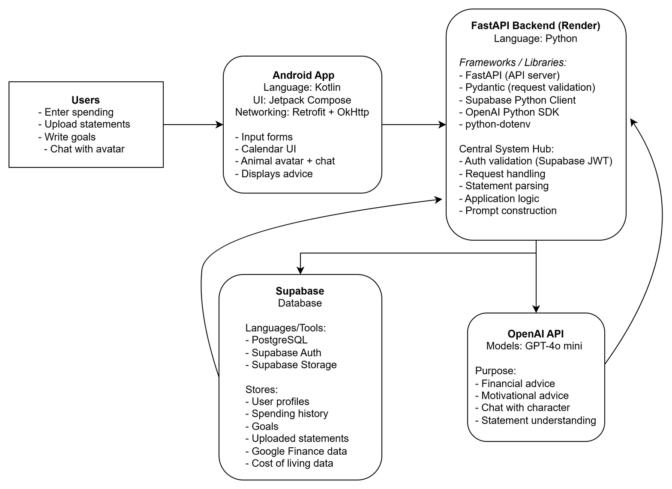
System Architecture

