Slide 1
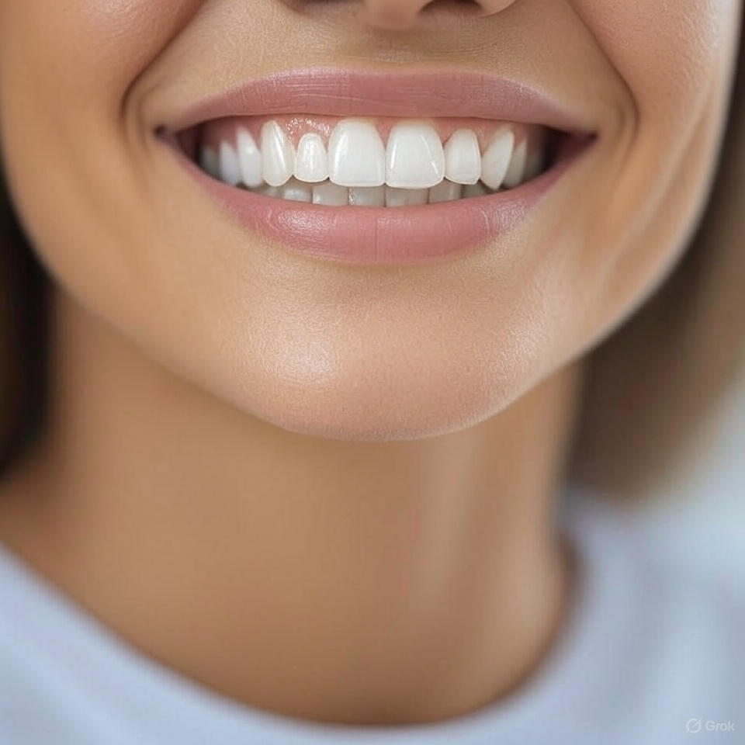
Gender Prediction Using Dental Metrics
DSBA-6211 PROJECT
LEELA JOSNA KONA
GitHub : DentalAnalysis

Slide 2
Project Overview
• Objective: Predict gender using dental measurements
• Dataset: 1,100 records with features like inter canine distance, canine width
- Features: various dental measurements such as inter-canine distance, canine width and canine index.
- Target variable: Gender(Male/Female)
• Application: Forensics, anthropology, biometric classification

Slide 3
Techniques Used
Data Cleaning and Preprocessing
Standardization of Features
Build Models
Logistic Regression
Decision Tree
Random Forest
XGBoost
Hyperparameter Tuning (GridSearchCV)
Cross-Validation

Slide 4
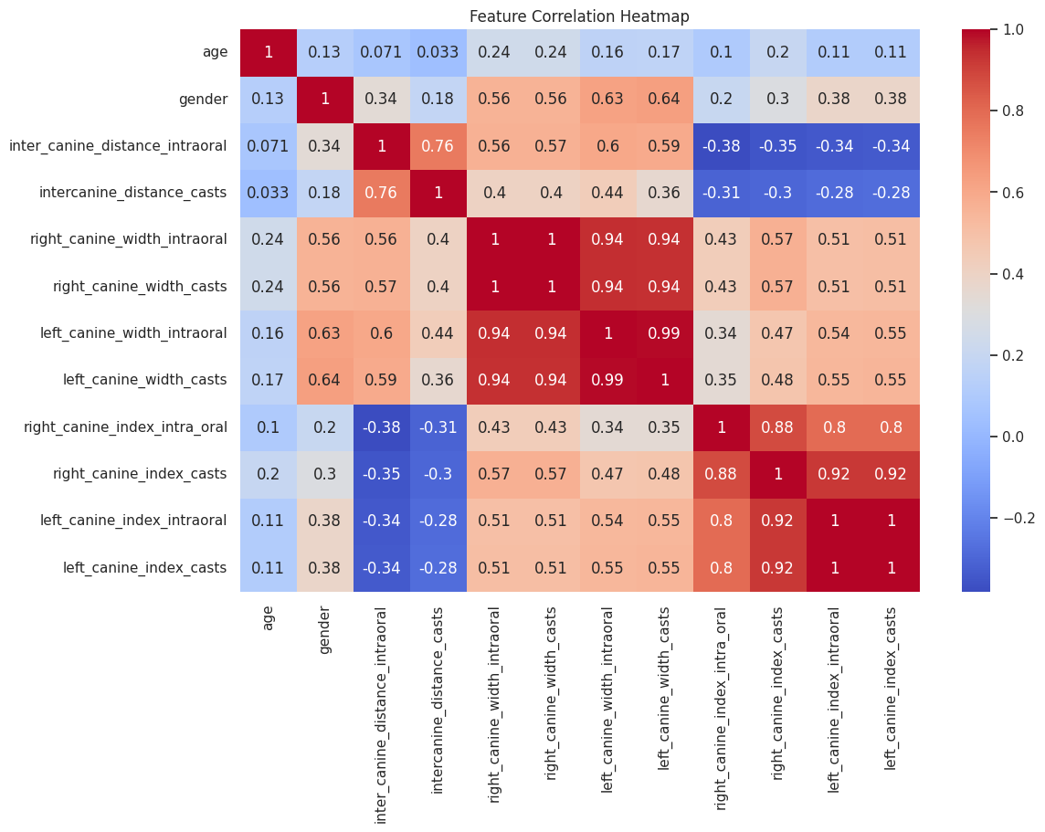
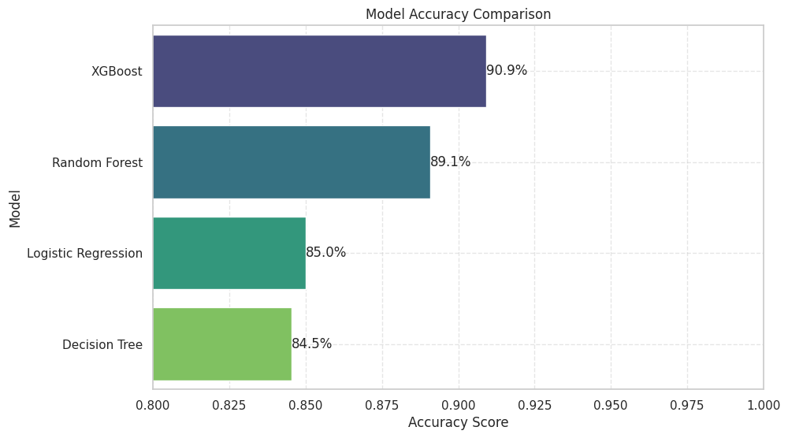
Feature Correlation Heatmap
Model Accuracy Comparison

Slide 5
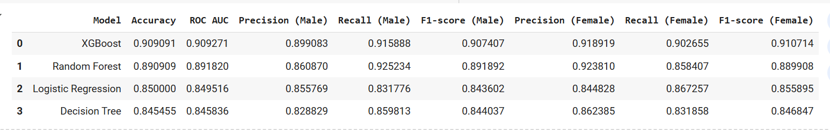
Model Performance Comparison
XGBoost:
- Accuracy: 90.9%
- ROC AUC: 0.91
Random Forest:
- Accuracy: 89.1%
- Strong F1-scores across both genders
Logistic Regression: Lower accuracy but interpretable

Slide 6
Feature Importance
Key predictive features:
- Inter canine distance (intraoral and casts)
- Canine width (right and left)
Consistency in importance across models
Helps understand gender-linked dental traits

Slide 7
Final Evaluation (XGBoost)
Accuracy: 90.9%
Precision (M/F): 0.87 / 0.91
Recall (M/F): 0.91 / 0.88
F1-score (M/F): 0.89 / 0.89

Slide 8
Technologies Used
Programming Language: Python
Libraries:
Pandas, Numpy
Matplotlib, Seaborn
Scikit-learn
XGBoost
IDE: Jupyter Notebook

Slide 9
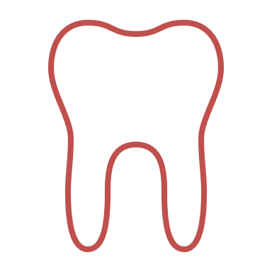
Suggestions for Future Work
EXPAND THE MODEL TO PREDICT AGE, ETHNICITY, AND DENTAL DISEASES
Experiment with deep learning models
Use larger and diverse datasets
Develop forensic or clinical applications

Slide 10
Thank You
Questions?
Presented by:
Leela Josna Kona
GitHub repo: DentalAnalysis

