Slide 1

William Douglas Property Management Analysis
Team Two:
Rachael Dewey
William (Billy) Edwards
Zac Morris
Tristan Richard

Slide 2
Problem Definition
Our goal is to better understand what attributes and features of social media and search engine results are most important to customers to help WDM make informed decisions on where to best focus their time and resources to grow their business organically. In doing so, we plan to assist WDM increase the volume of potential clients searching, following, and interacting with their business online.
We will focus on the following objectives:
· Assess customer sentiment towards WDM and through Google and Yelp reviews
· Compare the sentiment findings to local competitors such as Cedar, Henderson, and Kuester Management Groups
· Analyze and rank customer interaction through Facebook posts to see which topic generates the most activity

Slide 3
SWOT Analysis
Strengths | Weaknesses
State of the art web based specialized software designed for HOA management companies Timely communication from each account manager only tasked with up to 12 accounts at a time Offer educational promotions through YouTube videos and newsletters | Low customer engagement and follows on Facebook page Lack of html tags on geopages Online chat on their website has a slow response time Have 2 LinkedIn pages which creates disorganization for the customer Small amount of google reviews when compared to competitors Marketing budget only allows for $10-15k spend per month

Slide 4
SWOT Analysis Pt. 2
Opportunities | Threats
Can utilize new forms of social media to attract younger customers Increase the rate at which data on their website is updated Can optimize their website to be voice searched via alexa and siri Already have established offices around growing real estate markets in NC & SC (Asheville, Charlotte, Columbia, Fayetteville, Raleigh, Wilmington, Winston-Salem) Affordable housing market in the Carolinas and low interest rates Reach top quality clients by having consistent account managers Acquire new HOA clients by providing advice and education on the industry | Increased interest rates Rising sea levels could shrink coastal markets where current offices are located HOA fees could be impacted by COVID infections HOA board members are wary of constantly changing HOA managers New technology and social media not being utilized before competitors Incorrect or late charge of customer fees

Slide 5




Data Description
William Douglas
Cedar Management Group
Henderson Properties
Kuester Management Group

Slide 6
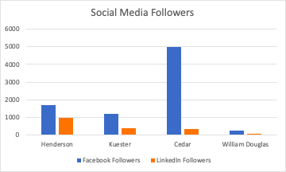
Social Media Competition

Slide 7
Text Pre-processing
Original Text | Great experience. Becky Miller was the person who helped me. Very knowledgeable, kind and just awesome. I highly recommend them!
Convert Text to Lowercase Form and Remove Punctuation | great experience becky miller was the person who helped me very knowledgeable kind and just awesome i highly recommend them
Tokenization | [great, experience, becky, miller, was, the, person, who, helped, me, very, knowledgeable, kind, and, just, awesome, i, highly, recommend, them]
Removal of Stop Words | [great, experience, becky, miller, person, helped, very, knowledgeable, kind, just, awesome, highly, recommend, them]
Stemming | [great, experience, becky, miller, person, help, very, knowledge, kind, just, awesome, high, recommend, them]

Slide 8
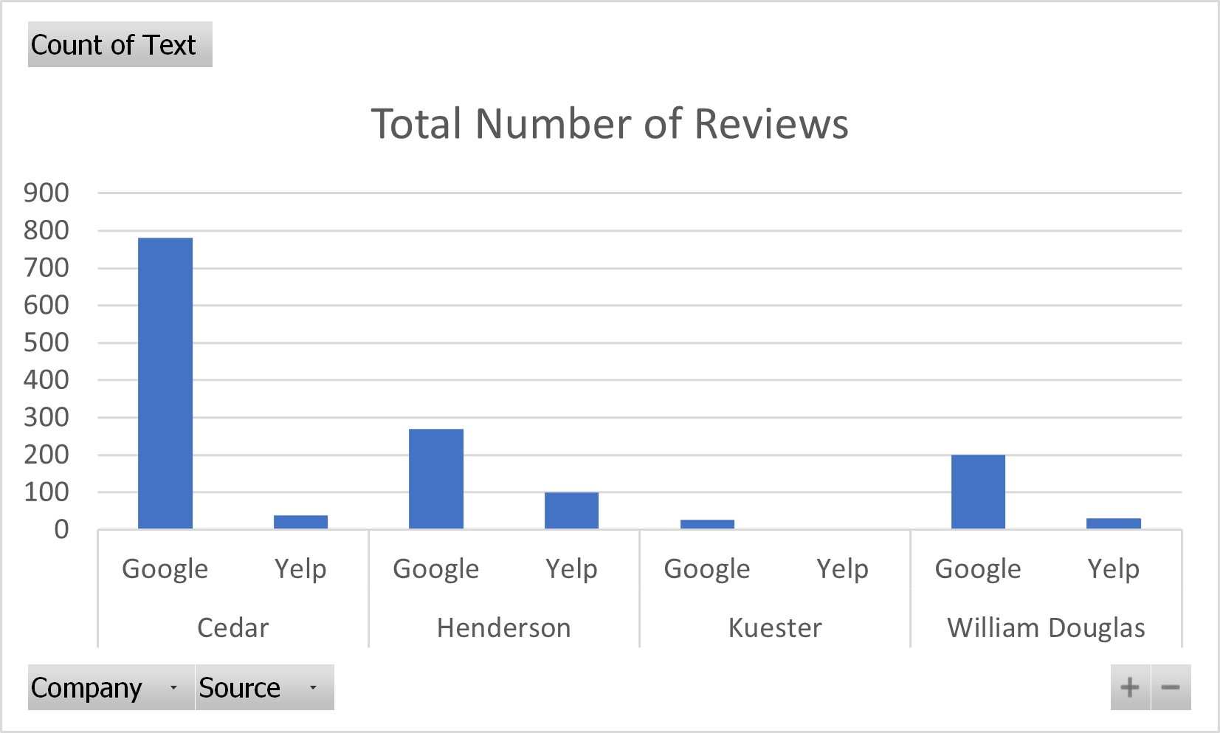
Total Number of Reviews per Company

Slide 9
Top Features

Slide 10
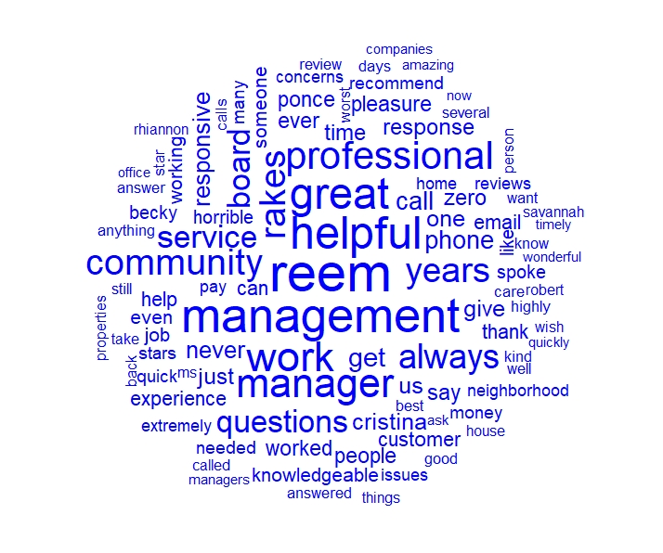
William Douglas Word Cloud

Slide 11
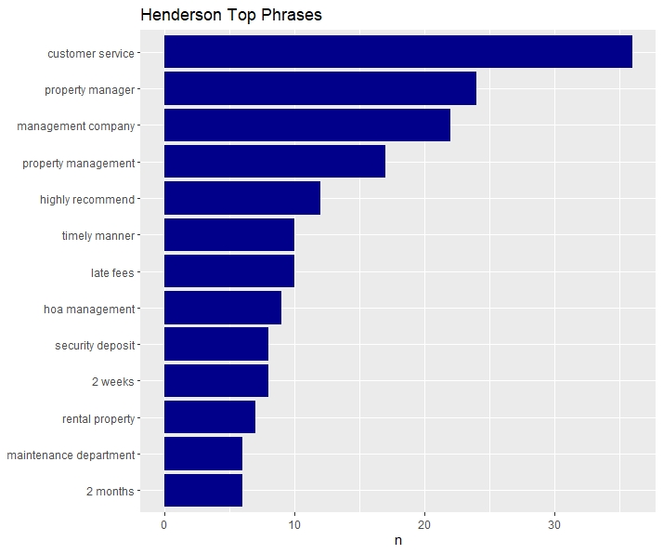
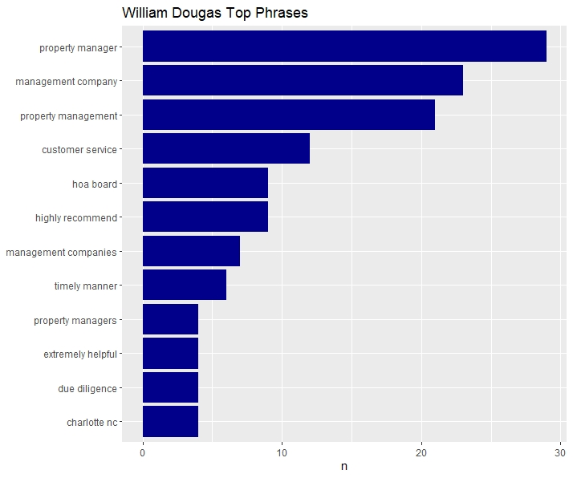
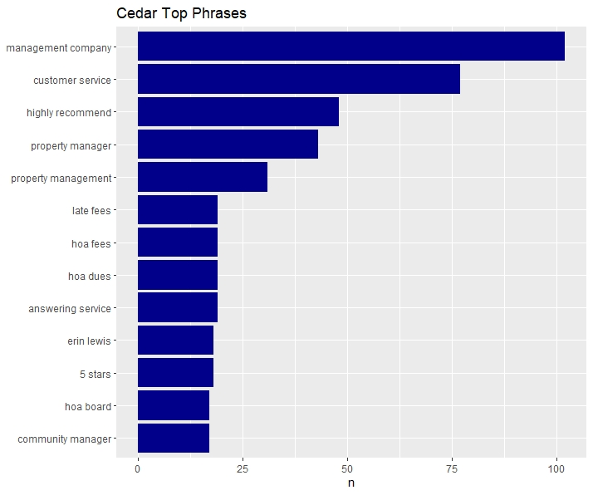
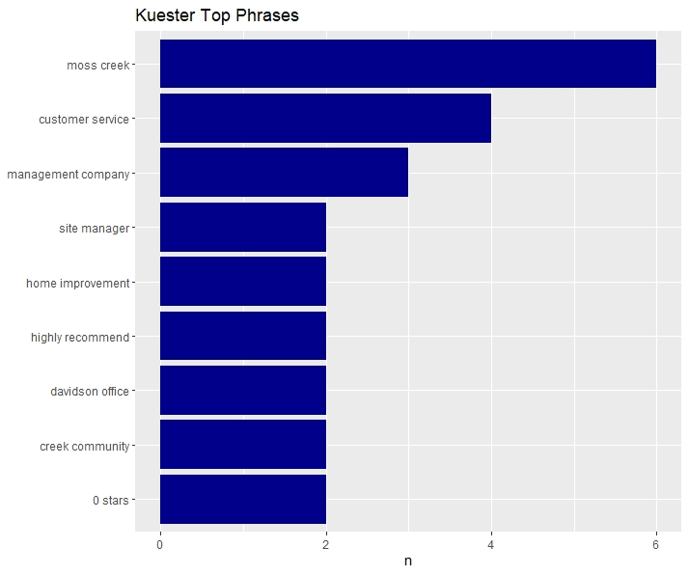
Top Phrases

Slide 12
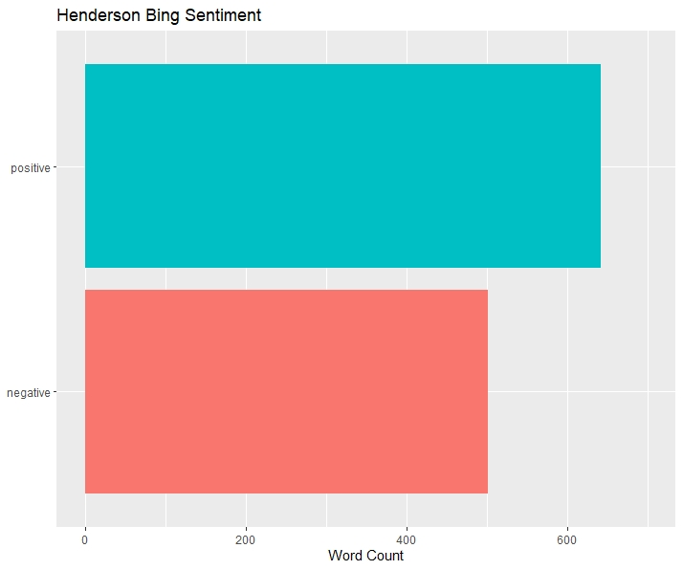
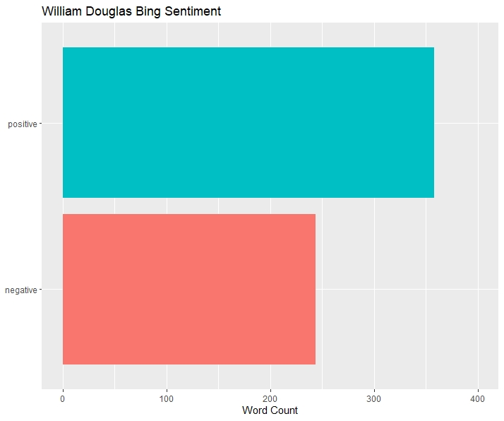
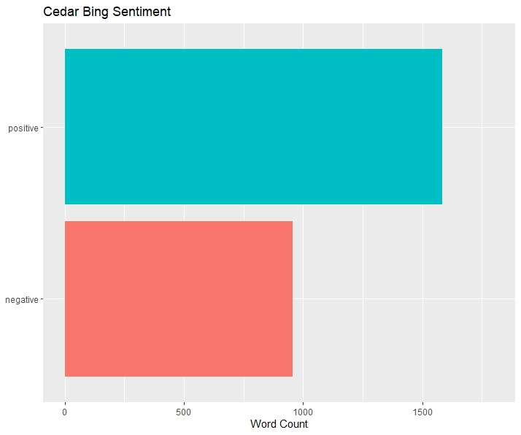
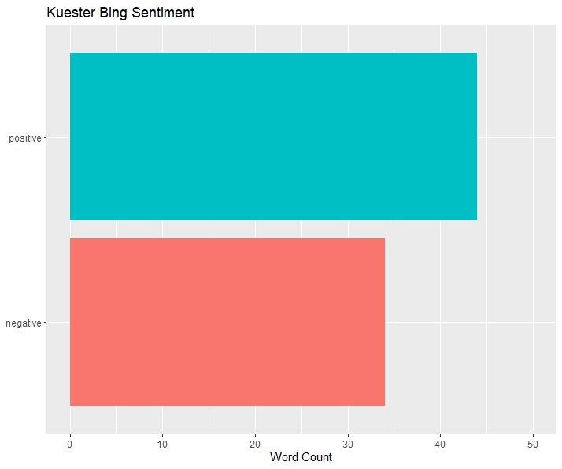
Sentiment Analysis - Bing Positive/Negative

Slide 13
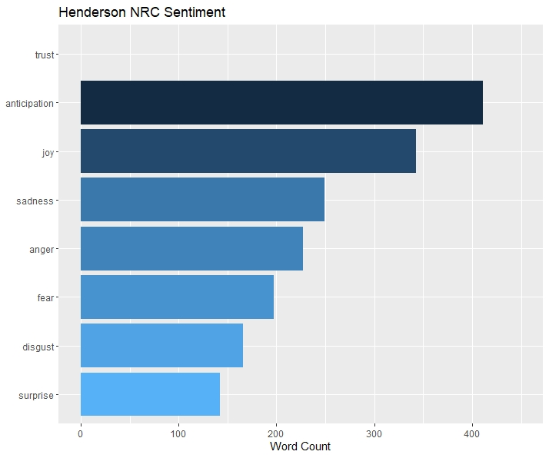
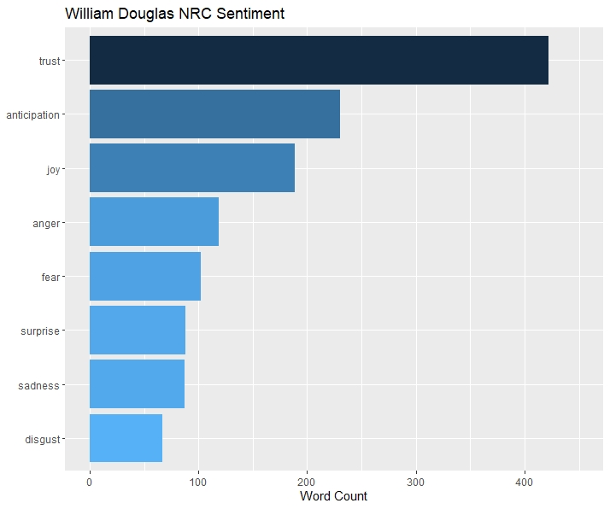
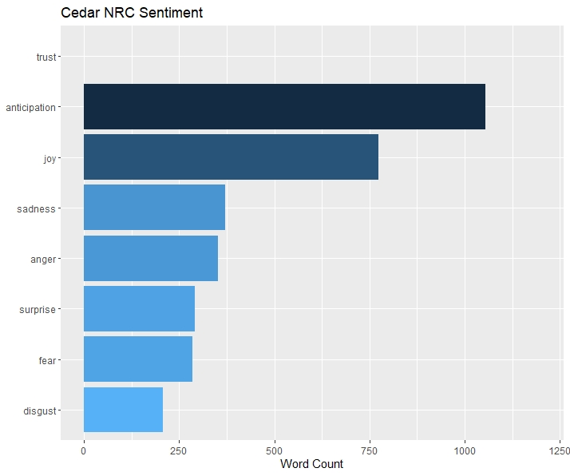
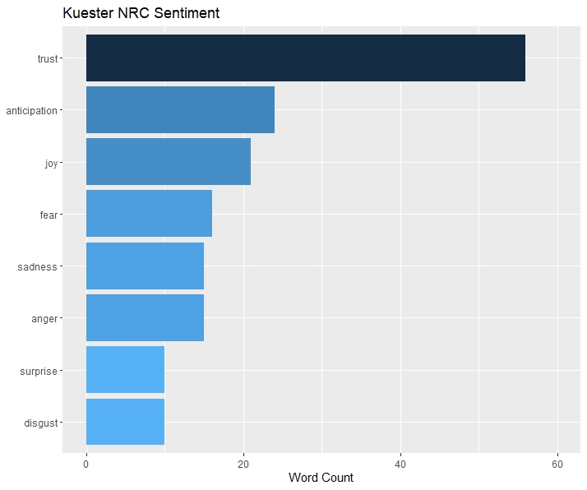
Sentiment Analysis - NRC Sentiment

Slide 14
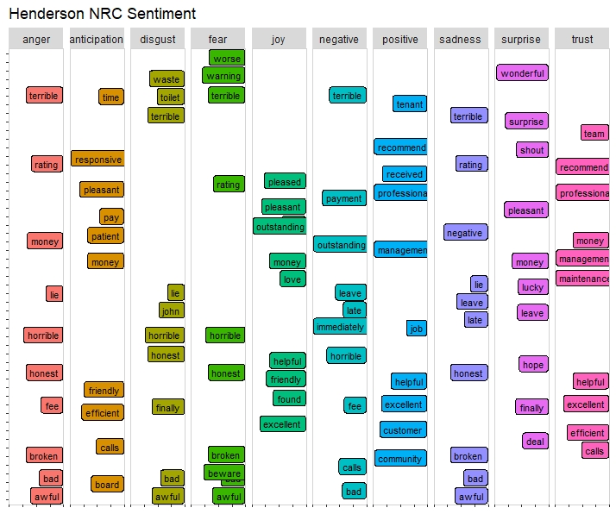
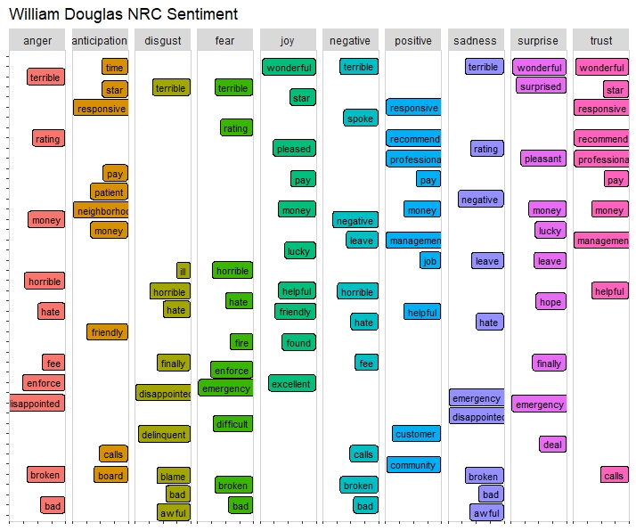
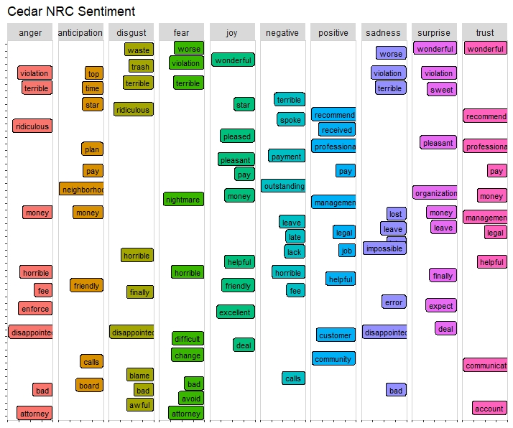
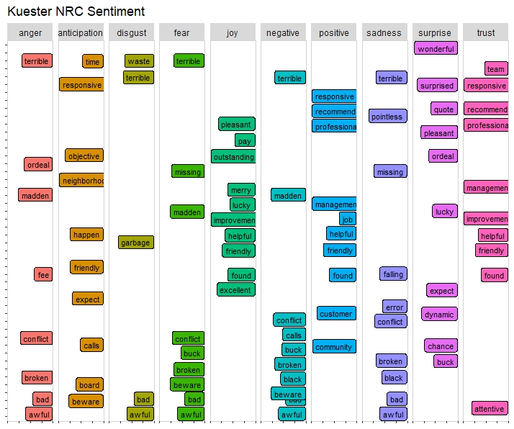
Sentiment Analysis - NRC Breakdown

Slide 15
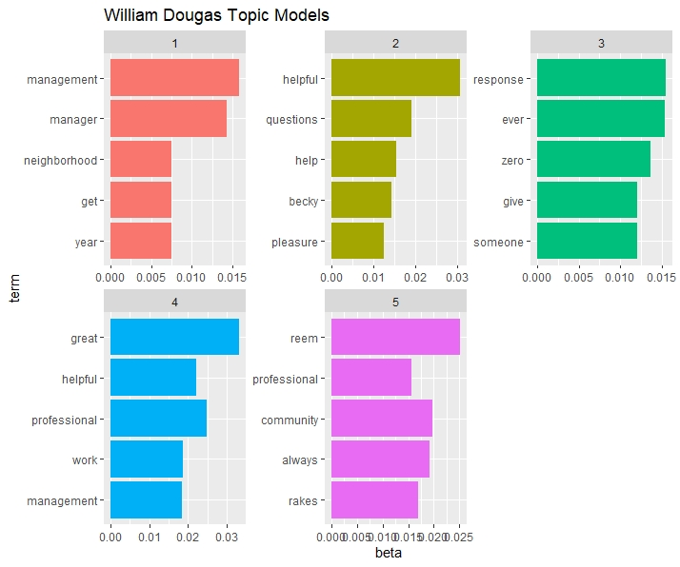
William Douglas Reviews Topic Modeling
Topics
General management
Specific employee
Responsiveness/timeliness
Helpfulness/professionalism
Specific employee

Slide 16
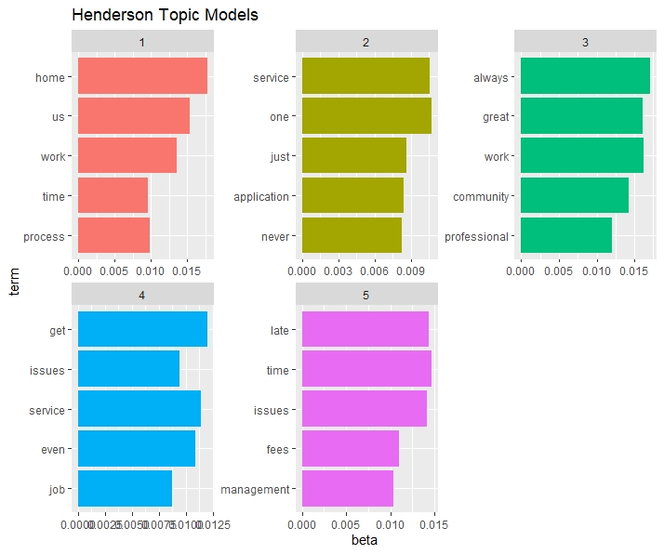
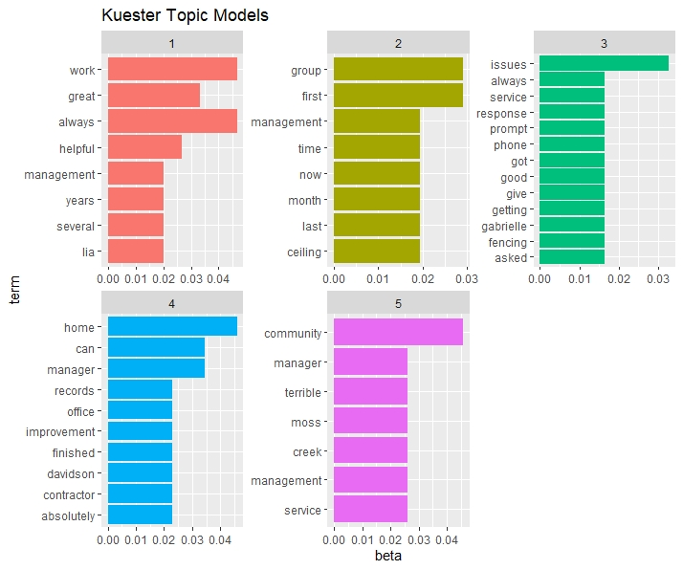
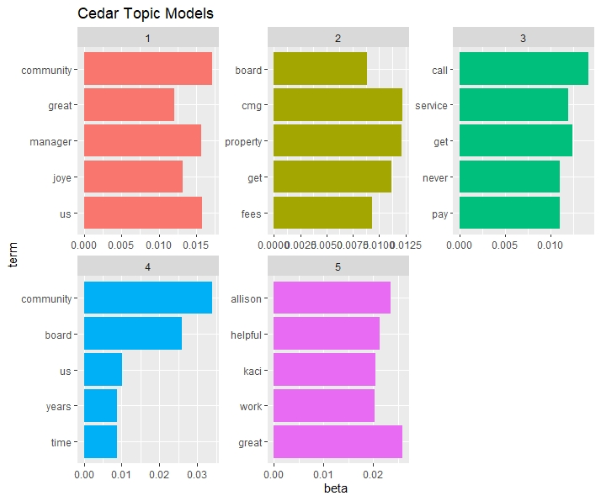
Competitor Reviews Topic Modeling

Slide 17
Review Results Summary
Less reviews than competitors
Google, Yelp
Trust is the most important sentiment to customers
Reviewers are highly concerns about:
Specific managers
Communication
Professionalism
Timeliness
Top phrases used in reviews
Customer service, timeliness, professionalism, diligence, management, helpfulness, consistency
William Douglas has a good positive to negative sentiment ratio

Slide 18
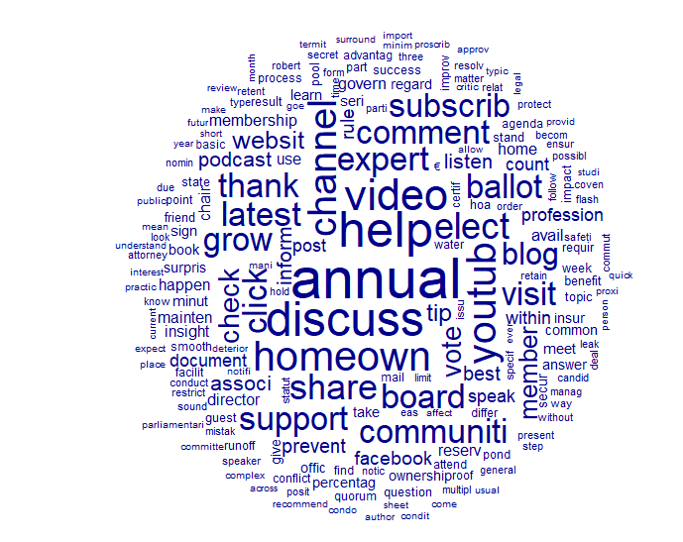
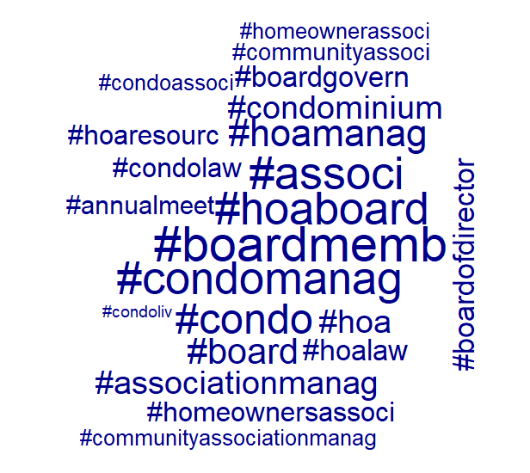
Social Media Word Clouds

Slide 19
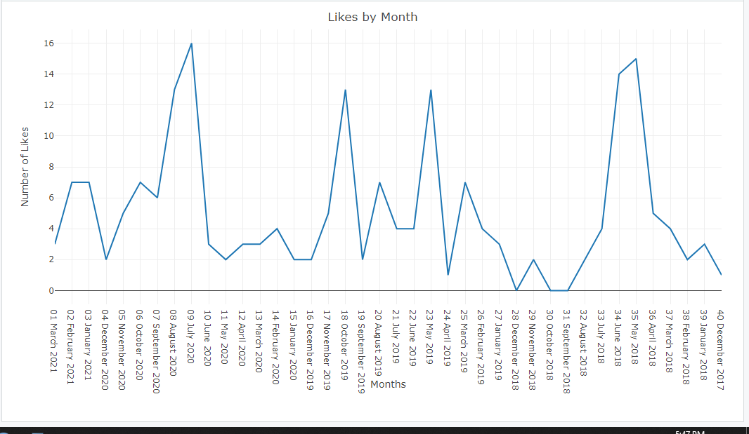
Social Media Likes per Month
Notes:
Shows the number of likes per month over 4 years

Slide 20
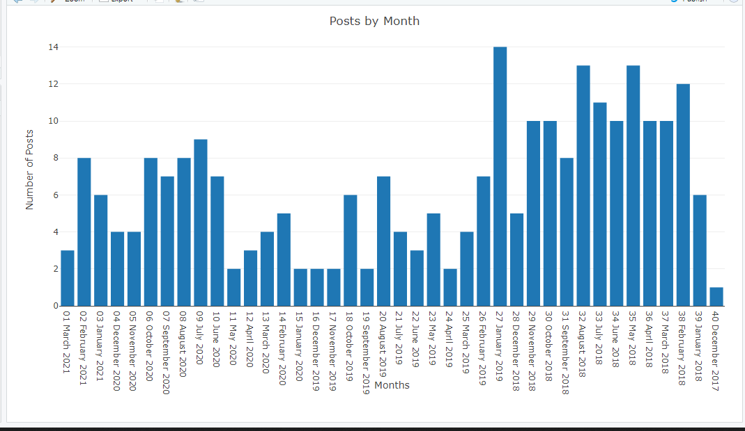
Social Media Posts per Month
Notes:
Shows the number of posts per month over 4 years

Slide 21
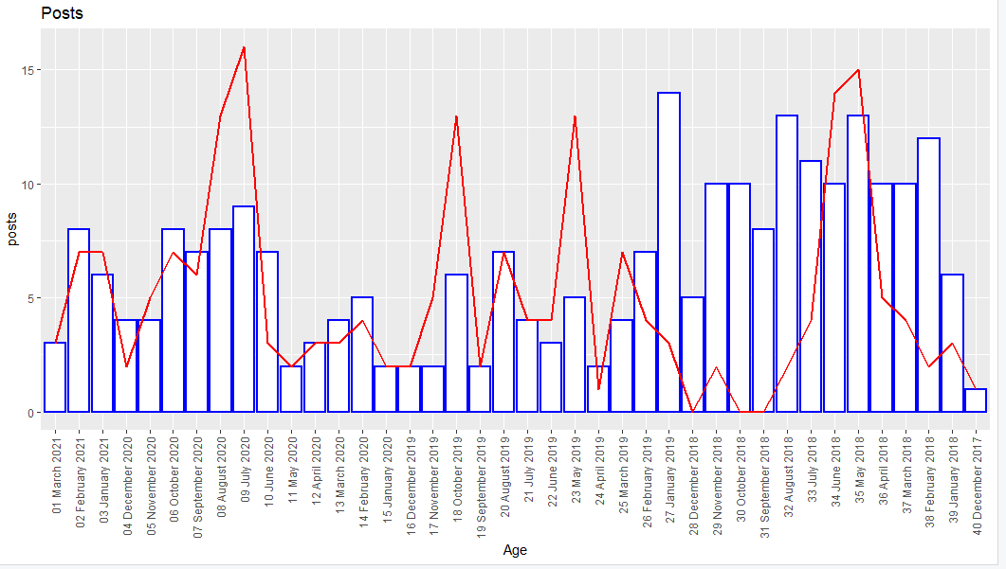
Social Media Activity
Notes:
Shows the number of posts per month and the number of likes per month. There is a decrease in the frequency of posts but the number of likes stays generally the same with seasonality. Most of their likes come from summer and spring months.

Slide 22
Social Media Results Summary
Post Frequency has decreased since end of 2018
Started posting more recently but nowhere near earlier years
Likes remain at a similar level throughout even though post frequency has decreased
Spring and Summer have large spikes in likes for posts
Summer has more activity on social media than other seasons

Slide 23
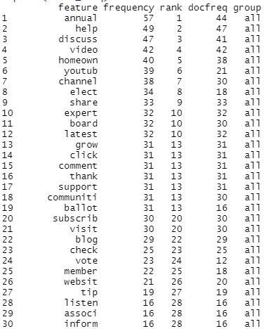
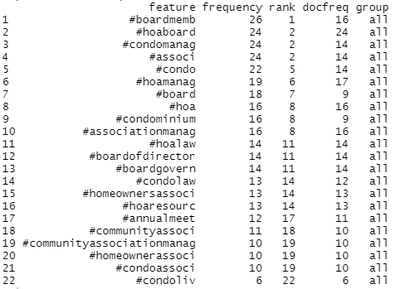
Post Analysis Analysis
Word Frequency Table
Word Frequency Table (Hashtags)
Notes:
These are the words that pop up most frequently in your posts after we removed some of the more common words.
Frequency= number of times the word shows up total Docfrequency is the number of documents the word is used in

Slide 24
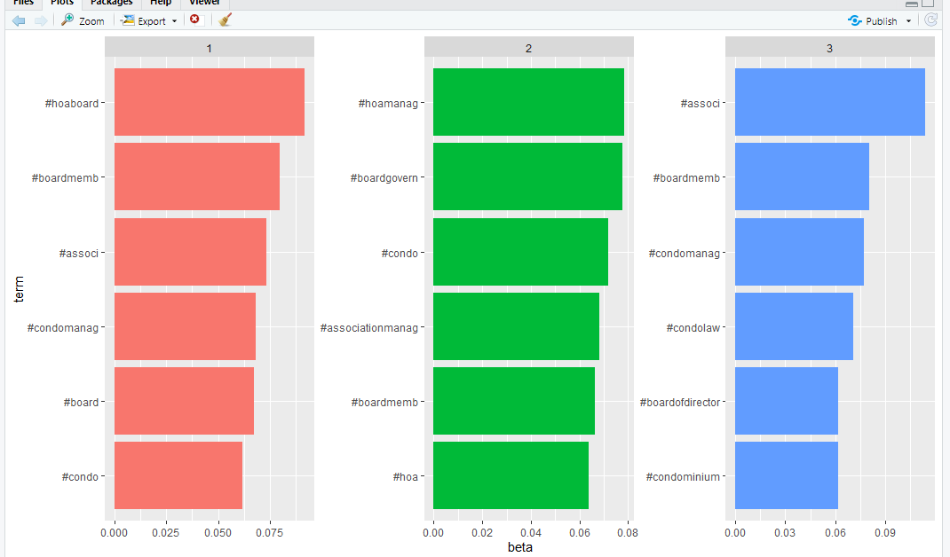
Post Analysis Topics (Hashtags)
Notes:
After running some analysis on the post data we came up with these topics for the hashtags you use

Slide 25
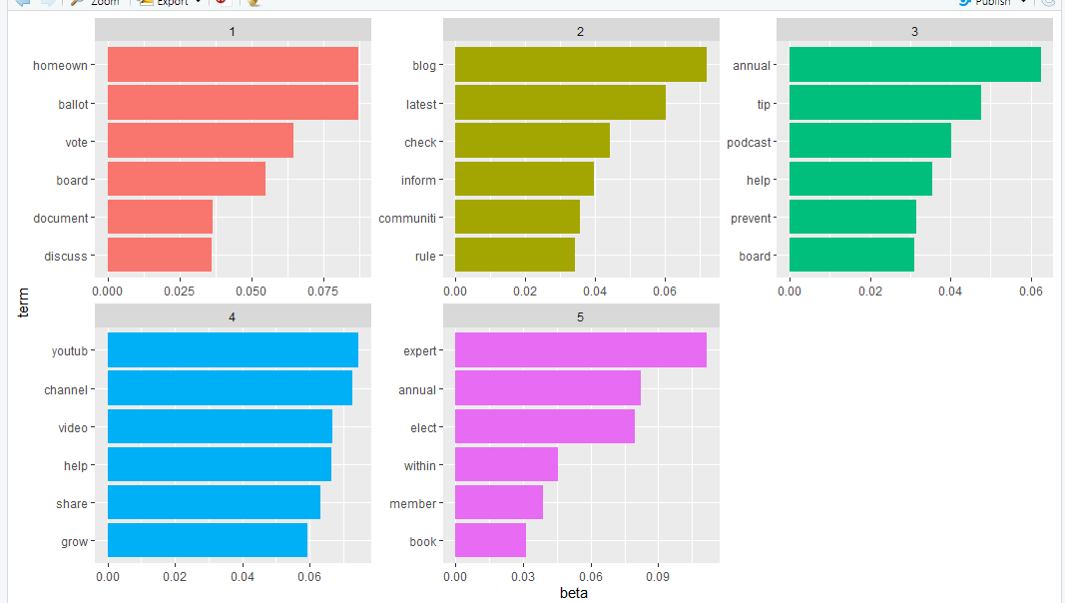
Post Analysis Topics
Topics
HOA Voting and Board Meetings
Blogs, Communication & Information for HOA
Podcast & Annual Tips and Help
Youtube/Help Videos
Election & Board Members
Notes:
After some text analysis we generated these topics for your posts, and we labeled these topics as the following:

Slide 26
Post Analysis Summary
We combined the likes, comments, and shares into one variable and ran a regression model on the text data to see which topic generates the most activity
Topic 1: HOA Voting and Board Meetings has the greatest weight in the regression model
This means that posts on this topic generates the most amount of activity on social media
Order of Topics that generate the most activity on social media
Topic 1, Topic 4, Topic 2, Topic 3, Topic 5

Slide 27
Recommendations
Solicit more Google Reviews from customers
Focus on what’s important to customers
Trust, anticipation
Customer service, timeliness, professionalism, diligence, management, helpfulness, consistency
Generate more engagement on Facebook and LinkedIn
Post about the right topics
HOA voting, board meetings, help and advice
Use hashtags
Increase post frequency (spring and summer)
Share profile links
Incorporate keywords into website
Share website link and generate traffic
Take advantage of growing markets
Asheville, Charlotte, Columbia, Fayetteville, Raleigh, Wilmington, Winston-Salem

Slide 28
Limitations & Improvements
Limitations
Small scope
Limited data
Multicollinearity across variables
Outliers in regression data
Improvements
Generate national data instead of regional data
More in-depth data for competitive companies’ social media

Slide 29
Sources
https://iopscience.iop.org/article/10.1088/1757-899X/1022/1/012097/pd
https://www.fortunebuilders.com/north-carolina-real-estate-market
https://www.google.com/amp/s/www.cbs17.com/community/health/coronavirus/how-the-pandemic-is-driving-a-sellers-market-for-housing-in-north-carolina/amp/
https://learn.roofstock.com/blog/columbia-sc-real-estate-market
https://www.kppm.com/5-signs-change-hoa-management-companies/
https://www.nrdc.org/stories/climate-change-floods-north-carolinas-housing-market’
https://www.ibisworld.com/united-states/market-research-reports/homeowners-associations-industry
https://www.kppm.com/5-signs-change-hoa-management-companies/
https://www.facebook.com/williamdouglaspropertymanagement/
https://www.google.com/search?q=william+douglas+management&oq=william+douglas+management++&aqs=chrome..69i57j69i60l3.5477j0j7&sourceid=chrome&ie=UTF-8#lrd=0x88569e569803dee7:0x5128947692f84cc0,1,,
https://www.linkedin.com/company/william-douglas-property-management/
https://www.google.com/search?q=henderson+management&oq=henderson+management&aqs=chrome.0.69i59j35i39j0j46i175i199j0j69i60l3.2872j0j4&sourceid=chrome&ie=UTF-8#lrd=0x8854203ca358a837:0xddeda6d2b2ede570,1,,,
https://www.hendersonproperties.com/
https://www.facebook.com/HendersonProperties/
https://www.linkedin.com/company/henderson-properties/
https://www.google.com/search?q=kuester+hoa+management&oq=kuester+hoa+management&aqs=chrome..69i57j46i175i199j69i57.4128j0j4&sourceid=chrome&ie=UTF-8#lrd=0x88568ff7fa28f591:0x3c5825c1305a933b,1,,,
https://kuester.com/hoa-locations/fort-mill-sc-corporate-office/?gclid=Cj0KCQjwppSEBhCGARIsANIs4p5kuX9z0FazWLSbVyDYY4Dou8kYSUdYGocCMzGm03sbyx0VLozjruIaAi6XEALw_wcB
https://www.linkedin.com/company/kuester-management-group/
https://www.facebook.com/kuestermanagement/
https://www.google.com/search?gs_ssp=eJzj4tZP1zcsy6lKNjIoMGC0UjWosLAwNUs0NzdNtUgzSDE1MLUyqEg0NjE2SjQ3Skm0MDdOMTf3EklOTUksUsjIT1TITcxLTE_NTc0rAQAC2hXp&q=cedar+hoa+management&oq=ceder+hoa+man&aqs=chrome.1.69i57j46i13i175i199j0i8i13i30l5.4411j0j4&sourceid=chrome&ie=UTF-8#lrd=0x8856a775e8f0d505:0xa3432a72da873d77,1,,,
https://cedarmanagementgroup.com/
https://www.facebook.com/hoacharlotte
https://www.linkedin.com/company/cedar-management-group/
https://wmdouglas.com/

