Slide 1

AGENTICBILL
AI Security Analyst
Search before asking. Ask when it matters. Never invent an answer.
RegoDIT Hackathon • Risk & Compliance Track
Jyothsna R • Kaushik Kumar • Kolar Ravindra Kumar
01
Notes:
Hi, we're the team behind Agenticbill. Every company that sells into an enterprise eventually gets hit with a security questionnaire, and answering it well usually takes days and a lot of guessing. We built an AI Security Analyst that investigates before it answers, and it follows one rule above everything else: it never invents an answer.

Slide 2



THE PROBLEM
Enterprise sales runs on a questionnaire nobody enjoys answering
Scattered
65
Answers live across policies, Slack threads, infra notes, and people's heads.
real vendor security questions across 14 topics
Contradictory
A policy says MFA is mandatory. A message says a contractor never enrolled.
MFA · data residency · encryption · backups · vuln scans · production access · offboarding · background checks · incident response · and dozens more
Ambiguous
“We use encryption” isn't an answer a security team can rely on.
02
Notes:
Here's the real questionnaire we built against: 65 questions across 14 topics, MFA, encryption, backups, offboarding, and dozens more. The answers already exist inside the company, but they're scattered across policy documents, Slack threads, and infrastructure notes. Worse, they sometimes contradict each other. A policy might say MFA is mandatory, while a message says a contractor never actually enrolled. That gap between what's written and what's true is exactly what we're solving.

Slide 3




THE SOLUTION
An analyst that investigates before it answers
Search first
Ask smart follow-ups
Surface contradictions
Every question checks company evidence before the model ever answers or asks.
Vague answers aren't accepted. It asks for the specific missing detail.
Conflicting evidence is never silently resolved by guessing a side.
Remember everything
Complete the questionnaire
Never invent an answer
Facts confirmed once don't need to be asked again.
Every answer is Verified, User-confirmed, Partial, Conflict, or Unknown.
The golden rule. A policy is not proof of implementation.
03
Notes:
Agenticbill behaves like a real analyst, not a form-filler. It searches company evidence first, before it ever asks a person anything. When an answer is vague, it asks for the specific missing detail instead of accepting it. When two pieces of evidence disagree, it surfaces the contradiction instead of quietly picking one. It remembers what's already been confirmed so nobody answers the same question twice. And it works toward one goal: a fully completed questionnaire it can stand behind.

Slide 4


THE GOLDEN RULE
Never invent an answer. Every claim carries its own confidence.
Verified
User-confirmed
Partial
Conflict
Unknown
Confirmed from company documents, with evidence attached.
Stated by an employee, with no documentary evidence yet.
Some, but not all, of the required details are known.
Two sources disagree. The assistant asks, it doesn't guess.
No evidence and no confirmation exist yet.
04
Notes:
This is the core idea, and it's the reason judges should care: every single answer carries an honest confidence level, not just a yes or no. Verified means we found it in a real document. User-confirmed means a person told us, but there's no paper trail yet. Partial means we know some of it, not all. Conflict means two sources disagree, and we're not going to guess which one is right. And Unknown just means we haven't found it yet, which is a far more honest answer than making one up.

Slide 5
ARCHITECTURE
One bounded investigation loop, one system of record
Read-only connectors
Ingestion & versioning
PostgreSQL + pgvector
Files · Slack · Drive · GitHub · Azure
SHA-256 hash · chunk · embed
sources · chunks · claims · evidence
Chat agent
Hybrid retrieval
AI SDK tool loop, stopWhen(5 steps)
full-text + vector, ranked, top 5–8
Claim / conflict engine
Security profile
Questionnaire dashboard / export
verified · partial · conflict · unknown
persisted per workspace
the completed answer set
Conflict found → agent asks one targeted follow-up question
05
Notes:
Under the hood it's one bounded loop. Read-only connectors pull in company files, Slack, Drive, and GitHub. Everything gets hashed and versioned so we only re-process what actually changed. Retrieval is hybrid, keyword search plus vector similarity, and it's ranked so the model only ever sees a short, high-quality shortlist, never the raw database. The chat agent runs a small tool loop, hands anything it extracts to a deterministic claim and conflict engine, and that engine is what actually updates the security profile and the questionnaire dashboard. When it hits a conflict, it loops back and asks one targeted follow-up question instead of stalling.

Slide 6



TECH STACK
Deliberately small, deliberately boring where it should be
Next.js 16 + Vercel AI SDK
Streaming chat UI and a bounded tool-calling agent loop, forked from the Vercel AI Chatbot template.
PostgreSQL + pgvector
One database for structured claims and vector search. Hybrid full-text plus cosine similarity.
Azure OpenAI, Gateway fallback
Chat and embeddings on Azure when configured, the Vercel AI Gateway otherwise.
Read-only connectors
Company files, Slack, Google Drive (OAuth), and GitHub, each honestly reporting ready, demo, or needs_setup.
06
Notes:
We kept the stack small on purpose. Next.js and the Vercel AI SDK give us streaming chat and tool-calling for free, we forked it from the official Vercel AI Chatbot template so we didn't reinvent the UI. Postgres with pgvector is one database doing both structured claim storage and vector search, which means one less system to keep in sync. Azure OpenAI handles chat and embeddings when it's configured, and it falls back to the Vercel AI Gateway otherwise, so the product never just breaks if a deployment isn't set up. And every connector honestly reports its own status, ready, demo, or needs setup, so nobody's misled about what's actually live.

Slide 7
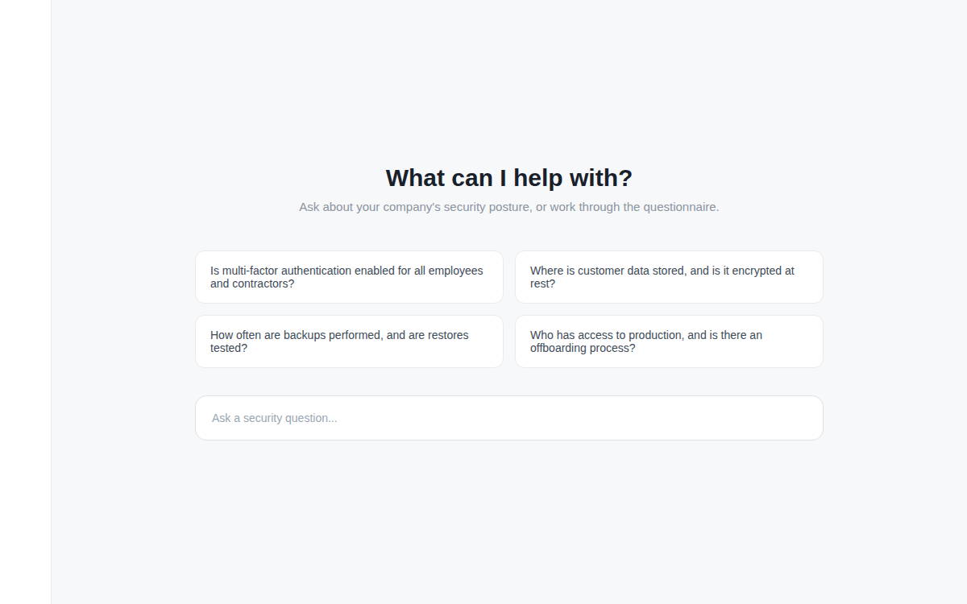
LIVE DEMO
Seeded with Regodit's real security posture, not synthetic data
13
real company policies ingested
65
real vendor questionnaire questions
18
sources hashed, chunked, embedded
07
Notes:
This isn't a toy demo running on made-up data. We seeded it with Regodit's actual security posture: 13 real company policies, the real 65-question vendor questionnaire, SOC 2 and penetration test reports, access review records, and the asset inventory, 18 sources in total, all hashed, chunked, and embedded. [Switch to the live app here and ask one of these questions live.]

Slide 8
EVIDENCE, NOT CHUNKS
A retrieved passage is evidence. A claim is the answer.
retrieved chunks → LLM extracts candidate claims → deterministic code compares → claim saved with evidence → questionnaire status recalculated
Never verified without evidence
{
"subject": "mfa",
"property": "enabled",
"value": true,
"scope": "Google Workspace",
"status": "verified",
"evidence": ["chunk-123"],
"confidence": 0.94
}
A person's word alone is user_confirmed, not verified
Two disagreeing claims become a conflict, never a guess
Corrections create a new version, they never overwrite history
08
Notes:
This is what actually gets stored, not the raw text chunk, but a structured claim like this one. MFA, enabled, true, scoped to Google Workspace, verified, backed by a specific evidence chunk, with a confidence score. A claim is never marked verified without evidence behind it. If it only came from a person's word, it's user underscore confirmed, a real but weaker status. If two claims about the same fact disagree, that's a conflict, and the assistant asks about it rather than picking a side. And if something changes later, we version it. We never silently overwrite history.

Slide 9
WHY THIS APPROACH
What we didn't build, on purpose
AI SDK, not LangGraph
A bounded 5-step loop doesn't need durable checkpointed workflows yet.
No Deep Agents
This needs a controlled, auditable evidence trail, not autonomous delegation.
Custom RAG, not a framework
Versioned hashing and claim/evidence separation are specific to this domain.
pgvector, not Azure AI Search
One database for structured and vector data, no second system to sync.
Direct connectors, not an abstraction
Slack, Drive, and GitHub are wired up individually until there are enough real integrations to know what a shared interface should look like.
09
Notes:
We also want to be upfront about what we deliberately didn't build. We didn't reach for LangGraph, because a bounded five-step loop doesn't need durable checkpointed workflows yet. We skipped autonomous Deep Agents, because this problem needs a controlled, auditable trail, not open-ended delegation. We wrote our own retrieval instead of adopting a RAG framework, because versioned hashing and claim separation are specific enough to this domain that a generic library would fight us. And we didn't build a generic connector abstraction before we had enough real integrations to know what it should even look like.

Slide 10


What's Next
From demo to daily driver
Live Slack + GitHub sync
Move remaining connectors from demo mode to fully credentialed.
Multi-workspace support
One analyst, many companies, isolated evidence per workspace.
SOC 2 evidence mapping
Map each questionnaire answer directly to its control framework.
Thank you.
10
Notes:
Where we take this next: getting Slack and GitHub fully live instead of running in demo mode, supporting multiple workspaces so one analyst can serve many companies with isolated evidence, and mapping every questionnaire answer directly to its SOC 2 control. Thanks for listening, happy to answer questions or walk through the live app.

