Slide 1
Namma Yatri – Business Performance Overview
High-level summary of platform performance, demand trends, and operational efficiency based on ride data.

Slide 2
1. Executive Snapshot
Highlights:
Strong activity across morning and night periods.
High-performing pickup zones consistently drive revenue.
Post-quote conversions remain perfect at 100%.

Slide 3
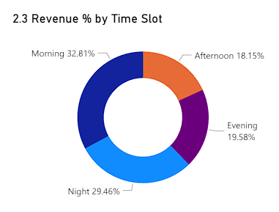
2. Demand by Time Slot: Where Customers Ride Most
Morning and Night account for the majority of revenue.
Afternoon demand is notably weaker and shows potential for improvement.

Slide 4
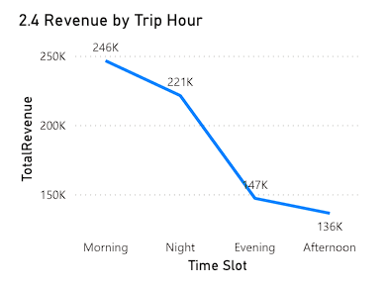
3. Hourly Ride Performance
Early morning and late-night hours drive high trip revenue.
Afternoon drop indicates inefficiency or reduced demand

Slide 5
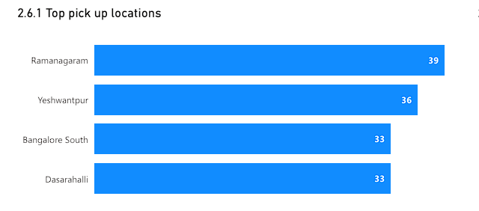
4. Top Pickup Locations (Volume Contribution)
Ramanagaram, Yeshwantpur, and Bangalore South lead in total trip volume.
These zones act as consistent demand hubs.

Slide 6
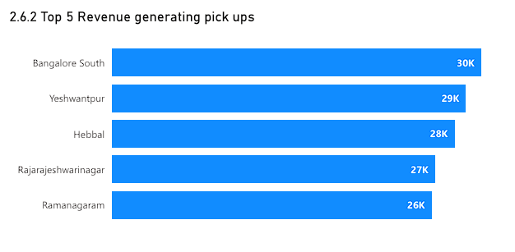
5. Top Revenue-Generating Pickup Zones
Bangalore South and Yeshwantpur generate the highest revenue.
Some lower-volume zones still produce high revenue per trip.

Slide 7
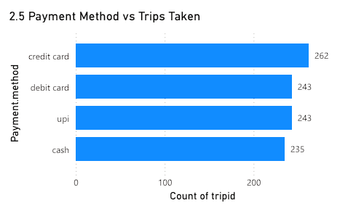
6. Payment Method Insights
Digital payments (Card/UPI) dominate.
Cash usage is lower, indicating strong trust in the platform

Slide 8
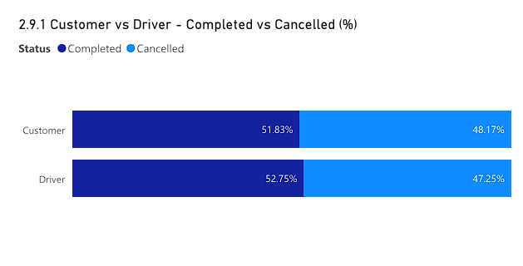
7. Platform Reliability: Completion vs Cancellation
Completion rates for driver and customer are almost identical.
Minimal cancellation imbalance indicates stable experience.

Slide 9
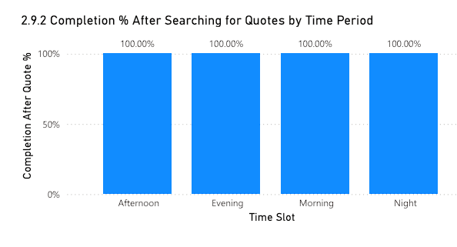
8. Quote-to-Ride Performance (Critical Funnel Insight)
100% completion after quote across all time slots.
Quote system performance is excellent and consistent.

Slide 10
9. Strategic Recommendations
Boost Afternoon Demand: Promo codes, targeted push notifications, and partner offers.
Strengthen High-Value Zones: Increase driver availability and enhance wait-time reliability.
Improve Digital Adoption Further: Reward UPI/card payments to accelerate digital behavior.
Protect Quote Funnel: Maintain low quote latency to preserve 100% conversion.
Supply Optimization: Align driver shifts to Morning/Night high-demand windows.

Slide 11
10. Conclusion
These strategies enhance revenue, improve customer satisfaction, and increase platform reliability with minimal operational overhead
THANK YOU

