Slide 1
Namma Yatri – Technical Analytics Report
Introduce purpose, data sources, and analytical focus (trips, revenue, cancellations, time slot performance).

Slide 2
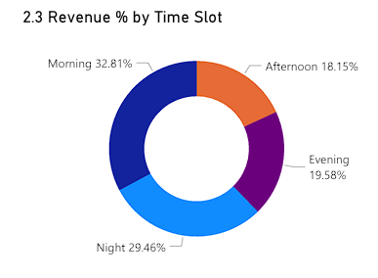
1. Revenue distribution across the day highlights demand cycles
NAMMA YATRI – TECHNICAL ANALYTICS REPORT
Insights:
Morning and Night contribute the highest share of revenue.
Afternoon is consistently the weakest slot.
Revenue peaks correlate strongly with commuter patterns.
Technical Angle:
Time-based grouping created using duration mapping; summarization via measures and category bins.

Slide 3
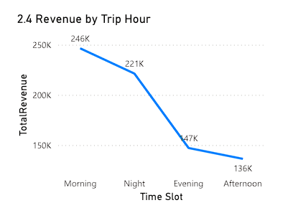
2. Granular hourly performance reveals micro-peak patterns beyond the broad time-slot categories
NAMMA YATRI – TECHNICAL ANALYTICS REPORT
Insights:
Clear spikes in early morning and late-night hours.
A sharp drop during afternoon hours.
Distribution supports shift optimization for drivers
Technical Angle:
Continuous hour modeling, aggregated via DAX using SUMX over trip-level revenue..

Slide 4
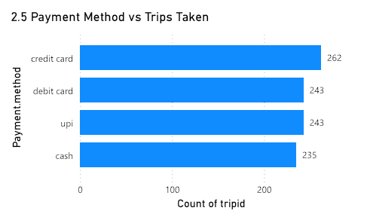
3. Understanding payment preferences helps validate system reliability and customer behavior
NAMMA YATRI – TECHNICAL ANALYTICS REPORT
Insights:
Credit card, UPI, and debit card show similar usage.
Cash usage is slightly lower, showing digital adoption is strong.
Balanced digital methods indicate stable payment infrastructure
Technical Angle:
Payment lookup mapping done via left-join; counts computed using COUNTROWS with filter context.

Slide 5
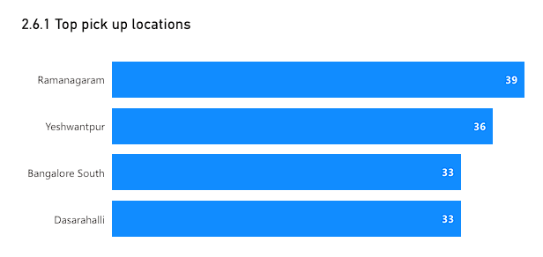
4. Identifies high-demand catchment zones essential for supply planning.
NAMMA YATRI – TECHNICAL ANALYTICS REPORT
Insights:
Ramanagaram and Yeshwantpur consistently appear as top pickup hubs.
Bangalore South and Dasarahalli also show strong demand.
Pickup demand correlates with dense residential or transit-heavy zones
Technical Angle:
Mapping location IDs to Assembly names via Power Query merges.

Slide 6
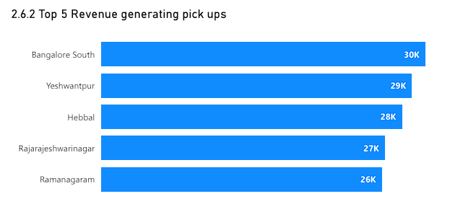
5. Helps distinguish between high-volume and high-value zones.
NAMMA YATRI – TECHNICAL ANALYTICS REPORT
Insights:
Bangalore South leads in revenue generation.
Yeshwantpur and Hebbal follow strong.
Revenue does not always scale linearly with number of trips
Technical Angle:
Revenue measures computed using SUM(fare); zone-level aggregation done through DAX grouping.

Slide 7
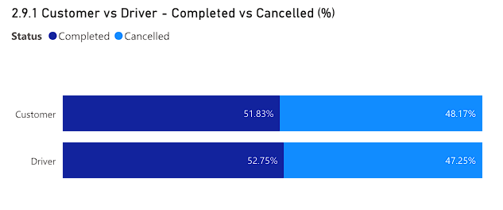
6. Technical validation of booking flow reliability
NAMMA YATRI – TECHNICAL ANALYTICS REPORT
Insights:
Completion rates for both customer and driver are nearly identical.
Cancellations are balanced, indicating system stability.
No major bias in cancellation initiation observed
Technical Angle:
Binary flags converted into metrics using boolean DAX + percentage measures..

Slide 8
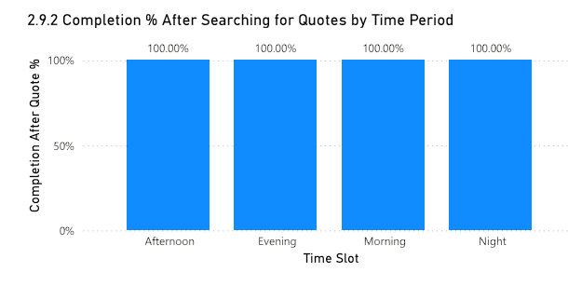
7. Evaluates quote system effectiveness
NAMMA YATRI – TECHNICAL ANALYTICS REPORT
Insights:
100% completion after quote in all time slots.
Indicates flawless quote acceptance → ride completion flow.
Suggests no technical blockers in post-quote journey
Technical Angle:
Trip_Details joined with Duration; filtered % computed via DIVIDE with TREATAS to ensure time-slot context.

Slide 9
NAMMA YATRI – TECHNICAL ANALYTICS REPORT
THANK YOU

