Slide 1



NYC Airbnb Dataset Visualization Project:-
Python • Pandas • NumPy • Matplotlib • Seaborn
Presented by Jyoti Biradar.

Slide 2



Introduction
  Data visualization is the graphical representation of information and data using visual elements like charts, graphs, maps, and infographics to turn complex numbers into clear, actionable insights.

Slide 3


Airbnb Data Visualization Project
The Airbnb Data Visualization project transforms listing data into meaningful charts, graphs and support better decision-making using Python.
The project uses Univariate, Bivariate, and Multivariate Analysis to identify trends, understand relationships between variables, and generate meaningful business insights.

Slide 4



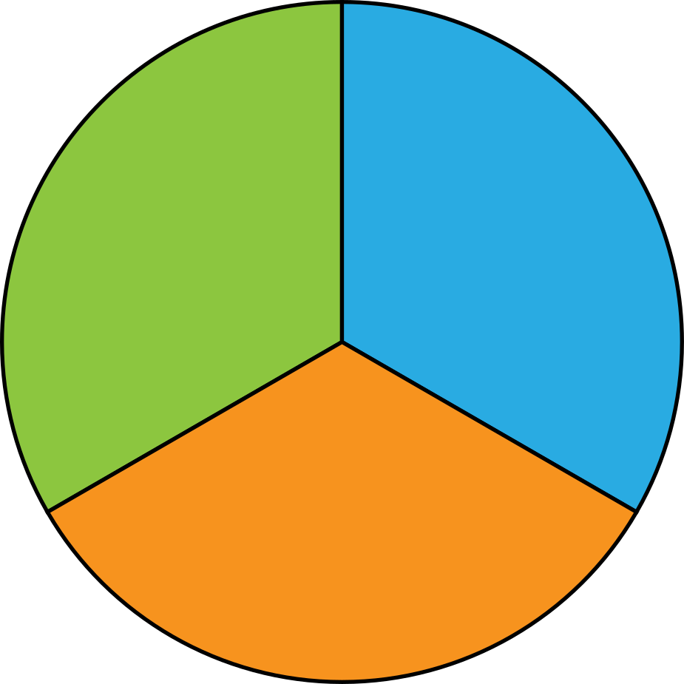
Type of EDA :-
Bivariate Analysis:
  Relationship between two Variable
Multivariate Analysis:
  Relationship between multiple Variable
Univariate Analysis:
  Analyzes one Variable

Slide 5
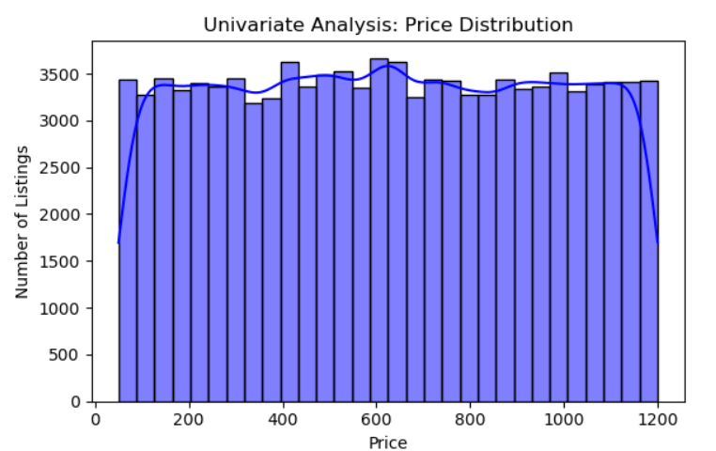
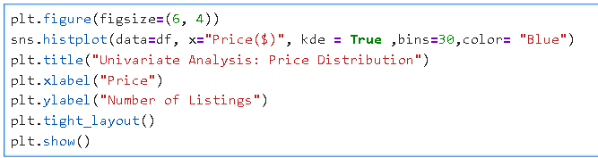
Univariate Analysis:-
a) Distribution of Price Column
Python Code:
Insights:
  The price distribution chart shows how Airbnb listing prices are spread across different price ranges.
  The histogram displays the number of listings in each price range.

Slide 6
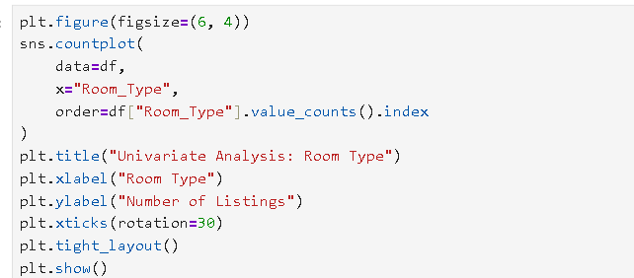
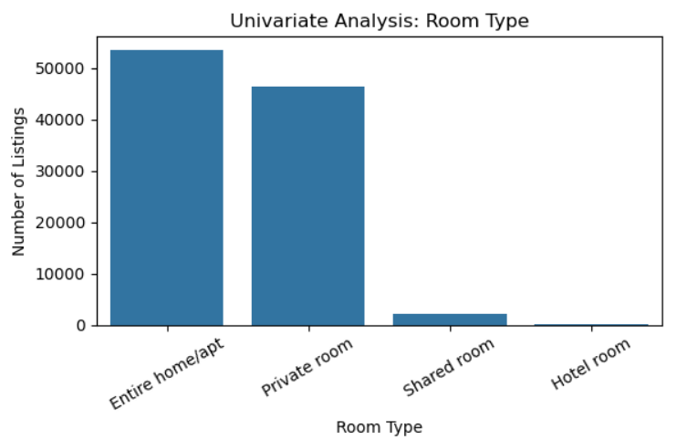
Univariate Analysis:-
Python Code:
b) Distribution of Room Type
Insights:
  Entire homes/apartments and private rooms make up most of the listings.
  The Countplot display the counts of observations in each categorical bin using bars

Slide 7
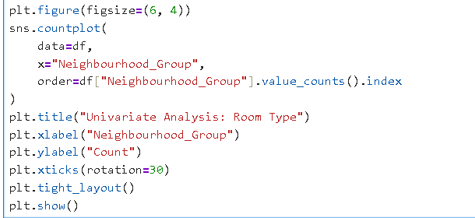
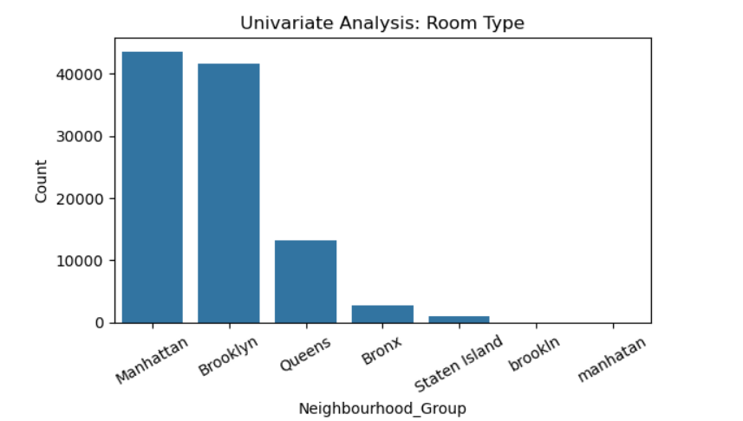
Univariate Analysis:-
Python Code:
c) Distribution of Neighbourhood:
Insights:
  Manhattan and Brooklyn make up most of the listings.

Slide 8
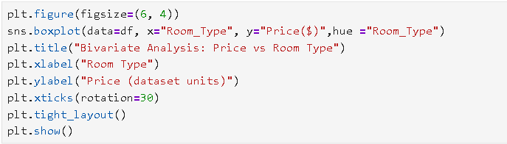
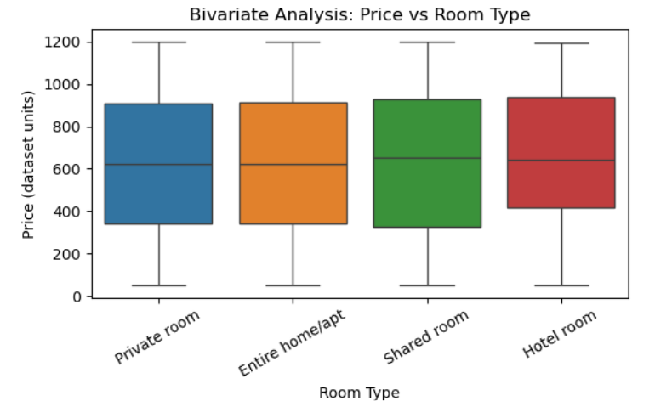
Bivariate Analysis:-
Python Code:
a) Price vs. room type:
Insights:
  Hotel rooms have the highest average price, while entire homes and private rooms have similar average prices.
  The box plot also highlights price variations and potential outliers across room types.

Slide 9
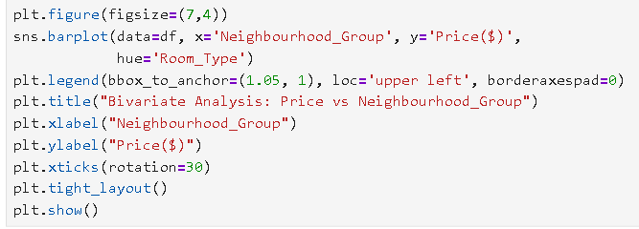
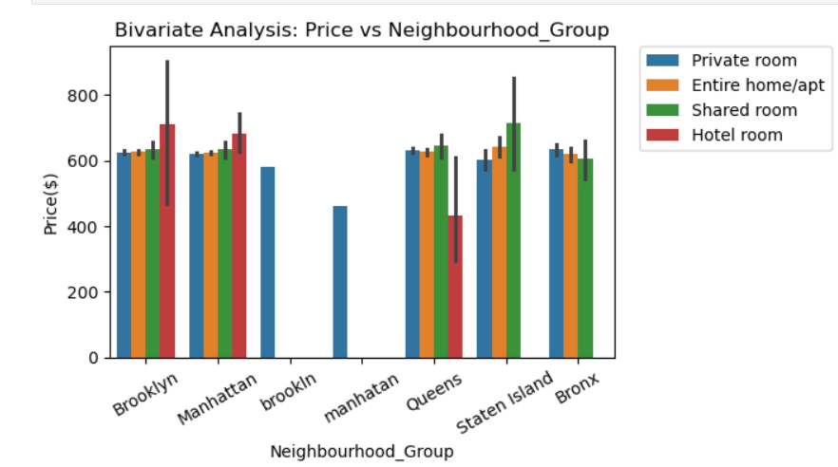
Bivariate Analysis:-
b) Price vs Neighbourhood_Group
Python Code:
Insights:
  Average Airbnb prices vary across neighbourhood groups and room types.
  This chart helps identify which room types and neighbourhoods have higher average listing prices.

Slide 10
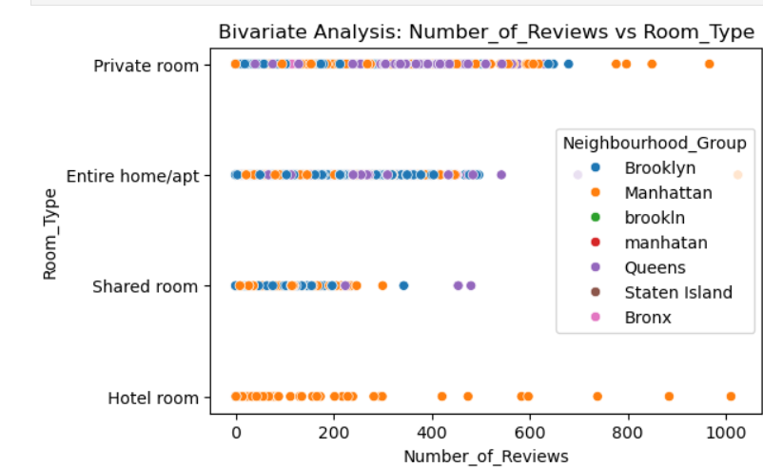
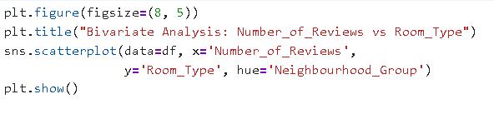
Bivariate Analysis:-
c) Room_Type vs Number_of_Reviews
Python Code:
Insights:
  The scatter plot compares review counts across room types and neighbourhood groups. It helps identify patterns in review activity and differences between listing categories.

Slide 11
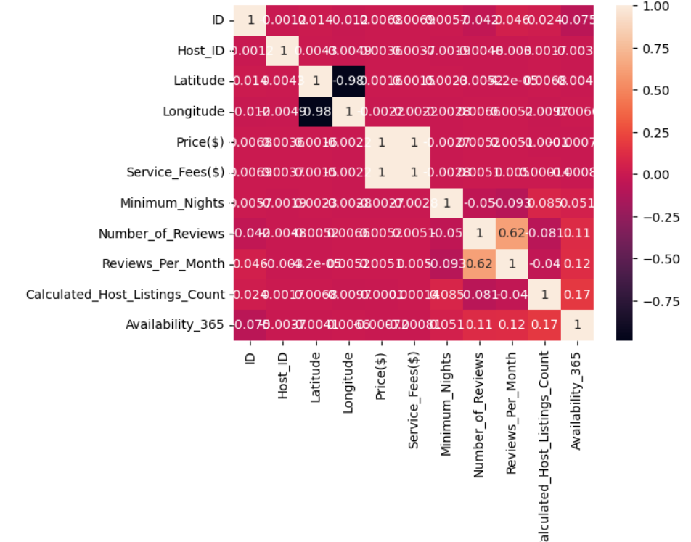
Multivariate Analysis:-
## HeatMap
Python Code:
## HeatMap
sns.heatmap(df.select_dtypes(include=['number']).corr(), annot=True)
plt.show()
Insights:
  The correlation heatmap shows the strength and direction of relationships between numerical variables in the Airbnb dataset.
  It helps identify highly correlated features and patterns that may influence listing prices

Slide 12


Conclusion:
  This project helped me analyze Airbnb listing data using Python libraries such as Pandas, Matplotlib, and Seaborn.
  Through univariate, bivariate, and multivariate analysis, I explored pricing patterns, room types, neighbourhoods, and relationships between numerical variables.
  The visualizations helped identify useful patterns and generate insights to support data-driven decision-making.
Data Analytics Portfolio Project

